Slide 1
What Does a Family-centered medical home look like for children with special healthcare needs
Nevada Disabilities Conference
July 20, 2015
Melanie Kauffman, GPC Chanel Pervere, Intern
Executive Director School of Community Health
Family TIES of Nevada Sciences
University of Nevada, Reno

Slide 2
Family TIES of Nevada
mission
Dedicated to providing culturally competent support, information and assistance to achieve family-centered care for individuals with disabilities or special health care needs through family, community and professional partnerships
Notes:
Family TIES was established in 2001 as a statewide non-profit to offer information, assistance, education and peer support to families with loved ones with special needs and people with disabilities. Through these services we work to reach diverse groups and partner with families, service professionals and others to achieve family-centered care.

Slide 3
Children/Youth with Special Health Needs
Family TIES of Nevada
People w/ Disabilities
1-1 Assistance
Information & Referrals
Broad Community Outreach
Emotional Support
Parent to Parent Matching
Community Partnerships
Topical Calls and Education
Resources for Families w/ CSHCN
Advocacy

Slide 4
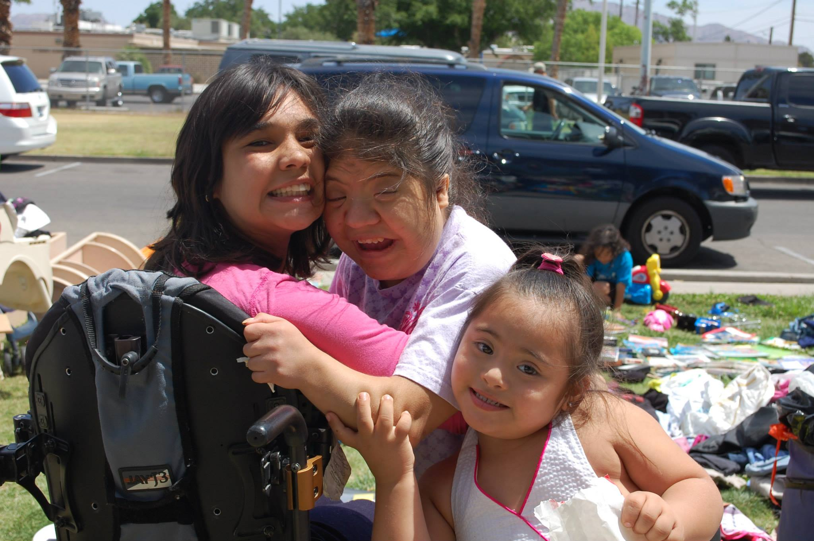
WHAT IS FAMILY-CENTERED CARE ?
Assures the health and well-being of children and their families through a respectful family-professional partnership.
Honors the strengths, cultures, traditions and expertise that everyone brings to the relationship.
Nevada Affiliate
Notes:
The foundation of family centered care is the partnership between families and professionals. Based on this partnership model, family centered care :
Acknowledges the family as a constant in a child’s life.
Builds on family strengths
Supports the child in learning about and participating in his/her care and decision making.
Family Centered Care also Honors cultural diversity and family traditions.
And it recognizes the importance of community based services.
Promotes an individual and developmental approach.
Encourages family-to-family and peer support.
Supports youth as they transition to adulthood.

Slide 5
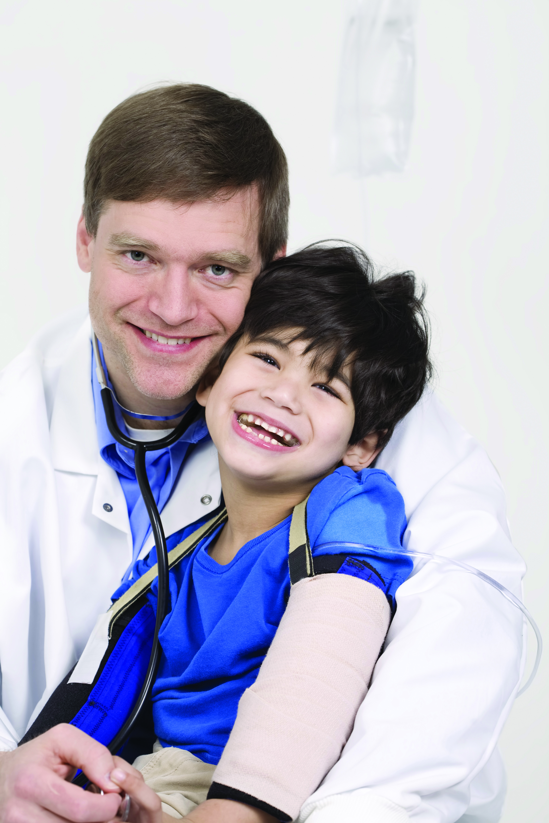
WHAT IS A MEDICAL HOME ?
An Approach to providing coordinated health care services in a high quality and cost effective manner.
Children and their families who have a medical home receive the care that they need from a pediatrician, a specialist, or other physician whom they trust in a hospital or community.
Children with special health care needs often receive services from a variety of sources.
Pediatricians and other providers, their staff, and parents act as partners in a medical home to identify and access all the medical and support services needed to help children and their families achieve their maximum potential.
Notes:
A family-centered medical home is not a building, house, hospital, or home healthcare service, but rather an approach to providing comprehensive primary care.
Children have a “medical home” if they have a usual source of care, are able to get referrals when needed and receive help in coordinating health care needs, such as for a patient with chronic illness or special needs who sees multiple specialists.
A medical home must be “family-centered”, meaning that the doctor or care team are good listeners, spend enough time with the patient, are sensitive to family values and make an interpreter or accommodations available when needed.
In a family-centered medical home the pediatric care team works in partnership with a child and a child's family to assure that all of the medical and non-medical needs of the patient are met.
Through this partnership the pediatric care team can help the family/patient access, coordinate, and understand specialty care, educational services, out-of-home care, family support, and other public and private community services that are important for the overall health of the child and family.

Slide 6
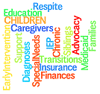
Family TIES Can Help You Find Quality Information
What does this diagnosis mean for my child
and his/her future?
Are there treatments available for my child's
condition?
How can I find information I can trust?
Where can I find another parent who has a
similar situation to talk to?
What services are available in our area?
Are there support groups for parents like me?
Notes:
Information and Resources are so helpful in assisting families of children with special needs to navigate a complicated road after a diagnosis. Traveling this road will bring you to many stops where you will need to ask questions and gain knowledge, support, and resource information.
Some of the common questions you may have are:
What does this diagnosis mean for my child and her future?
Are there treatments available for my child's condition?
How can I find information I can trust?
Where can I find another parent who has a similar situation to talk to?
What services are available in our area?
Are there support groups for parents like me?

Slide 7
Health Insurance
Specialist Doctors
Health Care Providers
Hospitals
ERs
Urgent
Care
Services for Special Needs
Community Programs
You
Medical
Home
Care Team
Physician
Notes:
This slide shows examples of a broader framework of patient-centered services in a medical home. Different things that have been implemented include:
1. Partnership with patients and families in preventative, acute, and chronic care needs.
2. 24-hour access to care with clinician support.
3. Extended access to care (e.g. advanced scheduling, evening and weekend hrs)
4. Care coordination – continuity and integration of care across all the patient’s conditions and health care needs.

Slide 8
You Can Make Medical Home Improvements
One Stop Place of Care
Do you have a primary care physician
Patient provider partnership
Do you work with your provider to make sure that the medical and non medical needs of your child/youth and family are met?
Care Plan
- Have you developed a care plan (Treatment goals, what to expect in the future, and available resources)
Care Coordination
- Do you receive needed help coordinating care across multiple providers and types of available services
Notes:
WHAT WILL YOU DO?
How can you better care for your child with chronic and complex conditions, and become a more effective partner in your child’s care.
Effective partnering with physicians and other health care professionals are the foundation of the Medical Home approach to care.
You play an active role in your plan to help your child stay healthy. You are the key to taking care of your child’s health. To be a full
partner in your child’s health care, means working with your doctor and talking about any health concern you may
have upfront. When you get to know and trust your doctor, taking care of your child’s health becomes easier.
A Care Plan document can look like a “Care Plan Notebook” . The care notebook is designed to help organize the information in a central place to assist both families and providers. A major role of a care notebook is to help parents/caregivers maintain an ongoing record of their child's care, services, providers, and notes. This care notebook is a great tool in empowering families to become the experts on their child's care.
Tools to help you build Your Care Notebook can be found on the National Center for Medical Home Information website at:
www.medicalhomeinfo.org/for_families/care_notebook. The Notebook will include personal info., keeping track of appointments/care, personal notes, care needs of my child-abilities and special needs, and community health care service providers, and school issues
Tools to help you build Your Care Notebook can be found on the National Center for Medical Home Information website at:
www.medicalhomeinfo.org/for_families/care_notebook. The Notebook will include personal info., keeping track of appointments/care, personal notes, care needs of my child-abilities and special needs, and community health care service providers, and school issues

Slide 9
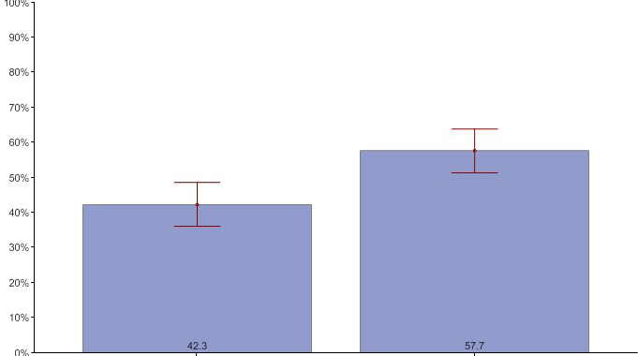
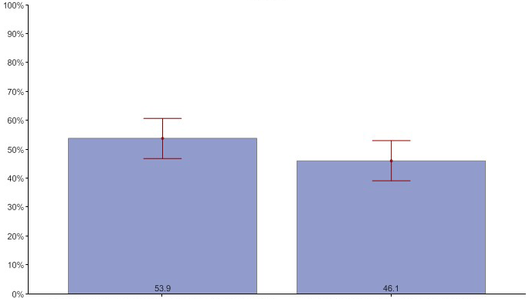
Medical Home Indicators
CSHCN With and Without Family-Centered Care in Nevada
CSHCN Receive Effective Care Coordination, Among Those who Needed Care Coordination
53.9%
46.1%
42.3%
57.7%
Did not meet 1 or more needed elements of care coordination
Met all needed components of care coordination
No family Centered
Care
Family Centered Care
Notes:
According to national data sources, there are 82,108 children with special healthcare needs in Nevada:
42.3% of children with special health care needs in Nevada lack family centered care and 53.9 percent of CSHCN are not meeting 1 or more elements of care coordination.
Medical Home has the ability to close this gap. The goal of medical home is to reach all the health goals of our patients which will produce better health outcomes for our children.

Slide 10
Medical Home Organizations in Nevada
Reno/Carson City
Sierra Family Health Center
Carson Mental Health
Sierra Nevada Health Center
Community HealthAlliance/HAWC
Reno/Sparks Health & Human Services
Renown
Miles for Smiles
Fallon Tribal Health Clinic
LAS VEGAS
Cambridge Family Health Center
Eastern Family Medical and Dental Center
Las Vegas Outreach Clinic
Martin Luther King Family Health Center
North Las Vegas Family Health Center of Las Vegas
Beatty Medical Center
STATEWIDE
Nevada Health Centers Inc.
Notes:
Some Organizations required to practice with a medical home structure in Nevada are referenced on this slide:
Re emphasize though that medical home doesn’t have to be a specific place but rather a type of care and a new way of communication with your physician.
Medical Home Portal Handout -The State of Nevada is partnering w/ the Univ. of Utah, Dept. of Pediatrics to create a customized Medical Home web portal to provide easier access to resources, information on diagnoses and conditions, and allow physicians, professionals, families and communities to support local statewide services to work together.

Slide 11
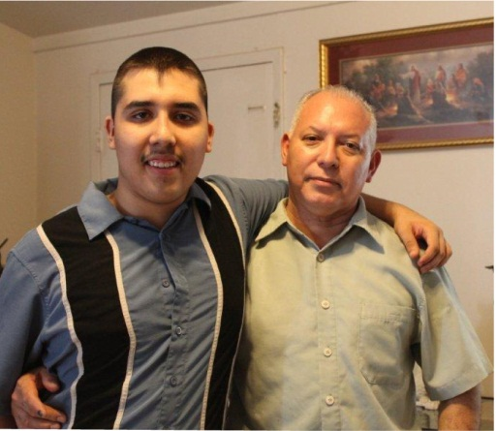
American Academy of Pediatrics National Center for Medical Home Implementation
EVERY child and youth deserves a
MEDICAL HOME
“My son was diagnosed with autism as a child, but did not receive the treatment he needed because my health insurance did not cover it and I didn't know where to go to look for help. When I contacted Family TIES, it changed my life. I have received a lot of support and information to help me with my son’s transition services, guardianship, employment opportunities, and reviewing the different health care financing options. When Family TIES connected me with another family that has a child with autism, it was a great relief. The support I received from this family was very important because they shared their experiences, their successes, and failures. I am very grateful and I thank Family TIES for helping us.”
Parent of a youth with special health care needs
Notes:
This family story is an example of the kind of Medical Home outcomes and improvements we can provide.
We helped a father with two children, ages 18 and 12, both diagnosed have autism. His son received a diagnosis in early childhood; however, up until this time he did not receive the treatment he needed because his health insurance did not cover it. He didn't know where to go to look for help. His 12 year old daughter was diagnosed about the time he came to see us and he didn’t want her to have the same experience.
We provided emotional support, resources and information, which helped him get the services his children needed such as help with his son’s transition services, guardianship, job opportunities, and reviewing the different financial options for his daughter. We also helped him organize his children’s medical records into a Healthcare Notebook to have the information on hand which is necessary to search for services.
We also connected the dad with another family that has a child with autism. The support he received from this family was very important because they shared their experiences their successes and failures; they helped guide me in this process and gave me advice on how I should treat my children.

Slide 12
Reno Office:
3100 Mill Street, #117
Reno, NV 89502
Phone: 775.823.9500
Fax: 775.323.2205
Statewide: 866.326.8437
Become a friend on facebook: http://www.facebook.com/
familytiesnvAuthorized Page
Follow us on Twitter:
@FamilyTIESofNV
www.familytiesnv.org
________________________
Melanie Kauffman, GPC
Executive Director
mkauffman@familytiesnv.org
Las Vegas Office :
6130 Elton Ave, Suite #100
Las Vegas, NV 89107
Phone: 702.740.4200
Fax: 702.216.0321
Additional information about MEDICAL HOME can be found at the National Center on Medical Home Implementation: www.medicalhomeinfo.org
Notes:
Q&A Thank you –

