Slide 1
UPDATE ON REPORT AND strategic Plan
Governor’s Taskforce on
Integrated Employment
DECEMBER 2014 - JuLY 2015

Slide 2
Steps Toward Integrated Employment in Nevada
Business Leadership Network 2007-09
2010 Employment Policy Summit
Post-Summit Workgroups
SELN in NV since 2009
WCSD Community-Based Career Exploration Summer Camps
Employment First Ad-Hoc Committee

Slide 3
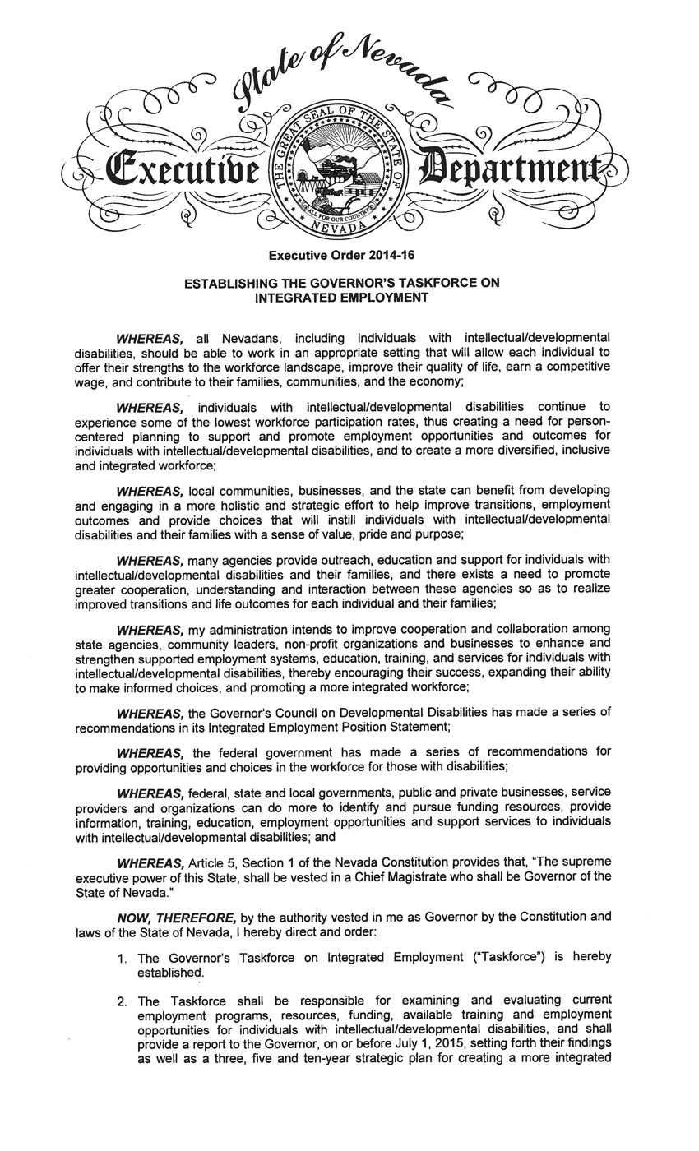
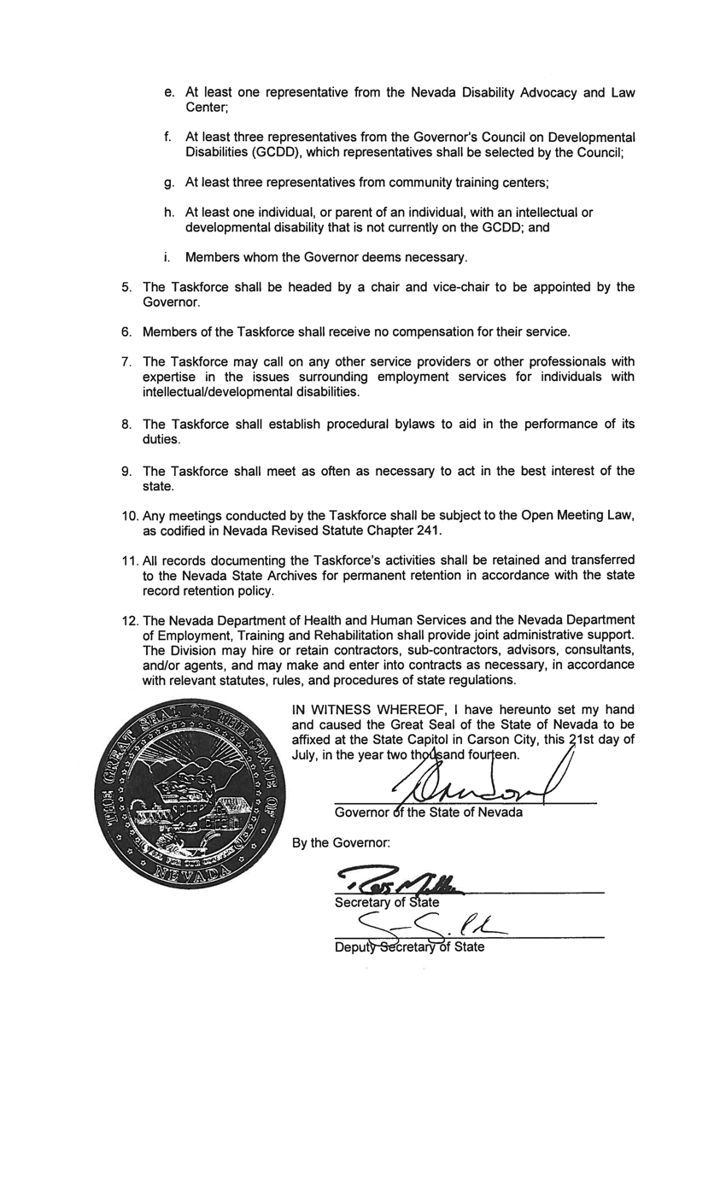
EXECUTIVE ORDER 2014-16

Slide 4
TASKFORCE MEMBERS
Jane Coorough-Gruner, Chair - Dept. of Health & Human Services (DHHS)
Joshua Baker – Education - University of Nevada, Las Vegas (UNLV)
Kelly Wales – Education - Washoe County School District (WCSD)
Kristine Minnich – Education - Clark County School District (CCSD)
David Jickling – Transportation - Regional Transportation Commission (RTC)
Ken Rodriguez – Transportation - Regional Transportation Commission (RTC)
Shelley Hendren – Dept. of Employment, Training and Rehabilitation (DETR)
Jack Mayes - Nevada Disability Advocacy and Law Center (NDALC)
Sherry Manning - NV Governor’s Council on Developmental Disabilities
Louis Renshaw - NV Governor’s Council on Developmental Disabilities
Stephen Schumacher - NV Governor’s Council on Developmental Disabilities
Brian Patchett – Community Training Ctr. - Easter Seals Nevada
Edward Guthrie – Community Training Ctr. - Opportunity Village, Inc.
LaVonne Brooks, Vice Chair – Comm. Training Ctr. – High Sierra Industries, Inc.
Mechelle Merrill – Bureau of Vocational Rehabilitation (BVR)
Mark L. Olson - Member of the Public
Lenn White - Member of the Public

Slide 5
MISSION
To develop and implement a sustainable system for individuals with intellectual and developmental disabilities (I/DD) to achieve competitive, integrated employment in the setting of their choice.

Slide 6
vision
We Believe:
Our job is to increase opportunities and decrease barriers
All individuals, schools, families and businesses must raise their expectations
People will be hired because of their ability not because they have a disability
Employment is a win/win for everybody
People are healthier, safer and happiest with meaningful work of their choosing

Slide 7
PHILOSOPHY
The prevailing philosophy that guides all aspects of this plan is that Nevada will be strengthened by promoting competitive, integrated employment where people with I/DD are employed at or above the state minimum wage.

Slide 8
TASKFORCE PROGRESS TIMELINE
Executive Order Signed | July 22, 2014
Majority of Members appointed. Social Entrepreneurs, Inc. hired to facilitate. | July through Dec. 2014
First Meeting Held. Mission statement created and approved. Bylaws approved. Outreach Plan presented and approved. Discussions began on Values and Guiding Principles. | December
Second Meeting Held. Vision and Guiding Principles approved. Discussed Outreach Plan and Research Plan and current results. | January
Third Meeting Held. Report on Outreach results including: Scorecard response (13 Members), Key Informant Interviews (13), Focus Groups (8 groups, 87 individuals), and Survey responses (356). Discussed Critical Issues. | February

Slide 9
OUTREACH
The Alliance for Full Participation State Team Scorecard
13 Members completed (100% at the time)
12 Key Informants completed
Member ranked the recommendations within the Nevada Governor’s Council on Developmental Disabilities’ “Employment First” Position Paper
(Used a Likert scale to rate)

Slide 10
OUTREACH
Key Informant Interviews
13 interviews conducted with individuals identified by Members as having specialized expertise
Over the phone
45-90 minutes each

Slide 11
OUTREACH
Focus Group Discussions
10 scheduled. 8 conducted (2 had no participants)
Total of 87 individuals
Consisted of consumers, caregivers, family members and advocates
Locations in northern, southern and rural NV
Local service providers recruited participants and provided the space

Slide 12
OUTREACH
Consumer Surveys
Distributed through Members to consumers, caregivers, family members and advocates
On-line or hard copy
356 surveys collected/compiled from across the state
13 of Nevada’s 17 counties were represented
Only 10 surveys in Spanish were received

Slide 13
OUTREACH
Consumer Surveys Results – Identified three areas of Priority:
Working in a job they like
Having the opportunity to earn a wage that is fair for the work they do
Having the opportunity to earn minimum wage or higher

Slide 14
TASKFORCE PROGRESS TIMELINE
Fourth Meeting Held. Definition of I/DD discussed and approved. Research results and Outreach results approved. Presentation on State’s 700 Hour program. Discussion of critical issues and potential goals. | March
Fifth Meeting Held in-person in Reno. Presentation by the Regional Transportation Commission (north and south). Received update on federal Advisory Committee on Increasing Competitive Integrated Employment for Individuals with Disabilities. Created and prioritized Goals. | April
Sixth Meeting Held. Approved Critical Issues and Goals. Discussed Strategies. | May
Seventh Meeting Held in-person in Las Vegas. Approved Strategies and rough draft of Report and Strategic Plan. | June
Report and Strategic Plan submitted to the Governor’s office. | July 1, 2015
Final Meeting Held. | July 15, 2015

Slide 15
ResourceS
Integrated Employment Research Report
Integrated Employment Research & Supplemental Databook
Integrated Employment Outreach Summary Report
Integrated Employment Report and 2015-25 Strategic Plan
http://adsd.nv.gov/Boards/IntegratedEmployment/ Agendas

Slide 16
Critical Issues Ranked
Issue | Weighted Average (Lower is better)
2. Resource Development and Sustainability | 4.42
5. Collaboration and Coordination | 4.42
3. Employment First Policies and Practices | 4.83
10. Transportation | 5.15
1. Government as a Model and Leader | 5.33
6. Workforce Development | 5.38
7. Employer Engagement, Development and Support | 5.75
8. Culture Shift and Community Awareness | 6.00
9. Early and Timely School Assessment and Planning for Transition | 6.15
4. Outcomes Measurement and Review Process | 6.50

Slide 17
CRITICAL ISSUES, GOALS & Strategies
Governor’s Taskforce on
Integrated Employment
DECEMBER 2014 - JuLY 2015

Slide 18
Resource Development and Sustainability (2015-18)
Goal 1. Education, employment and other related systems within Nevada have and maintain sufficient resources and funding for competitive, integrated employment.
Strategies:
Collaborate to access and leverage all available resources for programs & services
Engage Governor & Legislators to add resources
Develop new & strengthen existing partnerships
Pursue alternative/complementary funding through private foundations and grants

Slide 19
Resource Development and Sustainability (2015-18)
Goal 2. Systems within Nevada implement a reimbursement structure for service providers that increases competitive, integrated employment of people with I/DD.
Strategies:
Establish a funding & rate plan that includes braided and blended funding across agencies
Maximize available state and federal resources through improved rate and payment systems
Educate legislators (importance of increased funding)
Develop sustainability plans

Slide 20
Collaboration and Coordination (2015-18)
Goal 3. Nevada develops effective partnerships that include all stakeholders to implement competitive, integrated employment.
Strategies:
Expand partnerships & promote communication to avoid duplication & expand opportunities
Establish MOUs with key partners to define roles
Implement data sharing policies, practices & systems with state agencies, schools & providers
Research & employ evidence-based practices

Slide 21
Professional Development (2015-20)
Goal 4. Nevada has well-trained, competent professionals that educate and prepare people with I/DD to achieve competitive, integrated employment.
Strategies:
Invest in building the skills of Employment Specs. & key paraprofessional staff
Provide evidence-based curriculum, career readiness professional development and training to teachers & support staff
Link colleges/universities’ disability services with career services

Slide 22
Transportation (2015-20)
Goal 5. People with I/DD have affordable and reliable transportation options across all regions of Nevada to participate in all aspects of life.
Strategies:
Develop & expand transportation service options
Expand the use of voucher programs
Promote & expand travel training services to high school and adult users
Work with trans. companies & employers to create a system for paid/reimbursed ride sharing

Slide 23
Employer engagement, development and support (2015-20)
Goal 6. Nevada provides ongoing training and support for employers and their employees with I/DD.
Strategies:
Develop long-term employment supports beyond 90 days
Pursue creative partnerships with employers for job carving and job sharing & on-the-job training and self-advocacy training
Utilize employers to share success stories
Provide proactive benefits planning

Slide 24
Employer engagement, development and support (2015-20)
Goal. 7 All Nevada companies have enough information about and access to people with I/DD seeking employment to make informed business decisions to hire them.
Strategies:
Identify business leaders to serve as outreach leaders to other businesses & liaison between agencies and schools
Provide outreach, training and support to employers

Slide 25
Employer engagement, development and support (2015-20)
Goal. 7 All Nevada companies have enough information about and access to people with I/DD seeking employment to make informed business decisions to hire them.
Strategies:
Develop a structure to support local coalitions that link providers, businesses, schools & families
Create and implement marketing strategies and share success stories with employers. Use social media.

Slide 26
Government as a Leader and Model Employer (2015-25)
Goal 8. There are measurable increases in employment of Nevadans with I/DD within the State of Nevada, including local governments and the publicly-funded university system.
Strategies:
Implement job carving, job sharing, & part-time/ non-traditional shift offerings
Align statewide infrastructure to promote fast-track hiring & create more under-fill, intern & trainee jobs
Centralized fund source for accommodations
Develop communications and marketing to attract & encourage applicants with disabilities to apply

Slide 27
Government as a Leader and Model Employer (2015-25)
Goal 9. The State of Nevada, including the publicly-funded university system, is a model employer who supports policies, procedures, regulations, and practices to increase opportunities, foster innovation, reduce barriers, facilitate accommodations, and informed choice for competitive, integrated employment of people with I/DD consistently across the state.
Strategies:
Develop & implement policy for day habilitation for either long-term placement or temporary with a specific plan to establish employable skills gain
Promote policies to protect SSI and other benefits

Slide 28
Government as a Leader and Model Employer (2015-25)
Goal 9. The State of Nevada, including the publicly-funded university system, is a model employer who supports policies, procedures, regulations, and practices to increase opportunities, foster innovation, reduce barriers, facilitate accommodations, and informed choice for competitive, integrated employment of people with I/DD consistently across the state.
Strategies:
Encourage leaders to publically champion & educate others about hiring people with I/DD
Educate workforce development boards so they fully support initiatives

Slide 29
Government as a Leader and Model Employer (2015-25)
Goal 10. Information is gathered and reported annually on key indicators for competitive, integrated employment across education, employment, and other related systems.
Strategies:
Use WIOA combined state plan accountability workgroup’s recommendations to establish outcomes tied to length of time to achieve job, wages, benefits & satisfaction
Develop & adopt statewide universal data elements
Collect data beginning in school and measure assessment, placement, retention, wages & satisfaction
Monitor, track & share performance measures, trends and other data and review annually to refine strategies

Slide 30
Early and Timely School Assessment and Planning for Transition (2015-25)
Goal 11. Young people with I/DD have work experiences that are typical of their peers.
Strategies:
Incorporate career-readiness content into educational curriculum, linking with colleges
Provide career-readiness & hands-on work exp.
Paid or unpaid work experiences incl. career-based assessments, internships, job shadowing, volunteer work & summer jobs
Require community based career exploration

Slide 31
Early and Timely School Assessment and Planning for Transition (2015-25)
Goal 12. Every person with I/DD in Nevada transitions to adulthood with vocational experiences and the education that will enable them to obtain competitive, integrated employment.
Strategies:
Use customized approach. Use AT & tele-services
Resources/services available beginning at age 14
Implement services including staff training, person-centered supports, volunteer opps., development of soft skills & ways to be out in community
Increase communication: VR, Spec. Ed. & Sec. 504

Slide 32
WHERE ARE WE NOW?

Slide 33
WHERE ARE WE NOW?

Slide 34
WHERE ARE WE NOW?

Slide 35
WHERE ARE WE NOW?

Slide 36
WHERE ARE WE NOW?

Slide 37
QUESTIONS?

