Slide 1

All Inclusive
“Raising Mindful Citizens”
Joanna Jezierska, Ph.D.
University of Nevada, Las Vegas

Slide 2
Inventive Method (1984)
(authors: Tomasz Jezierski, Ph.D. & Joanna Jezierska, Ph.D.)
Experimental teaching method used in foreign language courses based on creative problem solving abilities of the individual
The learning process was treated as a transformation of the individual’s way of seeing and interpreting the world with the aim of applying the student’s behavior to new situations
.

Slide 3
Venues:
Classroom setting
Outreach initiatives
Professional development workshops and seminars

Slide 4
2006-Present Outreach initiatives;
Series of professional development workshops, seminars, training sessions for students, faculty, community members
2009-2016 Classroom Setting – Academic and Life Success (ALS) 101 at CSN
2014-2017, National Summer Transportation Institute – Federal
2019 grant funded by FHWA, US DOT, NDOT, residential 2-week camp for Nevada high school students at UNLV

Slide 5
This is How It Works:
Educate students first of who they are and how they learn by showing them
personality type (student’s preferences and patterns)
learning style (how a student processes information)
brain dominance (how students learn and behave)
Create safe and friendly environment
Build groups
Build skills
Being transparent, inclusive, accessible, honest, and open-minded
This approach helps to maximize effectiveness of a learning-teaching process regardless the environment

Slide 6
Building Groups:
Assess of who they are (Self Discovery Process)
Color Personality Test, Brain Dominance, Learning Styles
Encourage exchanging phone numbers and emails to enable easy communication among class or group members (on voluntary basis)
Peer Mentoring

Slide 7
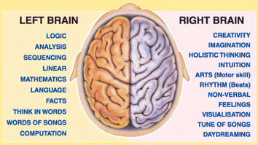
Brain Dominance
https://openpsychometrics.org/tests/OHBDS/

Slide 8
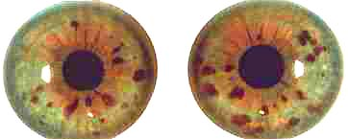
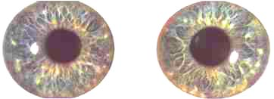
Additionally to the test, we look at other possible ways of determining brain dominance. Your eyes, and other body signs indicate the pattern of switching hemispheres
the leg you prefer to kick with or which leg do you prefer to stand on?
the hand you write with
observe that some people fold their arms in different ways - left over right or vice versa
as you look in pairs of eyes, you will notice that people's left and right eyes are rarely the same - it is this difference that reflects differences in the way they use their hemispheres
(your left eye is connected to your right brain hemisphere and vice-versa)
Right eye
Left eye
Right eye
Left eye
Jewel Structure
Flower Structure

Slide 9
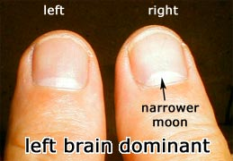
which of your thumbs has the more directed (higher or narrower) moon?
do you ask a lot of questions?
do you tend to reveal all when questioned?
Left brain dominant people are more questioning
Right brain dominant are more answering
Logical responses are the province of the Left hemisphere
Creativity and intuition are regarded as Right hemisphere skills
Survival of the self is a concern of the Left hemisphere
Survival of others (a child, loved one or the group for instance) is a matter for the Right hemisphere

Slide 10

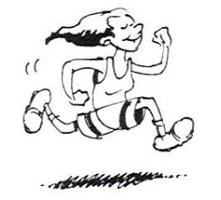
Three Learning Styles:
Visual – “eye smart”
Auditory – “ear smart”
Tactile/kinesthetic – “action smart”
Which one is yours?

Slide 11
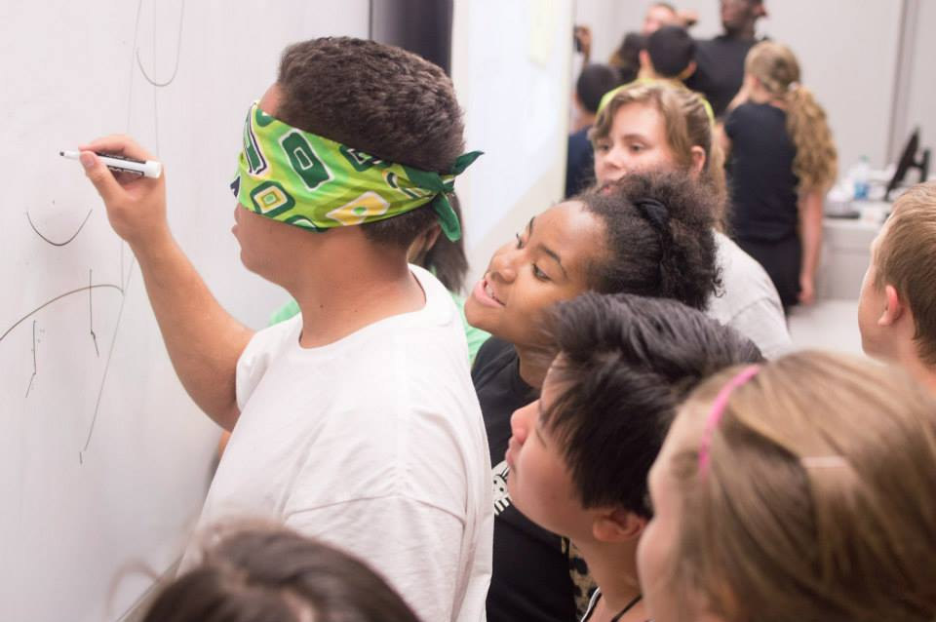
Building Skills
Being empathetic to other people’s needs is a transferrable skill. Can be applied to seniors, children, non-native speakers, disadvantaged, non-traditional, etc.
How does this make you feel?
What changes would you make?
Learning patience
  Wait 10 seconds before you speak.
Tolerance
We are enriched when we are together,
yet represent our uniqueness as individuals.
https://www.unlv.edu/multicultural/about
Social skills
Clear communication
Flexibility
Creativity
  Think outside the box
  Look beyond the obvious
  Being resourceful

Slide 12

What can you use a plastic bottle for?

Slide 13
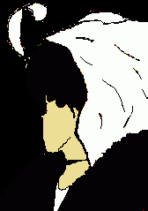
Brain Teasers

Slide 14


Slide 15
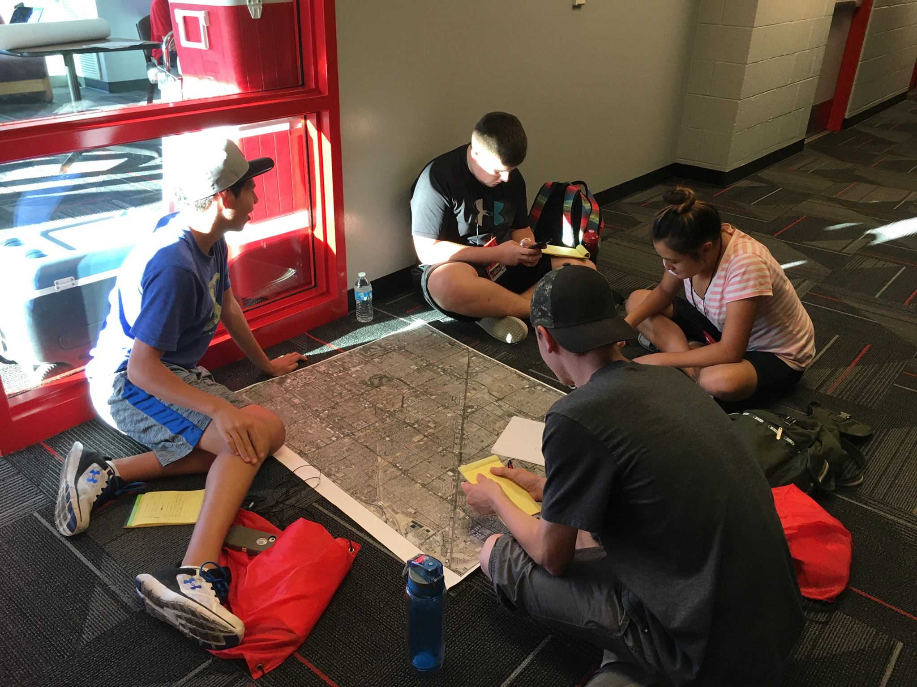
Values of Peer Mentoring
1. Generalized benefits
Socialization
Reading comprehension (reading out loud)
Value of including all participants
Application of different perspectives
Group rehearsing and public speaking
2. Benefits in their quest to become engineers
Interpretation
Math and science application
Analysis, implementation of data, maps, context, etc.
Project design process – from an idea, through research to building a model

Slide 16
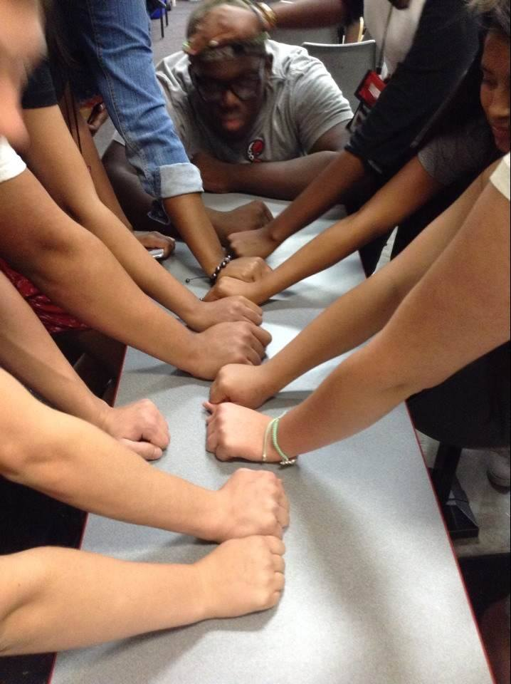
How can we teach others being more empathetic?
Experience:
Put yourself in somebody else’s shoes
Educate yourself about others’ needs, struggles, etc.
Physical disabilities - Use of equipment such as blindfolds, wheelchairs, or crutches to simulate
sensory/mobility impairments.
Intellectual disabilities – Simulation of communication,
comprehension, and socialization differences through the implementation of specific behavioral rules and guidelines.
communication issues, disorientation, slow responses, etc.

Slide 17
Examples of Workshops:
Student Learning Challenges (including
Disabilities in the Classroom)
Brain Dominance vs. Learning and Career Choice
Dimensions of Diversity
Thinking Has Future
Proper Public Speaking Etiquette
Assessing and Changing Study Behavior
Effective Teaching
The Importance of Change
Job Interview? No problem!
Conflict Management
Effective Time Management
Cross Cultural Awareness
STEM Like A Woman
Dining Etiquette
Dress for Success
Stress Management
Test Taking Skills
Discipline Specific Resume Writing Session
Career Development Tips
Women Salary Negotiation Skills

Slide 18
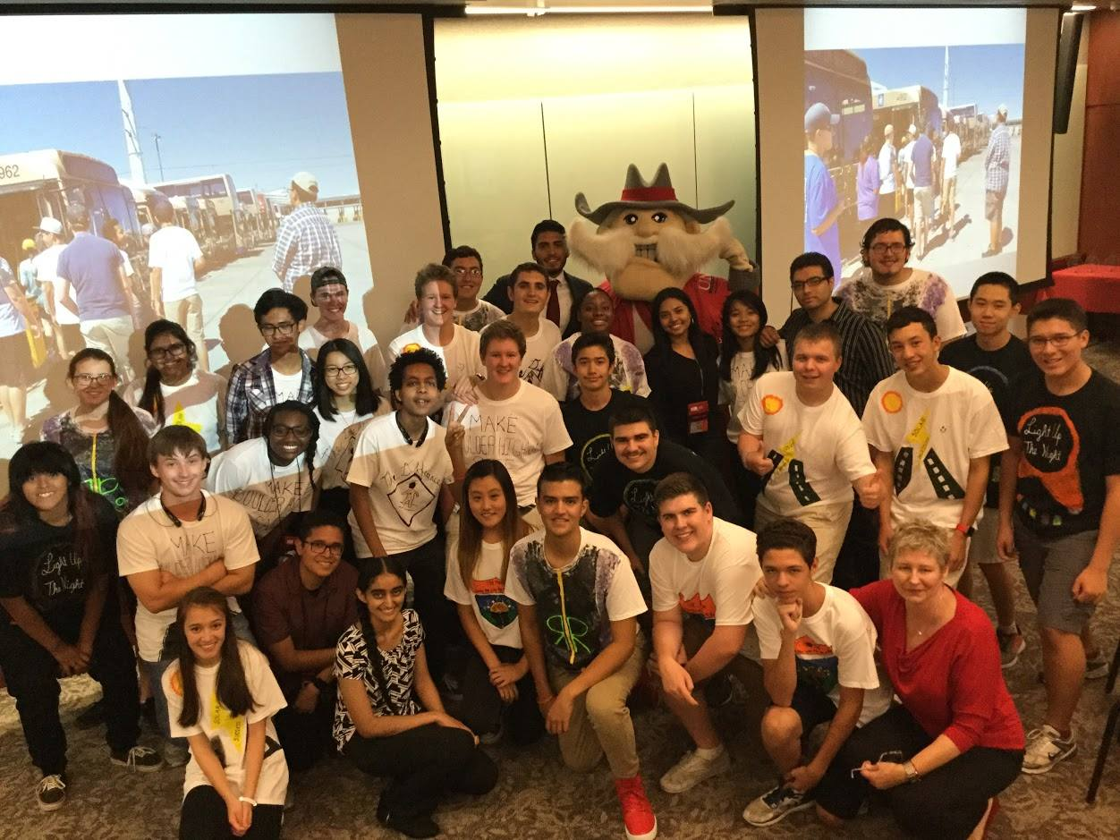
National Summer Transportation Camps (2014-2017, 2019) federal grant funded by FHWA, US DOT, NDOT
Working on RTCSNV real life projects in Las Vegas alongside workforce experts
Competitive project design in groups
Brain storming sessions with experts
and users
Field trips to the locations
Group presentations & Grand Prize
winners

Slide 19

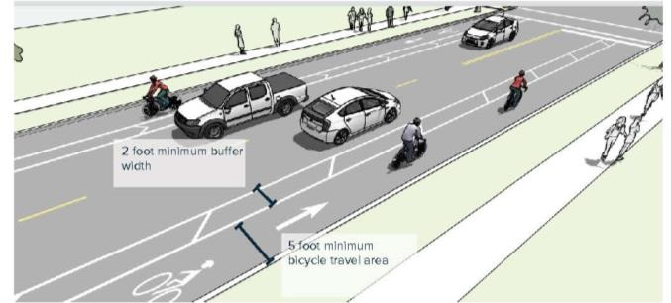
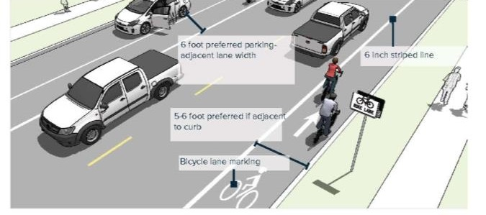
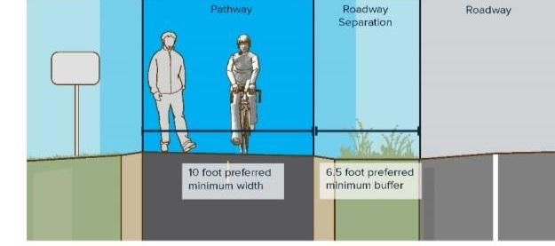

Complete Streets
BUFFERED BICYCLE LANE
COMFORT
SAFETY
ACCESS & EQUITY
HEALTH
BICYCLE LANE
SHARED USE PATH / SIDEPATH
Notes:
The plan includes design guidelines – based on the Complete Streets Design Guidelines for Livable Communities, and adding new best practices in design with new facilities like buffered and separated bike lanes.

Slide 20
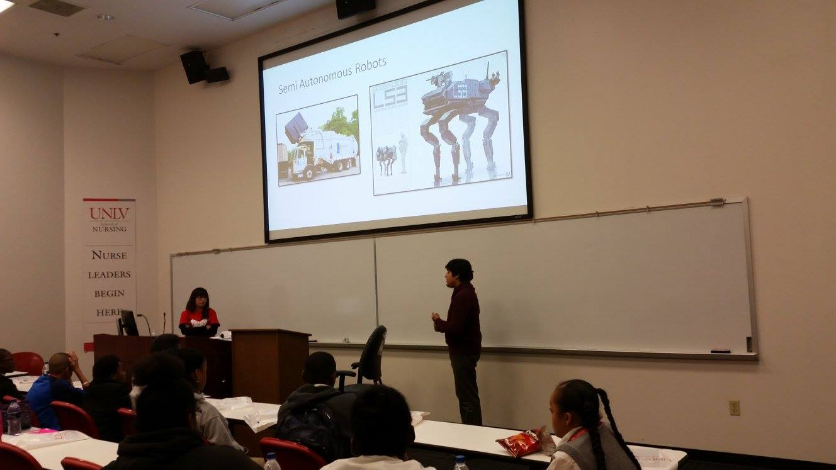
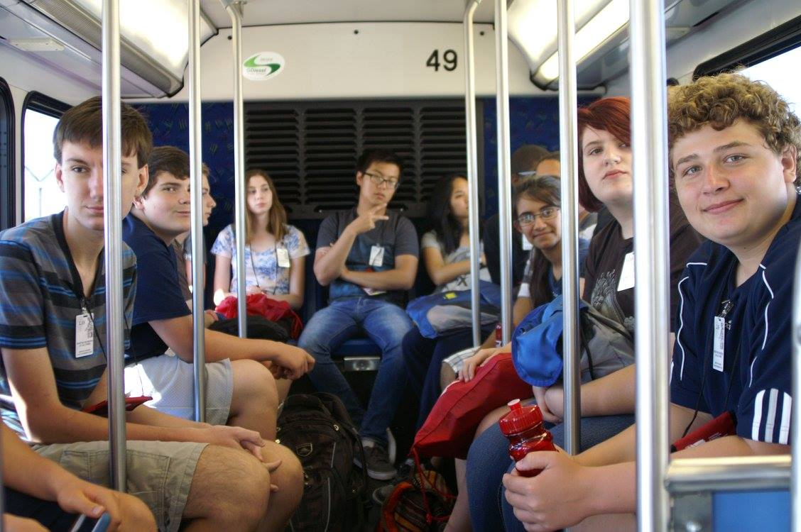
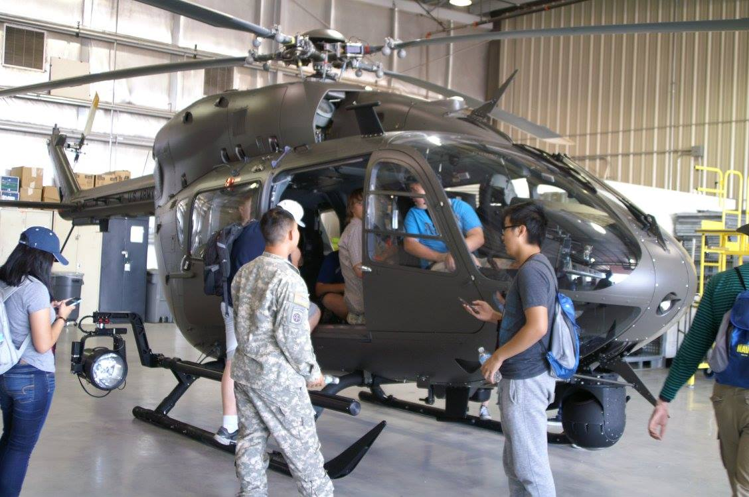
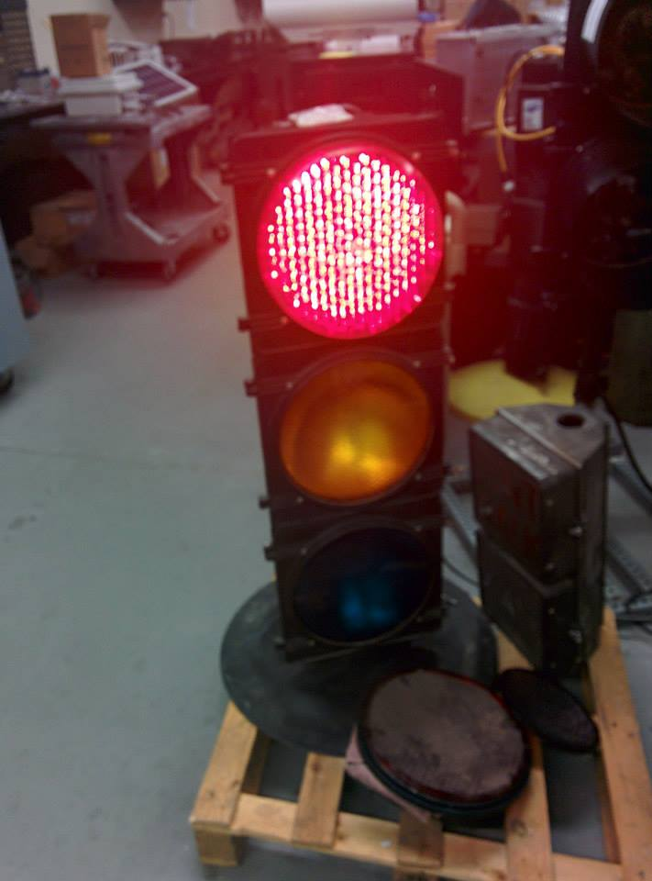
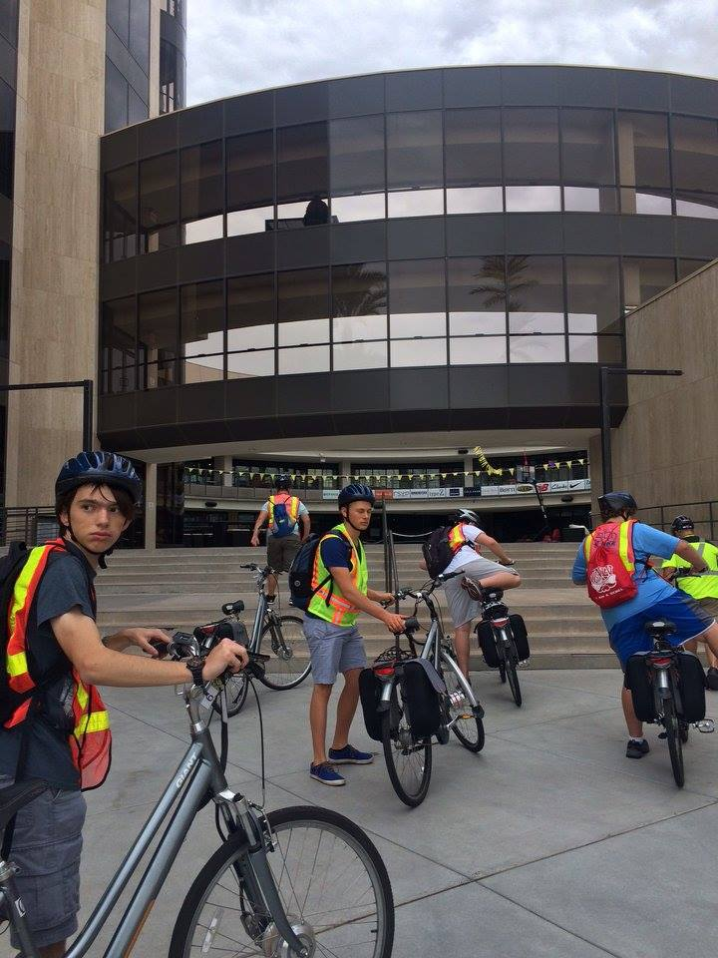
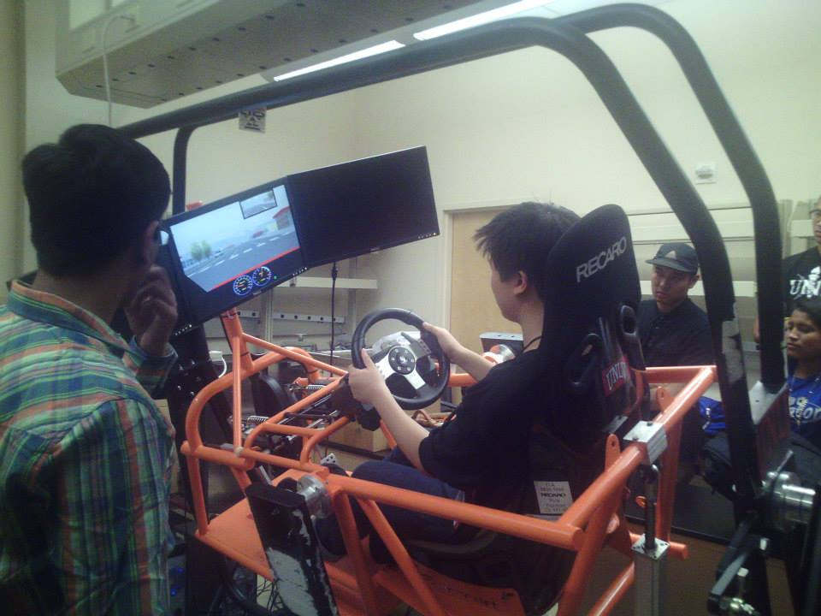

Slide 21
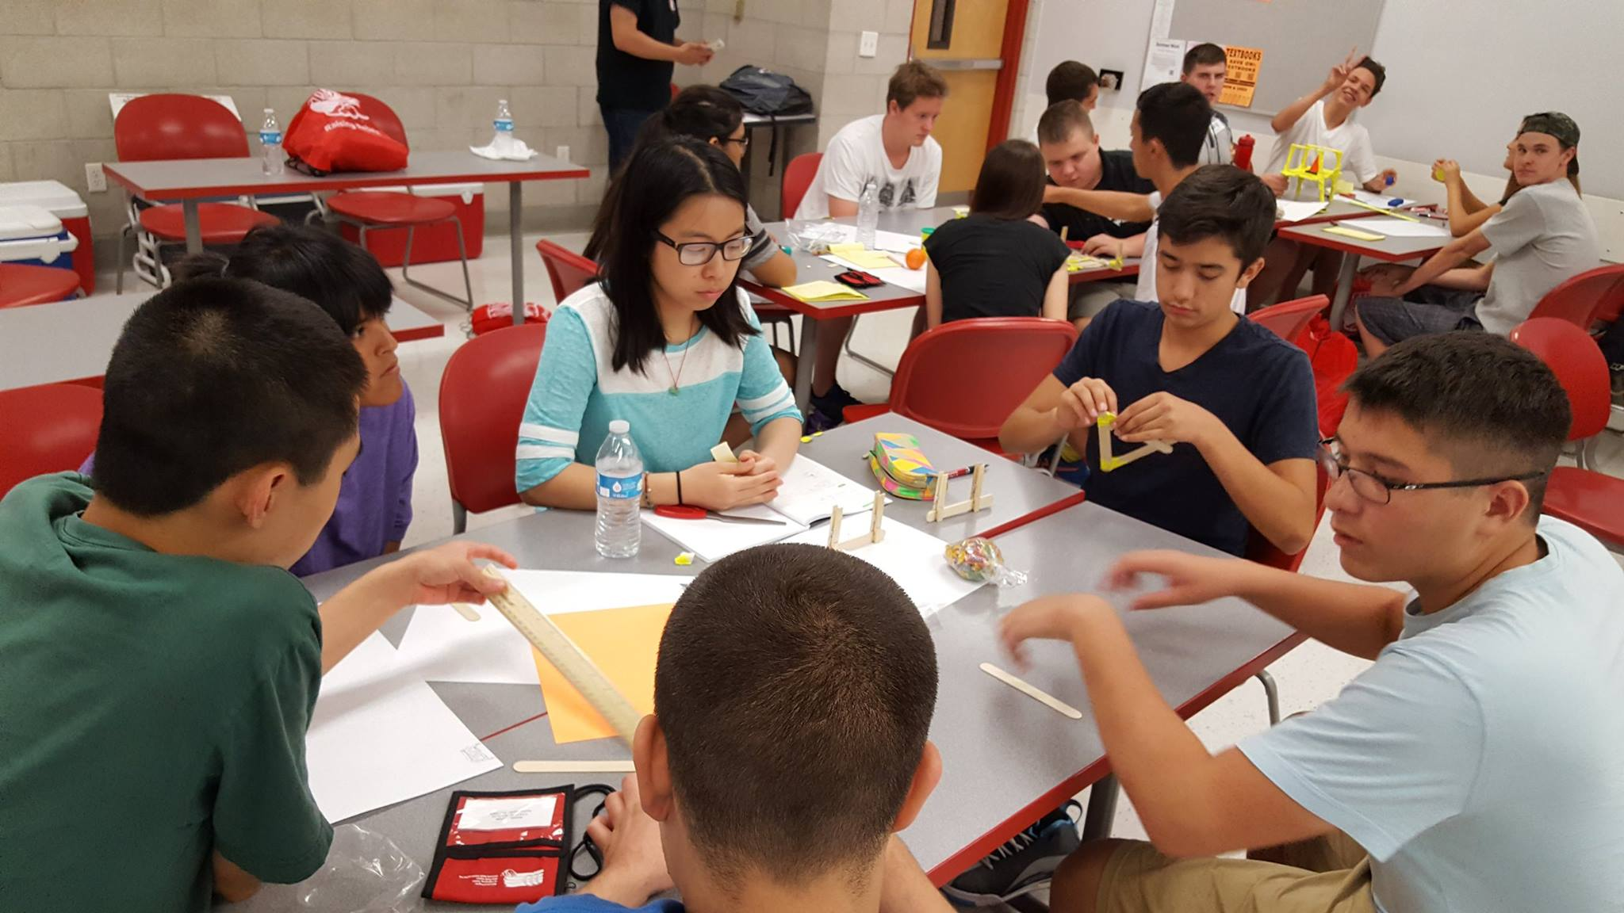
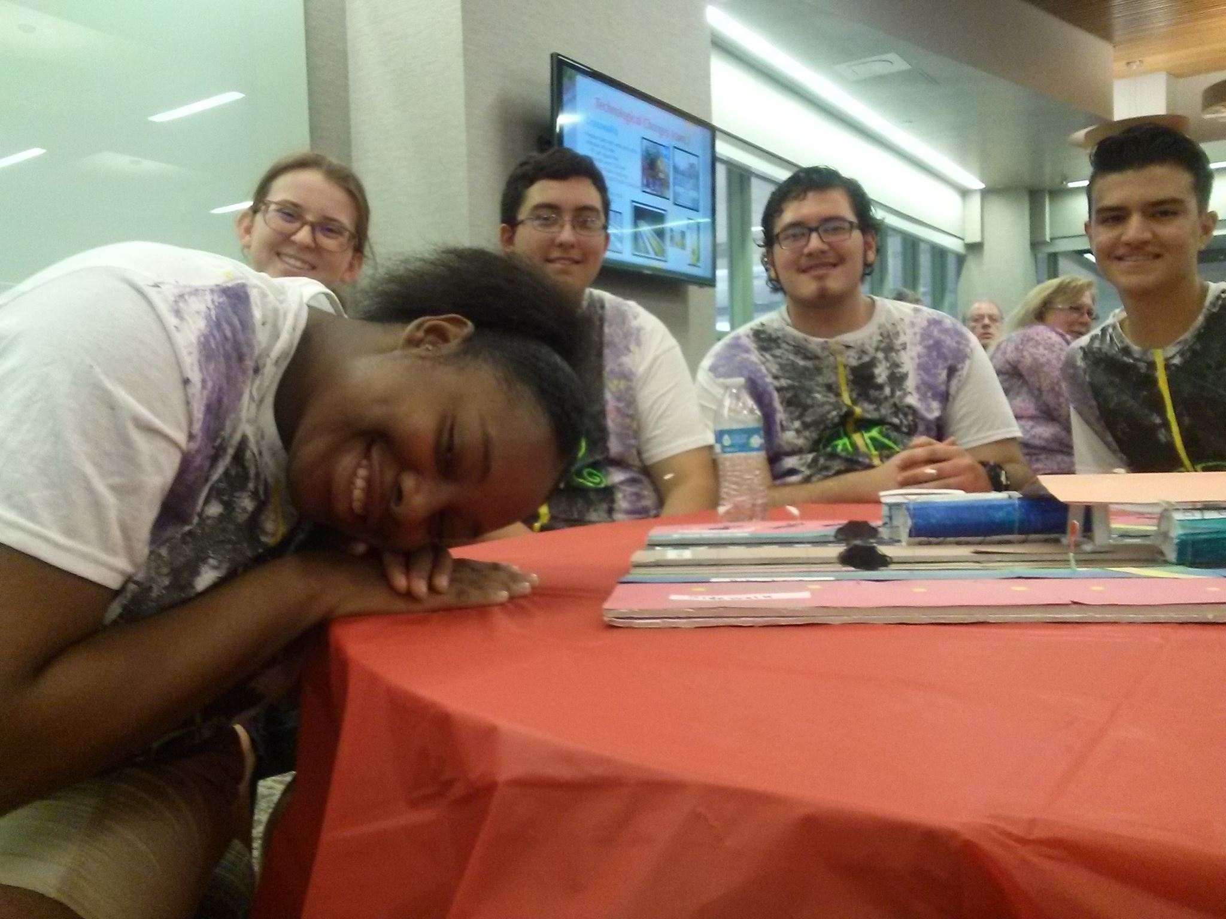
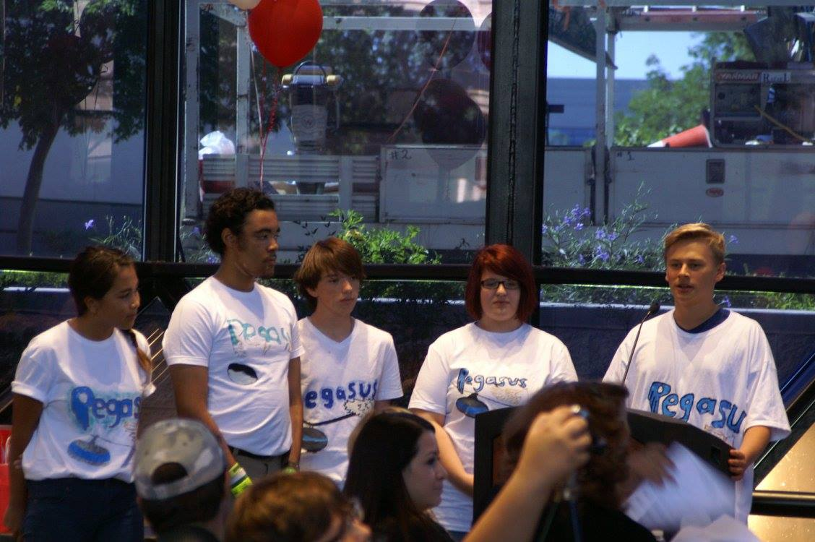
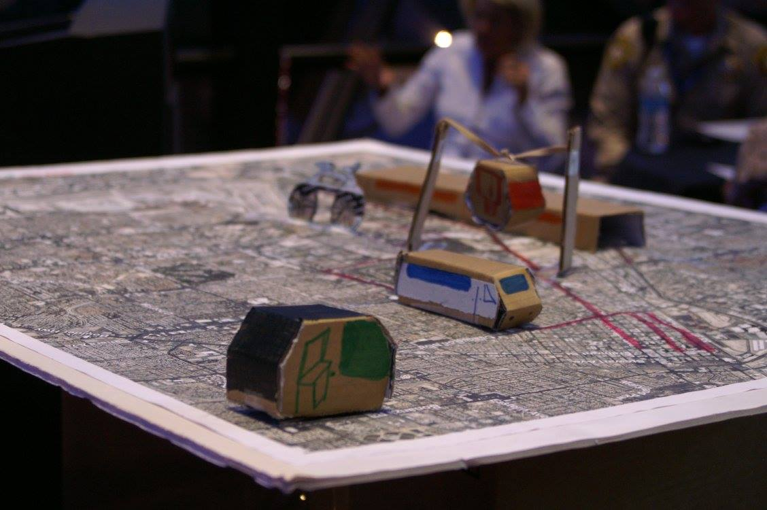
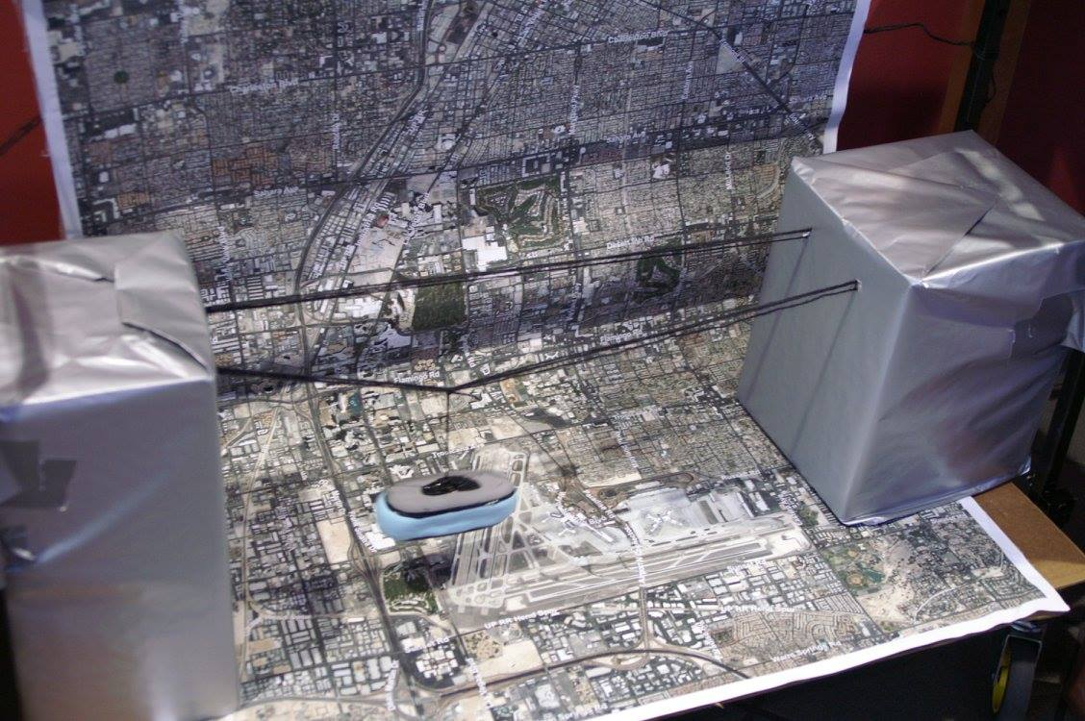
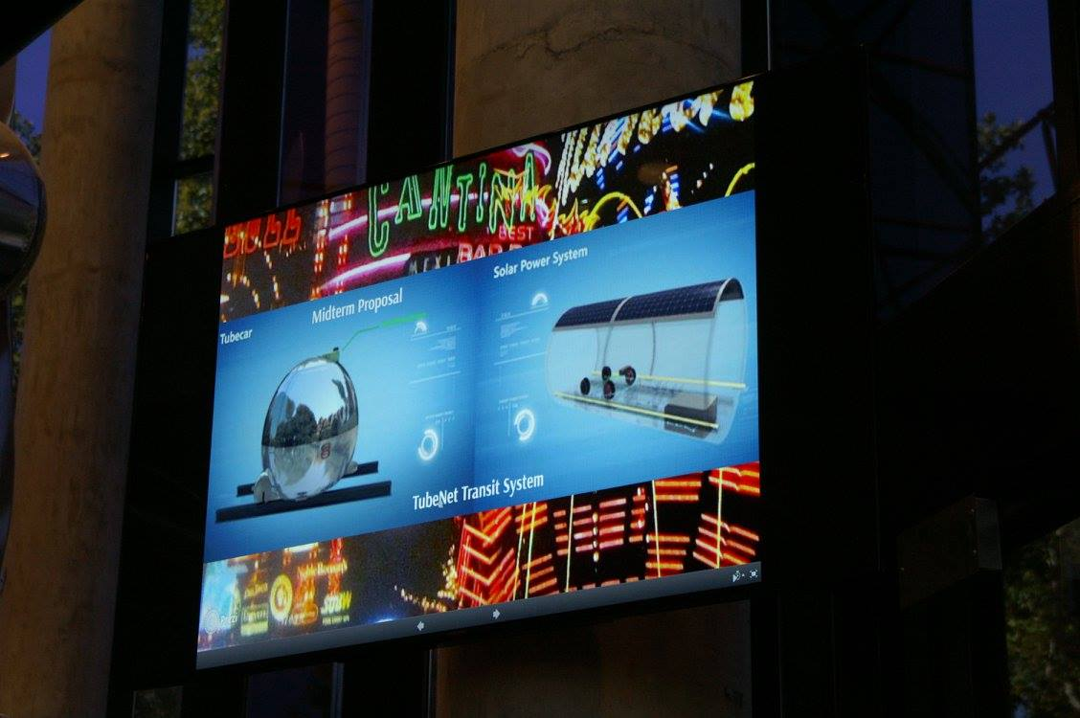
Group Work
Group Projects

Slide 22
All Inclusive. Raising Mindful Citizens.
Setting up friendly, safe and inclusive environment for all involved
Use other people’s perspective. The project is not complete until everybody contributes
Empathy – a must factor
Paying Back – Paying Forward strategy. Foundation for civic engagement.
Increasing academic, personal, and professional achievements and success
Building confidence, consistency, work ethics
Increasing motivation and interest in STEAM majors and careers

Slide 23
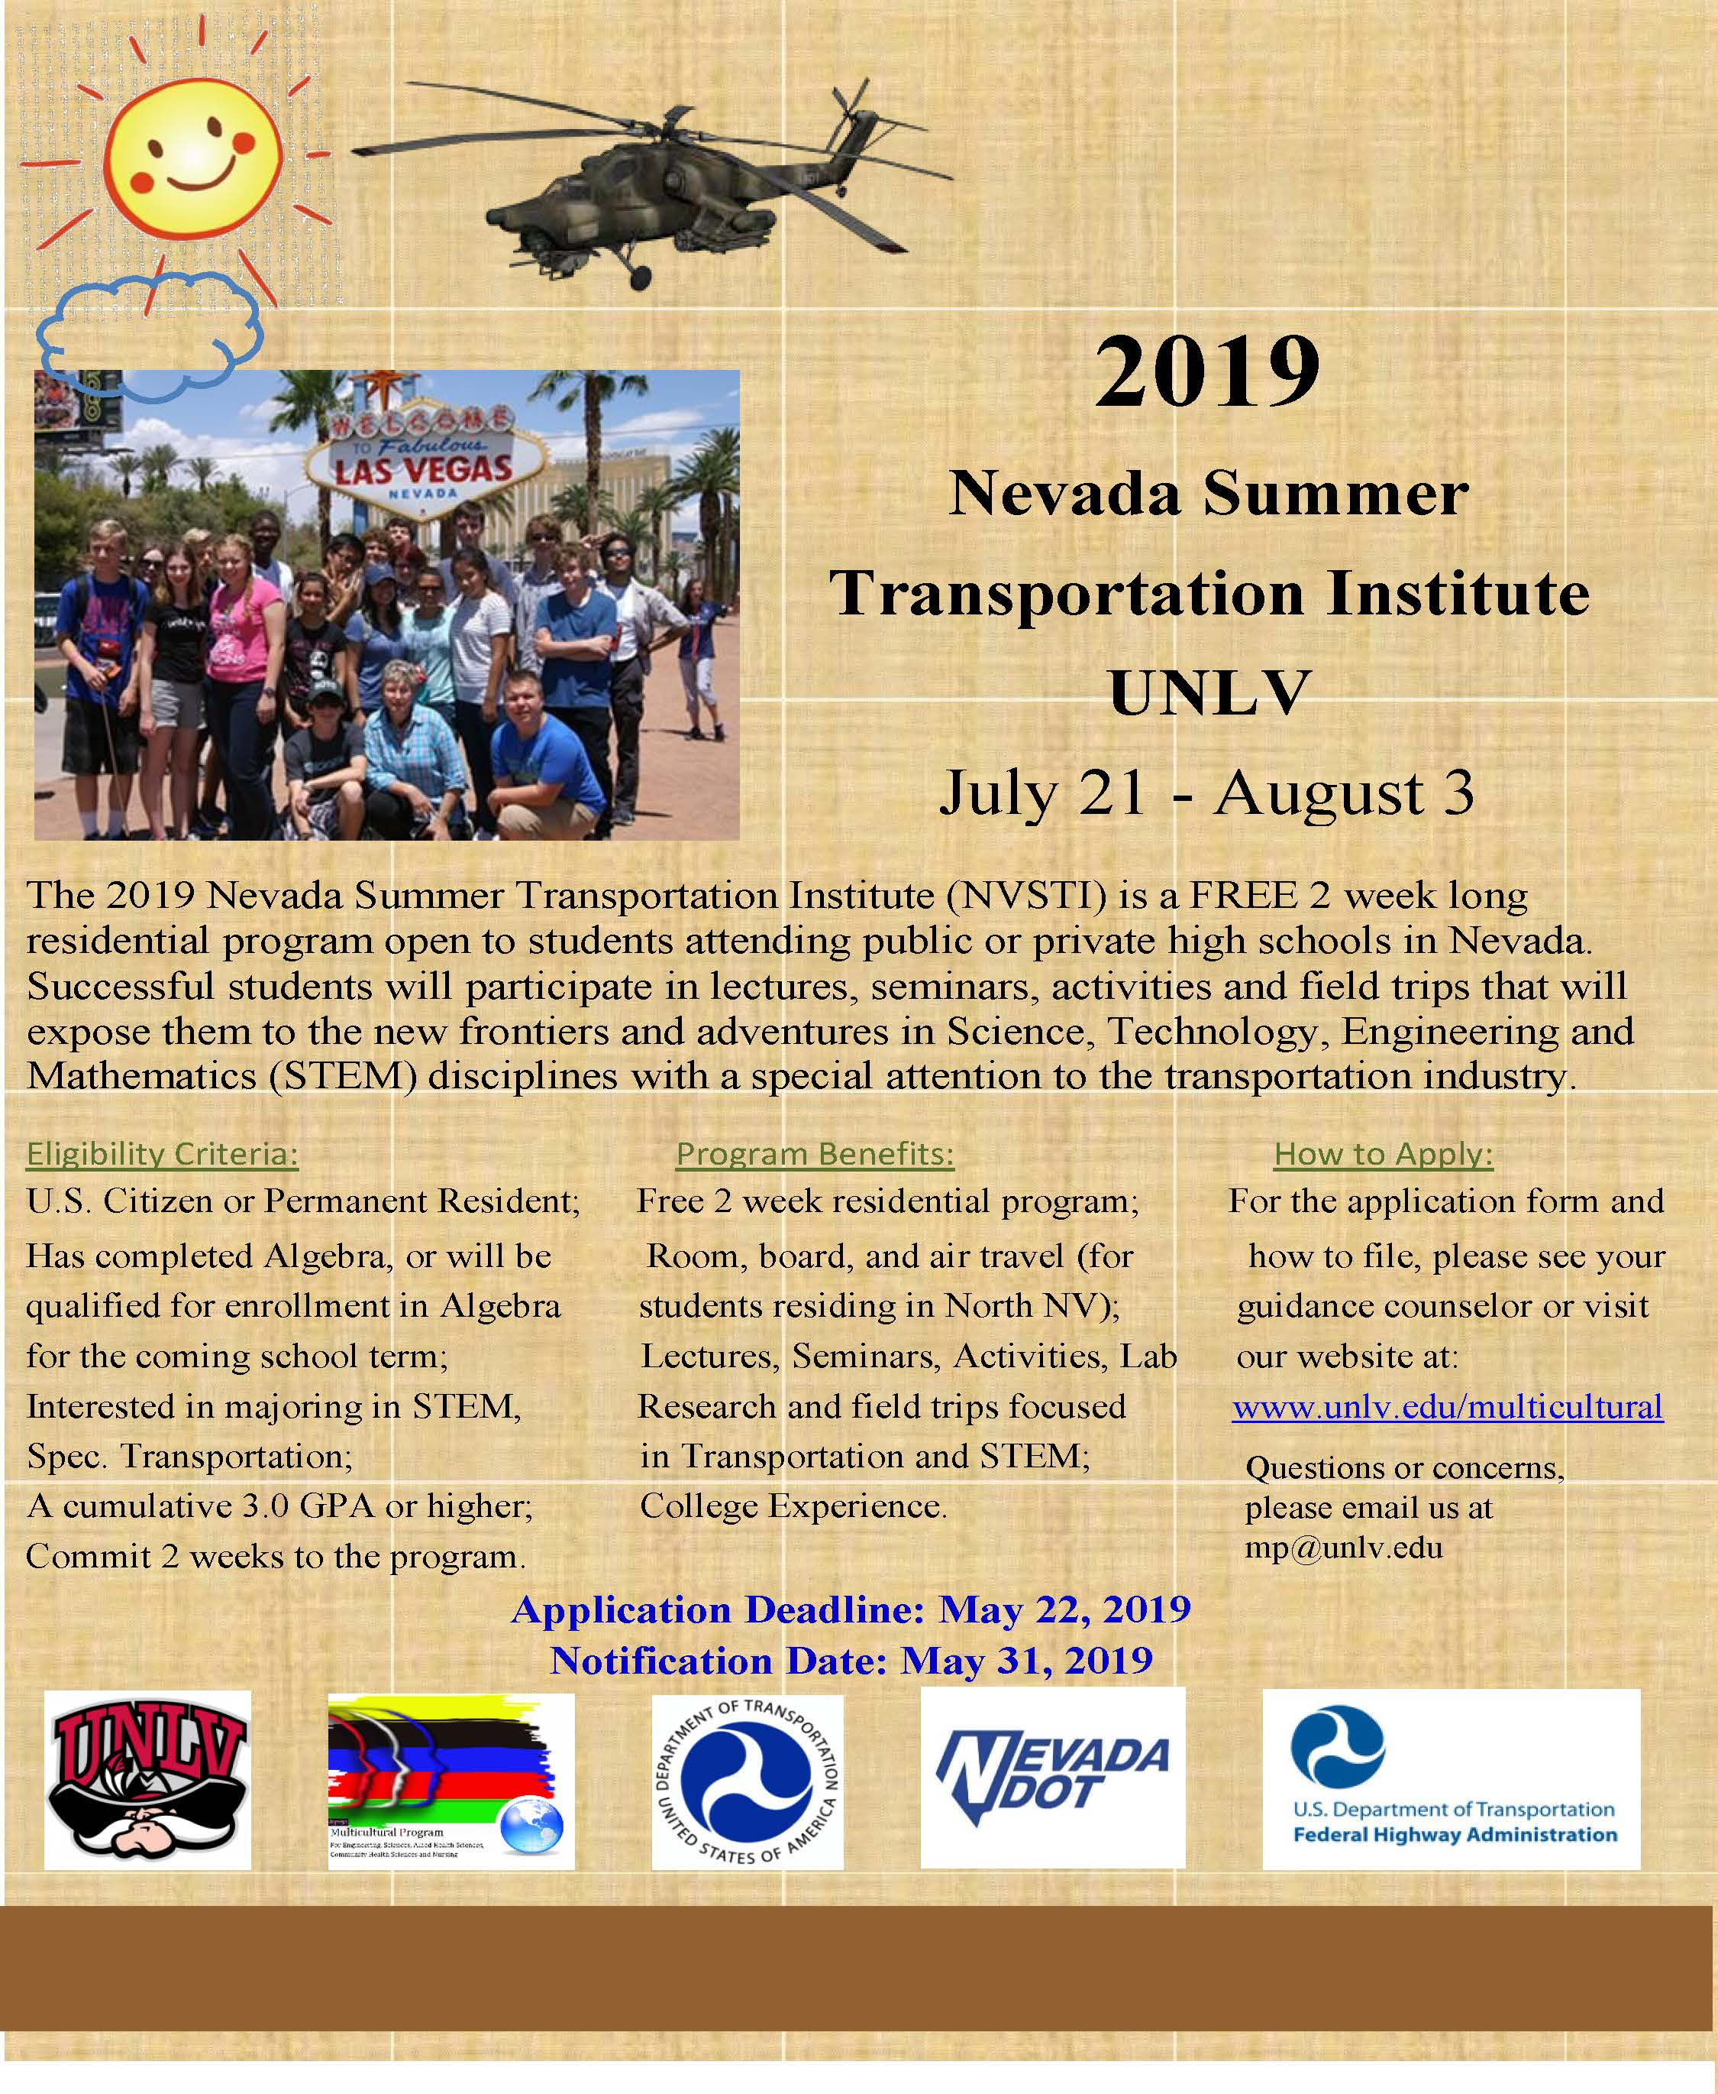
Currently recruiting for

Slide 24



Contact Information:
Joanna Jezierska, Ph.D.
UNLV
Multicultural Program for STEM and Health Sciences
Phone: 702-895-1345
Email: mp@unlv.edu or Joanna.Jezierska@unlv.edu
Follow Us on Facebook (UNLV Multicultural Program)
https://www.unlv.edu/multicultural

Slide 25
References:
Eric Jorgenson (2015). "Development of the Open Hemispheric Brain Dominance Scale".
http://openpsychometrics.org/tests/OHBDS/development/
Color Test: http://www.colorquiz.com/
Brain Teasers: https://sharpbrains.com/brainteasers/

