Slide 1
Inequities on the Road:
Does Being Differently-Abled Make Your Travel More Dangerous?
Your Name

Slide 2
Who Feels Like This?

Slide 3
10,000 Americans Turn 65 Daily
8,000 a day turn 75…
Should that matter if you want to go for a walk?
Does a lack of perfect mobility prevent any of you from walking?

Slide 4
Things Can ALWAYS be Worse!
Would you want to cross here?

Slide 5
How About Here?

Slide 6
Sad Fact:
According to Smart Growth America, from 2011-17, Las Vegas ranked 11th on their list of the most dangerous metropolitan areas for walking.

Slide 7
Why Do We Care About Walking?
Valuable form of transportation
Provides health benefits of physical activity
Opportunity to socialize
Contributes to a higher quality of life
No matter your abilities!

Slide 8
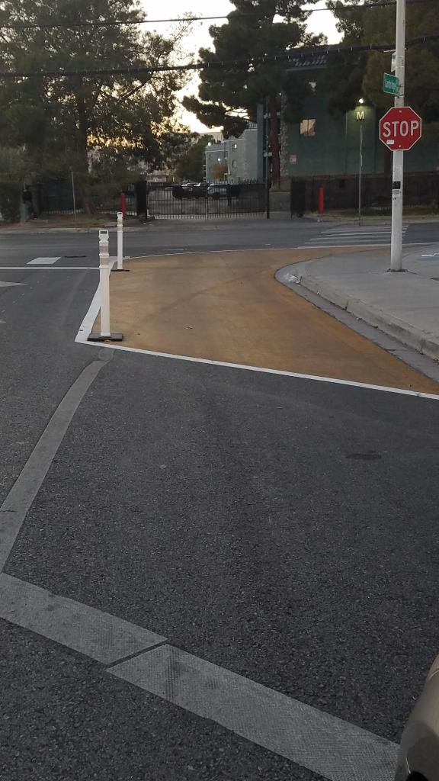
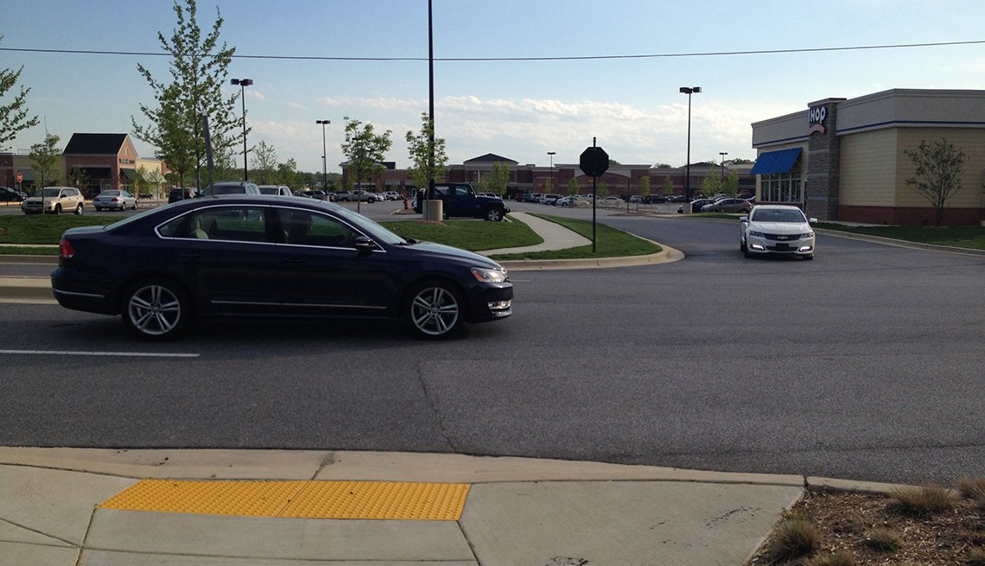
BUT…. Have We Planned for Everyone?

Slide 9
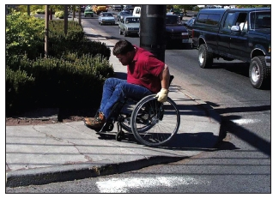
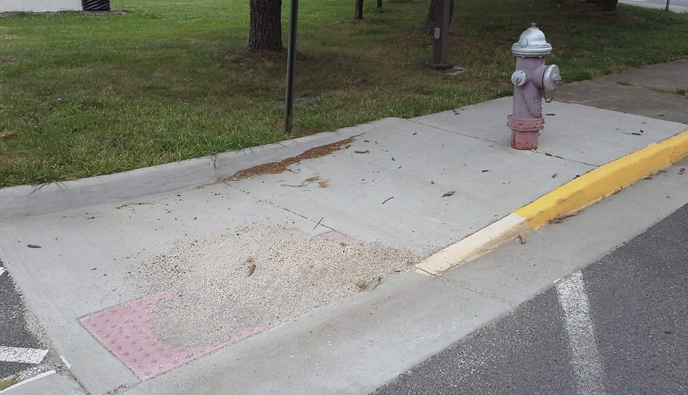
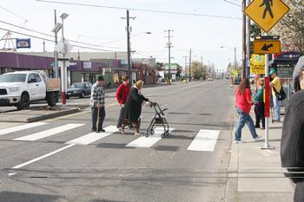

Slide 10
Who Walks?
Where do you walk to?
How do you walk?
When do you walk?
Do you have any fears?

Slide 11
Health Benefits of Regular Physical Activity Are Many:
Helps maintain mobility and independence
Increases balance and muscle strength
Helps prevent depression and has other mental health benefits
Associated with increased longevity and lower disability
Lowers risk of chronic illness, i.e.: high blood pressure, heart disease, colon cancer, obesity, diabetes and osteoporosis

Slide 12
Nevada: 24.7 percent of Fatalities in 2018 were Pedestrian Fatalities
“I started walking for exercise when I quit working and I only knew maybe the next door neighbors and the neighbors across the street, but I’ve gotten to know everybody in the neighborhood now”
-resident of Dorada, NC

Slide 13
… Tell Me Your Biggest Issues
Furniture on sidewalks in older neighborhoods
Low Lighting
Access management
Long crossing distances
Extend sidewalk across driveways
Complete streets
Signal head size
Signal timing
Noise/electric cars
Incomplete signal heads

Slide 14
We Need to Know:
What are the situations that increase the chances of being hit by a car
How can we control or help these situations?

Slide 16
Situations:
Intersections
Backing vehicles
Drivers not seeing you
Too much trust in the system
Long, fast blocks with no crossing

Slide 17
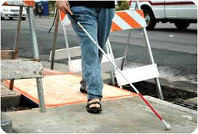
Situation:
Who would feel safe walking in their neighborhood if they could not see where they were?

Slide 18
Situation:
Too many driveways
Driveways too deep
Sharing the sidewalk
???

Slide 19
Situation:
How do you get where you need to be?

Slide 20
Situation:

Slide 21
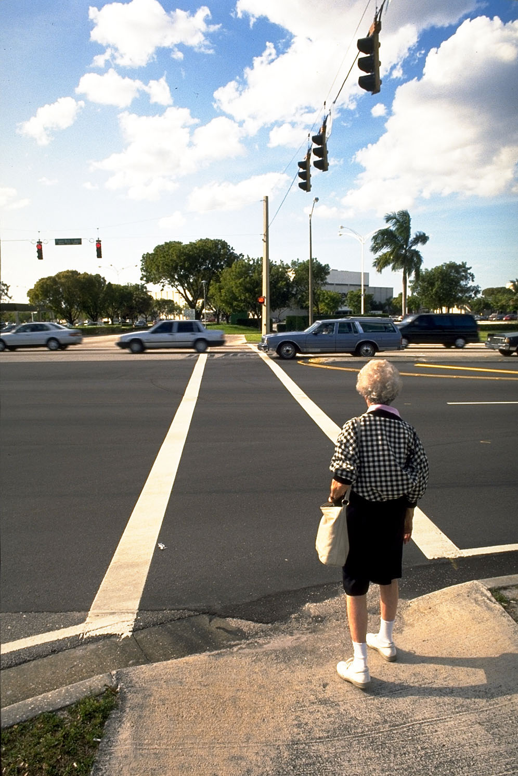
Visual Acuity
Decreases
with age
The average 65 year old cannot see the WALK, DON’T WALK signal when more than 60 feet.
Some intersections are 90 to 165 feet across.

Slide 22
Lack of Lighting
What happens when vision impaired in lighting like this?

Slide 23
Perception Versus Reality:
What are the dangers for EVERY person crossing?

Slide 24
Which Street Do You Cross?

Slide 25
Intersections
Sight Distance
Width of intersection
Size of signal head
Signal timing
Light intensity
Visual screens
Fear

Slide 26
Parking Lots
Backing vehicles
Distractions
Bad lighting
Too much trust in people

Slide 27
Pedestrian Laws to Know: Walkers
Wherever two streets intersect there is an implied crosswalk; it does not have to be painted
To legally cross mid-block there does have to be a crosswalk painted
Always look in all directions before you cross, even with a light!
Beware of green lights, never assume drivers will stop for you!
Be visible by every way possible, your life depends on it!

Slide 28
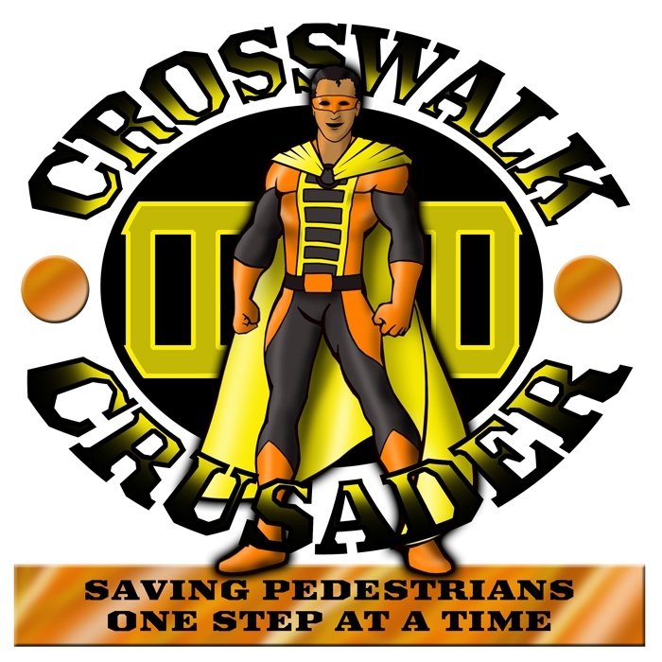
What Can Pedestrians Do?
Before you step in front of a car make sure the driver has seen you.
Make direct eye contact with the driver
Even at signalized intersections!
Pay full attention, it’s your life on the line!

Slide 29
Pedestrian Laws to Know: Drivers
It is the drivers job to see what is there to be seen!
Drivers are required to yield or stop whenever a pedestrian is crossing at a corner or marked mid-block crosswalk.
It is illegal to pass a vehicle that is stopped at a corner or mid-block crosswalk
When turning right on green the pedestrian has the right of way!
Same is true on permissive left turns!
Pay full attention, put the phone down!

Slide 30
What Can Drivers Do?
Pay FULL Attention!
Scan for people waiting to cross the street at corners and marked mid-block crosswalks
STOP for them!
Look right again before turning …
Look past the traffic gap when turning left
Pay attention to speed, especially at night.

Slide 31
What DO Our Laws Say?
Are there accommodations for those who need extra care in our laws governing road users?

Slide 32
Things We Can Do Now
Shorten crossing distance on streets where people live and walk
Restrict parking at corners or mid-block crossings to help sight lines for drivers and peds
More mid-block crosswalks with refuge and lighting
Improve markings, look into solar dots for added tactile visibility
Limit right and left turns if necessary
Make sure systems are upgraded as quickly as possible to include latest upgrades
Make sure there is adequate time to cross

Slide 33
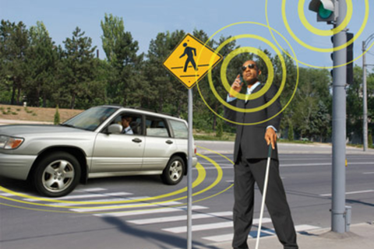
Things We Can Do Now….
EMBRACE Technology!

Slide 34
Things We Can Do Now…
In Specifically Requested Areas:
Tighten turning radius
Add tactile crosswalks, new talking signals, raised arrows with alignment…
Add brighter “pedestrian” lighting
Wider, open sidewalks
Narrower lanes with lower speeds
Improve transit placement

Slide 35
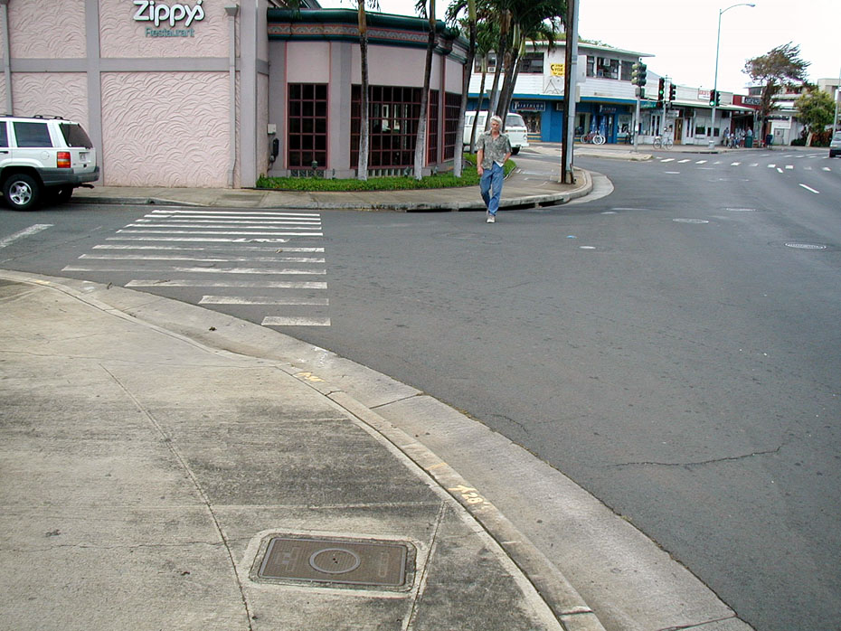
Where Do We Place Crosswalks for Better Mobility For All?

Slide 36
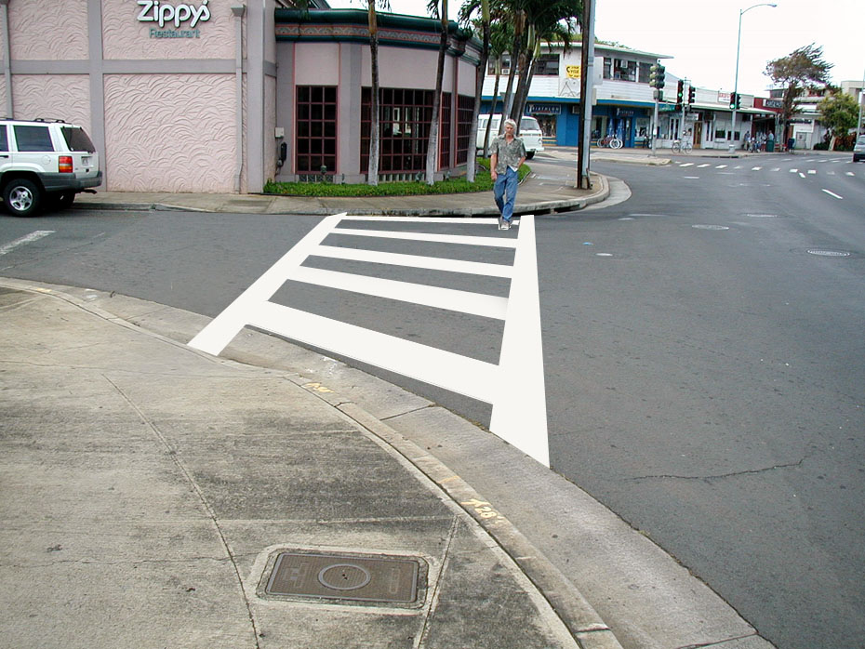
Is This Better?

Slide 37
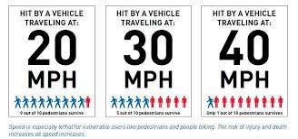
What About Speed?
Speed is a central issue for all pedestrians, especially those with varied abilities.

Slide 38
A Word About Standing Out
YOU HAVE TO BE SEEN
Lights, flashers
Bright and reflective clothing
EYE-CONTACT With Drivers!

Slide 39
Some Examples….
Simple reflectors!

Slide 40
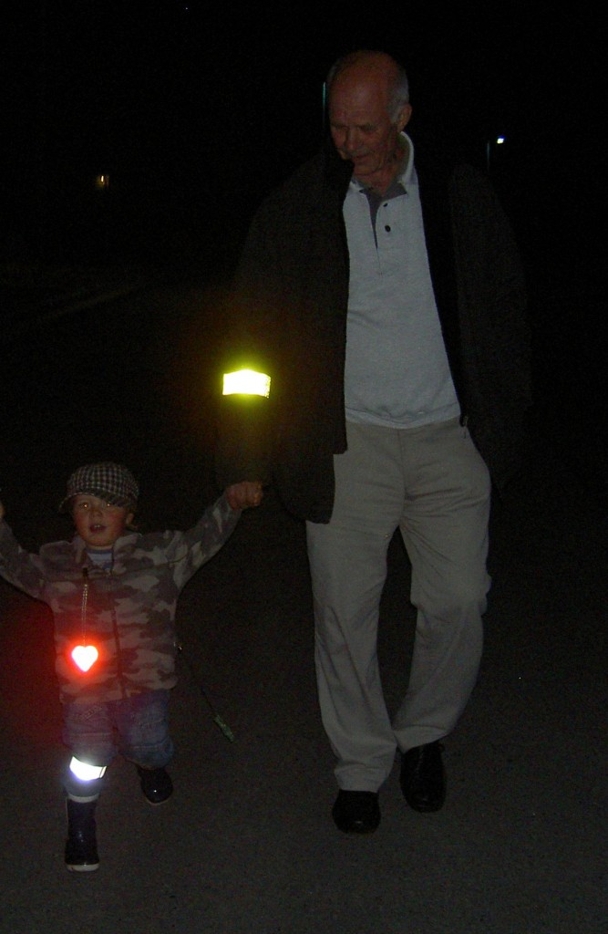

Slide 41
If the Driver is Paying 100 percent Attention…
At night, in Clark County, most drivers have no idea they are over-driving their headlights…
Literally, they do not have time to stop once they see you, unless you are well lit.

Slide 42
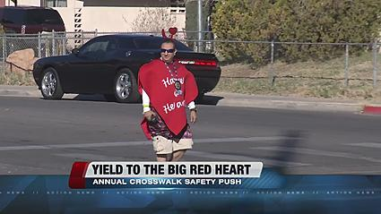
TARGETED CROSSWALK ENFORCEMENT
Objectives:
Increase driver awareness
Increase pedestrian safety
Address location complaints

Slide 43
TARGETED CROSSWALK ENFORCEMENT
20%-30% of pedestrian crossings resulted in drivers failing to yield.
Most common excuse from drivers: “I never saw the pedestrian”.

Slide 44
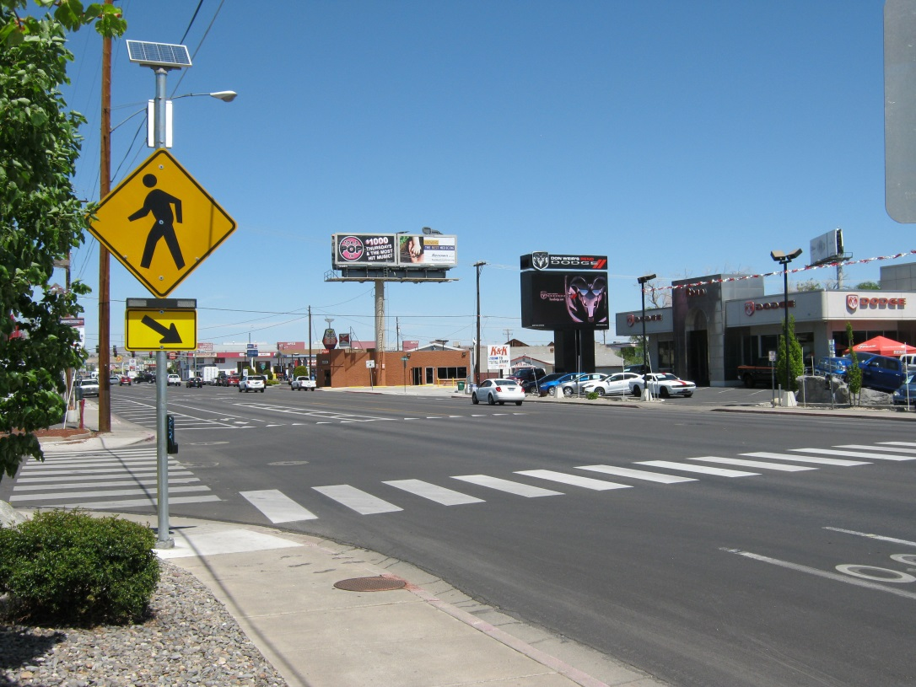
Targeted Crosswalk Enforcement Statistics
Kietzke Lane
7 Operational hours
160 Traffic stops
120 Right of way to pedestrian citations
44 Cellphone citations
Over 30 “got away” because the enforcers were all busy writing tickets.

Slide 45
The violator said she “never saw the (blind) pedestrian”

Slide 46
Watch Out for Each Other

Slide 48
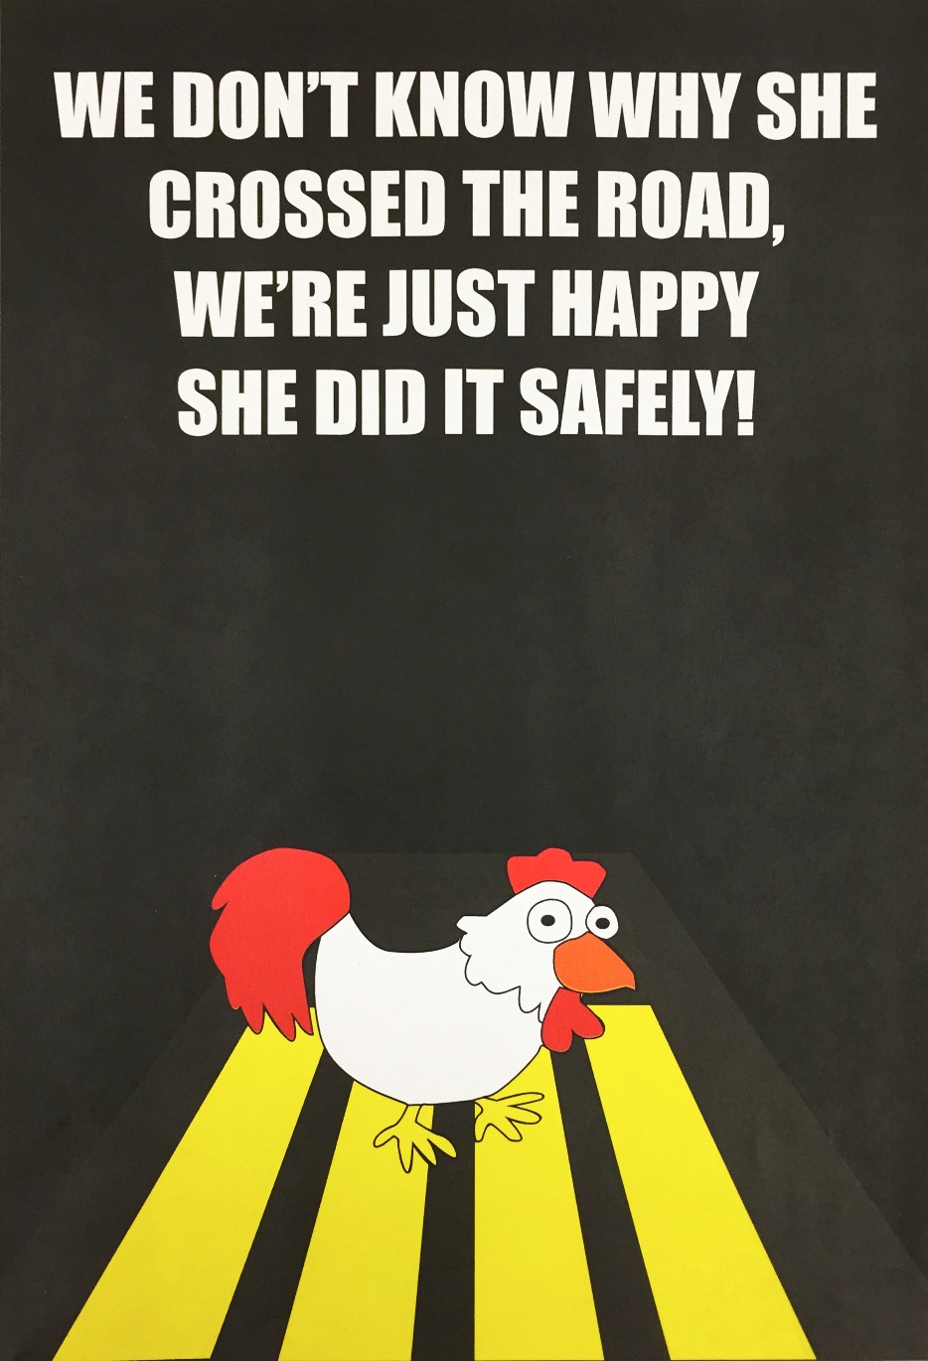
www.pedsafe.vegas
Notes:
We all have a role to play getting everyone safely across the road. (This is an honorable mention from the Save A Life, Win A MacBook contest 2 years ago)

Slide 49
For More Information:
Erin Breen, Transportation Research Center, UNLV 702-895-2015
Visit us at www.pedsafe.vegas

