Slide 1
Speak Up and Be Heard: A Study of Social Engagement
Kelley Macmillan, PhD, LSW
Director Community and Social Services
Sanford Center for Aging
School of Medicine
University of Nevada, Reno
May 1, 2019

Slide 2
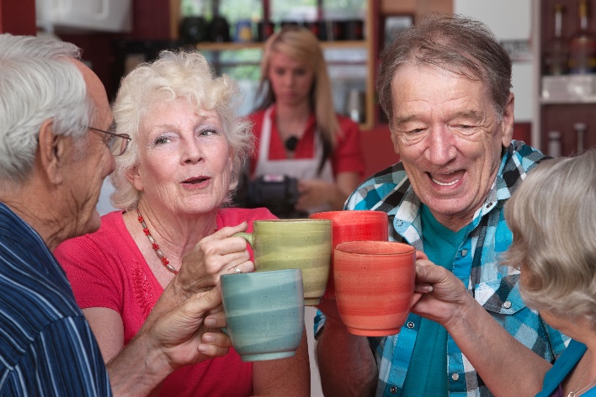
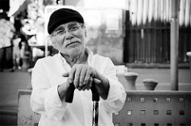
Social & Recreational Engagement: Understanding Barriers to Access
Yoga Social Clubs Exercise Wellness

Slide 3
Purpose of the Project
Enhance and develop innovative transportation and mobility options that support the engagement of older adults and persons with disabilities in meaningful social and recreational activities in Washoe County Nevada to reduce social isolation.

Slide 4
Project Objectives
Engage persons with disabilities and older adults to identify transportation needs and their goals to increase social engagement.
Identify the social and recreational activities outside of the home that older adults and people with disabilities enjoy.
Identify barriers and potential strategies to engagement in social and recreational activities.

Slide 5
Partners and Key Stakeholders
Persons with disabilities
Older Adults
Washoe County Senior Services
Northern Nevada Neighborhood Network
Northern Nevada Center for Independent Living
Nevada Aging and Disability Division
Population Health, Renown Health Care
Regional Transportation Commission
Sierra Nevada Transportation Coalition
Parks and Recreation, City of Reno
Catholic Charities
ADSD Mobility Manager
Notes:
.

Slide 6
Engagement and Participation Plan
Partner with the Northern Nevada Neighborhood Network and their project to engage persons with disabilities and older adults in identifying transportation needs and planning to increase transportation options.
Convene community meetings
Convene focus groups
Conduct one-on-one surveys (on-line and in person)
Engage Key Partners to convene a meeting of human service and transportation services to identify current and innovative transportation and mobility opportunities to address the goals of older adults and persons with disabilities.

Slide 7
Anticipated Challenges
Current transportation programs and plans do not address social engagement and recreation for persons with disabilities and older adults.
Current mobility and transportation planning/assessment do not adequately obtain input from older adults and persons with disabilities.
Reno/Sparks and Washoe county are experiencing population growth and attention is focused on roads and commuters.
Notes:
.

Slide 8
Social Engagement Outside of the Home
Outside Activities & Recreation (60) | Social Activities & Engagement (35)
Entertainment and the Arts (35) | Special Events (23)
Shopping (20) | Learning & Self-improvement (16)
Travel to Family & Destinations (13) | Community Engagement & Volunteering (8)
Notes:
.

Slide 9
Barriers To Social Engagement
Logistics (25) | Financial (25)
Social/Psychological/Emotional (24) | Accessibility (20)
Transportation Related (19) | Health & Physical (15)
Safety (10) | Climate (8)
Notes:
.

Slide 10
Ideas and Strategies
Public Information & Notices (22) | Transportation Related (20)
Activities (16) | Accessibility (11)
Financial (6) | Citizen Engagement & Advocacy (5)
Interagency Collaboration (3)
Notes:
.

Slide 11
Lessons Learned
Older adults and people with disabilities are eager to participate in projects that support their goals for social engagement.
Community partners are motivated to participate in community collaborations.
Transportation options to engage in social and recreational activities requires coordination.
Notes:
Persons with disabilities
Older Adults
Washoe County Senior Services
Northern Nevada Center for Independent Living
Nevada Aging and Disability Division
Population Health, Renown Health Care
Regional Transportation Commission
Sierra Nevada Transportation Coalition
Parks and Recreation, City of Reno
Northern Nevada Neighborhood Network
ADSD Mobility Manager
Sanford Center for Aging

Slide 12
Project Accomplishments
Convened a Steering Committee Meeting- the outcome was to hold a Community Gathering to learn directly what people with disabilities and older adults value.
Organized a Community Gathering “Speak Up and Be Heard” held December 7, 2018.
Disseminated a paper and on-line survey during January 2019 to gather more information.
Final Report printed for presenting findings at numerous venues.
Notes:
Persons with disabilities
Older Adults
Washoe County Senior Services
Northern Nevada Center for Independent Living
Nevada Aging and Disability Division
Population Health, Renown Health Care
Regional Transportation Commission
Sierra Nevada Transportation Coalition
Parks and Recreation, City of Reno
Northern Nevada Neighborhood Network
ADSD Mobility Manager
Sanford Center for Aging

Slide 13
Sustainability
Meet with community partners who provide transportation or offer social and recreational services to share the data from the findings so that they can use the data to apply for funding and/or plan transportation services.

Slide 14
Funding
This project was funded by the National Aging and Disability Transportation Center (NADTC), which is administered by Easterseals in partnership with the National Association of Area Agencies on Aging in cooperation with the Federal Transit Administration (under the Catalog of Federal Domestic Assistance #20.514, contract number DC-64-5313 ), and with guidance from the U.S. Administration on Aging.

Slide 15
Contact Information
Project Lead- Kelley Macmillan, Ph.D., LSW
kmacmillan@unr.edu 775-327-2281
Mobility Program Director- Jennifer Baker
jbaker23@unr.edu 775-682-8001
VISTA Member- Cynthia Freeman
cfreeman@med.unr.edu 775-784-7557
MSW Intern- Manpreet Mann
manpreetm@med.unr.edu

