Slide 1
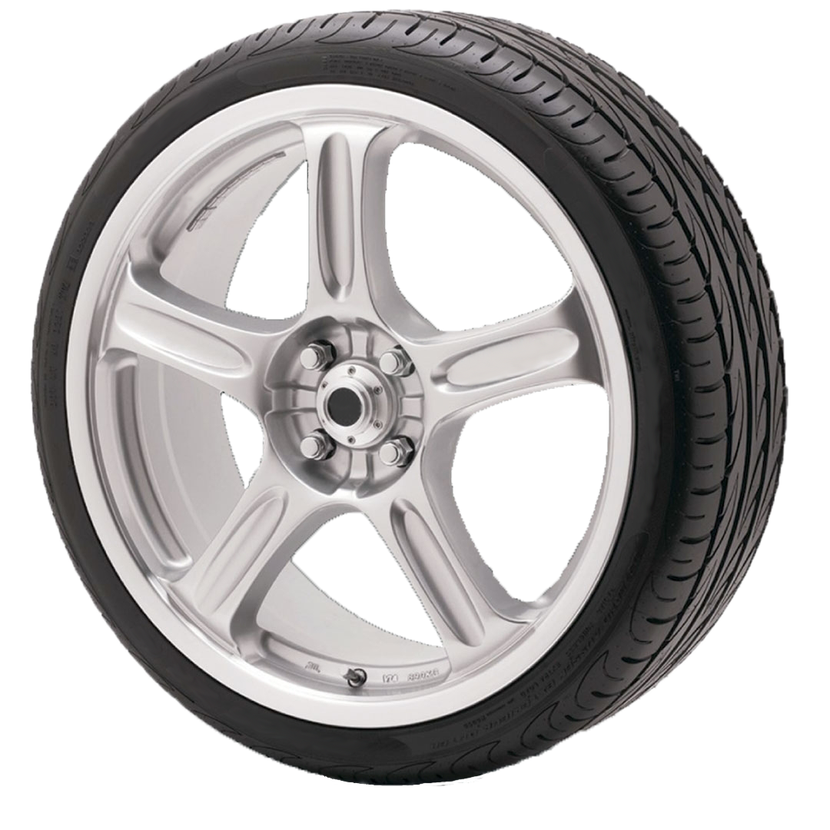
Transportation Funding, Leveraging and Brainstorming
Abby Wheeler
Notes:
Introduction
Abby Wheeler
Elko County Transit Coordinator
Transportation 15 years
Transit 7 years of the 15
Focus on Broad Overview in hopes of having brainstorming time at end
The information is factual, but it was easily findable on the internet and I did not drill down
Not fact finding or fact checking mission, but an overview of the moving parts
Found that people who are new, which can be the first few years, to grants don’t fully understand funding mechanisms. Which is why we are covering this broad information and funneling down to the state and local levels
Dept. of Trans. example

Slide 2
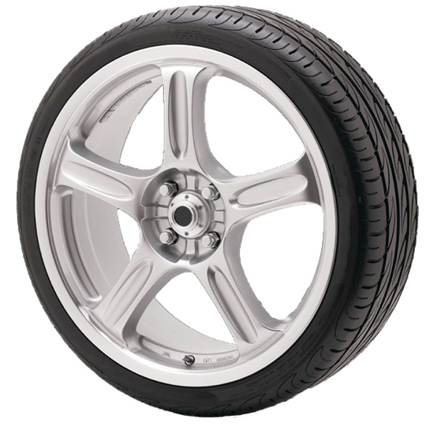
Federal Government Departments Not an Exhaustive List
FEDERAL OPTIONS
KEEP FUNDING AT THE FEDERAL LEVEL
FUND A DEPARTMENT ON THE REGIONAL OR STATE LEVEL (FTA REGION 9)
FLOW DOWN TO THE STATE LEVEL
MAKE FUNDS AVAILABLE THROUGH APPLICATION PROCESS
Notes:
There are 15 Federal Departments
Under those departments there are several sub-departments and divisions that represent different programs they represent
Keep in mind, in most cases, if not all, we either have federal representation or mirrors of the federal departments at the state level
That’s why we can talk about DOT, but it is similar to DHHS or DOJ
Down arrows – Federal Options, etc.
Once they receive their funding approvals they can take action to support their departments and projects
Keep funding at the federal level
Fund dept on reg level
Flow down
Make funds avail
I am going to focus on Department of Transportation. My field of expertise is really rural transit, but I do understand, again in broad strokes, the general transit world.

Slide 3
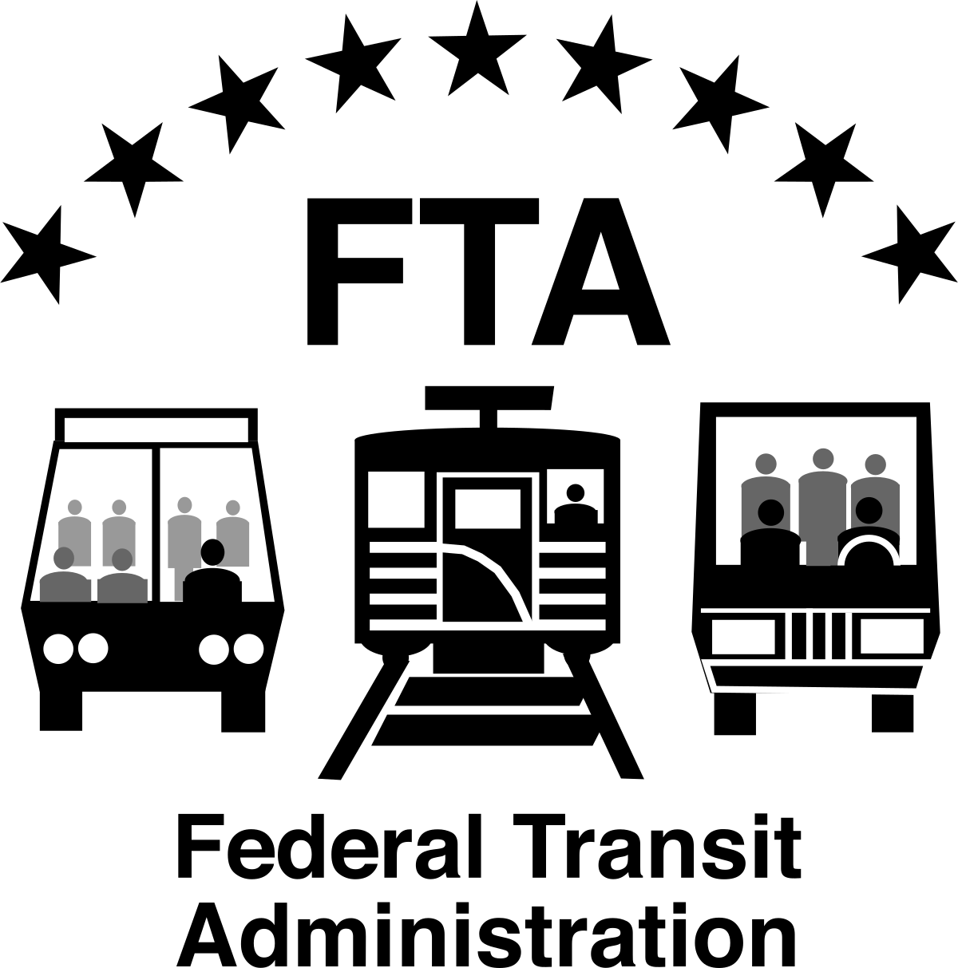
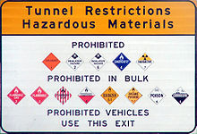
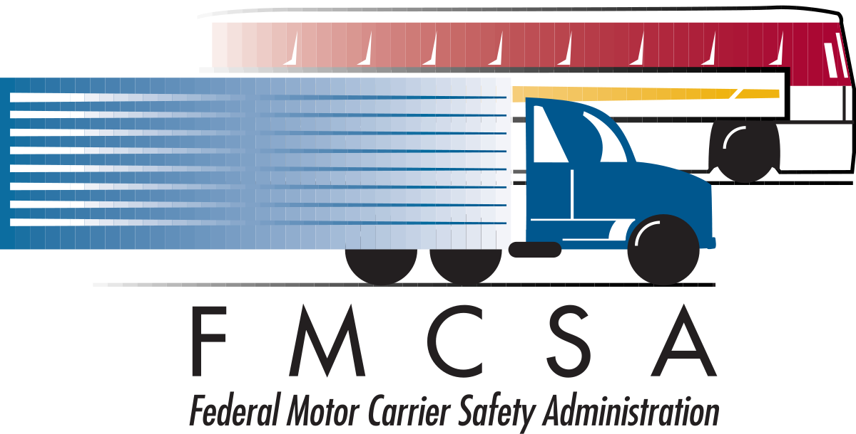
Sub Departments and Divisions of the US DOT
PHMSA
Pipeline and Hazardous Materials Safety Administration
National Highway Traffic Safety Administration
Notes:
Under the DOT there are 8 operational arms
Did not include the fiscal or safety departments
5 of these, that I know of, have grant making arms
I am going to focus on FTA or Federal Transit Administration

Slide 4
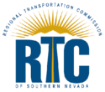
Using FTA How funding gets to State and Local level
Rest of the state, like:
Churchill
Elko
Ely
Pahrump
Silver Rider
Notes:
Under the FTA:
Grants are usually funded though what we call silos. It means that the grant is used to fund a specific purpose. So, funds from a transportation grant can’t be used to buy food for a senior center’s nutrition program.
Many of the silos are categorized by population.
In the case of Nevada:
RTC of Southern Nevada, because of population thresholds, can apply directly to the FTA
So can the RTC of Washoe County
So can Jumpin Around Carson,
But the rural counties meet the smallest threshold. Because of this threshold criteria we apply to NDOT who applies to the Feds in our behalf.

Slide 5
5307 & 5340 Federal Apportionments (Urbanized)
The Urbanized Area Formula Funding program (49 U.S.C. 5307) makes federal resources available to urbanized areas and to governors for transit capital and operating assistance in urbanized areas and for transportation-related planning. An urbanized area is an incorporated area with a population of 50,000 or more that is designated as such by the U.S. Department of Commerce, Bureau of the Census.
Notes:
This slide shows the national funding for 5307
You can see in the apportionment that the funding is based on population

Slide 6
5307 & 5340 Nevada Breakdown
Notes:
These are clippings from the 5307 Federally available apportionments for FY 2019 that are specific to Nevada

Slide 7
5311 & 5340 Federal Apportionments (Rural)
Notes:
This is a screen shot of the 5311 Funding with a highlight of Nevada.
5311 is the funding source Nevada Department applies for in behalf of the rural transit providers.
It is the rural transit operational funding, so it is the main grant source for my program in Elko.

Slide 8
5310 Apportionments Enhanced Mobility of Seniors and Individuals with Disabilities
Notes:
This is the screen shot of the 5310 Funding apportionment, followed by some funding that is made available to Nevada.
5310 funding is for Enhanced Mobility of Seniors and Individuals with Disabilities
Transit providers can apply for the this funding, but it can also distributed to non-profits and other agencies that work with this population.
It can be used to purchase ADA accessible vehicles for a senior center, for example

Slide 9
Capital Purchase Facilities Fleet Infrastructure Improvements
There are separate grants for Capital Purchase. They cover things like facility, fleet and infrastructure improvement
5311 (Rural Public Transit) has 5339 for capital purchases
5307 (Urban) has 5309 for capital purchases

Slide 10
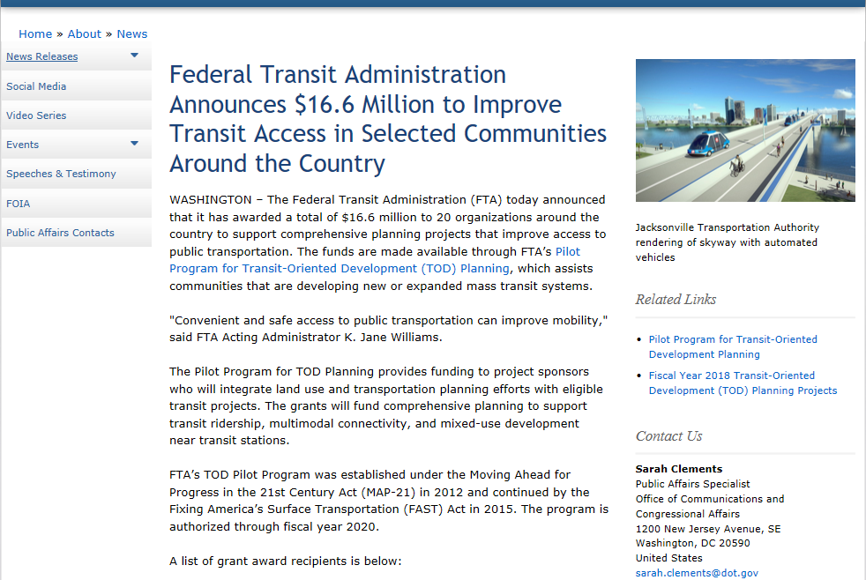
Planning, Oversight and Discretionary Grants

Slide 11
Budget & Local Match Payment for direct service and in-kind contributions
Administration | Capital Expense (Ongoing Maintenance) | Operations | Federal Reimb. | Local Match
Federal Reimb. 80% | Federal Reimb. 80% | Federal Reimb. 50%
Total Expense: $50,000 | Total Expense: $25,000 | Net Expense*: $100,000
FTA Reimb.: $50,000 x .80 = $40,000 | FTA Reimb.: $25,000 x .80 = $20,000 | FTA Reimb.: $100,000 x .5 = $50,000 | $110,000
Local Match: $10,000 | Local Match: $5,000 | Local Match: $50,000 |  | $65,000
*Net expense: expenses minus (-) income = Net
In FTA budgets, we subtract income (fare) from the operations category. Each grant source has specific requirements depending on where income comes from.
In my budget: the reimbursement from the FTA is 65% of the total budget and Local Match is 35%.

Slide 12
Leveraging vs. Match
In the financial industry, leveraging means: to use borrowed money to increase the potential return on investment.
This can also apply to the amount of debt a firm uses to finance their assets.
This application of leveraging is, not to increase our return on investment, but to INCREASE OUR IMPACT to our community.
Match is pretty straight forward, we need $65,000 to complete our budget
Leveraging is using multiple sources as match, but also to create a more meaningful program, to be more inclusive and make our dollars work harder for us.
Rotary Polio Plus and Bill and Melinda Gates Foundation example.
Notes:
Theoretical from myself
Rotary Example: triples the return on investment or the impact for those without polio vaccines.

Slide 13
What Leveraging Looks Like
HRTG (Highly Rural Transportation Grant) through Federal Department of Veterans Affairs. Grant for up to $50,000 for any county that qualifies as highly rural (most of Nevada). Connect veterans to medical services.
We requested to use this as match, which was allowable as this is a transportation grant, however, VA denied the request.
Veterans Grant Stand-Alone: $50,000
What this could look like if it were approved:
Using previous slide as base of FTA 65% & Local 35%
Veterans Grant as Match to FTA Grants:
FTA: $92,857
VA Match: $50,000
Total Budget: $142,857
Matching to another funding source also reduces expense duplication, like administration expenses.
Notes:
This is a grant that I really have
It is a USVA grant for $50,000
It does great work on it’s own, but look what it could do if we could use it to leverage with FTA.
Just like Polio Plus, we could triple it’s return on investment or impact on our community.

Slide 14
Focus on “Leveraging” Funding Federal Match
Can we match federal dollars to federal dollars?

Slide 15
Coordinating Council on Access and Mobility (CCAM) More than 80 Federal Programs that support transportation services.
Over 80 federal programs

Slide 16
Coordinating Council on Access and Mobility (CCAM) More than 80 Federal Programs that support transportation services.
A 2012 General Accounting Office report, Transportation-Disadvantaged Populations: Federal Coordination Efforts Could Be Further Strengthened, defines federal programs available for use in coordinated transportation arrangements in Appendix II - Inventory of Federal Programs Providing Transportation Services to the Transportation Disadvantaged:
Eighty federal programs are authorized to fund transportation services for the transportation disadvantaged, but transportation in not the primary mission of most of the programs GAO (General Accounting Office) identified. Of these, Department of Transportation administers seven programs that support public transportation. The remaining 73 programs are administered by seven (7) other federal agencies and provide a variety of human services, such a job training, education, or medical care, which incorporate transportation as an eligible expense in support of program goals. Total federal spending on transportation services for the transportation disadvantaged remains unknown because, in many cases, federal department do not separately track spending for these services. However, total funding for the 28 programs that do track or estimate transportation spending, including obligations and expenditures, was at least $11.8 billion in fiscal year 2010.
https://www.transit.dot.gov/ccam/about/partner-agencies
Over 80 federal programs

Slide 17
Coordinating Council on Access and Mobility (CCAM) Federal Funding Local Match
Q. We currently receive Federal Highway Administration (FHWA) and Federal Transit Administration (FTA) grants. Are there any types of Federal grant money that can be used as local match for FHWA and FTA funds?
The following Federal funding may be used for local share of FTA programs to the extent described below:
Federal funds that are Derived from Amounts Made Available to a Federal Department or Agency Other than DOT.
Unless Federal Transit Law specifies program funding made available to other Federal agencies as eligible for local share for FTA programs, FTA leaves the determination whether another agency’s funding may be used for local share for FTA programs to that agency. Under the laws and regulations governing that funding, however, that funding must be eligible for use in public transportation projects.
Rural/Frontier Application of this rule:
If another Federal agency permits its funds to be used for local share, the following FTA programs are expressly authorized by Federal Transit Law to accept that funding for local share:
(1) Elderly Individuals and Individuals with Disabilities Program, 49 U.S.C. § 5310.
(2). Nonurbanized Area Formula Program, 49 U.S.C. § 5311.
Includes TANF, DOT/FHWA
(3) Job Access and Reverse Commute Program, 49 U.S.C. § 5316; however, specific program information for other types of Federal funding is available at https://www.transit.dot.gov/ccam/about/
(4) New Freedom Program, 49 U.S.C. § 5317, however, specific program information for other types of Federal funding is available at https://www.transit.dot.gov/ccam/about
Small Urban and Urban Application of this rule:
If another Federal agency permits its funds to be used for local share, the following FTA programs are implicitly authorized by law to accept that funding:
(1) Urbanized Area Formula Program grant, 49 U.S.C. § 5307 [because TANF funds are expressly authorized for use as local share].
(2) Programs for which FTA can provide 100% FTA assistance, provided that the conditions precedent for 100% FTA assistance are fulfilled, including but not limited to:
(a) Planning Program, 49 U.S.C. 5305(b).
(b) National Planning and Research Program, 49 U.S.C. 5305(e).
(c) National research program, 49 U.S.C. § 5312(a).
(d) National Transit Institute, 49 U.S.C. § 5315.
(e) Paul S. Sarbanes Transit in the Parks Program, 49 U.S.C. § 5320.
(f) Human Resources Programs, 49 U.S.C. § 5322.
Includes: TANF
https://www.transit.dot.gov/funding/procurement/third-party-procurement/local-matching-funds
Over 80 federal programs

Slide 18
EDA
According to 13 CFR 300.3 [Title 13 -- Business Credit and Assistance; Chapter III -- Economic Development Administration, Department of Commerce; Part 300 -- General Information], Local Share or Matching Share means “the non-EDA funds and any In-Kind Contributions that are approved by EDA and provided by Recipients or third parties as a condition of an Investment. The Matching Share may include funds from other Federal Agencies only if authorized by statute that allows such use, which may be determined by EDA's reasonable interpretation of such authority.”
FTA wording is similar, but basically, a letter of approval will do the trick.
Notes:
We applied to the VA to allow us to use their fund as match. Unfortunately, they denied it.
However, if they had approved it, I could have increased the service hours without affecting the County’s general fund.
Like the polio plus and bill/melinda gates partnership, this could have tripled my program’s impact.

Slide 19
Local Match Leveraging Resources
State General Fund
State Department Grants
State Department Cooperative Agreements (CCAM and NC)
Other Federal Agencies (Agreement)
Partnership with Human Service Agencies
If an agency purchases transportation services it may be counted as Match rather than Fare Box.
NEMT(Non-Emergency Medical Transportation - Medicaid)
Direct Agreement, NEMT broker pays fare to transit provider
RTC eligible transit provider receives eligible reimbursement from state
Contractual work outside of regular service
Coordinated with public transit
Local Governments
Funded Department of local government
Contributions from local governments
Taxes (Voter approved are pretty tough)
Donations
Goods, services, cash – must meet some allowability criteria
In-kind
Property rental, volunteerism
Foundation Grants

Slide 20
North Carolina Study Coordinating Agencies 1970s
TRANSPORTATION
$$$
HEALTH AND HUMAN SERVICES
$
SOCIAL SERVICES
$
ADDED LATER
ADDED LATER
VOC REHAB
$
AGING AND DISABILITY SERVICES
$
Local Communities
Notes:
This is from a study regarding North Carolina in 2015
The study was if they should continue using NEMT funding as leverage to their public transportation funds or to go to a brokerage firm
Powerful leveraging system
This funding supports local community transportation programs. All 100 counties have transportation systems.

Slide 21
North Carolina Study Coordinating Agencies 1990s
TRANSPORTATION
$$$
HEALTH AND HUMAN SERVICES
$
SOCIAL SERVICES
$
COUNCIL ON DEVELOPMENTAL DISABILITIES
COMMUNITY COLLEGES
INDIAN AFFAIRS
HEADSTART3
$
VOC REHAB
$
AGING AND DISABILITY SERVICES
$
COMMERCE
PUBLIC INSTRUCTION
SECURITY COMMISSION
ASSOCIATION OF COUNTY COMMISSIONERS
$
NEMT
(Medicaid)
DHCFP in NV
$
Notes:
Did require administration, which is covered in the study.
Each department had a liaison to the coordination committee.

Slide 22
NEMT (Non-Emergency Medical Transportation)
NEMT Partner with Public Transit
NEMT is the largest source of federal revenues for human services transportation
Benefits:
Cost efficiencies
Avoid service duplication
Leverage public transportation expertise and resources
Driver training
Drug and alcohol policy
Regularly maintained vehicles
Follow coordinated public transportation plan
Coordinated NEMT and public transportation can better meet the needs of the transportation disadvantaged
Provide Local Match
Notes:
Not trying to harp on anything or anybody, including state departments
It has hit home to me through my research that these are smart ways to grow programs and meet unmet needs

Slide 23
Abby’s Big Dream
Notes:
Biggest Dream is for the state departments to coordinate in a similar way as North Carolina
Second biggest dream, if I couldn’t have the first, is for NEMT money to match to intercity funds from NDOT, which could create route service from the rurals to metropolitan areas
Third biggest dream, whether the other two are realized or not, is to find more funding sources to allow me to grow our program, to meet our unmet needs and to coordinate with our transit neighbors. Imagine the size of this dream; my closest transit neighbor is 180 miles away.

