Slide 1
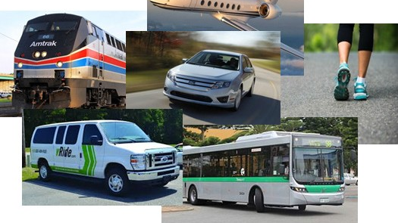
Re-Thinking Transportation for Individuals with Disabilities
Creating a Systems-Change Approach to Address Their Barriers

Slide 2
“If no mistake have you made, yet losing you are… a different game you should play.”
Master Yoda

Slide 3
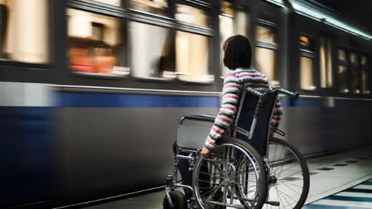
Transportation presents barriers to:
Employment
Independent Living
Health Care
Education
Social and Recreational Activities

Slide 4
Creating Systems-Change: How Do We Get Unstuck?
Understand the needs and priorities of the Individual.
Identify existing transportation options within the community to determine gaps and barriers.
Build partnerships at the state and local level to develop and implement solutions.
Develop a model that promotes long-term collaboration and sustainability.
Evaluate and adjust solutions for continued success.

Slide 5
How Can We “Think Different?”
Start with the customer experience and work backwards to the transportation solutions
Notes:
5

Slide 6
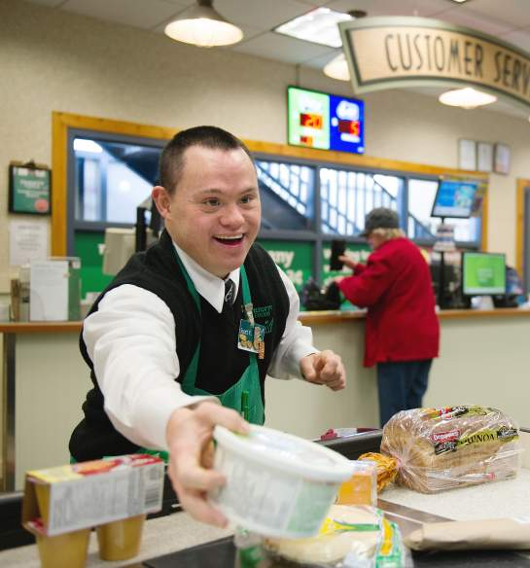
1. Understand our customer needs
Each individual has unique interests, strengths, and challenges.
Solutions vary by person and circumstance.
Informed choice is critical to finding the solution(s) that best meet those needs.
Some individuals may require training and trial-and-error to find the right fit.
Solutions should be a “win-win” for the individual and community at-large.

Slide 7
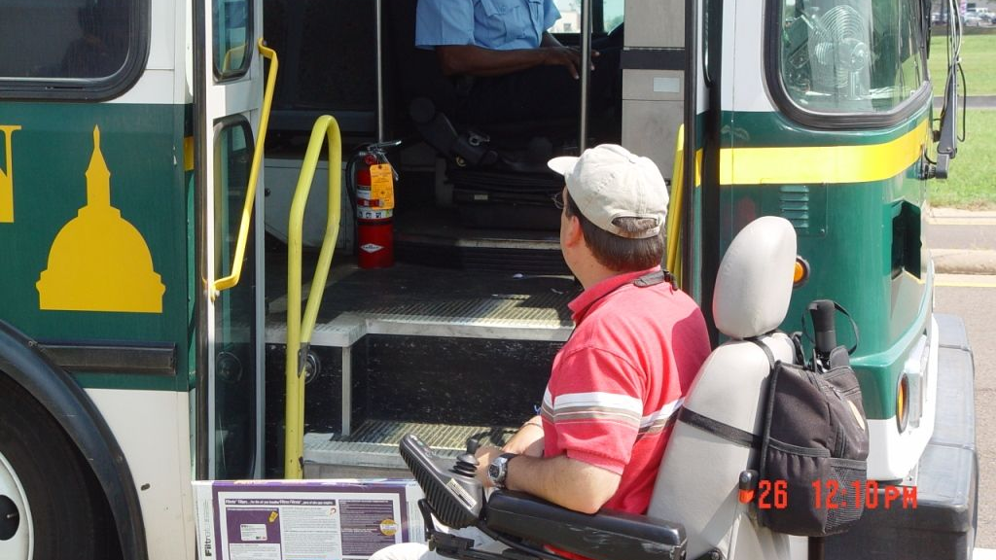
What Transportation Options Do Exist?
Notes:
7

Slide 8
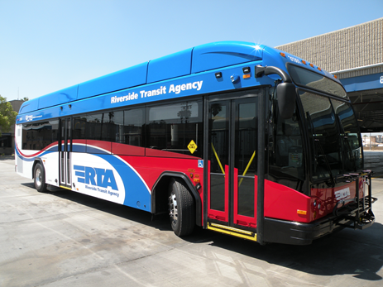
2. Identify what exists to determine what’s needed
Public transportation options:
Fixed-bus routes
ADA paratransit
Train/commuter rail
Private transportation options:
Taxi services
Transportation Network Companies (TNCs)
Human service options (e.g., non-emergency medical transportation)
Other mobility options (e.g., pedestrian paths)

Slide 9
What are the most significant gaps/barriers?
Public bus/paratransit is non-existent in rural and small urban communities?
Existing public transit routes are not conducive for many individuals with disabilities to ride?
TNC and cab services are not affordable or accessible for many persons with disabilities?
There is a general unawareness of what options exist in the community?
There is a lack of funding at the state and local level to support options outside of fixed transit?

Slide 10
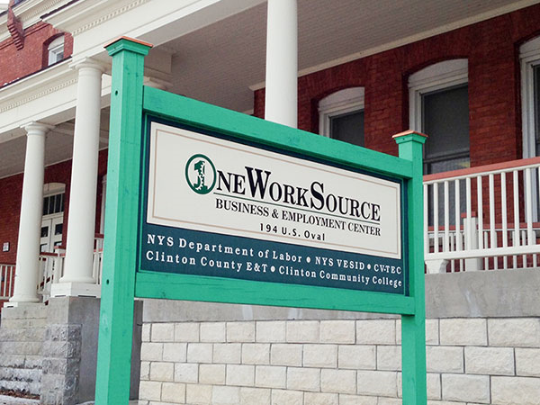
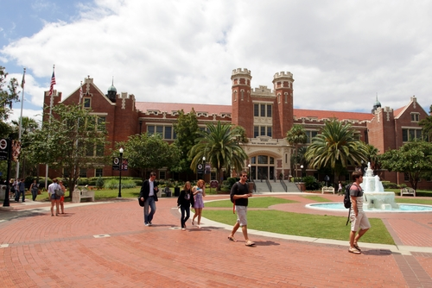
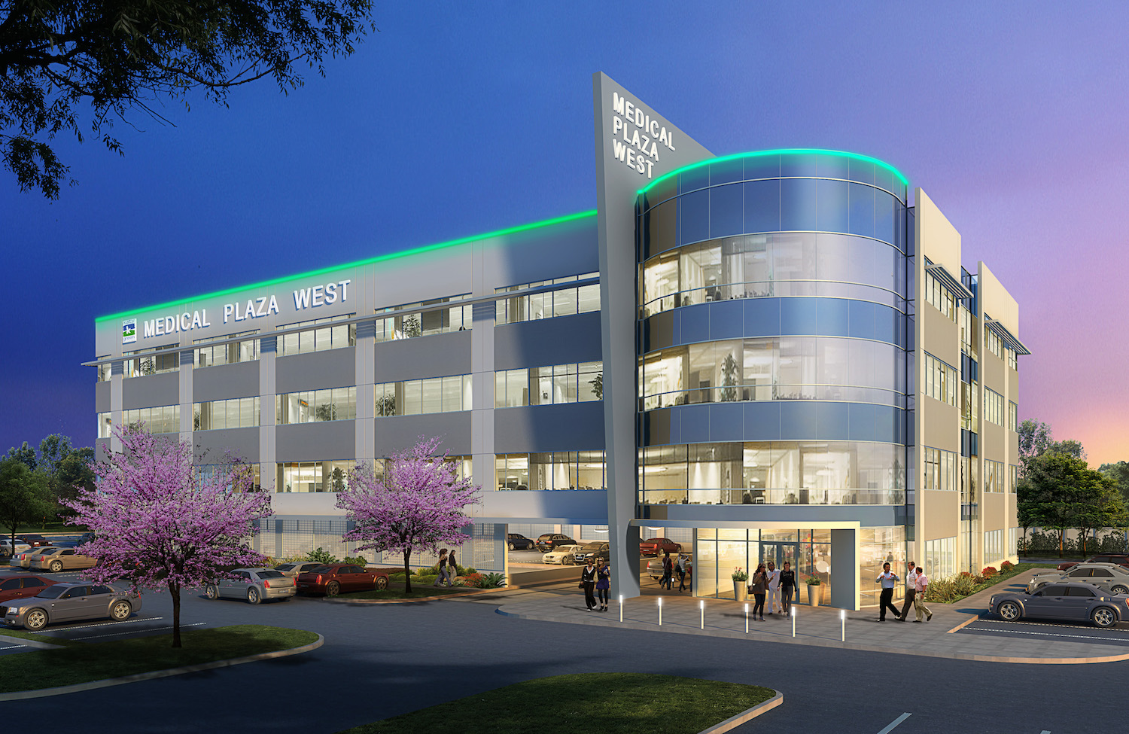
What Partners Are Needed to Help Address these Challenges?

Slide 11
3. Potential partners could include…
Transportation provider organizations
Local planning agencies
Self-advocacy and family networks
Human services agencies (e.g., assisted living facilities)
Educational institutions
Vocational/workforce training programs
Hospitals and medical centers
Employers and businesses
And… yes, elected officials

Slide 12
How Do We Move Partners Toward Systems-Change?

Slide 13
4. Assemble a collaborative team to tackle the problem
Develop a common vision and set of principles agreed to by all partners.
Conduct/gather research to support the need for change.
Define partners’ roles and responsibilities.
Align efforts with other state and community priorities.
Identify or develop a model for implementation…

Slide 14
Factors that contribute to a sustainable model
Leadership
Policy
Funding
Strategic planning
Performance/accountability data
Capacity development
Innovation and flexibility
Marketing and outreach

Slide 15
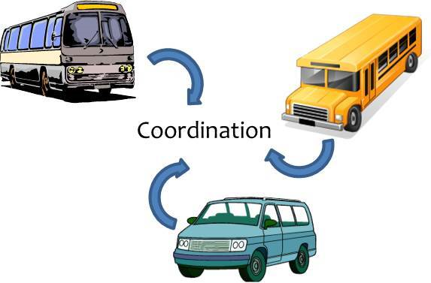
Systems-change efforts in the industry
Coordinated Transportation – Pulls funding, partners, and providers together to deliver transportation services in a cost-effective manner.
Mobility Management – Uses a customer-centered approach when designing transportation services, tailored to the individual’s needs.

Slide 16
^{Lessons Learned from Florida…}
Established Commission for the Transportation Disadvantaged to coordinate services statewide.
Commission develops policy/manages state trust fund.
Each community has different values, priorities, and needs that are factored into service planning.
Designates a “transportation coordinator” in each county to work with partners to deliver services.
Facilitates on-going community stakeholder forums to identify service gaps and unmet needs.
Provides annual reports to the Commission on outcomes and services.

Slide 17
What Can We Anticipate Ahead?

Slide 18
5. Planning for future success
Identify baseline data to measure on-going progress.
Seek continual feedback from individuals and community stakeholders.
Assess effectiveness of marketing efforts.
Anticipate programmatic changes, such as growth.
Adjust to market changes, such as technology.

Slide 19
Helpful Resources
National Center for Mobility Management provides information on state and local systems-change efforts in transportation: https://nationalcenterformobilitymanagement.org/
Design Thinking for Mobility provides tools and resources to assist communities in facilitating collaboration and solutions: https://www.designthinkingformobility.org/
The National Aging and Disability Transportation Center provides disability awareness and travel training for transportation providers: https://www.nadtc.org/

Slide 20
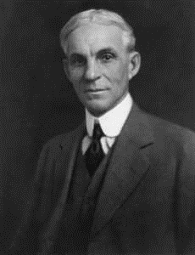
“Coming together is a beginning, keeping together is progress, working together is success”
Henry Ford

Slide 21
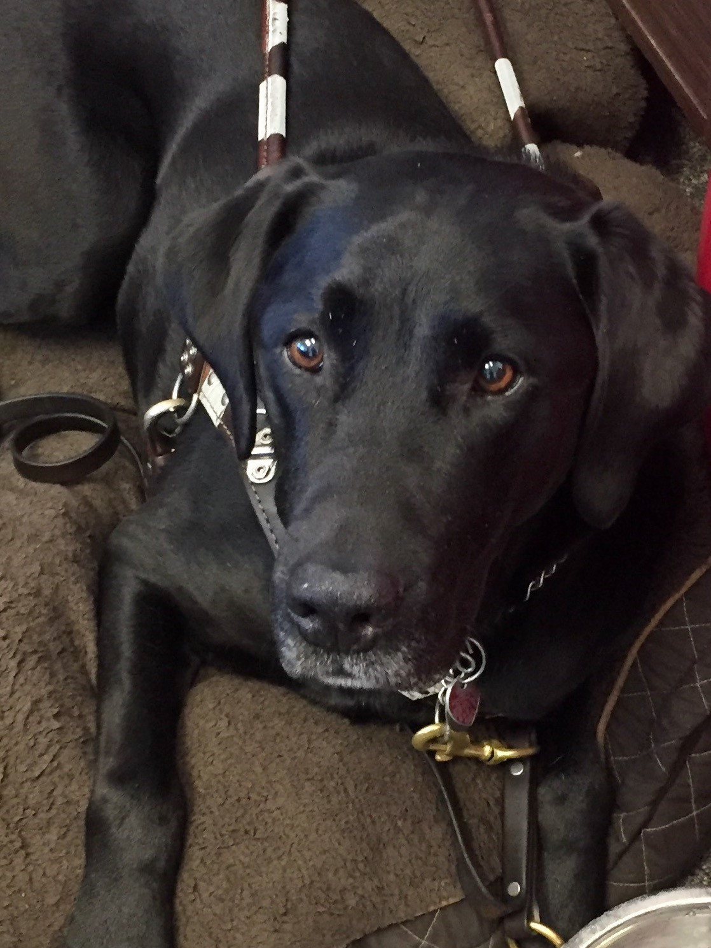
Questions?
For more information, please contact:
David Darm
Florida Agency for Persons with Disabilities
(850) 414-8096
David.Darm@apdcares.org

