Slide 1
Med-Express Transport A Division of Sierra Medical Service Alliance (SEMSA)
Wheelchair Transportation
Jason Larrieu, Manager
Notes:
HI IAM JASON LARRIEU WITH MEDEXPRESS TRANSPORT
A DIVION OF SEIERRA MEDICAL SERVICES ALLIANCE SEMSA
SEMSA IS THE PARENT COMPANY THAT MANAGES MED-EXPRESS
EMS MANAGEMENT COMPANY – SUSANVILLE , MERCED,CA AIR TRANSPORT IN NORTHREN CA
I am HERE TO TALK TO YOU ABOUT OUR WHEELCHAIR SERVICES THAT WE OFFER IN THE RENO , SPARKS AREA

Slide 2
Med-Express Transport
HISTORY
Est. 1996
To alleviate burden on the 911 system
911 = emergency
Right resource - the right time
Med-Express is non-profit
Notes:
1996 WHEN REMSA REACH OUT TO MEDEXPRESS TRANSPORATION
TO HELP ALLEVIAT THE 911 CALLS THAT THEY WERE HAVING FOR NON-EMERGERENT CALLS FOR PEOPLE THAT HAD NO WAY OF GETTING TO THE THERE DOCTORS AND THERE TRANSPORT TO CONTINUED CARE FASILITIES FORM THE HOSPITALS
Like our parent companies medexpres is non-profi
Right need for the right resores

Slide 3
Med-Express Transport
About us
70 years of EMS experience
Aero-medical / ground critical care
911 ground operation (ALS/BLS)
Wheelchair & Ambulatory transport
Dispatch operations
Notes:
SEMSA Med-Express senior leadership team holds over 70 combined years of experience in the healthcare and transportation industries.
commercial ambulance operations,
wheelchair and ambulatory transport services,
risk management and dispatch operations.
Med-Express takes great pride in the experience and stability of our leadership team who are all working together to achieve the one common goal, great patient care.

Slide 4
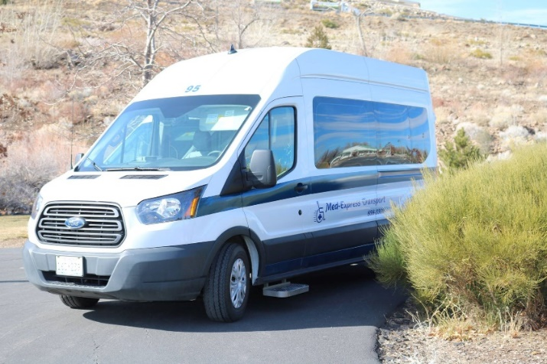
Med-Express Transport
SERVICES PROVIDED
(Partnerships with local hospitals, skilled nursing facilities, and/or private pay)
Bed to Bed Service
Local and Long Distance Transports
Wheelchair Transport Vehicles
CPR Certified and Highly Trained Transport Specialists
Notes:
WE ARE A BED TO BED SERVICE THAT IS
assist with transferring into a wheelchair
OR IF YOU’RE IN A W/C IN YOUR HOUSE WE WILL COME IN AND ASSIST YOU TO OUR VEHICAL
Long distance WE COVER CALIFORNIA, NEVADA
WE’VE GONE AS FAR AS IDAHO
VANS
ADA APPROVED
CAPABLE OF TRASPORTING 2 W/C
AMBULATORY INDIVIDUALS
FAMILY, AIDS CAN RIDE WITH
AHA American Heart Association BLS CURTIFIED
DOT Physicals
Strength Eval from MedExpress up our Flight nurse
UP TP 6LPM CURRY OUR OWN o2

Slide 5
Med-Express Transport
Services Cont’d
Wheelchair Provided
Reclining
Elevated leg rest
Standard wheelchair width 20”; up to 250 lbs.
Bariatric wheelchair width 22”; up to 350 lbs.
Access to oxygen up to 6LPM
Ambulatory patients

Slide 6
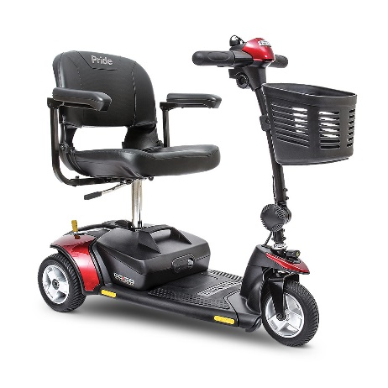
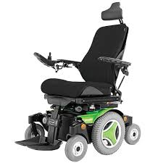
Med-Express Transport
POWER WHEELCHAIRS
Able to accommodate Power wheelchair – not Scooters
Power chairs have a joystick
Scooters have handle bars
600 lbs. maximum combined weight of chair and patient
Scooter
Power wheelchair
Notes:
Scooters – most can transfer out
Powerchair – most cant transfer

Slide 7
Med-Express Transport
TRANSPORT RESTRICTIONS
Gurney transport
Patients requiring restraints and/or containment
Narcotics
Transport to the ER
Insurance base transports
Medicare – wheelchair transport is not a covered benefit
https://www.medicareadvocacy.org/medicare-info/medicare-part-b/ambulance-coverage
Medicaid – requires pre-approval from Medical Transportation Management (MTM)
Notes:
REMSA has the service right for Washoe county

Slide 8
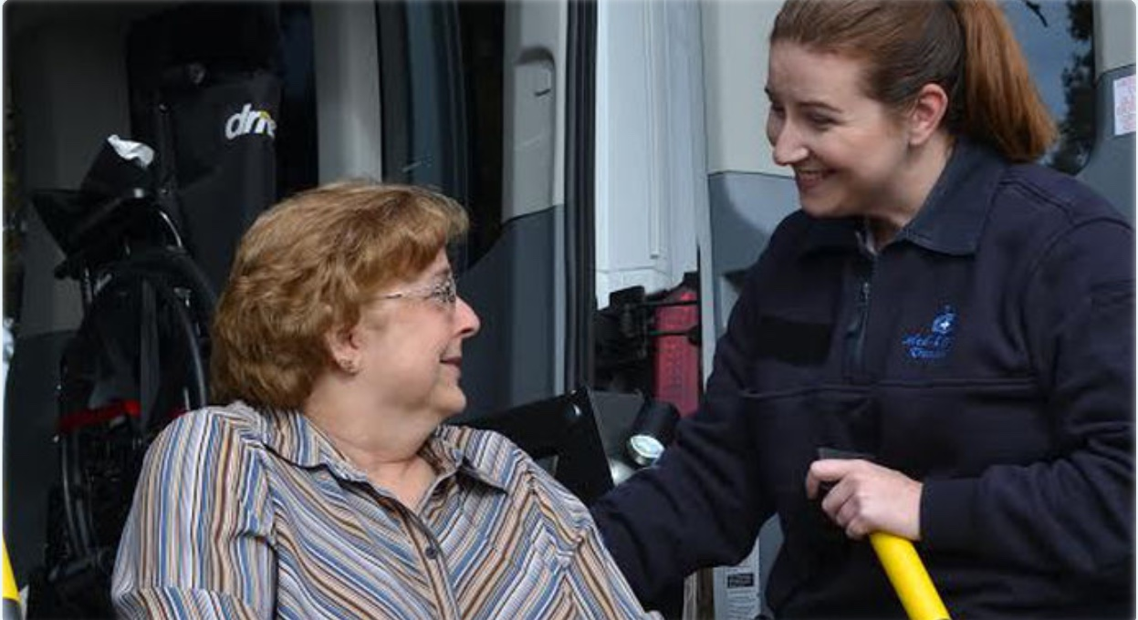
Med-Express Transport
Our Team Values
S afe
T eam based
A ttentive
R espectful
C ustomer accountabiility
A ppropriate
R easonable
E thical
Compassion & Commitment
Notes:
Med-express believes that the key to success is through the compassion and commitment of our specialized staff. Through the efforts and dedication of our team members, Med-Express has a strong reputation of providing excellent customer service and patient care. All of our team members have extensive experience and certifications in both the patient care and transportation industries. Furthermore, most of our team members are actively working in the ambulance, hospital and fire services within our respective communities because they enjoy helping others.

Slide 9
Med-Express Transport
CONTACT
Jason Larrieu
Manager
Med-Express Transport
Main : 775-858-3300
Email : www.med-express.me
Notes:
Need more

