Slide 1
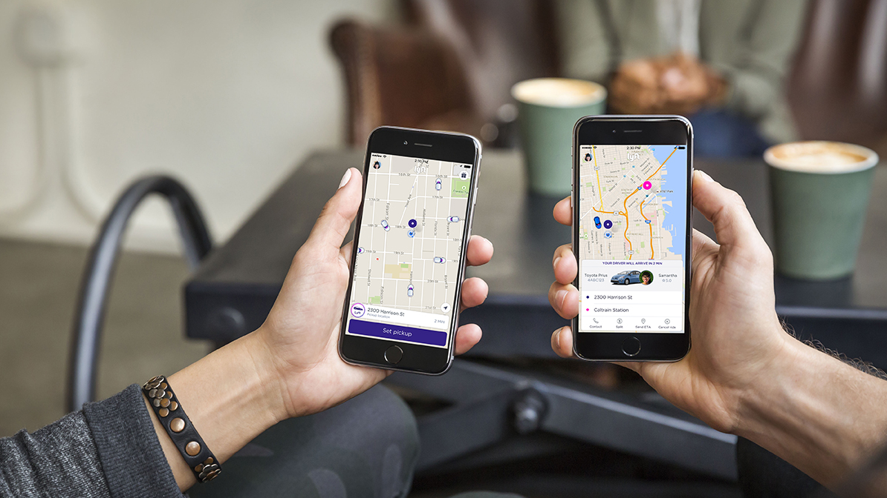
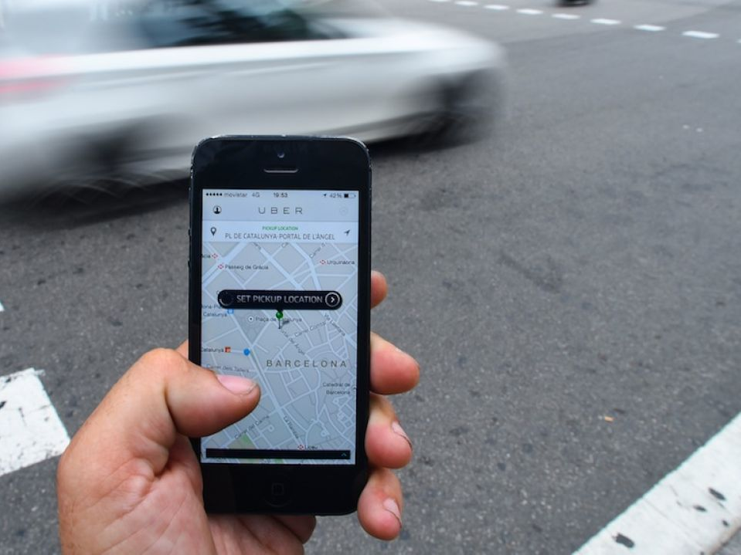
REGIONAL TRANSPORTATION COMMISSION
SAME-DAY ON-DEMAND

Slide 2
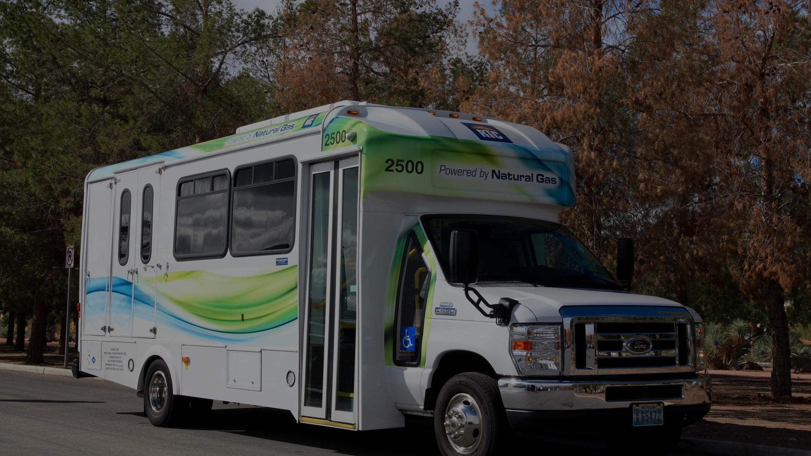
PARATRANSIT SERVICE
1.3M Total Rides
in Fiscal Year 2018
$51 Million Annual Cost for Service
Ride Fixed Route Free
$
FREE

Slide 3
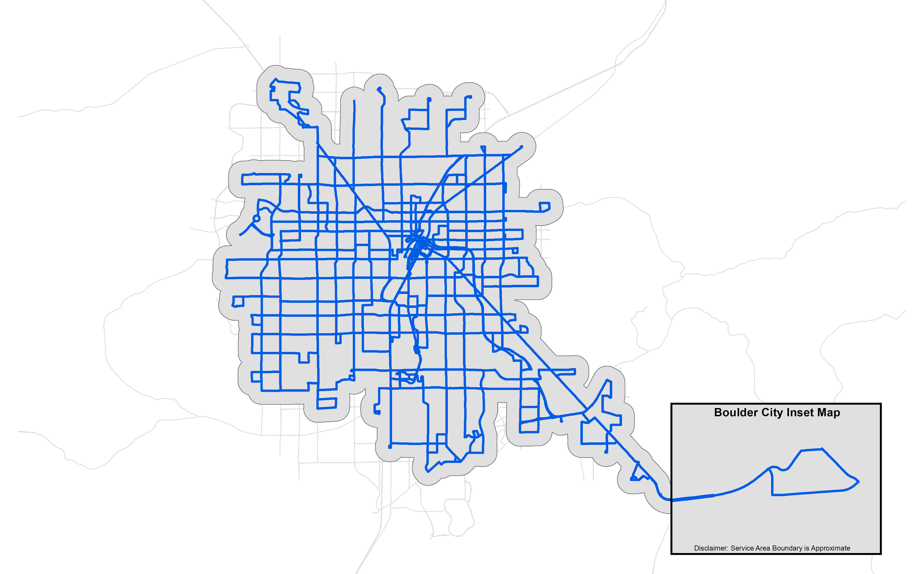
Paratransit Service Area Today
Current Bus Routes
Current Paratransit Area

Slide 4
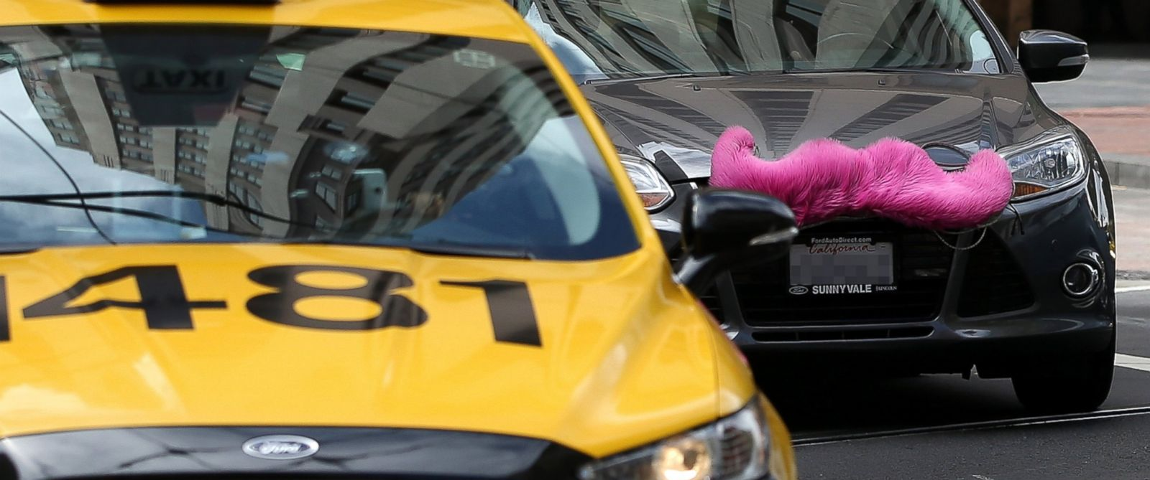
PEER REVIEW

Slide 5
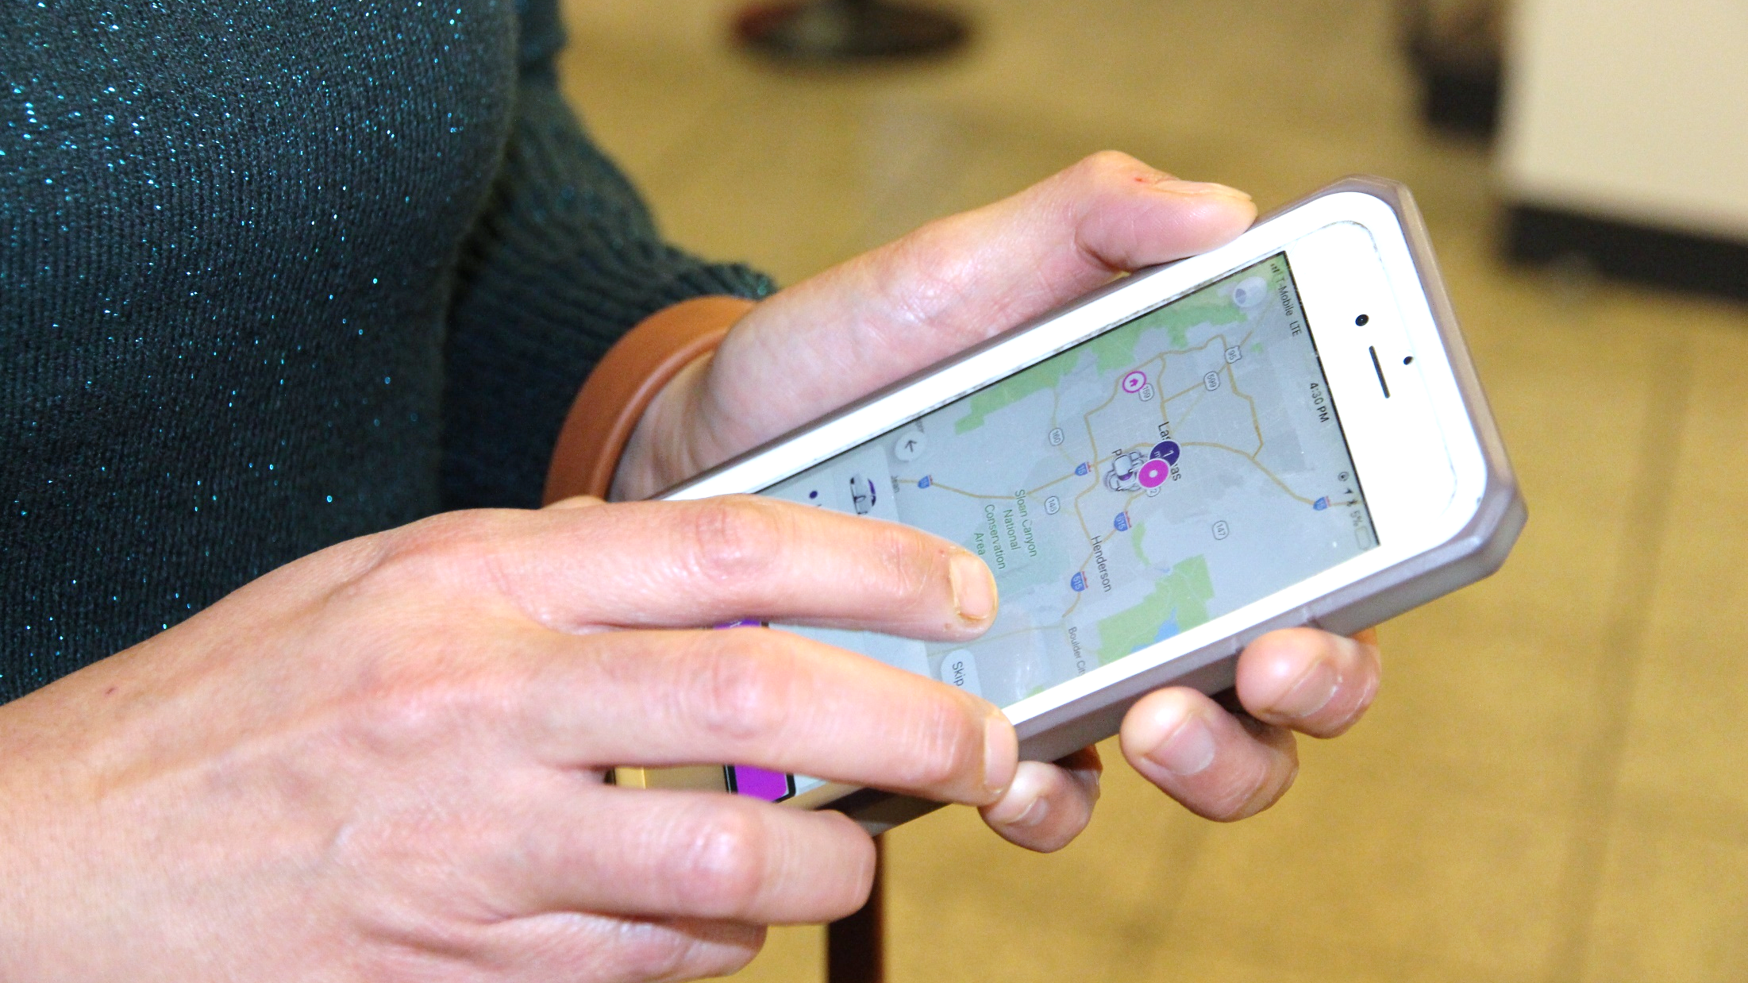
RIDE ON-DEMAND PILOT

Slide 6
ACCESSIBILITY AND DRIVER ONBOARDING

Slide 7
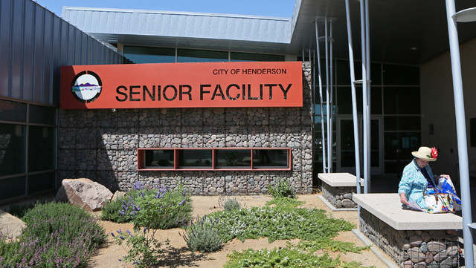
OUTREACH

Slide 8
CUSTOMER SATISFACTION
Please indicate your overall satisfaction with booking rides through the Lyft app. (98% Satisfied)
Please indicate your overall satisfaction with your RTC Ride On-Demand trip experience. (96% Satisfied)
Overall, how satisfied are you with the convenience of the Ride On-Demand program? (96% Satisfied)

Slide 9
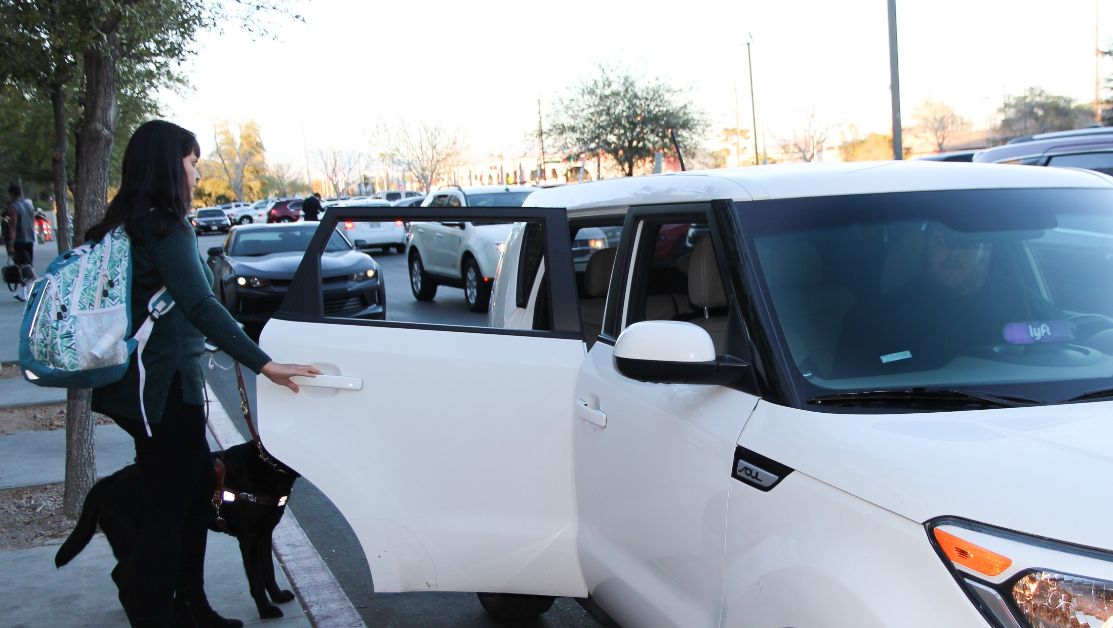
Customer satisfaction
“I am loving the freedom this program allows for.
I love the professionalism of the drivers, and the caring and customer concern.”

Slide 10
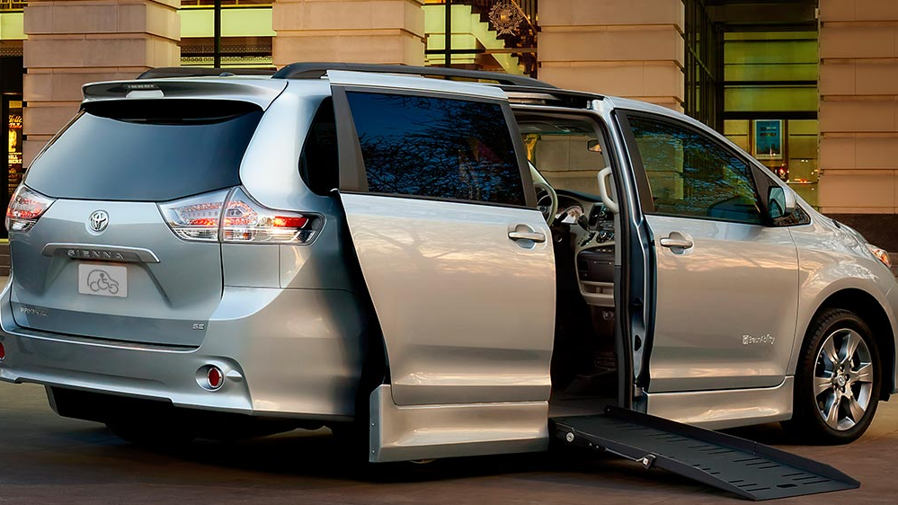
WAV AND TANGO

Slide 11
COST SAVINGS

Slide 12
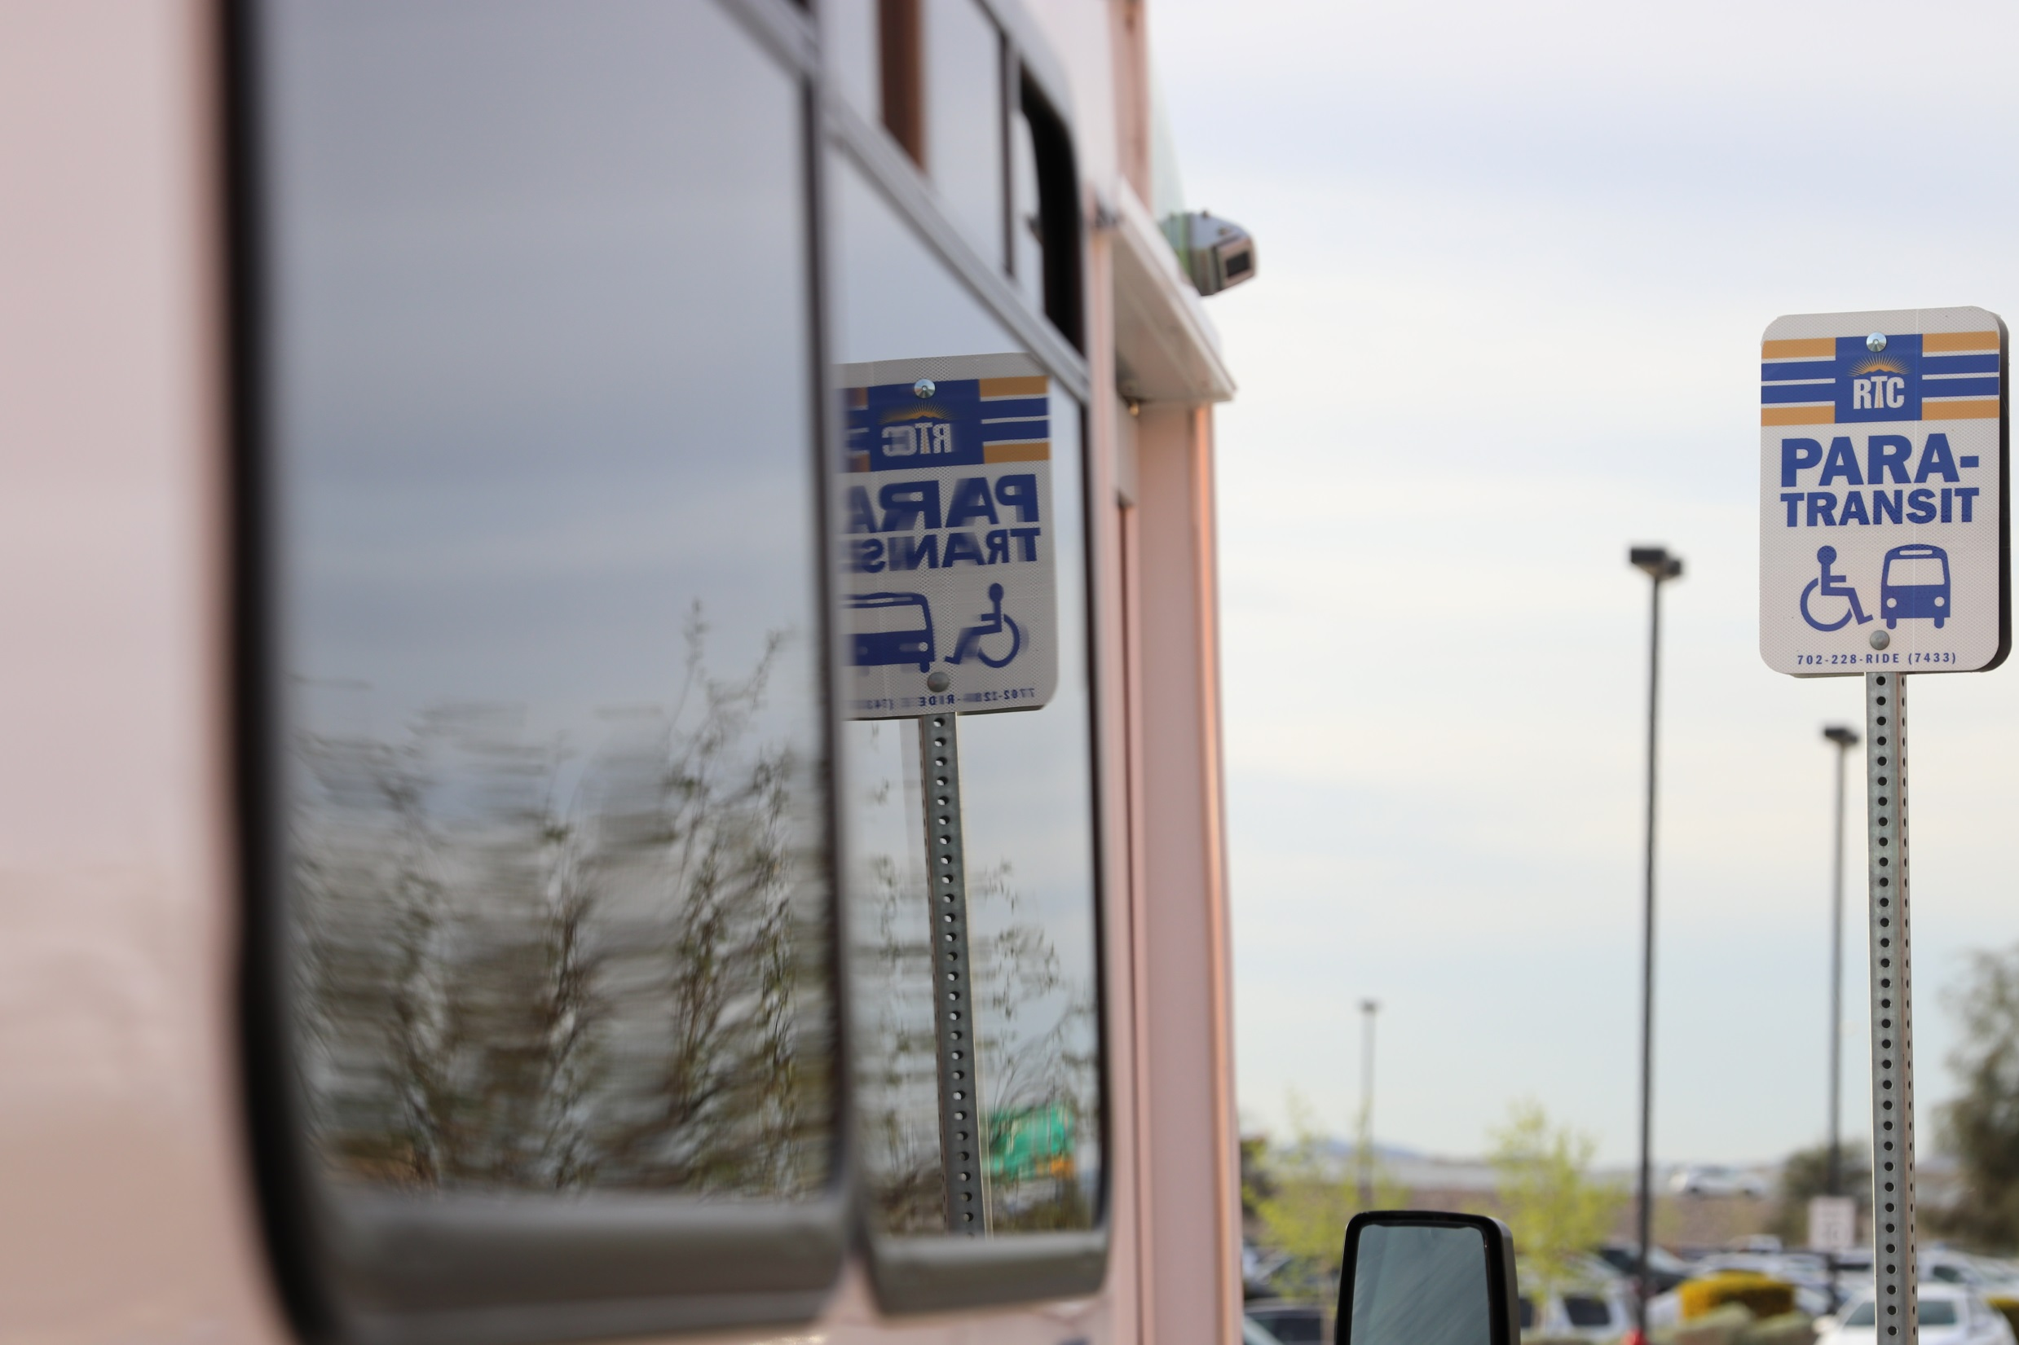
NEXT STEPS

