Slide 1
Advocating Beyond your comfort Zone
My Life Inside a Neurotypical Closet
by
Alison M. Greathouse, MRC, CRC
*No claim is made to any images used.

Slide 2
Feel Free to Stim…

Slide 3
But…
Please remember that one person’s stim is another person’s trigger.

Slide 4
My Life as a Pinterest Fail
Notes:
Look around…no one else is crying because a piece of grass touched their foot!

Slide 5
My Twins, age 3
Notes:
This is Alexandria and Cassia. They are twins with very different sensory needs. I had my own ideas on how to raise them.

Slide 6
A Case Study on Quirkiness

Slide 7
What happens when you accept yourself?

Slide 8
The Last of the Mohicans

Slide 9
In other words…

Slide 10
This is cruel.
Notes:
ABA and gay conversion therapy were created by the same behaviorist.

Slide 11
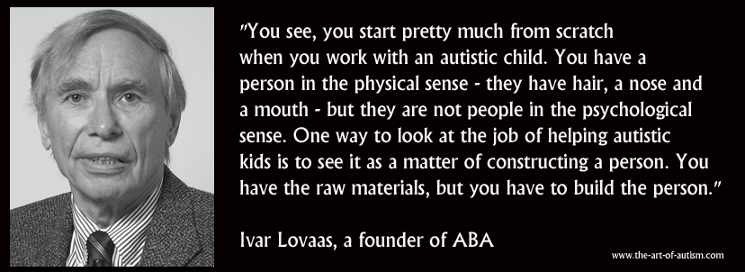
Antithetical to Autonomy
Notes:
Anyone know what else he created?

Slide 12
We are human, like everyone else.

Slide 13
Meltdowns are a manifestation of unrelenting distress, a form of learned helplessness

Slide 14
What is a Spectrum?

Slide 15
If you have met one autist, then you have met one autist.

Slide 16
Definition of “High Functioning”

Slide 17
Paradigm Shift

Slide 18
You have my permission…

Slide 19
Feel free to find yourself

Slide 21
Neurodiversity is part of diversity.

Slide 22
All we want is to be human.

Slide 23
Is this unreasonable?
Notes:
Failure to follow the desire to stim often leads to self-harm.

Slide 24
The struggle is real

Slide 25
Do what makes you feel right

Slide 26
A message to parents…

Slide 27
Accept me as I am.

Slide 28
Awareness vs. Acceptance

Slide 29
Advocate for Acceptance

Slide 30
Tell a Friend…

Slide 31
Acceptance is the key to success.

Slide 32
Autists are people, too.

Slide 33
Remember to be kind to you.

