Slide 1
National Down Syndrome Congress Conference 2022
Jenny Casselman

Slide 2

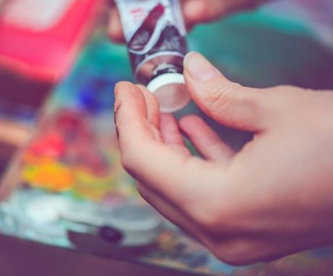


Agenda
Fun Pictures
Conference highlights
Self advocacy inspiration
Thank you

Slide 3
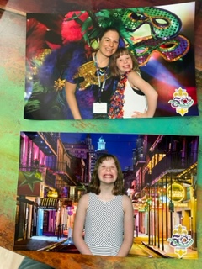
Conference Pictures
New Orleans, LA for the 50th Anniversary
Of the National Down Syndrome Congress Conference

Slide 4



Conference Highlights that make you smile
Research associated with Alzheimer’s
Clinical Trials are underway with Individuals with Down Syndrome who have a higher predisposition and can support research in this area. Treatments look promising for all!
New medical guides
New guidelines are available for individuals with Down Syndrome to assist with better and longer lifespans

Slide 5

The way to get started is to quit talking and begin doing.
Walt Disney

Slide 6
Self Advocacy
Meeting self advocates
Taking action
Kenley met and spent time with Frank Stephens who is an amazing and accomplished Self Advocate
He inspired her to take action in her own way
Kenley joined the Special Olympics Youth Activation Committee this fall to further her self advocacy skills.
She is working with her health class and students are taking the Respect Pledge to support respectful language for persons of all abilities.

Slide 7

Thank you
For supporting our ability to attend this conference

