Slide 1
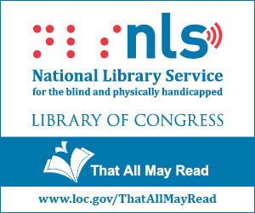
Nevada Talking Book Services
Notes:
Welcom to this webinar about the Talking Book program, an Joint program of NLS and NSLA

Slide 2
What is Talking Book Services?
A free national library program of Braille and recorded audio materials for blind and print disabled
Administered by the National Library Service, Library of Congress
The Talking Book program of the State Library circulates the materials and players to and from eligible patrons and interacts with patrons to customize their service
Notes:
We recruit, enroll and wok with patrons to set up their service the way they want it to work.

Slide 3
Eligibility
For indivduals and institutions serving eligible populations
Legally blind
Unable to read standard printed material due to visual or physical disability
For individuals with a reading disability
Resident of the U.S., Puerto Rico or Guam
Notes:
Institutions includes hospitals, nursing home, and schools.
Detailed explanation for the criteria is on the application.
A reading disability must be from a physical condition rather than cognitive.
Must be a resident but does not need to be a citizen

Slide 4
How It Works
Book cartridges, magazines and players are delivered by USPS free of charge
All materials can be returned to us postage free
No due dates for books
Must borrow one book a year
Players are loaned as long as the patron remains active on the program
Notes:
Free Matter for the Blind
No fines for lost, damaged or overdue books or players
Patrons are sent a single cartridge with several titles which are selected based on their reading preferences, preferred authors, titles, subjects, series and exclusions; Series can be sent multiple titles per cartridge in order. We are also able to excludes those they don’t want.
Another benefit, titles sent are tracked so the same one is not sent again unless requested.
Players are replaced as needed

Slide 5
Types of Materials
Titles are selected based on appeal across a wide range of interests
Books:
Same as what you would find in a public library
Magazines:
36 adult and 5 children’s titles
Braille:
Contract with Utah to provide Braille materials
Notes:
…In our collection
The majority of titles to record are selected by NLS using their collection development policy. The choose from the bestsellers: NYT, LA Times, Washington Post
Fiction, nonfiction, popular authors, popular topics; no text books. Other resources for text books and educational materials in audio from Bookshare and Learning Ally.
Magazine list offered when we do our follow-up by phone. Magazines are subscription free.
Braille materials are provided by NLS to those libraries that offer braille. Utah mails the braille books to our patrons or they are available for download through BARD with a refreshable braille display device.

Slide 6
How to Find Materials
Notes:
There are several resources available for finding titles in our collection.

Slide 7
Online Catalog www.ntbs.klas.com
Notes:
Our online catalog reflects what is available.
Patron’s can login to account
See what’s checked out
Add requests to account and remove requests.
The “Browse” page provides 4 titles in “added in last two months, popular titles, and Nevada titles categories” I will tell you more about Nevada titles shortly.

Slide 8
NLS’s Catalog http://nlscatalog.loc.gov/
Notes:
Contains titles recorded by the individual libraries that they have recorded.
Also contains braille titles.
They have recently added entries for the Jewish Braille Institute which patrons borrow directly.

Slide 9
Talking Book Topics
Bi-monthly catalog of new titles available in:
Large print
Braille
Audio
Notes:
This is a third way for patrons to find titles of books they would like to read.
Patrons tell us what format works best for them, and we subscribe them.

Slide 10
We can help too
Call us: 1-800-922-9334
E-mail us: nvtalkingbooks@admin.nv.gov
Write to us or
Visit: 100 North Stewart St., Carson City, 89701
Notes:
Staff are available to help.
Patrons can email to a general email address that all staff can access.
We are open the same hours as the mail library. We recently moved to the main level making us more accessible to patrons.

Slide 11
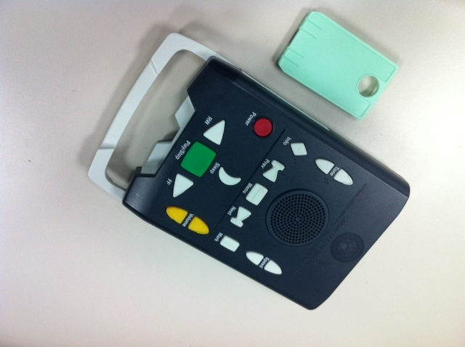
Digital Players and Cartridges
Advanced Digital Talking Book Machine
Standard Digital Talking Book Machine
Notes:
3.5 #
Operates on battery or by plugging in
Advanced player allows book marks for study material such as the Bible and more navigation options: skip forward or backward by chapter.
Both have volume, speed, tone and sleep options.
Weigh about 2.5 pounds
Battery charges up to 29 hours
No shortage of players; everyone gets one
The cartridge is a flash drive embedded in a plastic housing to make it easier to manipulate and keyed to fit into the player only the correct way.

Slide 12
Nevada Talking Book Services
BARD
(Braille and Audio Reading Download)
Notes:
More than 100,000 titles are on BARD in digital and/or braille
About 20% of our patrons are registered with BARD. We expect this number to increase as the population becomes more tech capable.
Allows patron to be independent of our circulation abilities. They can get books even when we are not working.

Slide 13
What is BARD?
A download site for:
Books and magazines
Web Braille
Available 24/7
No due dates
Books play on:
NLS’ players
Select third party players
iOS devices
Android devices
Kindles
All titles available into perpetuity
Notes:
This is where we get our downloads for patron cartridges
Patrons must purchase third party players and the other devices.
This is the source for our duplication on demand downloads.

Slide 14
Notes:
Application logo for Apple and Android devices for BARD Mobile.
Free app in Google Play or iTunes

Slide 15
Nevada Talking Book Services
Recording
Program

Slide 16
Recording Program
Provides an additional source of books with local and regional interest not provided by the NLS collection
Fiction and non-fiction books and magazines focusing on Nevada and the High Sierra/Comstock region
Books written by authors closely identified with Nevada or the High Sierra/Comstock region
We started recording Nevada titles in the 1990’s
We also record Nevada magazine
Notes:
We record mostly non-fiction titles. We have recorded titles about Reno, Las Vegas, rural Nevada, Fremont, Tonopah, mining, Patty Cafferata’s Christmas in Nevada, Bombast: spinning atoms in the desert, Todd Borg mysteries, Robert Laxalt, Backyard Traveler
We record and distribute the Nevada magazine and Women’s History(history, book reviews, editorials)
We switched to digital recordings in 2008. Most titles previously recorded in analog have been re-recorded in digital.

Slide 17
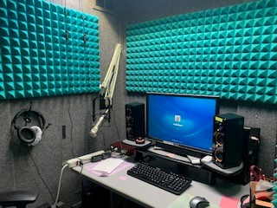
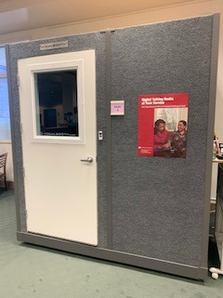
Recording Booths
Notes:
These are our sound proof booths. They have Adobe Audition for the recording software.

Slide 18
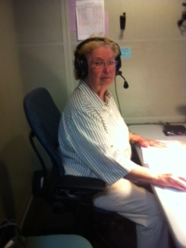
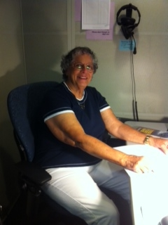
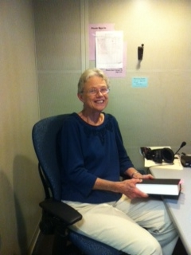
Narrator Volunteers
Notes:
All recording and reviewing is done by volunteers. We have a variety of male and female voices and we try to match the content of the book to the voice.
The narrator reads and records the book. The reviewer listens to the recording noting errors in the narration. Then the narrator re-records the sentence or paragraph with the error. The recording coordinator cuts out the error and pastes in the corrected narration. The recording coordinator then applies navigation to the file so patrons can jump to different parts of the book, i.e. chapters. The recording coordinator then creates the audio file with the required parts so it can be loaded onto BARD for access to patrons nationwide.

Slide 19
Support Provided by:
Notes:
Through LSTA funds

Slide 20
How to Apply
Obtain an application for patrons or institutions:
By phone
775-684-3354
1-800-922-9334
E-mail
nvtalkingbooks@admin.nv.gov
From our website:
http://nsla.nv.gov /ntbs1
Notes:
It on the web site under “become a patron.” Available in work and pdf and is ADA accessible which makes it screen readable by JAWS and NVDA, screen reading software.
Any questions?

