Slide 1
The Art of De-Escalation Presenter: Carmen S Johnson

Slide 2
What is a Crisis?
A time of intense difficulty, trouble, or danger. (catastrophe; setback; mess)
A time when a difficult or important decision must be made. (critical point; turning point)
A state of feeling; an internal experience of confusion and anxiety to the degree that formerly successful coping mechanisms fail us and ineffective decisions and behaviors take their place.

Slide 3
Elements of a Crisis
Three elements that define a crisis are:
The situation is overwhelmingly stressful; the breaking point has been reached.
There is time for an intervention. This is not a life-threatening moment or emergency situation.
The individual is escalated and is unable to utilize coping strategies to reach equilibrium.

Slide 4
Internal vs. External Crisis
DISCUSSION

Slide 5
Responses to Crisis
Fight – Attack the issue
Flight – Escape the issue
Freeze/Flop – Get stuck in the issue
Fawn – Try to fix the issue

Slide 6
The Crisis Cycle

Slide 7
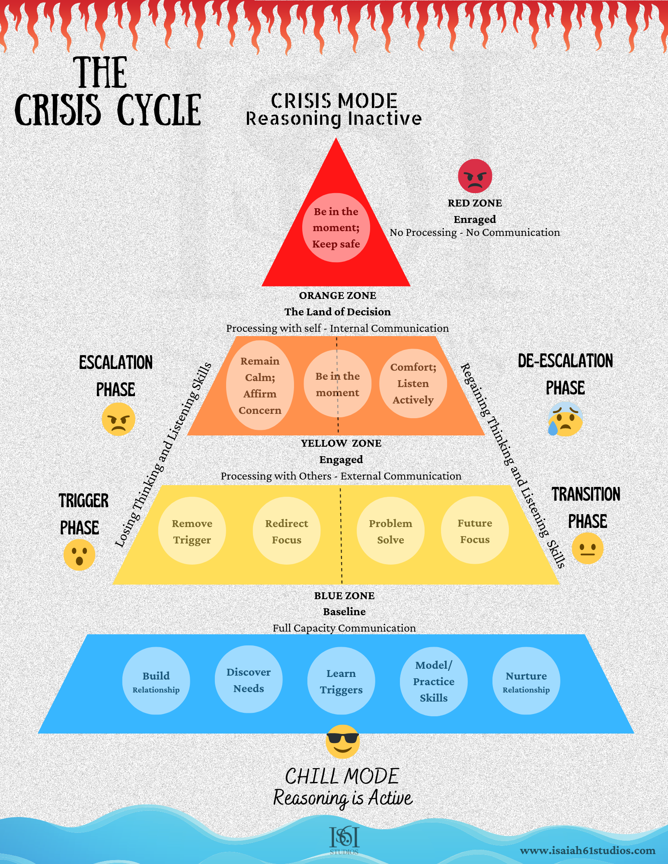
Zone Focus
RED: Crisis
Focus: Safety
ORANGE: Escalation/De-Escalation
Focus: Affirm The Concern
YELLOW: Trigger/Transition
Focus: Mitigating Risk
BLUE: Baseline
Focus: Relationship Building

Slide 8
Do’s & Do Nots

Slide 9
Do:
Maintain Safety
Get into the person’s moment – It’s all about them.
Prepare for crisis and disable(when possible)
Avoid escalating the crisis by using few words
Allow the person to process

Slide 10
Do Not:
T - hreaten
A - rgue or contradict
C - hallenge
O - rder or command
S - hame or disrespect

Slide 11
Questions?

Slide 12
The Art of De-Escalation Presenter: Carmen S Johnson

Slide 13
Thank You
Carmen S Johnson, Facilitator/Advocate
Isaiah 61 Studios, LLC.
www.isaiah61studios.com

