Slide 1
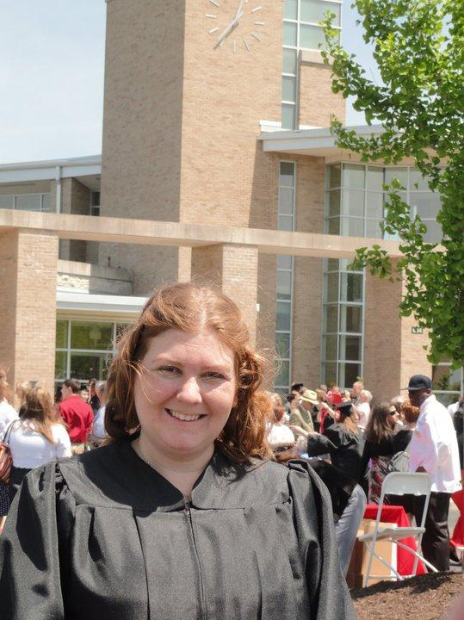
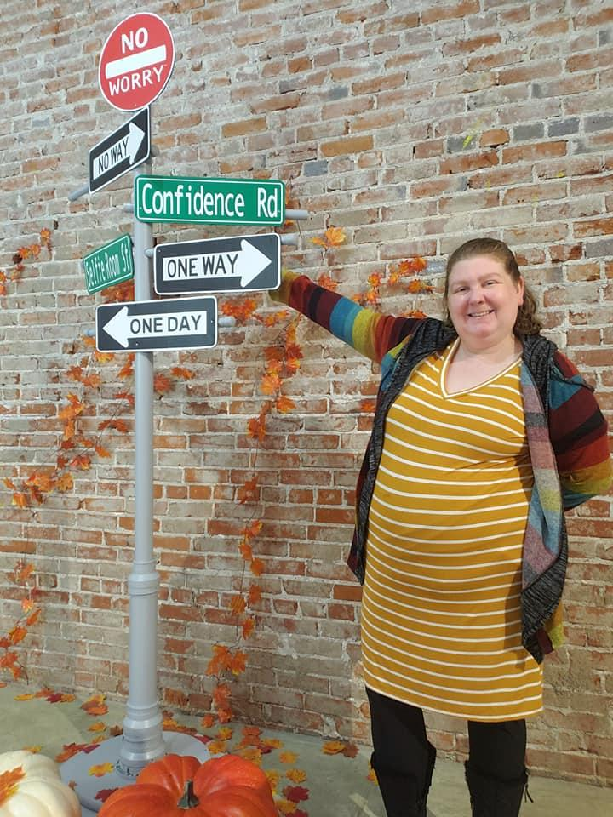
Helping Others Achieve Their Dreams Was the Secret To Achieving My Own
By: Katie Selby

Slide 2
How my journey started
-Pre-K I had some issues with behavior and communicating. As an infant and toddler I had some developmental delays
-I was enrolled in Special School District
SSD is a district supporting individuals with disabilities from preschool to twenty-one years of age. It has its own public schools, separate from general public schools, but also partners with all 265 general public schools in the 22 school districts in St. Louis County.
Notes:
When I was three years old I wasn’t communicating like typical developing children.
My doctor suggested to my mom that I needed speech therapy.
Insurance company would only pay for it if my dr. was the one giving me speech therapy. Dr didn’t offer this.
Parents researched private speech therapy but it was expensive.
A family member told my parents about a school named Gotsch Early Childhood program. Began Speech Therapy then was evaluated for other disabilities.
My mom told me that she remembers thinking my terrible twos began at three and a half-four years of age. The best way I knew how to communicate was through facial expressions and body language.
I would jump up and down and smile when I was happy or excited. I would exhibit tantrum behaviors such as throwing myself to the ground and lunging backwards almost hitting my head. When I was frustrated or unhappy.
My parents and teachers purposely ignored my pointing and gestures to encourage me to talk.
My behaviors were the only way I could let my parents and teachers know how frustrated I was and my non-verbal expressions were working.
When my parents and teachers understood that my tantrum behavior was related to my frustration with language, they began to figure out ways to help me effectively communicate my wants and needs.

Slide 3
Behavior Example
My mom told me that she remembers thinking my terrible twos began at three-and-a-half to four years of age. The best way I knew how to communicate was by using my facial expressions and body language. I would jump up and down and smile when I was happy or excited. I would exhibit tantrum behaviors (like throwing myself to the ground and lunging backwards almost hitting my head) when I was unhappy or frustrated. These behaviors sometimes lasted for quite a few minutes and occurred in multiple settings such as the garden shop where my mom worked, my grandma’s house or the grocery store, which made it extra challenging for everyone involved.
My Parents and teachers worked to develop my verbal language by purposely ignoring my gestures and encouraging me to ask for what I needed both at school and at home. When I couldn’t get my words out verbally, my behaviors were the only way I had to let my parents know how frustrated I was and my non-verbal expressions were working!
When my parents understood that my tantrum behavior was related to my frustration with language, they began to figure out ways to help me effectively communicate my wants and needs. They would redirect me with a sharp "No!", and give me verbal explanations for the consequences of my actions. They also began using more positive reinforcement to encourage me to communicate verbally. Through their efforts and the efforts of my teachers, I began making progress at school and learning new ways to communicate. I finally felt like my frustration of not being able to communicate was being heard. All of the hard work my parents, teachers and I had done came to pay off when I said my first full sentences at the age of five.

Slide 4
Early Years of Self-Advocacy
Today I realize that advocacy was part of my story from the beginning, even before I could express myself in words and sentences.
I communicated my frustrations to my parents and teachers who responded by trying to help me.
Most of the time, I just waited for them to notice and when I became uncomfortable enough, I would get their attention in the only ways I knew how.
I was not aware that I was advocating for myself then, but that is where it all began.

Slide 5
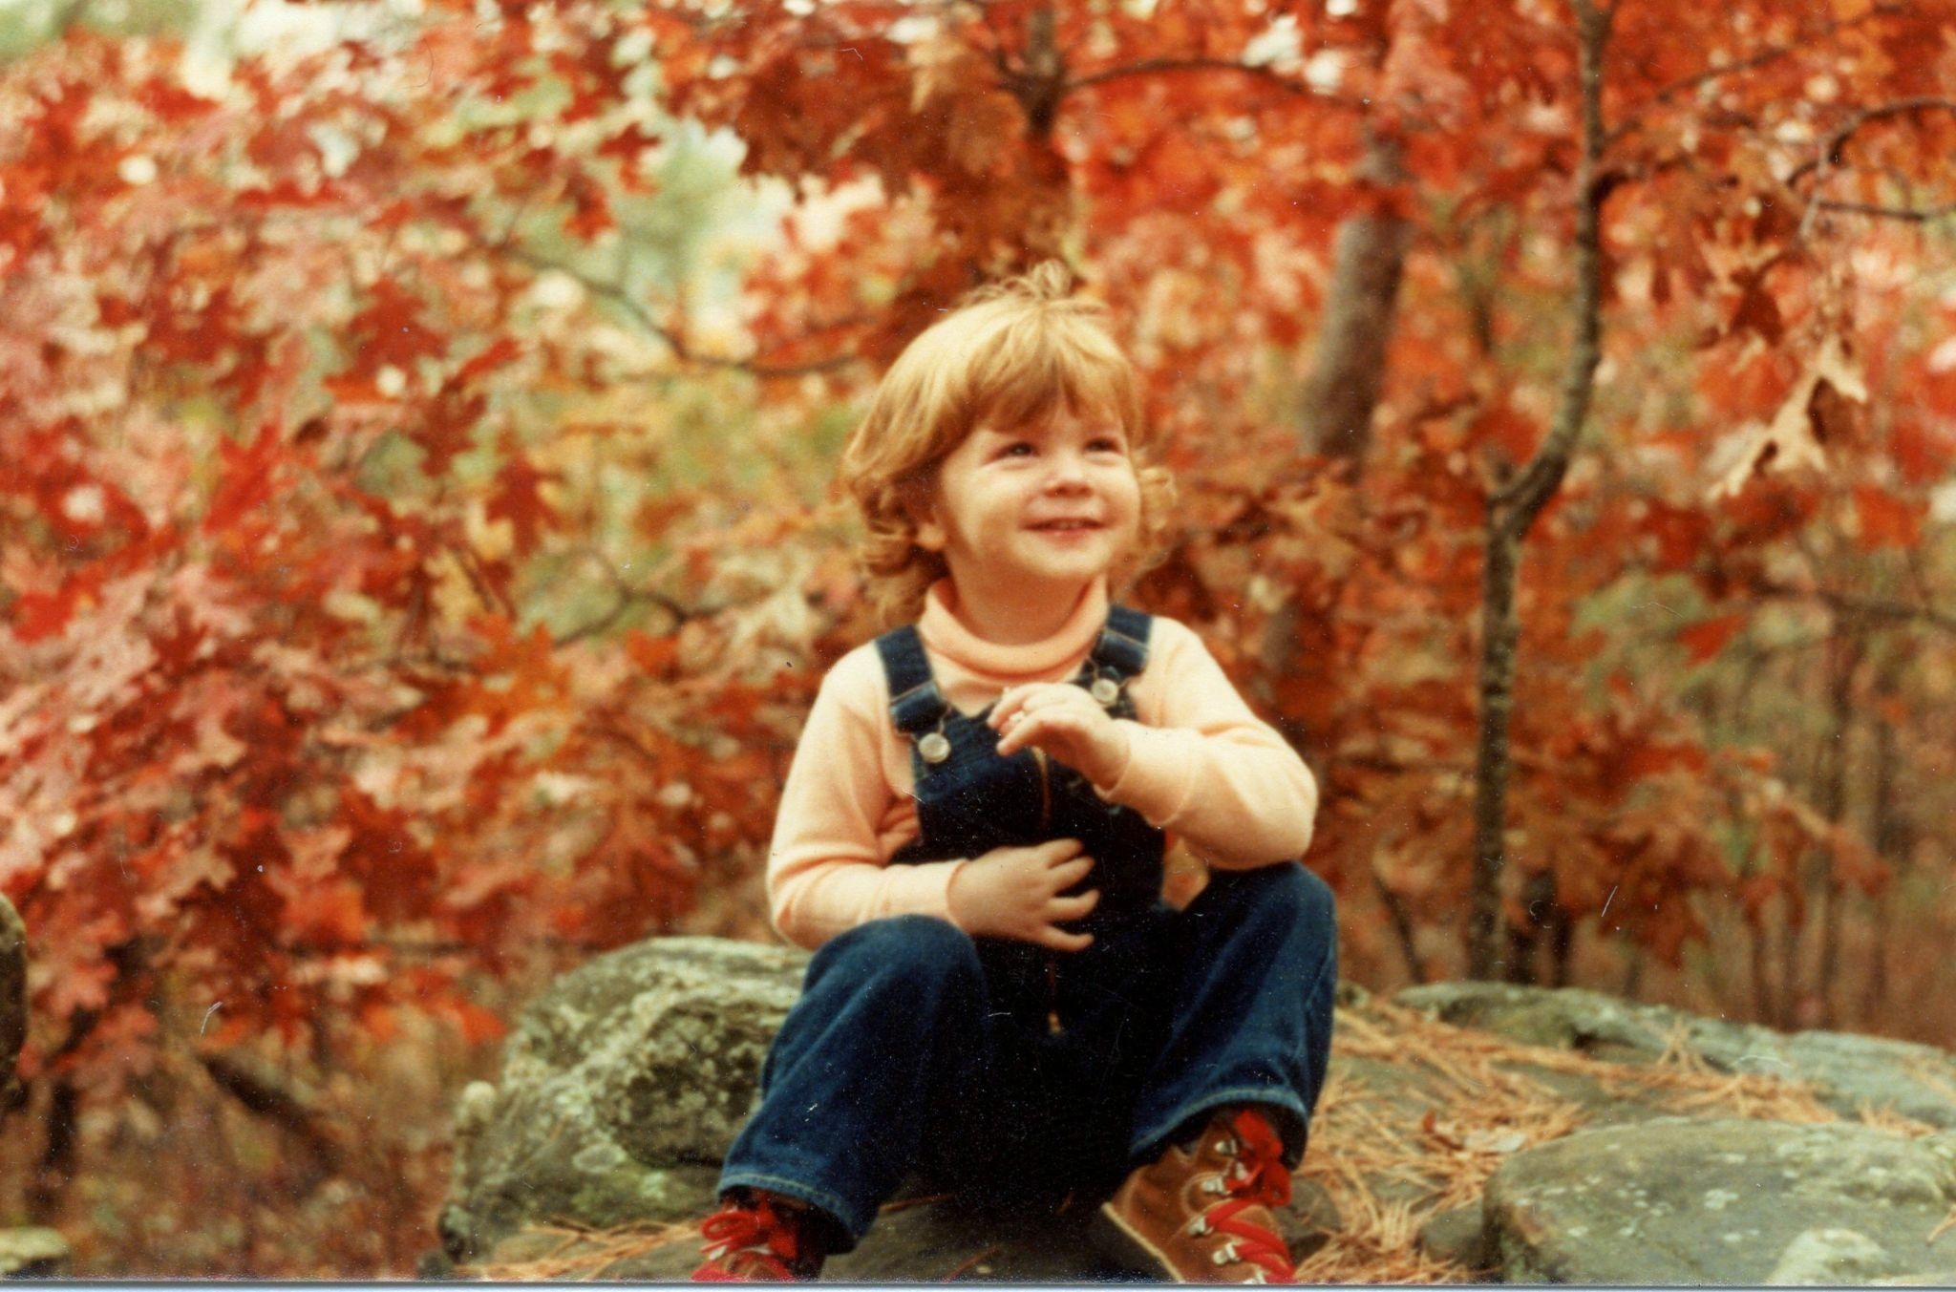
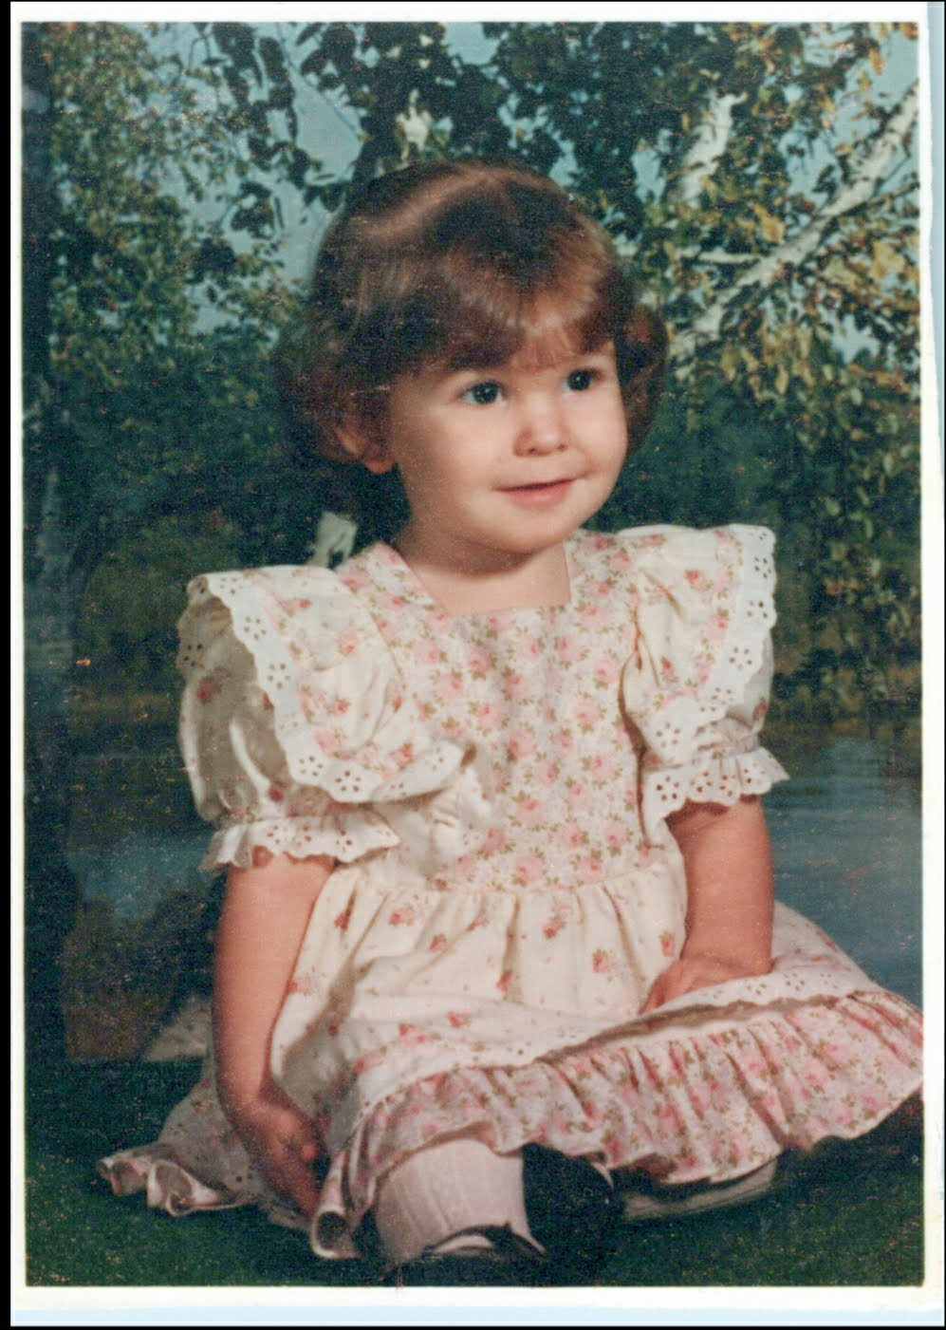
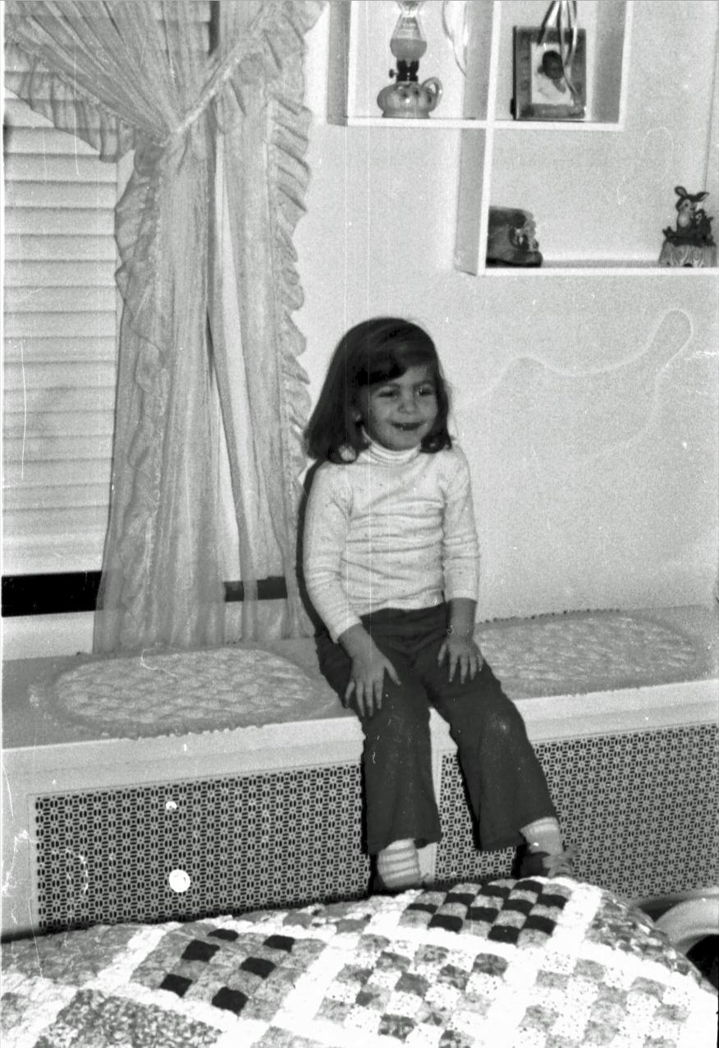
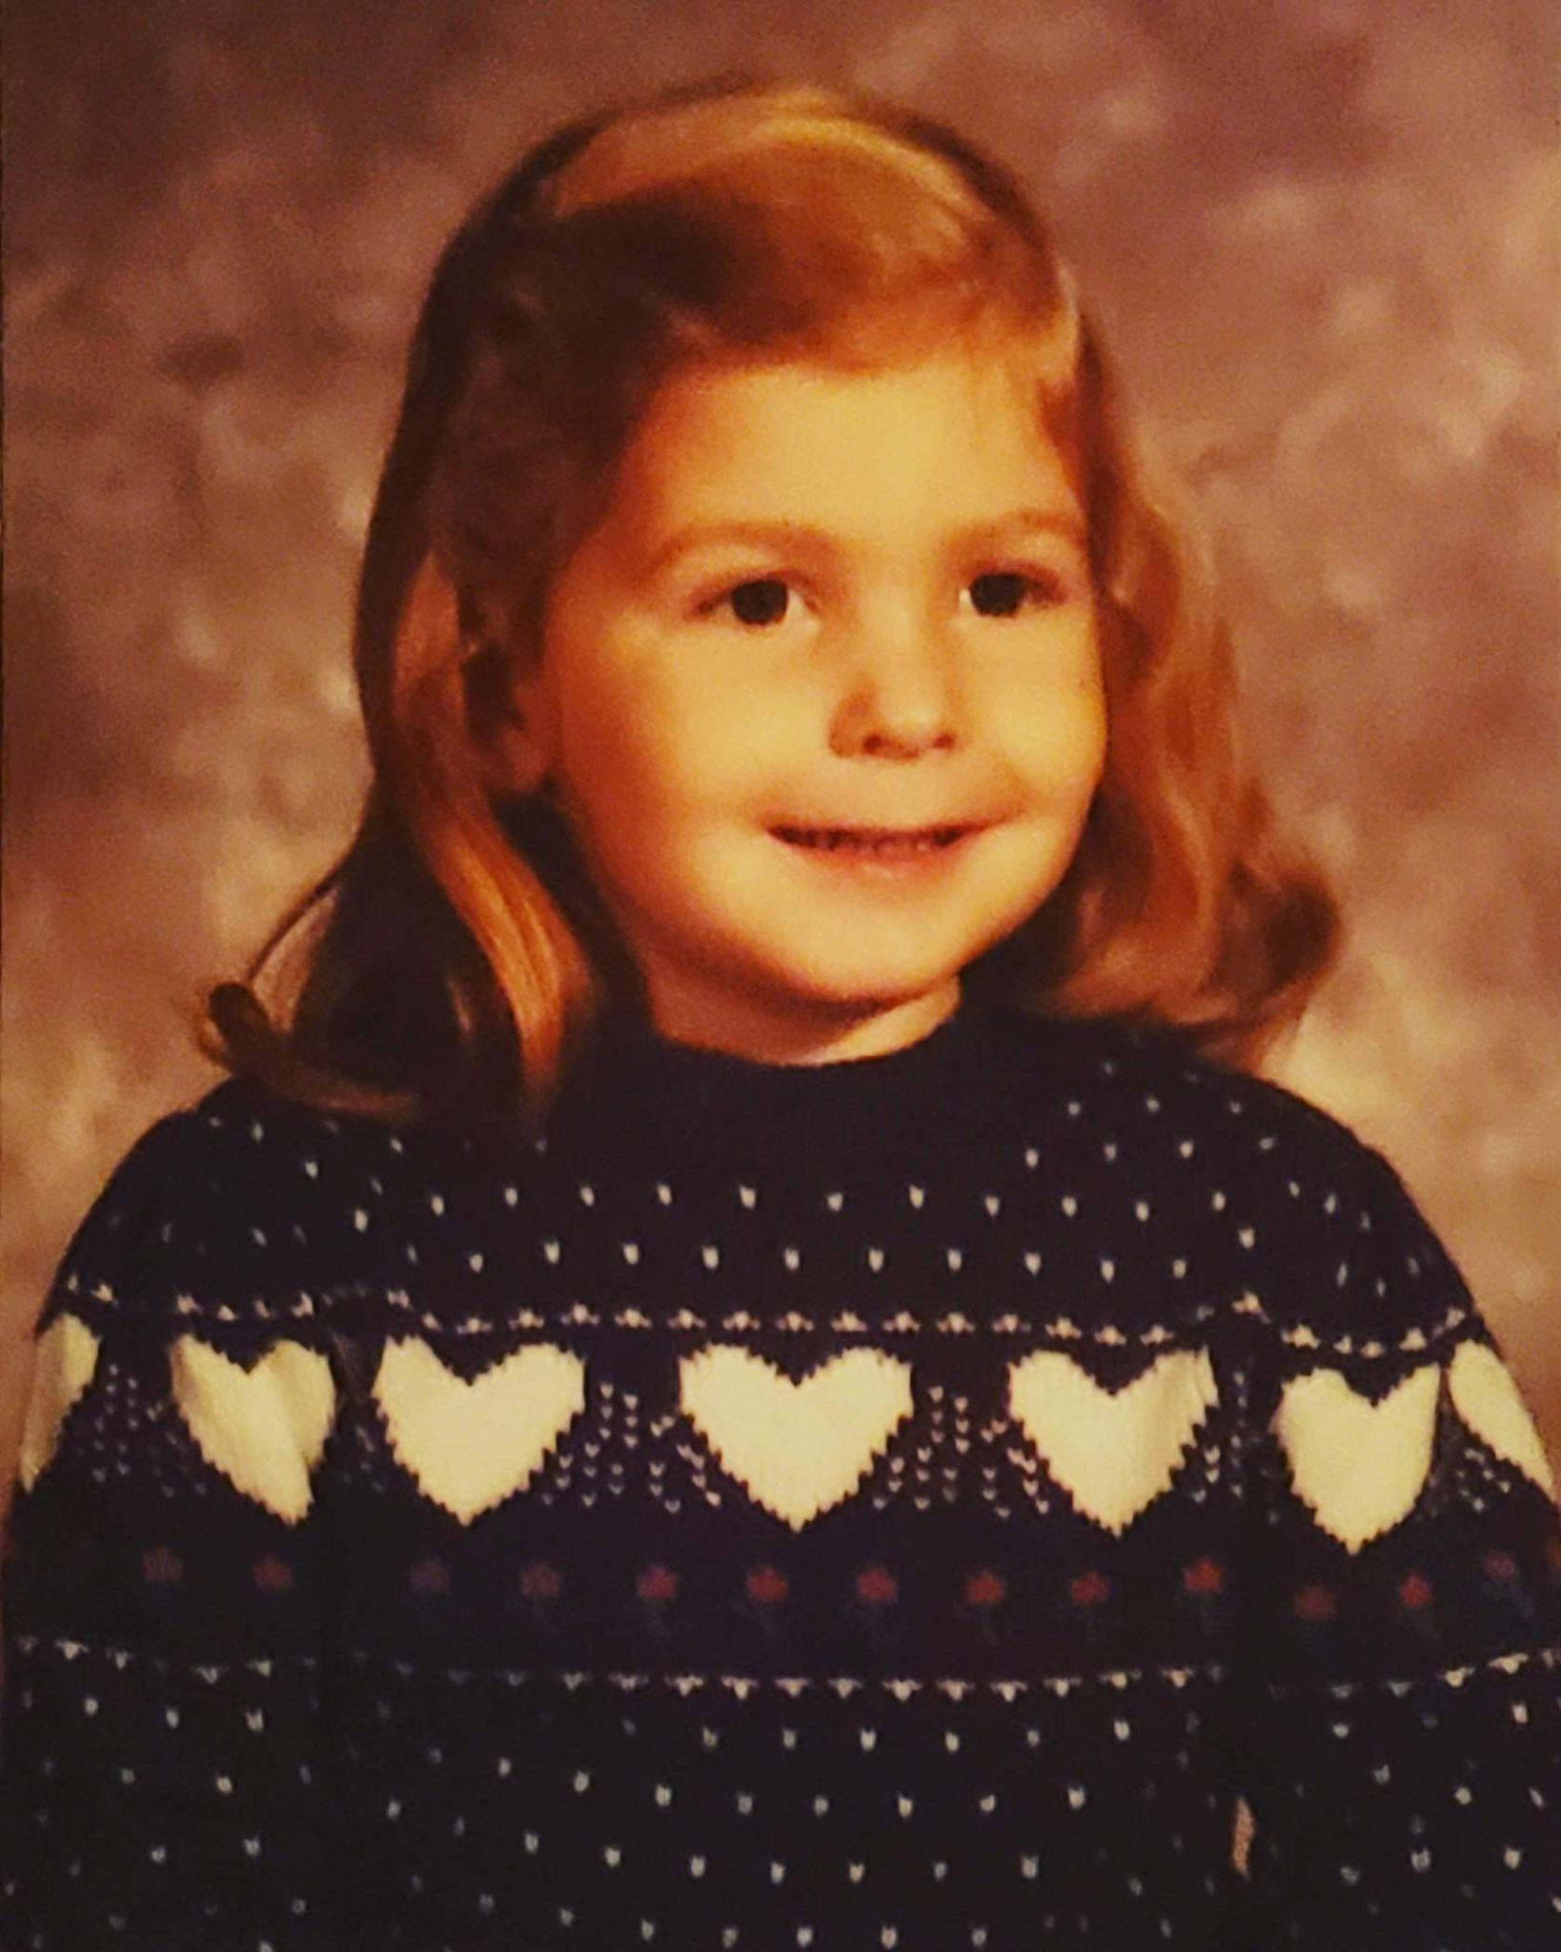
Preschool Photos

Slide 6
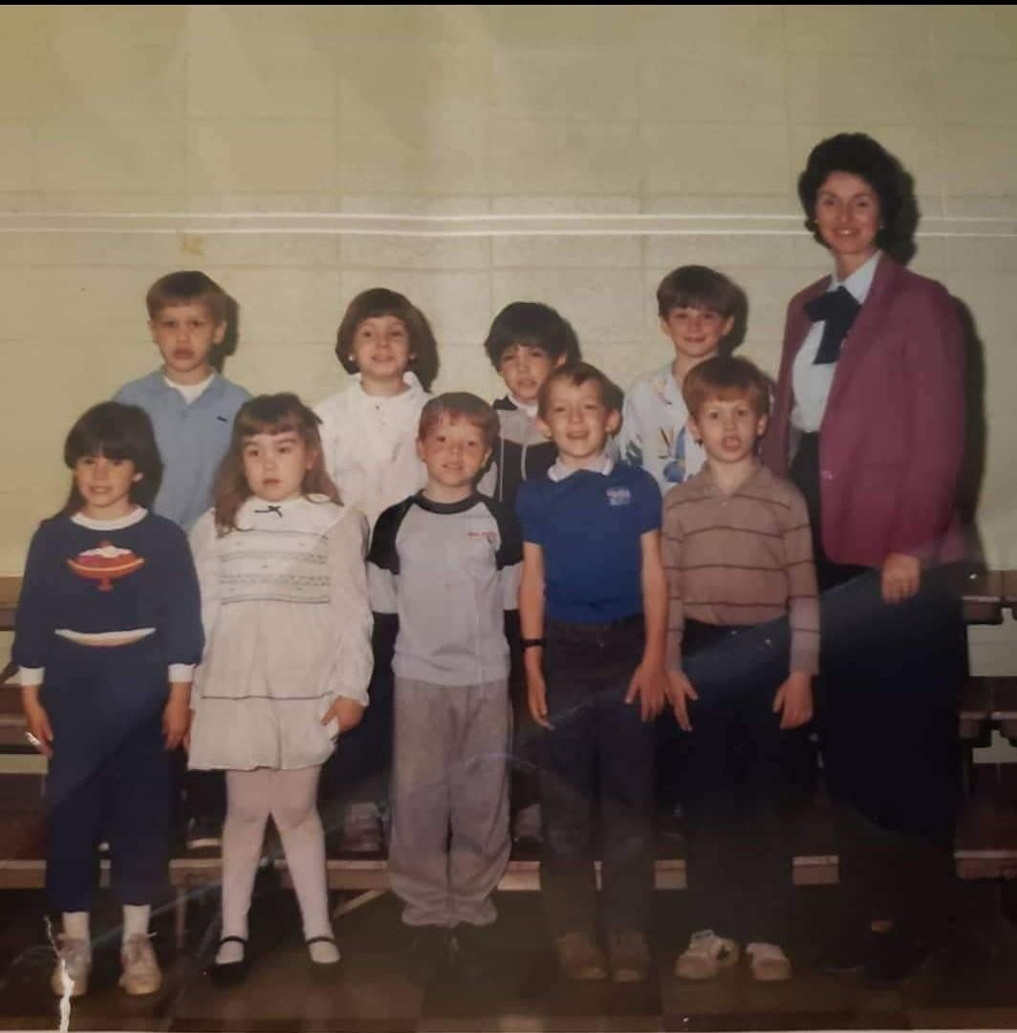
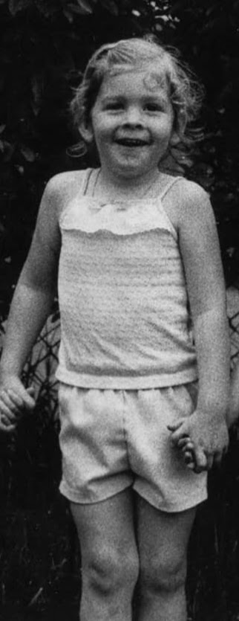
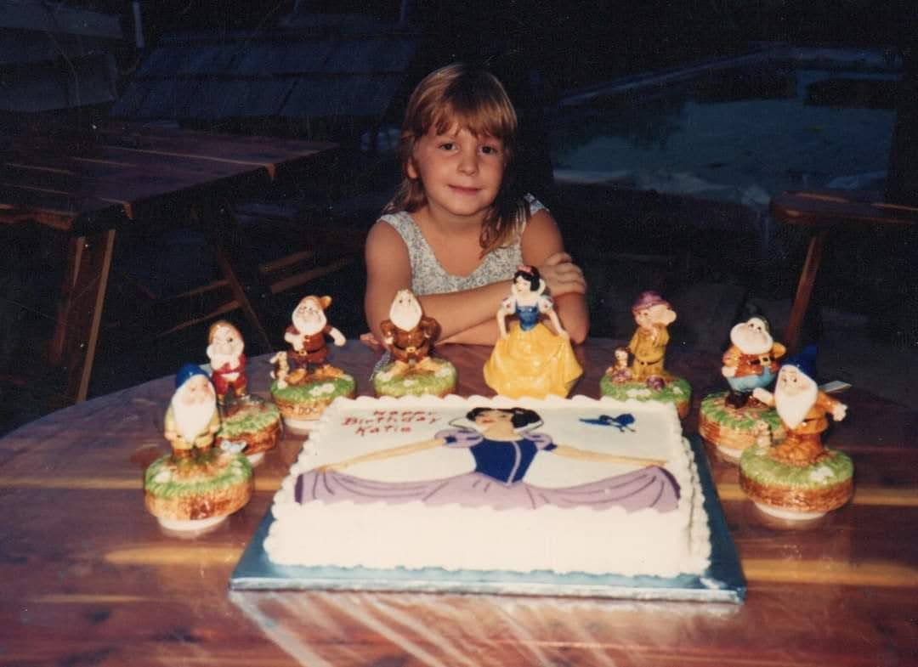
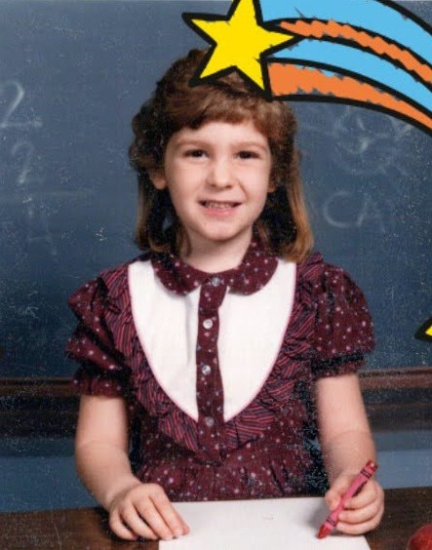
Elementary School Photos

Slide 7
Pre-K & Elementary School
I received lots of early intervention and therapies, and started in a speech and language based special education class.
I was diagnosed with a Learning Disability at the age of 5 years old.
My Learning Disabilities are in Reading Comprehension, Written Expression and Math.
I was in a self-contained classroom kdg-1st grade with 8-10 classmates.
I said my first full sentence in kindergarten. My parents and I do not remember what my first words were.
In the middle of 1st grade, I went to some general education classes to get ready to transition into general education class.
I went to all general education specials (Art, Music, PE) and was pulled out of my self-contained class for OT and SLP therapy. All of my academic classes were in the SSD class.

Slide 8
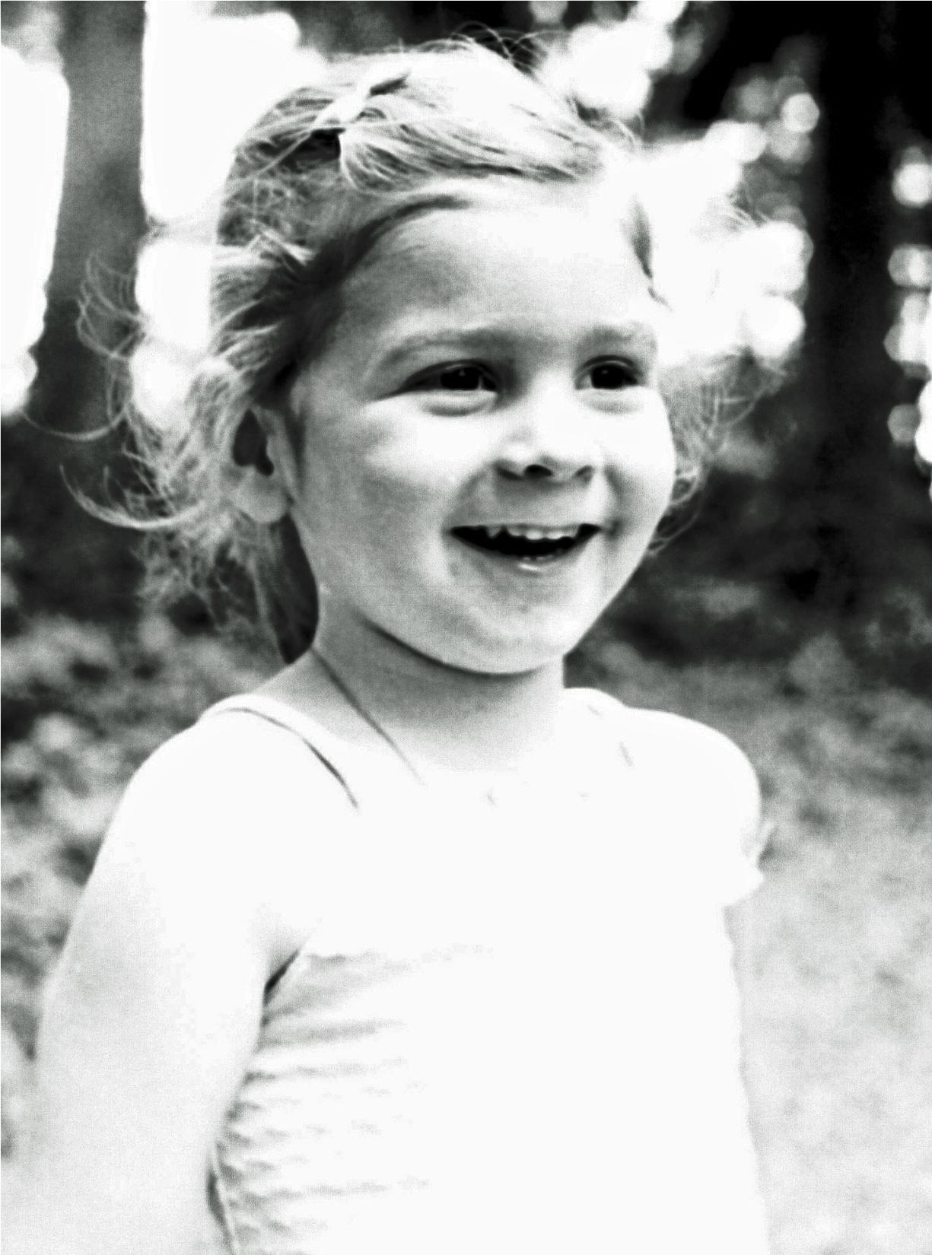
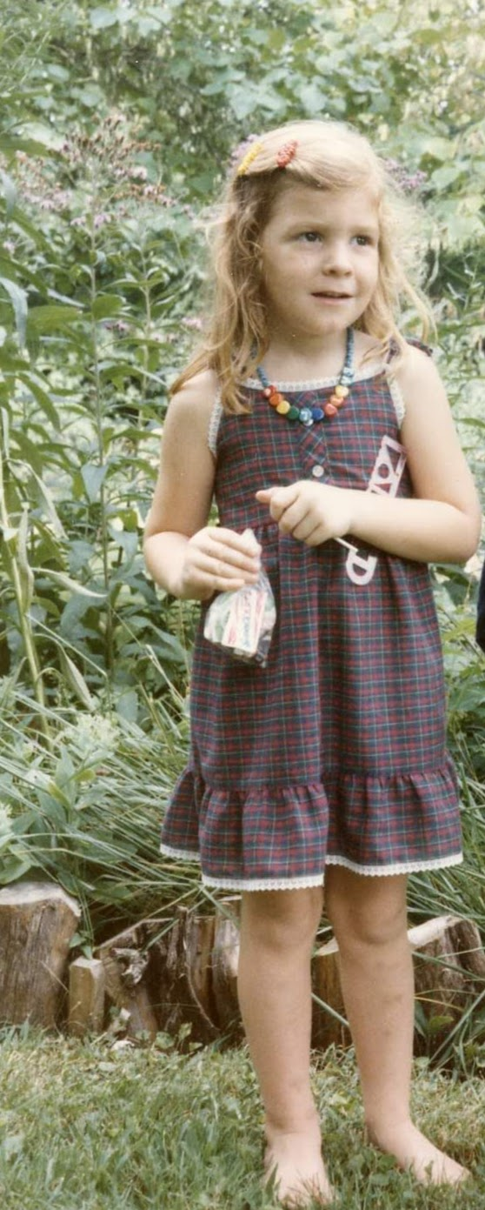
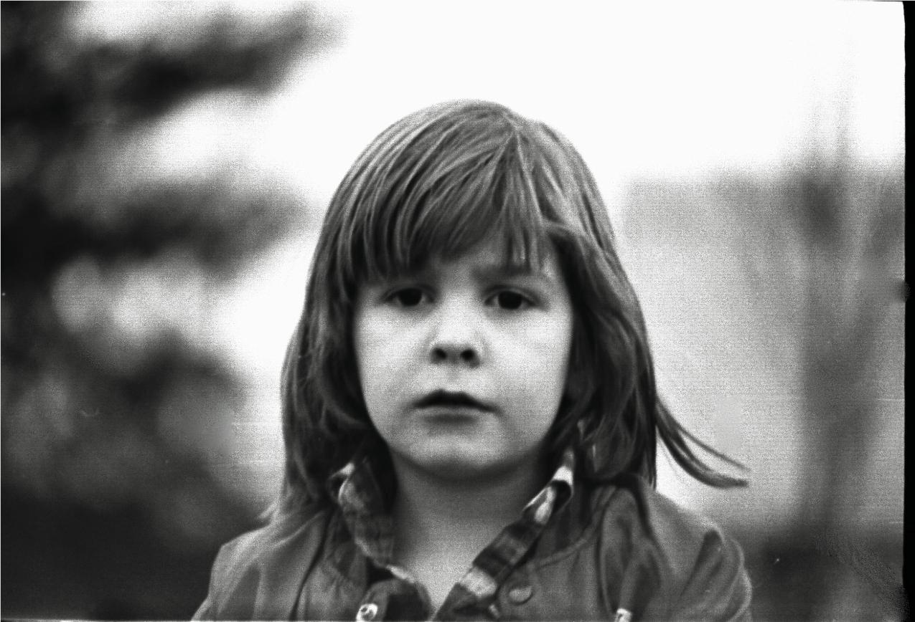
Elementary School Photos

Slide 9
Elementary School
By 3rd grade my OT services were dropped because I mastered all of my goals.
In grades 3rd-5th I continued the above educational services and was still in my grade level class and pulled out for my special education services.

Slide 10
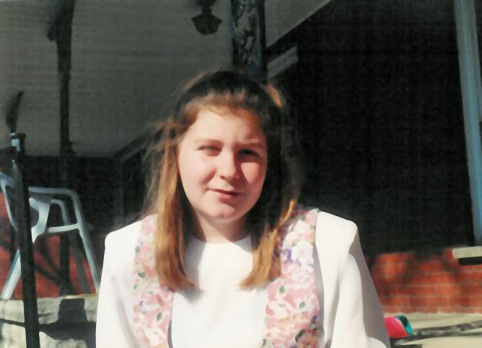
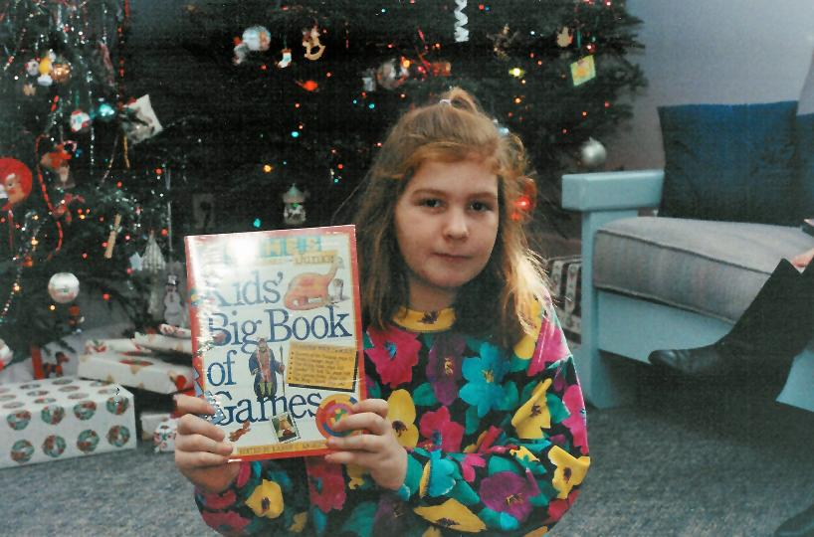
Middle School Photos

Slide 11
Importance of Teaching Self-Advocacy Skills at an Early Age
Builds Self-Confidence at an early age
Teaches students that it is ok to communicate with others and let them know what you need
Teaches self-determination to students such as problem solving skills, how to make decisions and how to set life goals(at every stage of education)
Teaching these skills at a young age helps students become more independent.

Slide 12
Middle School
In 6th grade, my special education teachers said that I would complete my work, but at a failing level. Today, I feel frustrated that my teachers did not help support me when I needed it.
I was in a CWC (Class within a class) for some of my classes in middle school such as math and science.
In 7th grade I was evaluated/tested for math. After the math testing the IEP team decided to keep me in my 7th grade math class. Today I feel that I should have been placed in a different math class.
I passed all of my 7th grade classes this year and it felt amazing that I could do it.
In 8th grade I started my transition to high school.
I did not feel like I had great rapport with my special education teachers
Notes:
In 6th grade, my special education teachers said that I would complete my work, but at a failing level. All math and science tests resulted in F grades. I do not remember what my parents or teachers did to help me with my failing grades. My mom has told me that she found me a private math tutor and assumed it helped me. Today, I feel frustrated that my teachers did not help support me when I needed it.
I was in all grade level classes by the second semester of 7th grade. I passed all classes this year and it felt amazing that I could do it.
I was in a CWC (Class within a class) for some of my classes in middle school such as math and science
In 7th grade I was evaluated/tested for math to see if I needed to be in a lower level math class since I was not progressing in my 7th grade general education math class. After the math testing the IEP team decided to keep me in my 7th grade math class. I felt that I should have been placed in a different math class. So that I could have had more of an individualized class and gotten more out of the math class.
In 8th grade I started my transition process to high school and I continued taking my grade level classes and still received special education services
I did not have a great rapport with my special education teachers in middle school I felt that I only really connected with one special education teacher. I did not feel that my special education teachers really understood how to teach me. As well as teaching me self-advocacy skills.

Slide 13
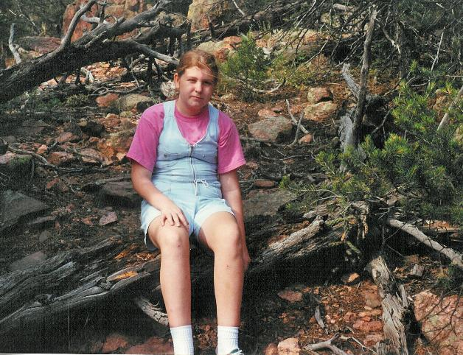
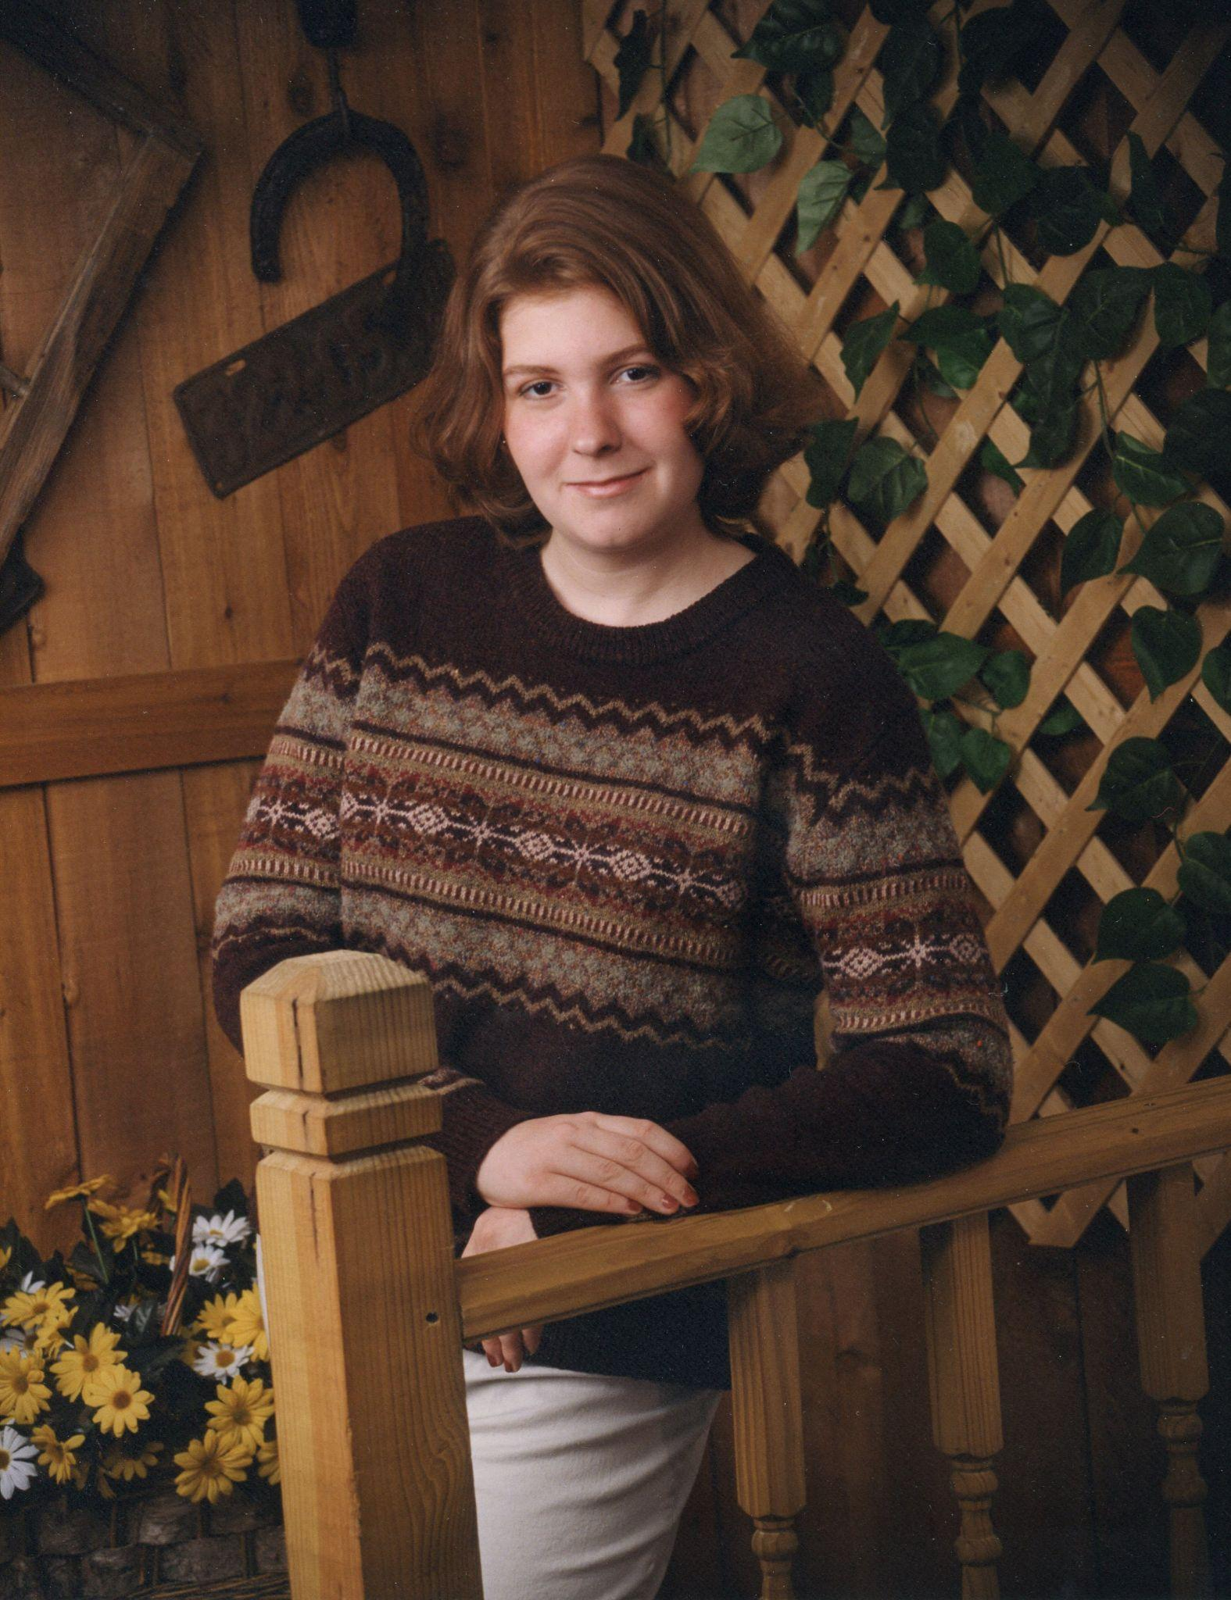
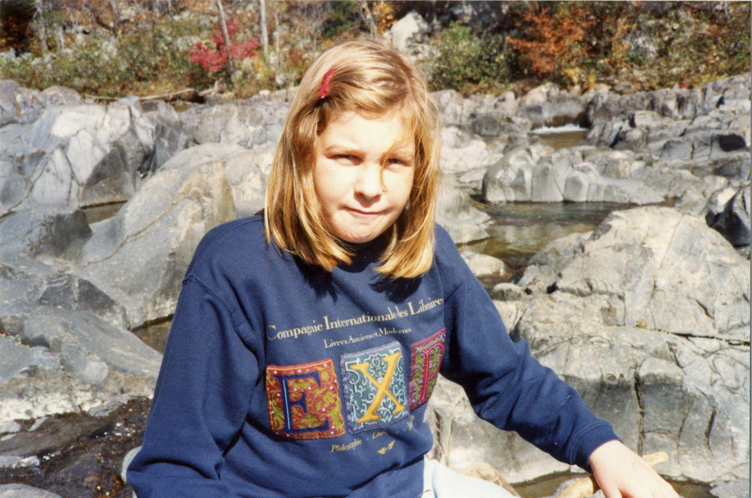
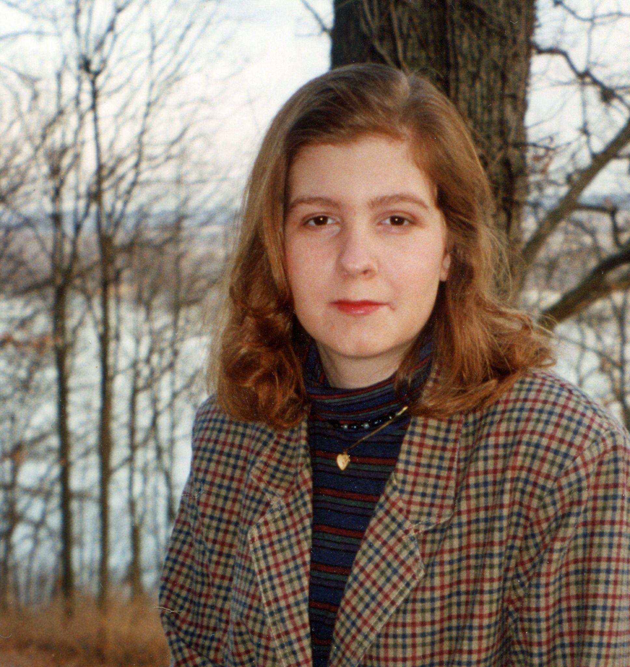
High School Photos

Slide 14
High School
I felt that I was not prepared to go to high school because my middle school SSD teachers didn't prepare me sufficiently.
In high school, I was in general education classes as well as CWC (Class within a class) classes.
I was pulled out of class to get support for resource and SLP services
Notes:
I did not advocate for my educational needs until I was a junior in high school
In an English (CWC class) I had a speech and language special education teacher bring me out of my shell and she helped me start advocating for myself
I do not know where I would be today without all of her support
I had a school guidance counselor tell me that I should not go to college and that I should just get a job as a child care worker.
I did not want to do that, so I then had an amazing resource teacher who supported me with going to college and with the transition.

Slide 15
High School
I did not advocate for my educational needs until I was a junior in high school.
In an English (CWC class) I had a speech and language special education teacher bring me out of my shell and she helped me start advocating for myself
I do not know where I would be today without all of her support.
I had a school guidance counselor tell me that I should not go to college and that I should just get a job as a child care worker. I did not want to do that.
Thankfully I had an amazing resource teacher who supported me with going to college and all that is involved with that transition.

Slide 16
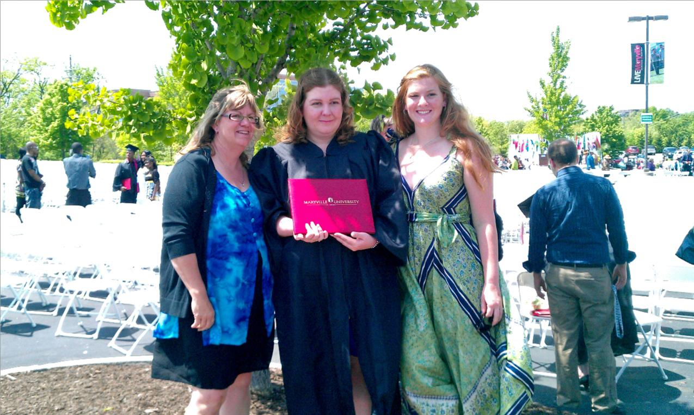
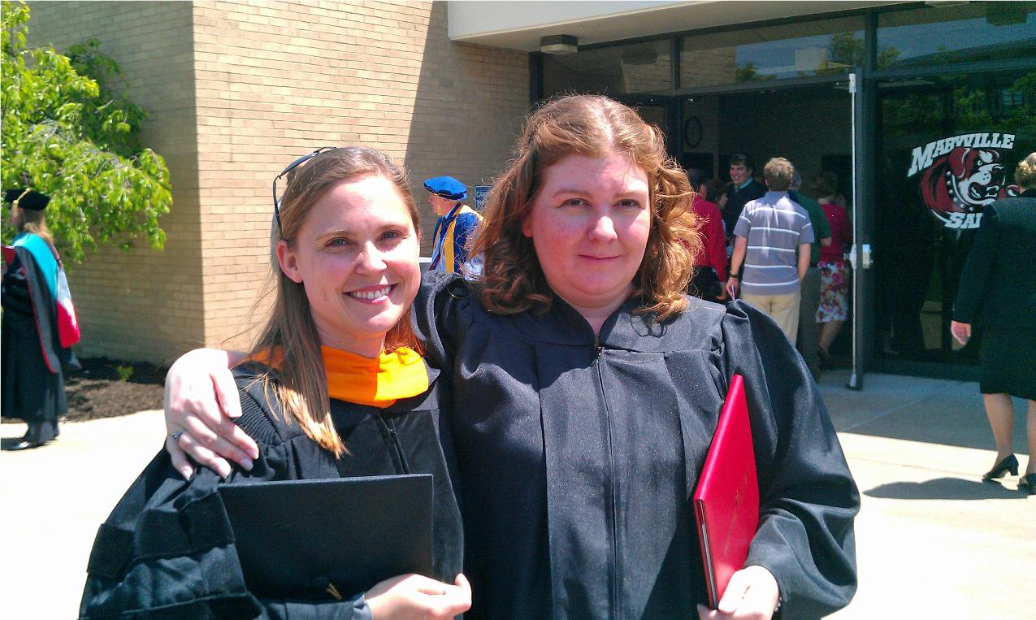
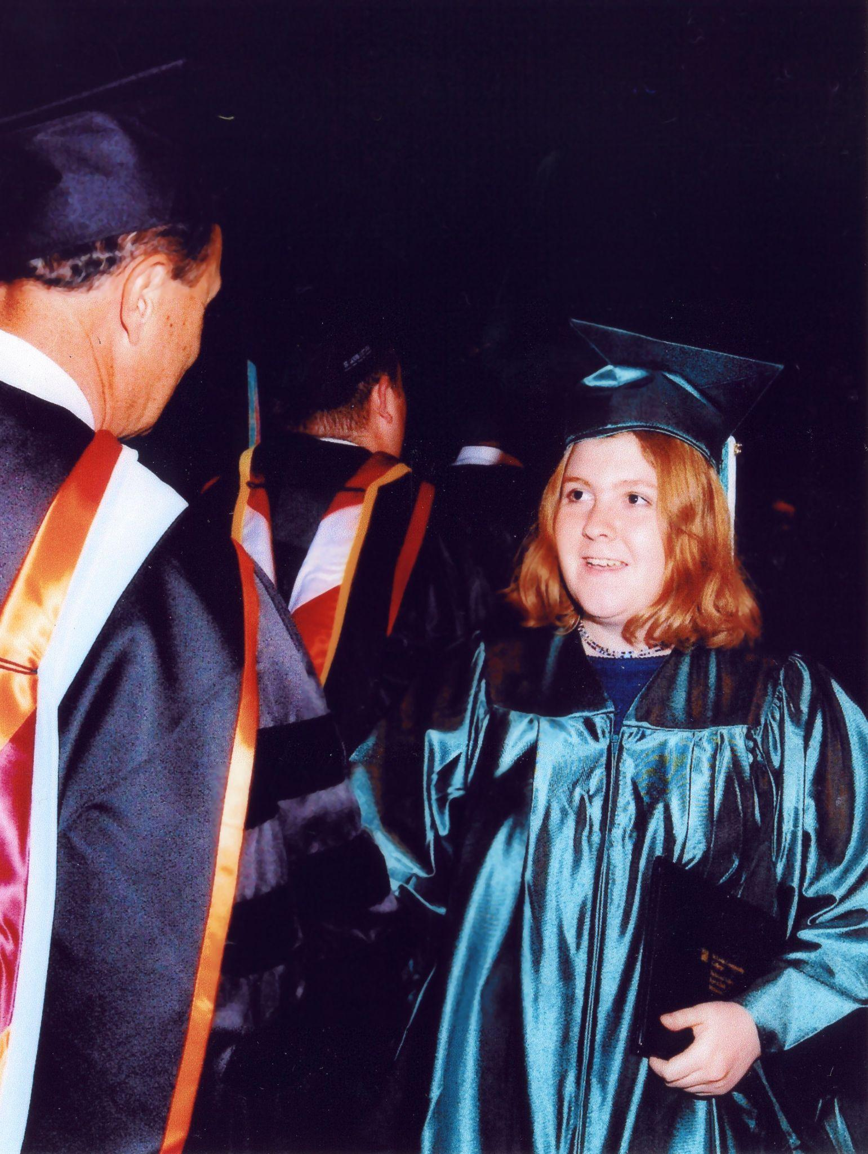
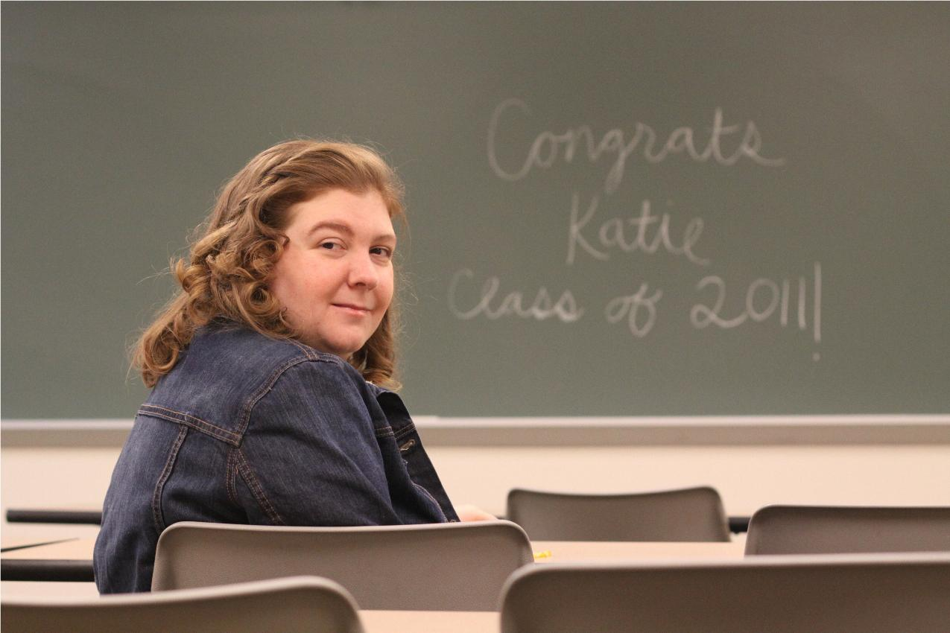
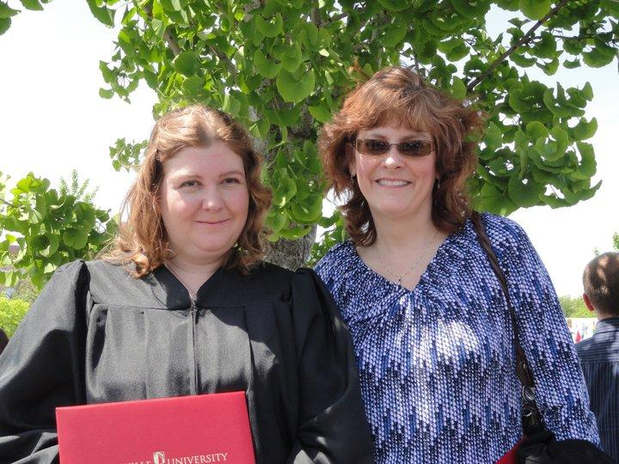
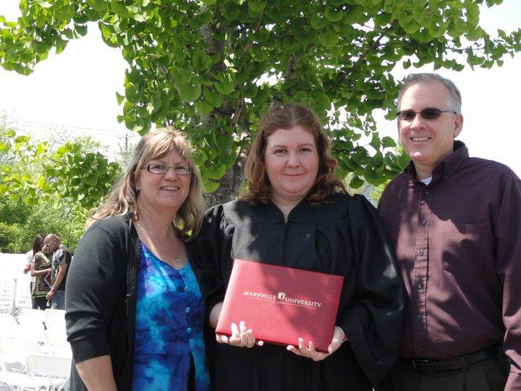
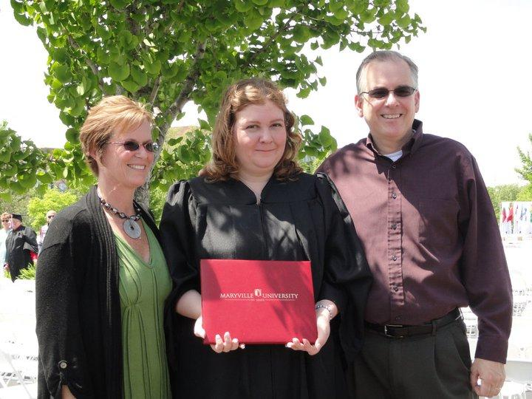
College Photos

Slide 17
College
Summer of 1999 I attended local community college
Fall of 1999 I took three classes instead of the full 12 hours
I completed an associate degree in Early Childhood Education
I took classes that would transfer to a four year university
I had family and friends who supported me with my college classes.
Notes:
I started college at a local community college summer of 1999. I took one class to help make the transition smooth
Then in the fall of 1999 I took three classes instead of the full 12 hours
I completed an associates degree in Early Childhood Education
Then I decided I was not finished with college so I took classes that would transfer to a four year university
Those classes were some of my hardest classes
I had family and friends who supported me with my college classes.

Slide 18
College
I had some professors, Vocational Rehabilitation counselor, who did not believe in me.
I had two disability office counselors who supported me the best that they could until I finally found a counselor who really understood me.
I finished my transfer classes in spring semester of 2008.
I decided to attend Maryville University and get a degree in Rehabilitation Services--Independent Living track.
Notes:
I had some professors who did not believe in me as well as other people, like my Vocational Rehabilitation counselor. I remember times when it felt like no one believed in me, not even myself. My parents even felt that I was not college material because I would not be able to read body language to help other people in the career I chose.
I had two access office counselors that supported me the best that they could until I finally found a counselor that really understood me.
I finished my transferring classes in spring semester of 2008. During that semester my access office counselor and I looked at local colleges and undergraduate programs that would be best for me.
I then finally decided to attend Maryville University and get a degree in Rehabilitation Services--Independent living
I did get support through the disability services office at Maryville for one year
until I decided that my college professors would be more helpful.
I also receive support from my access office counselor at Meramec while attending classes at Maryville University.
I then graduated with a Bachelors of Science degree in Rehabilitation Services--Independent Living track in the spring of 2011. When I graduated I felt that look what I just did! I just proved everyone wrong! And I reached my goal and followed my dreams!

Slide 19
College
I then started taking classes at Maryville Fall of 2008.
I did get support through the disability services office at Maryville for one year.
until I decided that my college professors would be more helpful.
I also receive support from my access office counselor at Meramec while attending
classes at Maryville University.
I then graduated with a Bachelor of Science in Rehabilitation Services–
Independent Living Track in the spring of 2011.
When I graduated I felt that look what I just did I followed my dream and reached my
goal! And I proved everyone wrong!

Slide 20
Life After College
I looked for a full-time job in my career field. I originally had an interview for a day program assistant. The people who interviewed me thought I was not qualified for that position so they decided to offer me a restroom monitor position.
I contacted Special School District to see if they had any ABA paraprofessional job openings.
The year I got hired back at SSD, ABA therapists/paraprofessionals got full-time benefits and health insurance.
I am glad that I advocated for myself and found the right career for me.
Notes:
I looked for a full-time job in my career field. In May of 2011 I got a full-time job working at UCP (United Cerebral Palsy Heartland) as a Restroom monitor (not sure exact job title). I originally had an interview for a day program assistant. The people who interviewed me thought I was not qualified for that position so they decided to still hire me for a restroom monitor position.
I only lasted two months at that job. I then advocated for myself and decided to call Special School District to see if they had any ABA paraprofessional job openings. And sure enough they did and I got hired back.
The year I got hired back they made sure all ABA therapists/paraprofessionals got full-time benefits and health insurance.

Slide 21
Work Life
After high school I worked at the Early Childhood Education Center as a teacher’s assistant
Then in the early 2000’s I was asked to be a special needs assistant
I looked into getting a job as a teacher’s assistant for SSD; substitute for SSD while in college classes
I worked as an ABA part-time therapist
I have been working for SSD for 16 years
I worked at other social service agencies
Notes:
After high school I started working at an Early Childhood Education Center as a teacher assistant working in the preschool classrooms
Then in the early 2000’s I was asked to be a special needs assistant and help support a child with Autism in the before and after care program. When I was asked to be a special needs assistant I was never told the child’s diagnosis so I had to find out the hard way. Then that job led me to the job I have today.
I then looked into getting a job as a teacher’s assistant for SSD and went through an interview but got denied the job. I received a letter in the mail stating I did not get the job as a teacher’s assistant. I felt very sad that I would not be able to help support students with disabilities.
Then I decided to be a substitute for SSD while I was taking college classes and worked on my days off of school
2005 I then applied for a part-time ABA implementer position and I got the job
I then continued working for SSD as I was completing college
I have been working for SSD for 16 years
I also worked for several other disability agencies in the St. Louis area part-time during my summers off SSD and as a second job
I also worked as a respite provider for Easter Seals Midwest supporting children and families with autism

Slide 22
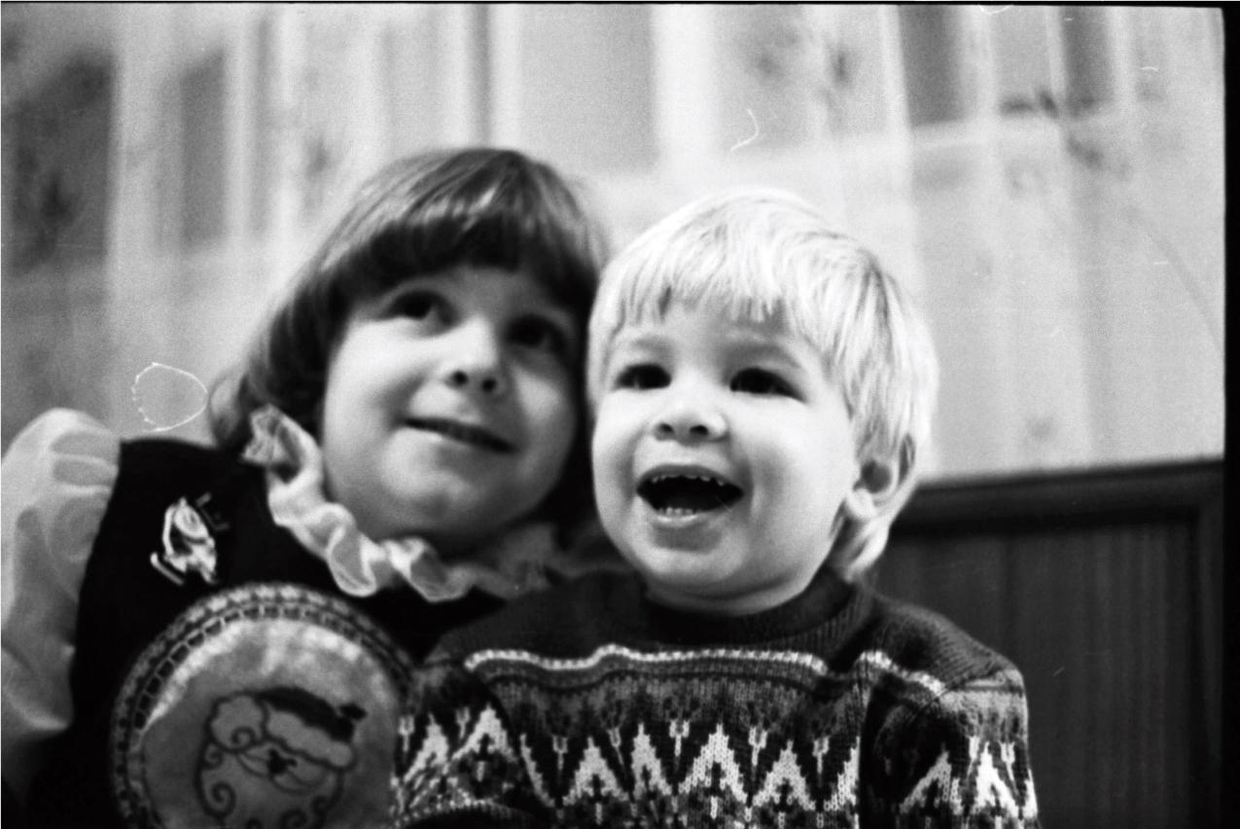
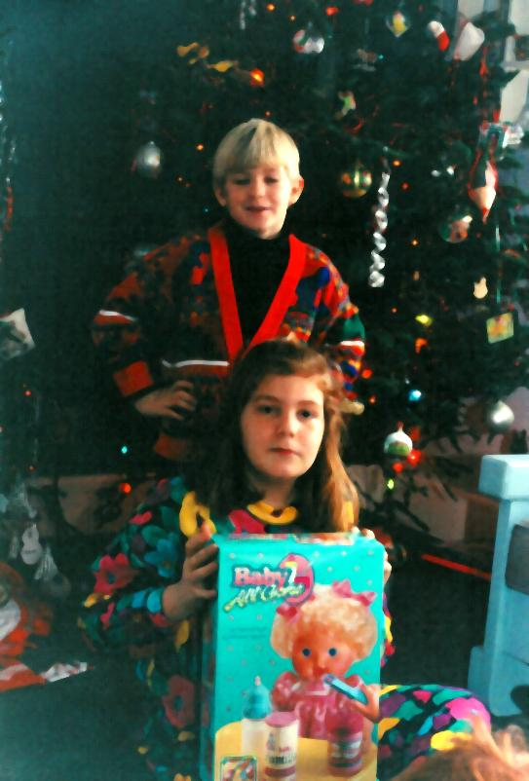
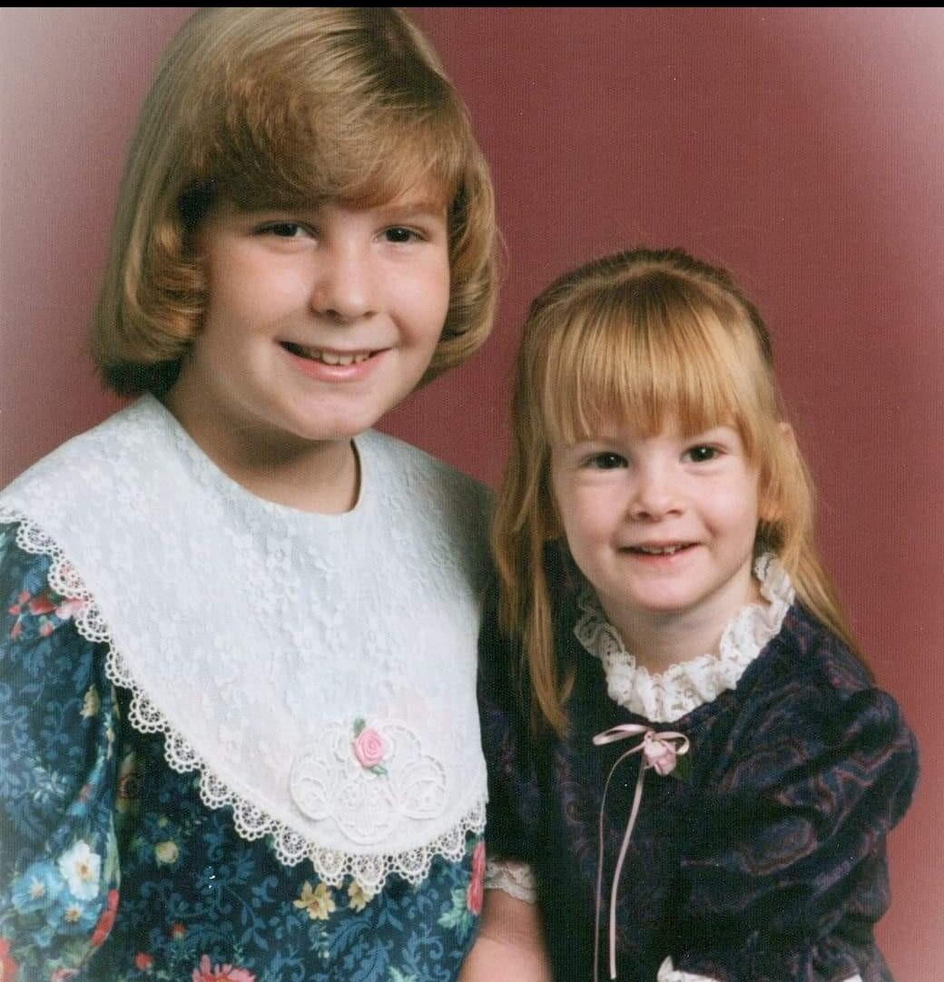
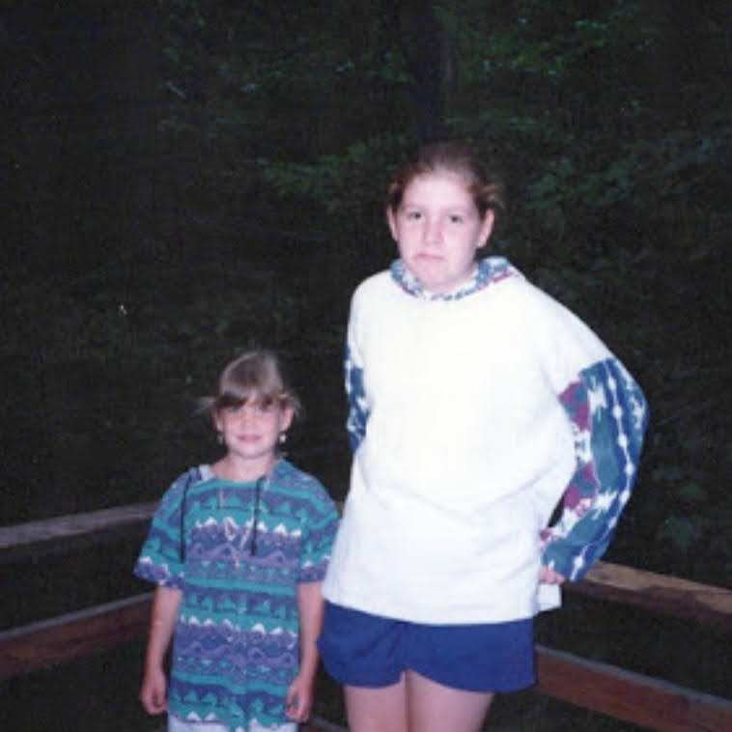
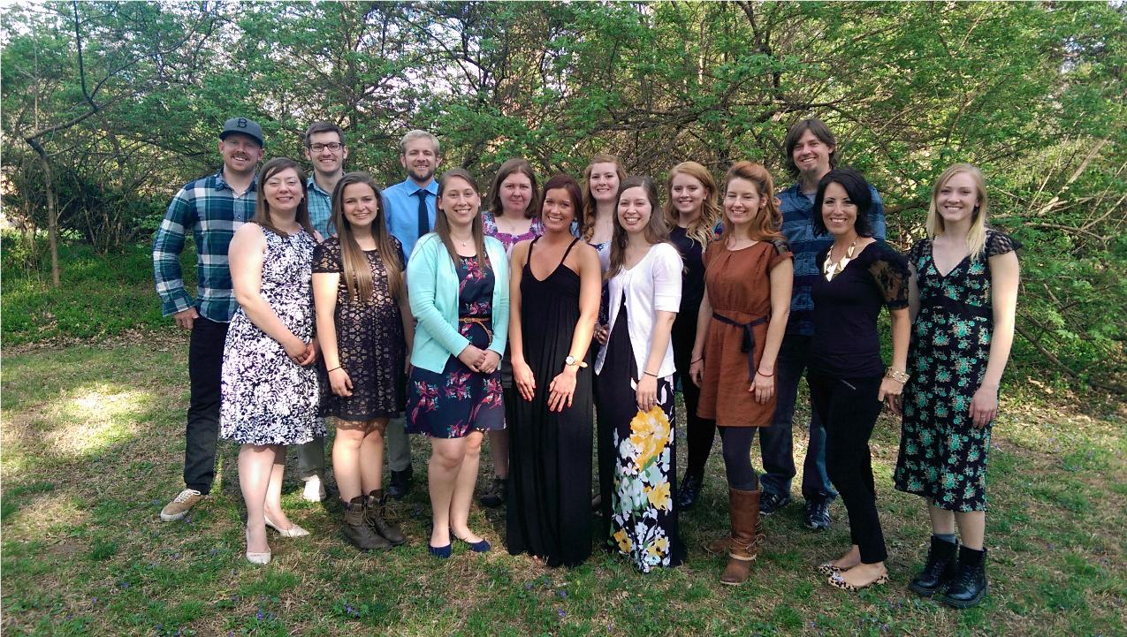
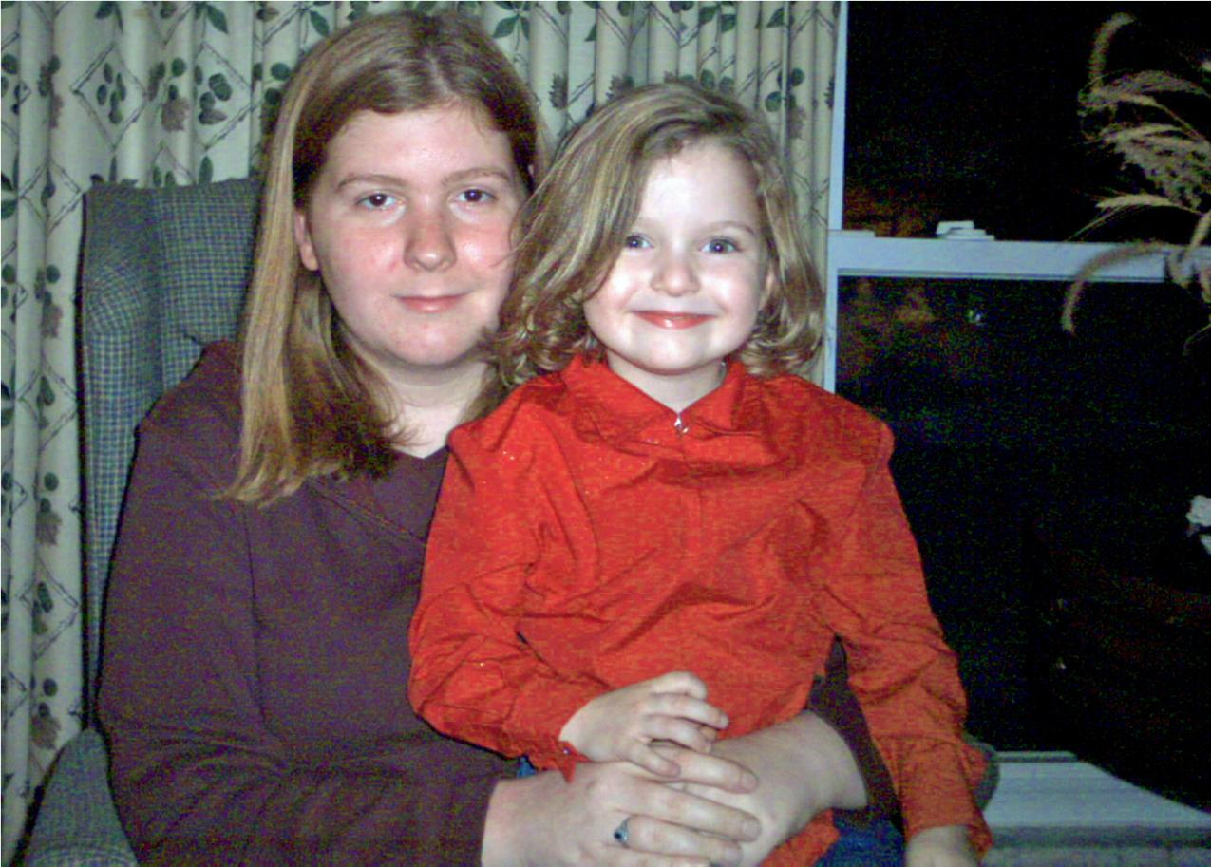
Family Photos

Slide 23
Friends and Family
It was difficult for me to make friends during preschool
My friends are people with disabilities because we understand each other
My friend group has grown since high school
I plan 1:1 outings with my friends for their birthday presents
I don’t think that anyone ever imagined that I would get married, own a house, own a car and adopt two silly dachshunds for whom I also advocate for.
Notes:
It was difficult for me to make friends during preschool since I was non-verbal and kept to myself. My only friends in preschool were my brother Alan and my cousins. My only true friend was my Cabbage Patch Doll Faye Ronnie until I met my first friend in KDG and we are still friends today.
I then continued to make friends throughout my education some I have lost touch with. Mainly my friends are people with disabilities because we understand each other.
My friend group has grown since high school. We hang out to celebrate birthdays and Christmas. I also hang out with my friends when my schedule permits.
The last few years I have been doing 1:1 outings with my friends for their birthday presents instead of giving them tangible items. Memories mean more to me than tangible gifts.
No one believed that I would get married, own a house, own a car and adopt two silly dachsunds.

Slide 24
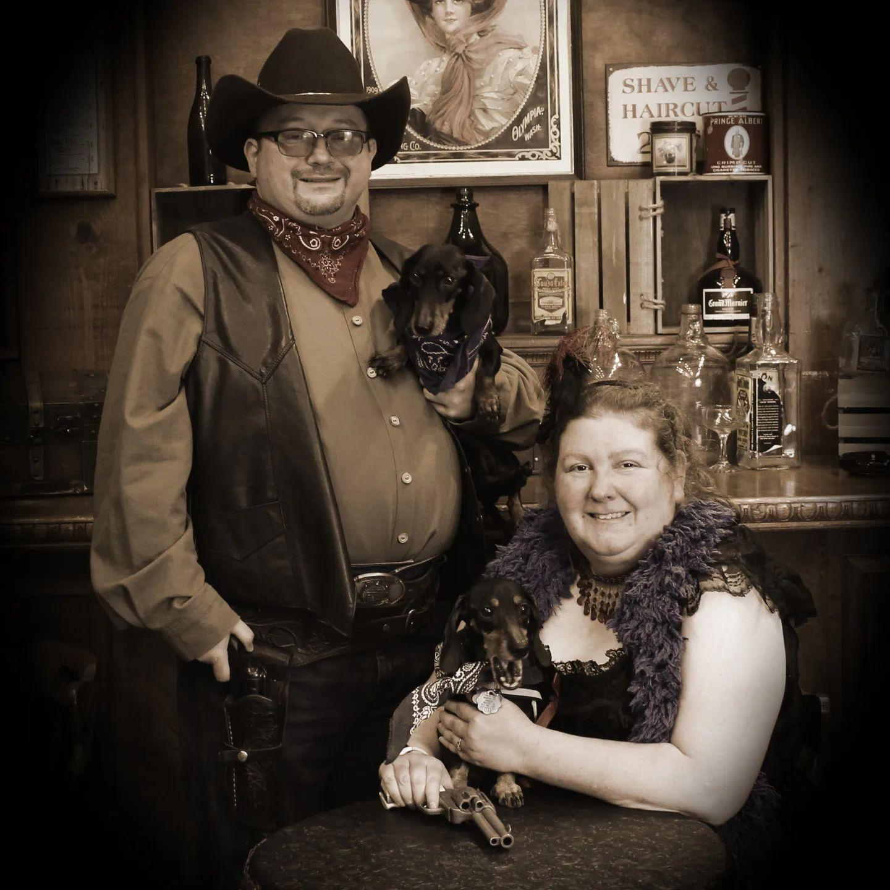
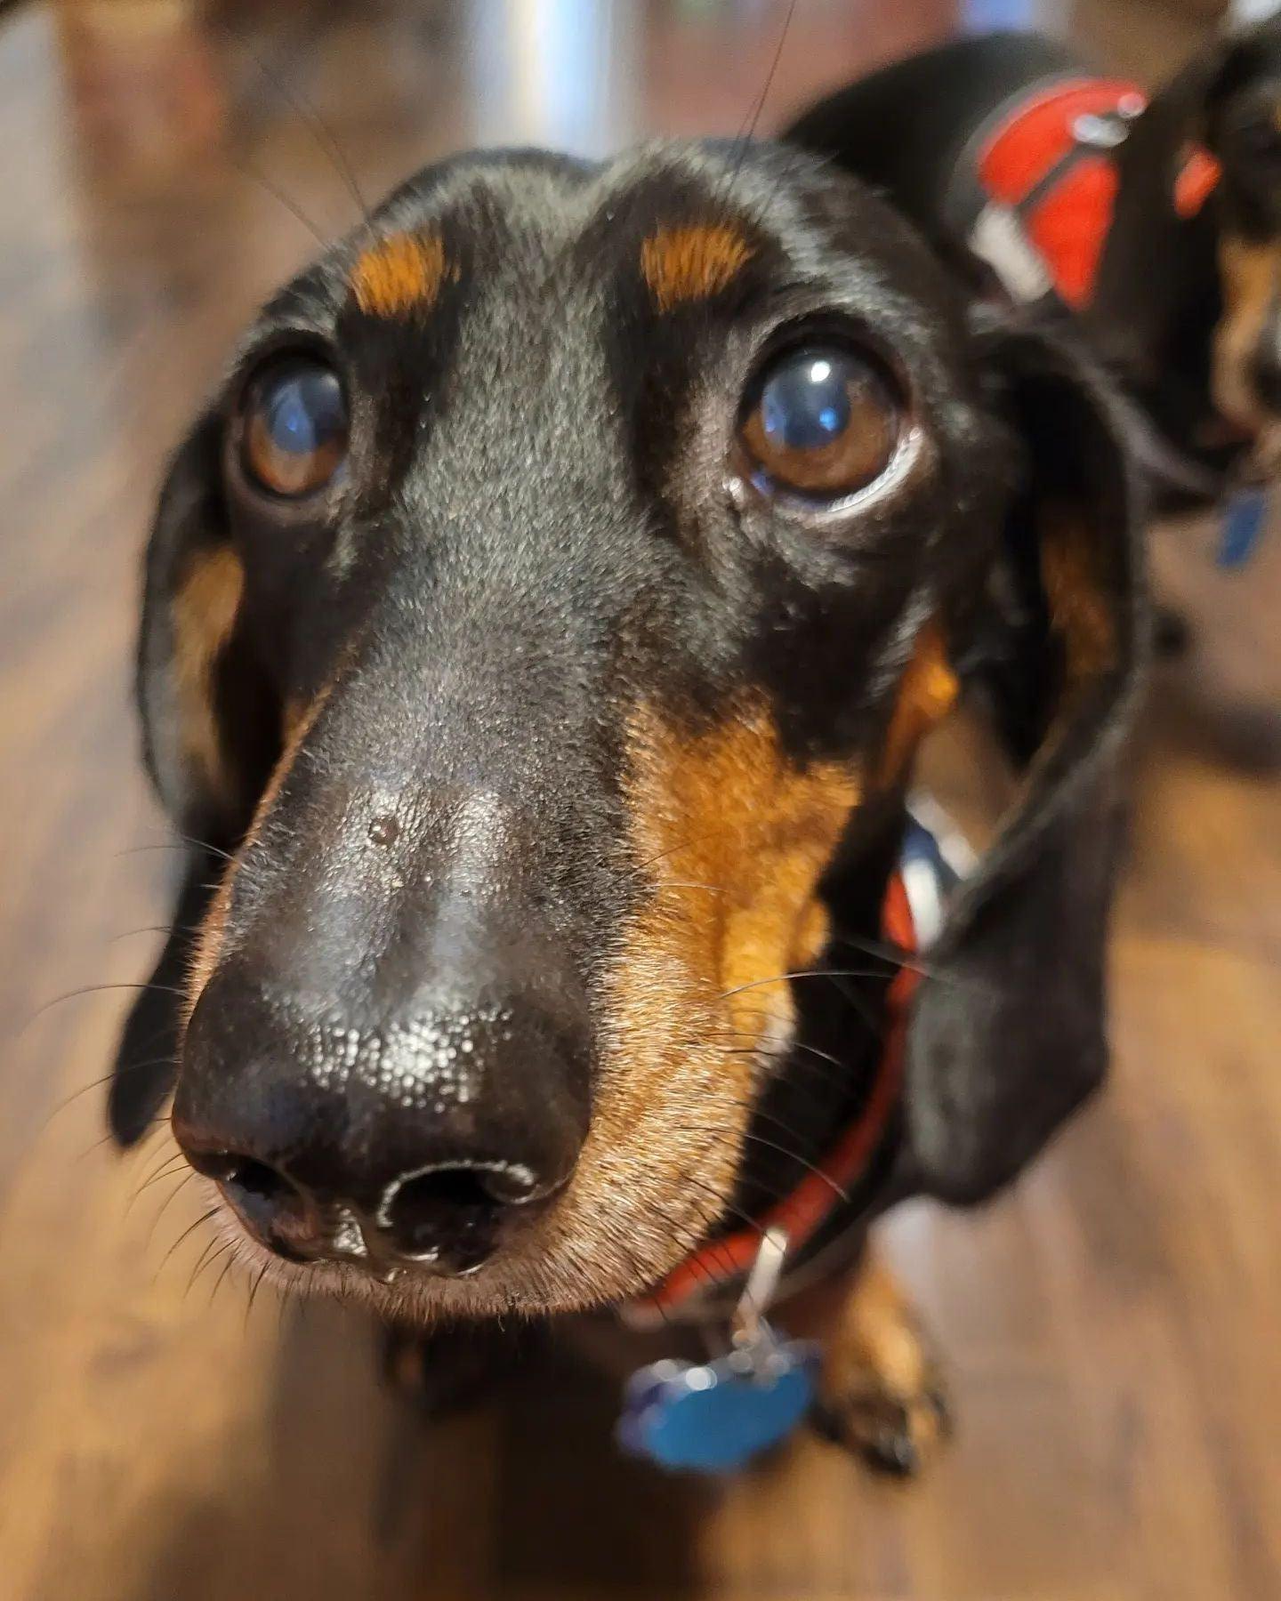
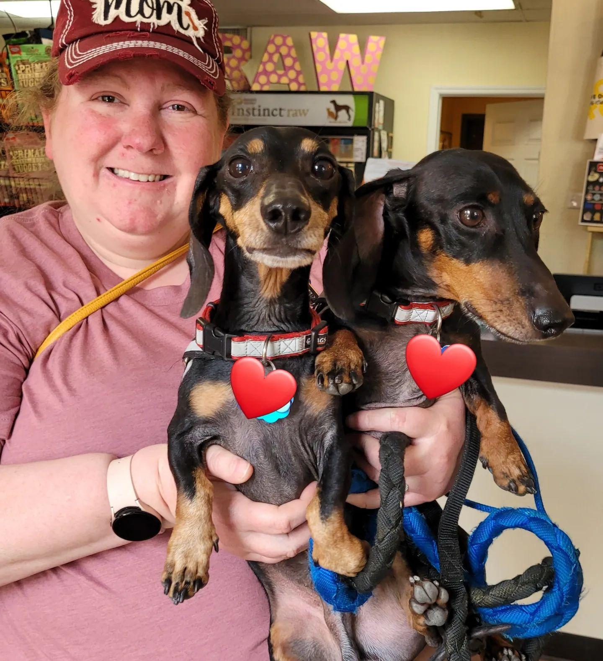
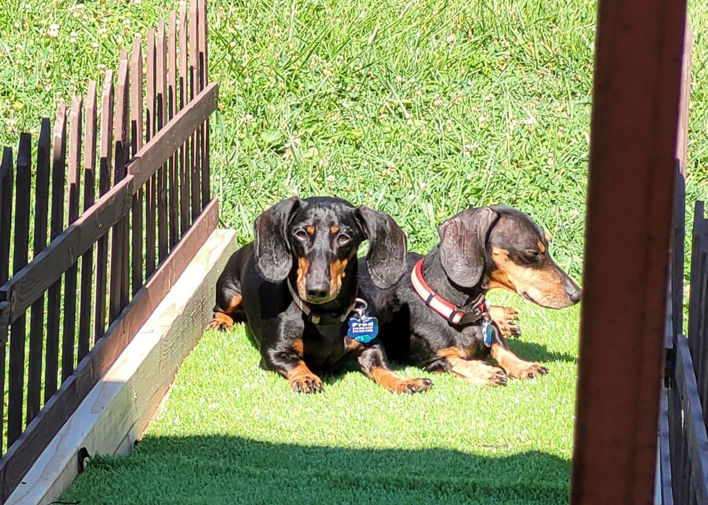
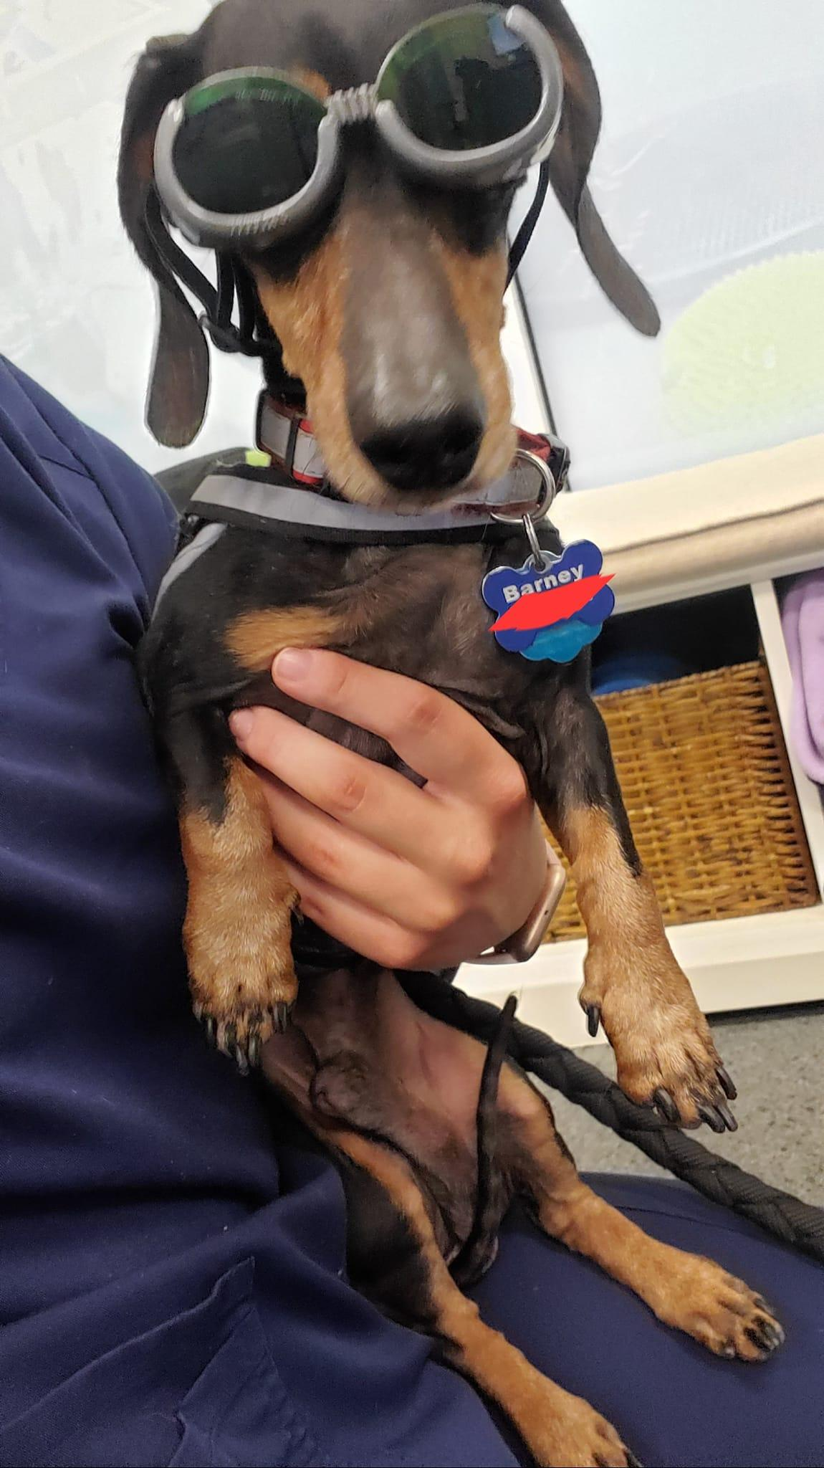
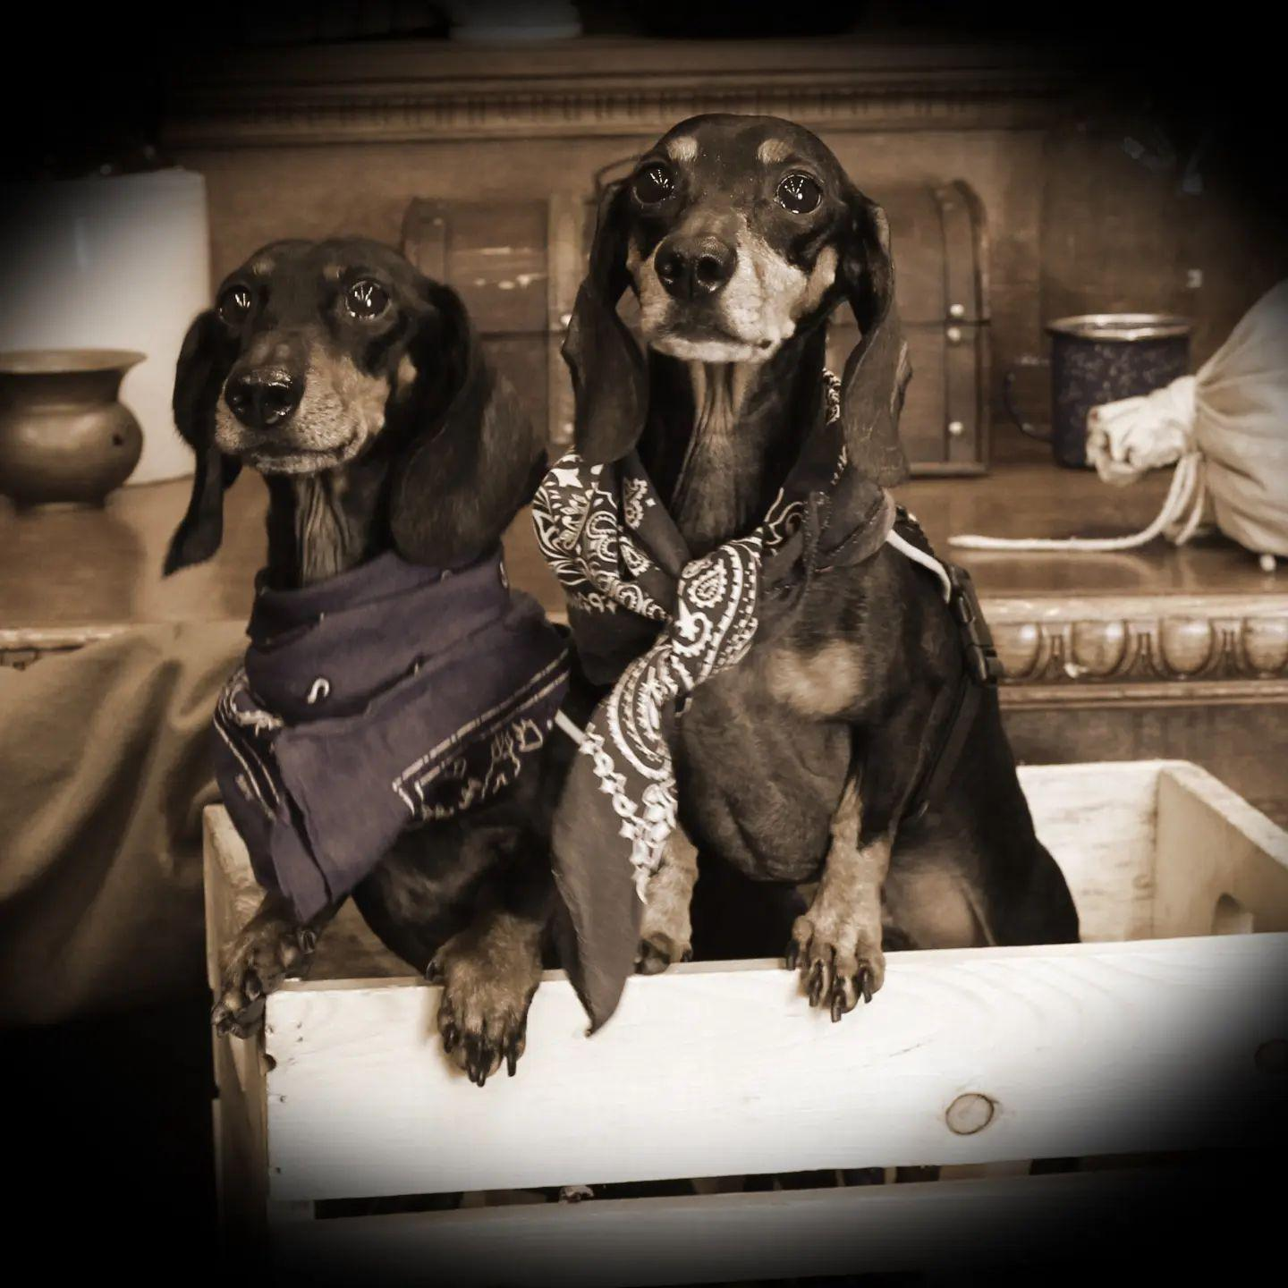
Many Adventures of Barney and Fred

Slide 25
Helping my friends and others learn to be an advocate
Developing my social group of friends who also have disabilities has helped me learn how to advocate for myself and others.
Before we can self-advocate, we must be aware of our own feelings and dreams for the future.
Before we can advocate for others, we must learn of their feelings and dreams for the future.

Slide 26
Helping my friends and others learn to be an advocate
It’s natural for me to ask my friends about their hopes and dreams and to figure out ways that I can help them achieve some of the things they want out of life.
As friendships grow and we become more aware of what we want and how to make it happen, we are better able to plan and participate in group activities that help us advocate for one another.
Sharing activities like dinners, concerts, and even road trips helps us learn more about one another’s hopes and dreams and also we can meet some of our goals together.

Slide 27
Helping my friends and others learn to be an advocate
My friends and I encourage one another to work for goals like getting more education, a driver’s license, finding jobs that suit us, or just trying something new.
The 1:1 birthday celebrations with my friends are a special way to celebrate their uniqueness and support their accomplishments.

Slide 28
Helping my friends and others learn to be an advocate
Everything that has happened in my friend group over the years has helped me learn to advocate for myself and others.
I use the same process to advocate for the people I work with.
I get to know them and learn about their hopes and dreams.
I spend time helping them set goals to improve their lives and identify the steps to take to meet their goals.
It feels good to pass on to others what I’ve learned and see them set and achieve their own goals.

Slide 29
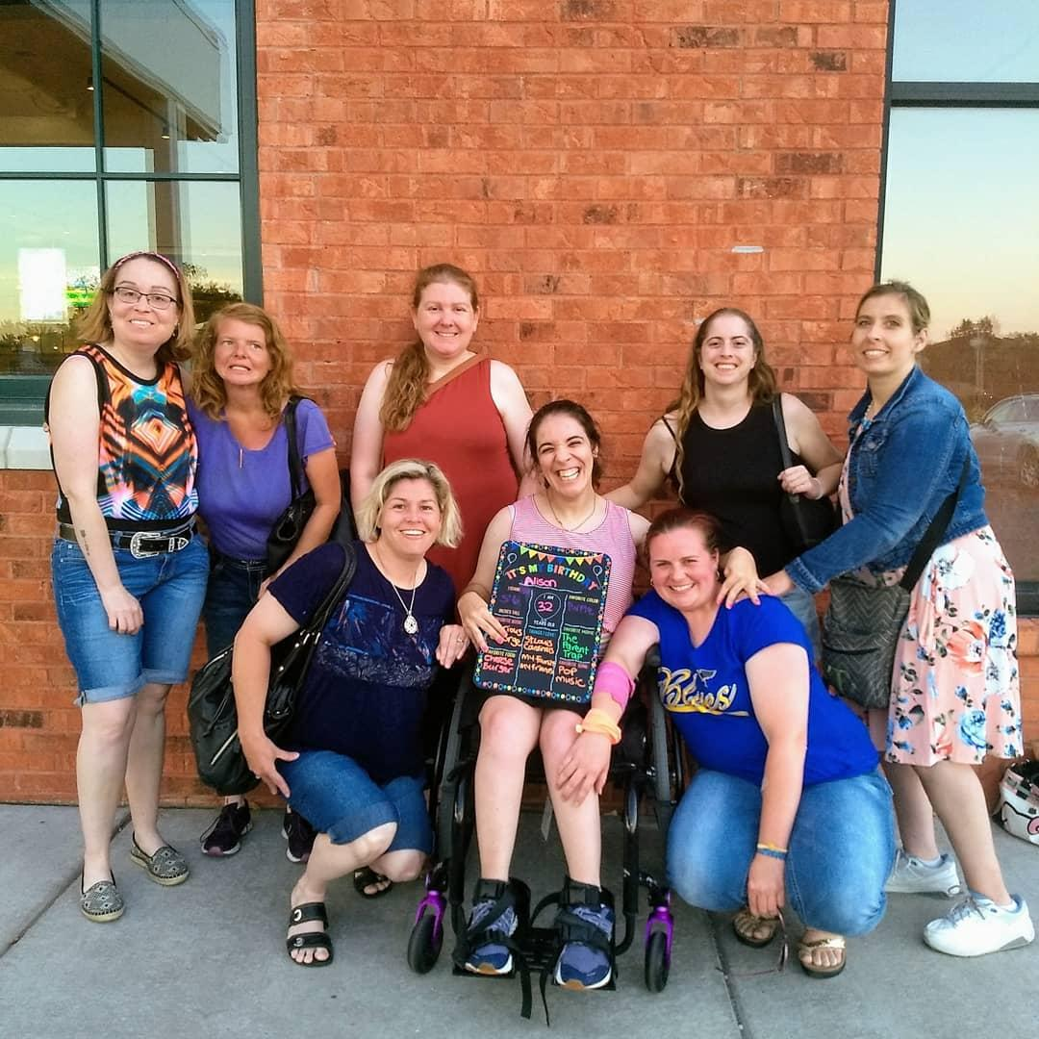
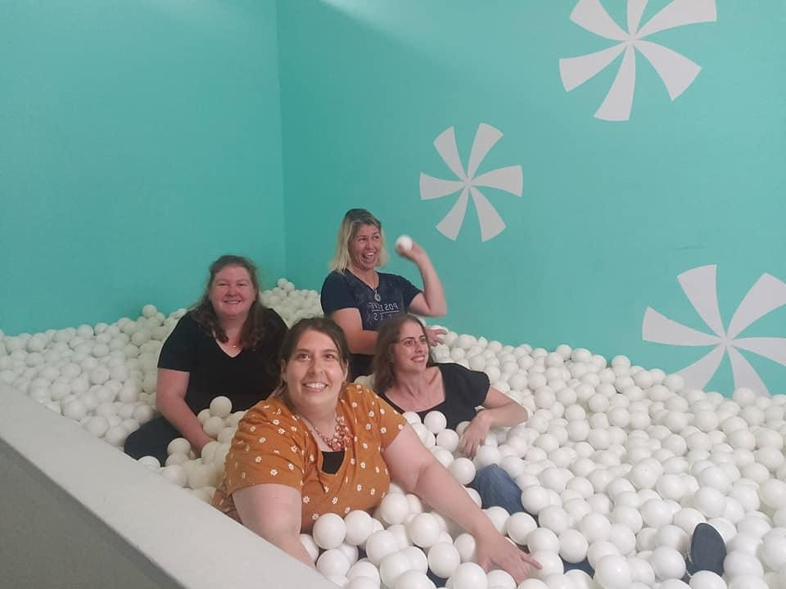
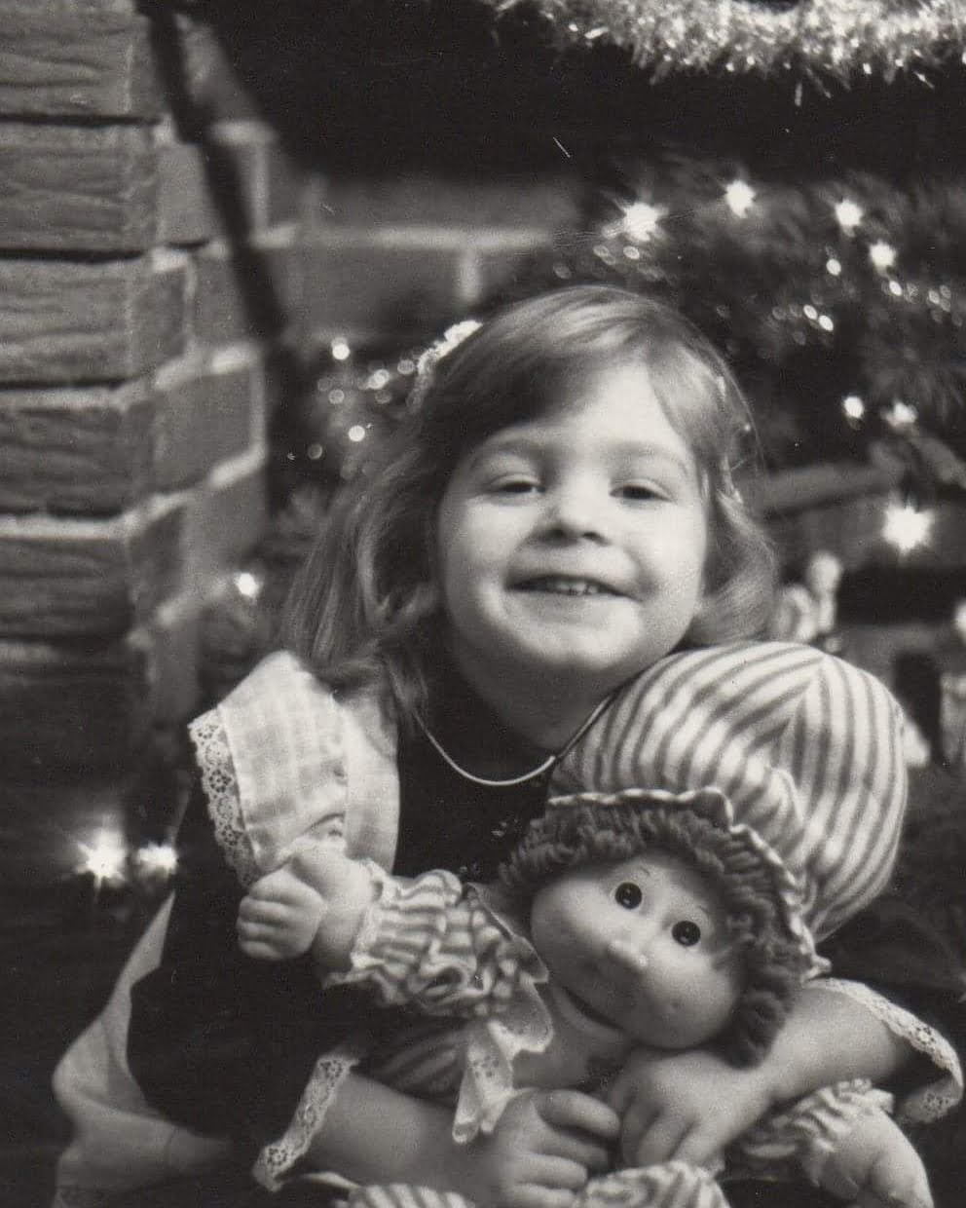
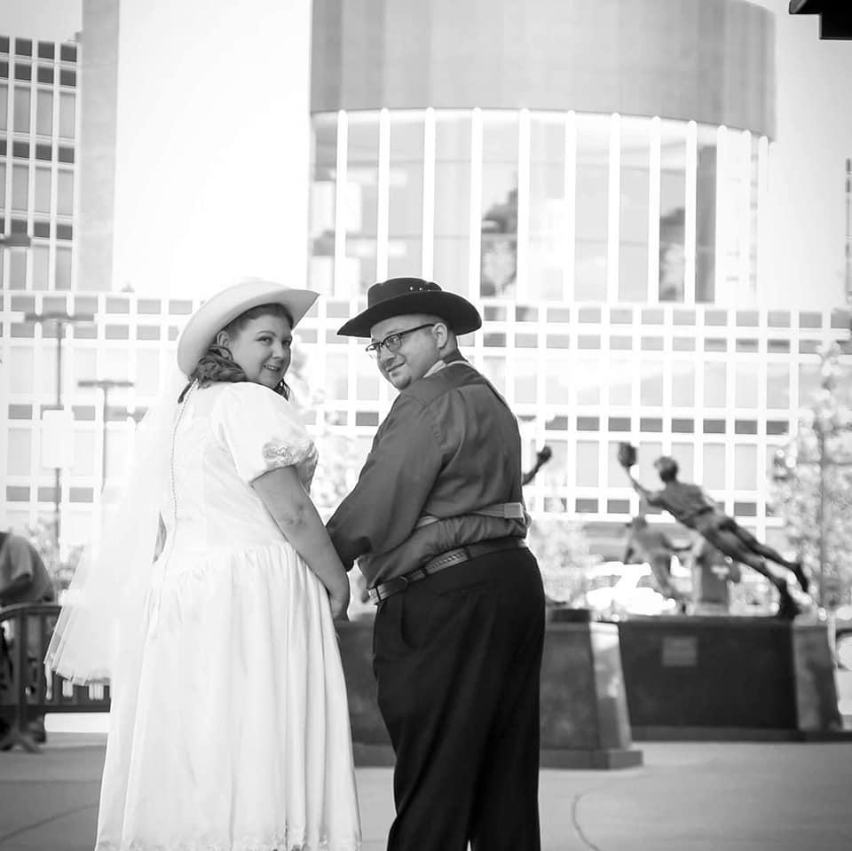
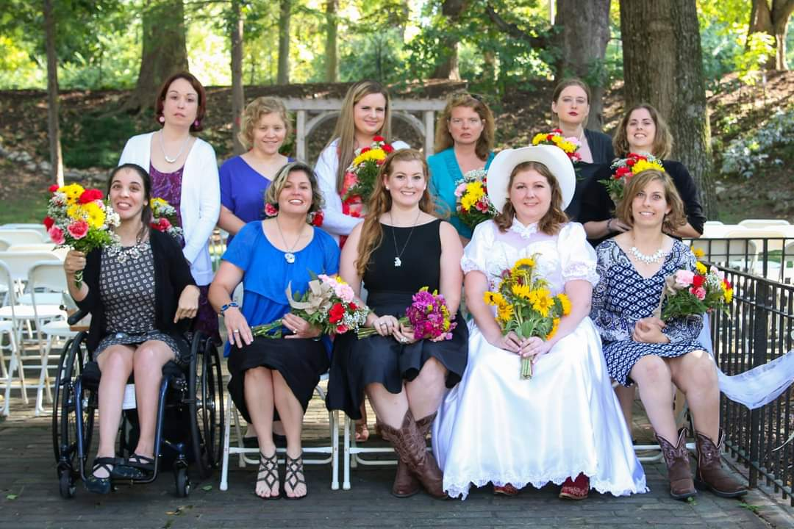
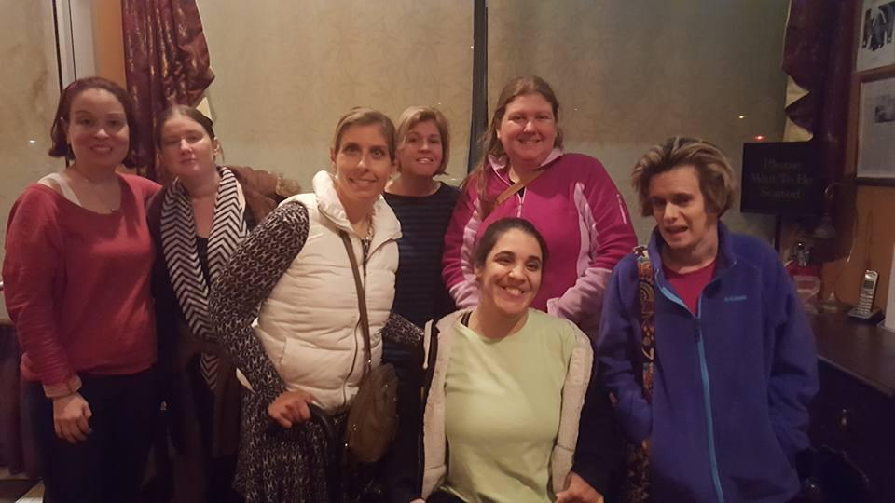
Friend Photos

Slide 30
Sharing my Story to the World
August of 2016 “The Mighty” was asking people to share stories about their college experiences
After my story was posted online; my story was shared to other social media pages
Decided to write a book about my life because there are not too many memoirs about people who live with a language impairment and learning disabilities.
Shared my story with “The Mighty” virtual presentation, “Love What Matters”, and Disability Pride PA. I was interviewed by an organization called Different & Able. I recently shared my story at The Silver State Advocacy Conference–Nevada Governor’s Council On Developmental Disabilities.
Notes:
August of 2016 I stumbled upon a blog site for people with disabilities called “The Mighty” they had a writing prompt asking people to share stories about their college experiences
Then I had to wait a few weeks for “The Mighty” to share my story
After my story was posted online I decided to share my story to other social media pages who I thought might like to share it
I then got a great response back from everyone who read my story so I decided to write a book about my life
No one ever thought I would write a book about my life that people all over the world could read! I am writing a book because there is not too many memoirs out there about people who live with a language impairment and learning disabilities.I also want to acknowledge all of the people who helped get me where I am today. I appreciate being in a position where I can help people realize their own dreams!
Then the past two years I shared my story with “The Mighty” virtual presentation, “Love What Matters”, Disability Pride PA and was interviewed by an organization called Different & Able
I then got a great response back from everyone who read my story so I decided to write a book about my life
No one ever thought I would write a book about my life that people all over the world could read! I am writing a book because there is not too many memoirs out there about people who live with a language impairment and learning disabilities.I also want to acknowledge all of the people who helped get me where I am today. I appreciate being in a position where I can help people realize their own dreams!
Then the past two years I shared my story with “The Mighty” virtual presentation, “Love What Matters”, Disability Pride PA and was interviewed by an organization called Different & Able

Slide 31
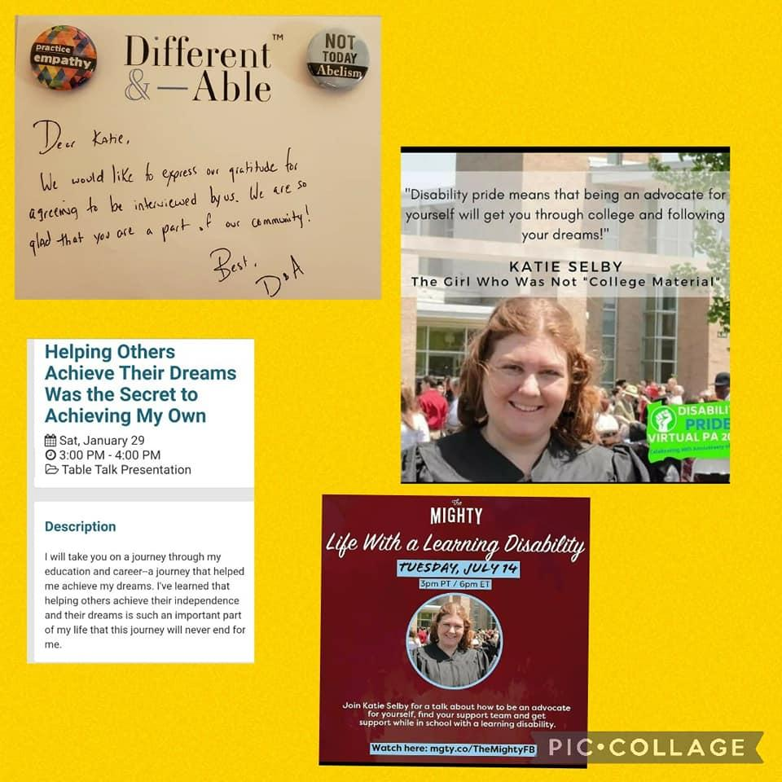
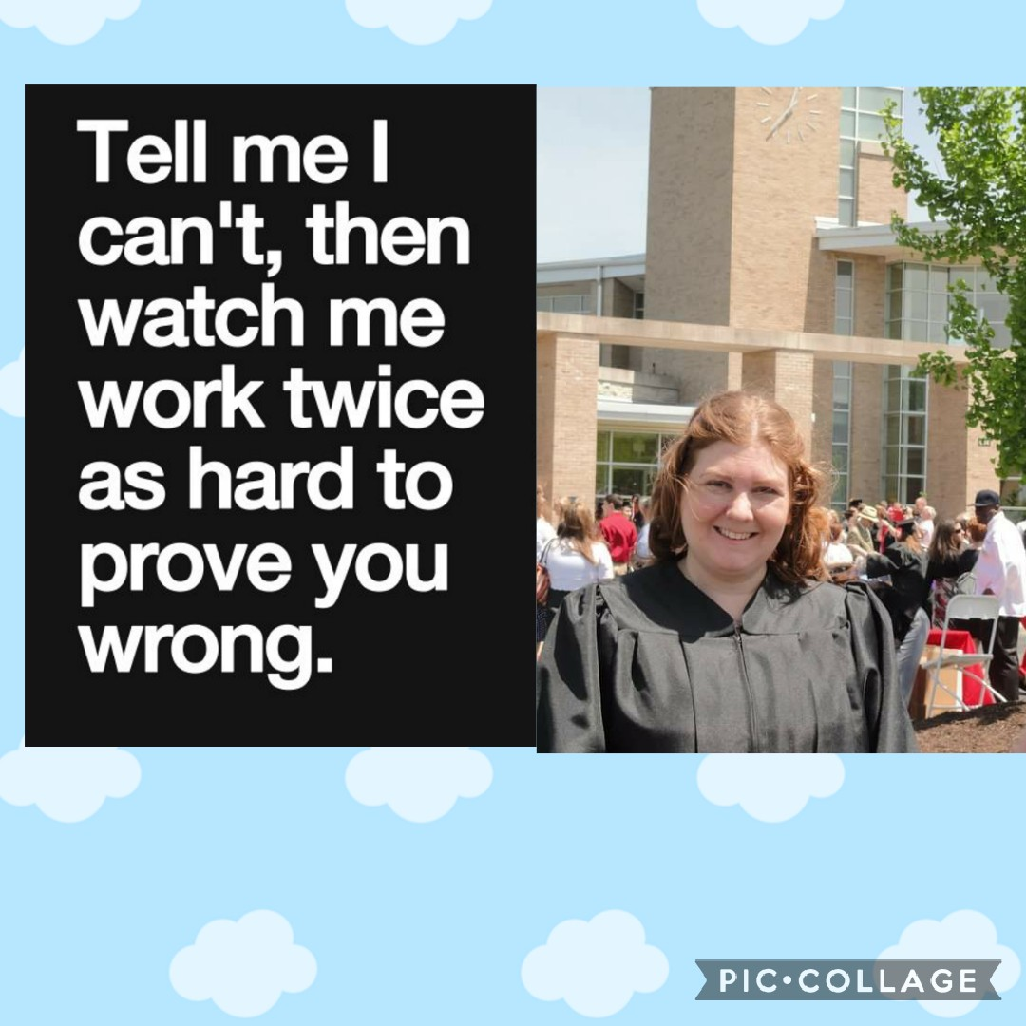
Sharing My Story to the World Photos

Slide 32
“What Disability Pride means to me!”
https://photos.app.goo.gl/ikQsDefFzKz8hkhs6
Love What Matters–Self-Advocacy video
https://youtu.be/-2O5G394zgA

Slide 33
Final Thoughts
I am thankful for being able to share my story with you today. I hope you can take away something from my life experiences to be able to support your students and children. I believe that you can help them realize that they, too, can reach their dreams by finding and utilizing support from their teachers, friends, and other people who cross their path. I know first-hand how important it is to teach self-advocacy skills at a young age. Being a self-advocate is a very important skill, maybe the most important of all, and it can take your children or students to the places they want and need to go.
For more information, questions and if you would like me to speak to your school or a group I can be reached at the following:
Email address: girlnotcollegmaterial@gmail.com
Facebook Page: The Girl Who Was Not "College Material"
Instagram Page: College Material Girl

