Slide 1
A TSC Advocacy Success Story

Slide 2
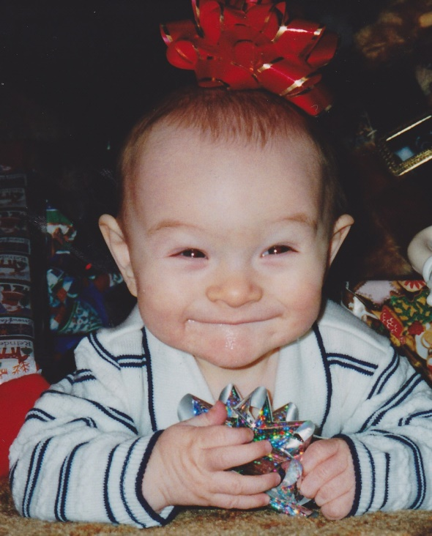
Jack Kingston at 6 months
Notes:
Thank you, Silver State Advocacy Confernece, for inviting me to speak with you all about a little known disease called Tuberous Sclerosis Complex.
I am excited and grateful to be here with you.
Tuberous Sclerosis Complex was our family’s devastating news.
When my son was born in 1998, the nurse doing his Agpar scores noticed an irregular heartbeat.
An ultrasound showed tumors in his heart.
The pediatric cardiologist let us know our son could have tuberous sclerosis complex.
A month later, an MRI showed tumors in his brain, confirming his diagnosis.

Slide 3
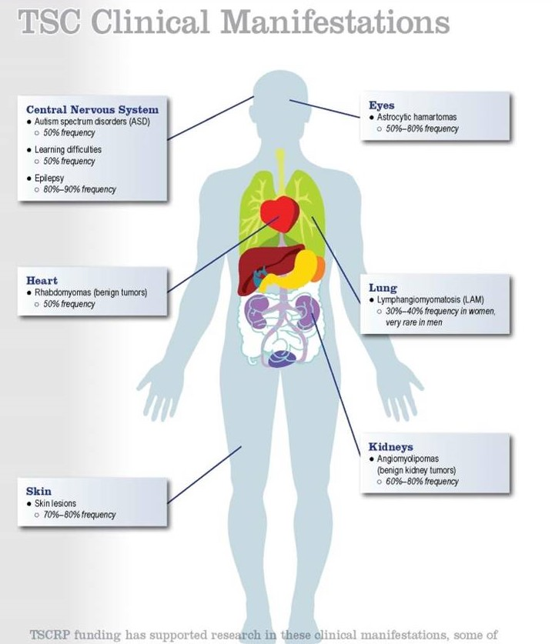
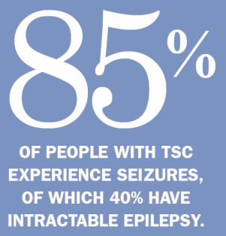
Tuberous Sclerosis Complex (TSC)
Notes:
Tuberous Sclerosis Complex, or TSC, is a genetic disease where cellular growth is not controlled, causing tumors to form in major organs, such as the brain, heart, skin, kidneys and lungs.
The tumors are not cancerous; however, they are quite mischievous. They frequently cause epilepsy, autism, cognitive impairment, and a host of other potential maladies including kidney, lung failure, and death.

Slide 4
TSC Family Conference – San Diego - 2001

Slide 5
Dedicated to finding a cure for tuberous sclerosis complex (TSC) while improving the lives of those affected.
www.TSCalliance.org
“Hope, No Matter How Complex.”
Four Mothers Began the TSC Alliance in 1974
Notes:
Shortly after Jack’s birth, his dad found the TS Alliance online. The TS Alliance began in 1974 with four mothers who received similar devastating news. Susan McBrine, a mom who is still active in the TS Alliance, sent a letter to Exceptional Parent magazine seeking other parents of children with TSC. Because they “Stepped Forward” and gathered others to build on what they started, I began my education. The mission of the TS Alliance is “to find a cure for TSC while improving the lives of those affected.”

Slide 6
Notes:
April Cooper, Will Cooper, Amelia and Abigail Cooper
Approximately a million people worldwide have TSC.
TSC affects each person differently.
A person can be so mildly affected they don’t know they have the disease
Or a person can be so severely affected that they have hundreds of seizures daily and need multiple brain surgeries to try to get the seizures under some kind of control.
Even though I consider my son to be moderately affected, his TSC has still resulted in him living in the group home due to aggressive outbursts that developed.

Slide 7
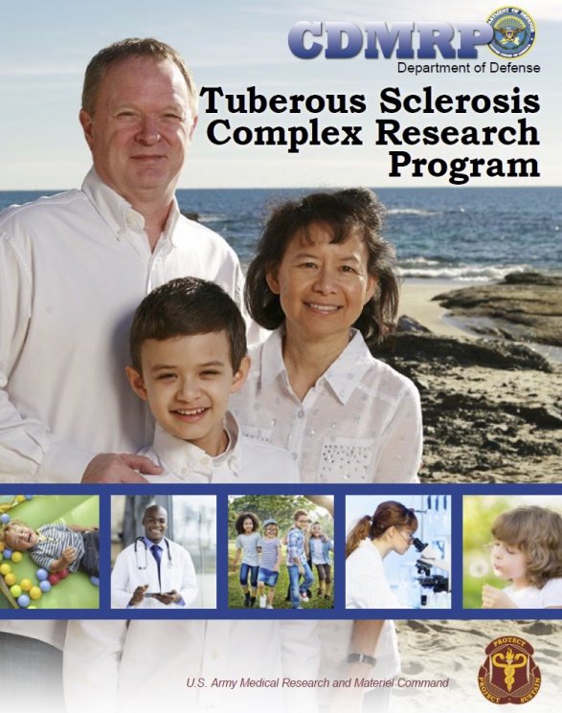
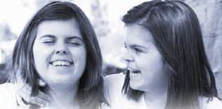
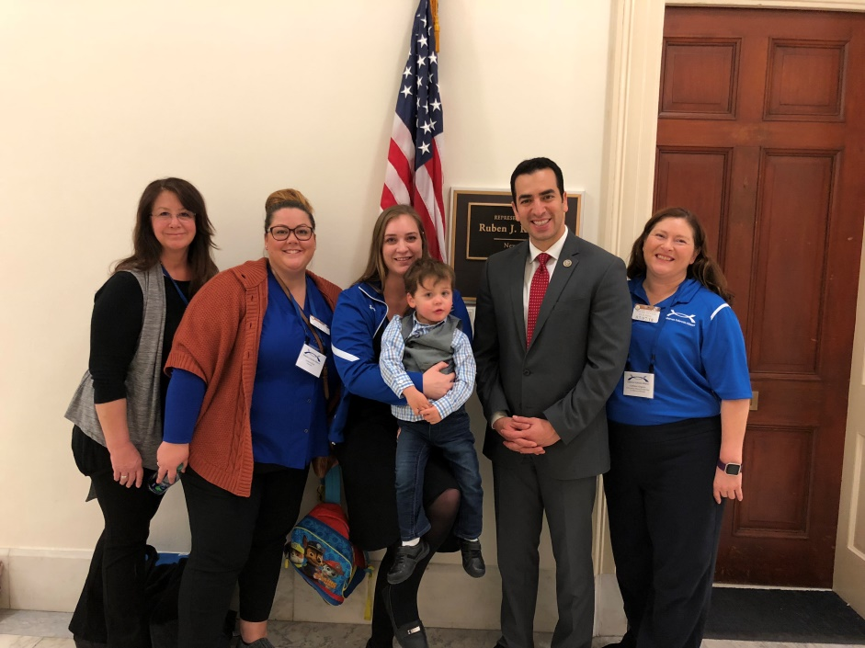
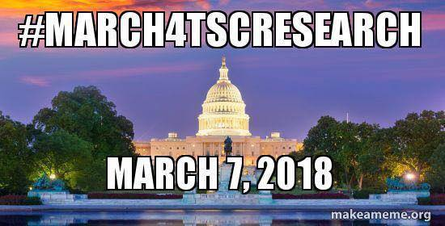
A Dedicated Grandfather
$1 Million appropriated in 2001
$97 Million total through 2021
Notes:
TS Alliance funds primarily collaborative projects and development of resources that are made available to any researcher
TSCRP funds smaller projects proposed by individual researchers
NIH can fund large research projects and clinical trials
NIH, TSCRP, and TS Alliance communicate often
Research funded by different organizations is non-overlapping
Information learned in the TSCRP studies can generate the large quantity of data needed so that the NIH can then begin larger studies of what we learn from the smaller studies

Slide 8
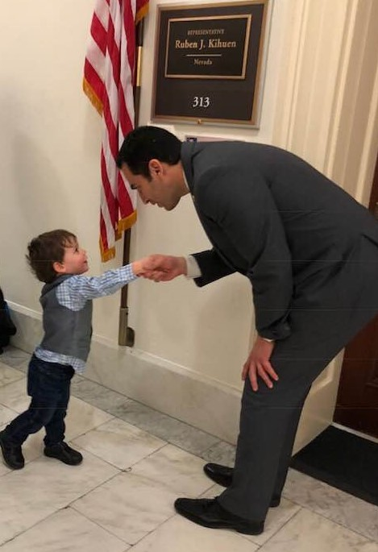
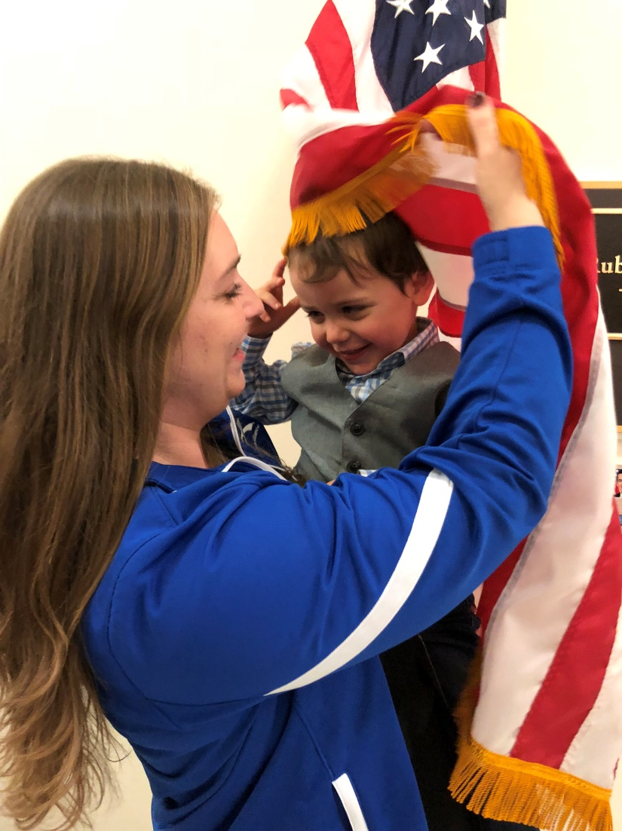
TSC Advocacy and Research - Helping Families
Billy, our youngest TSC Advocate at the annual March on the Hill in 2018

Slide 9
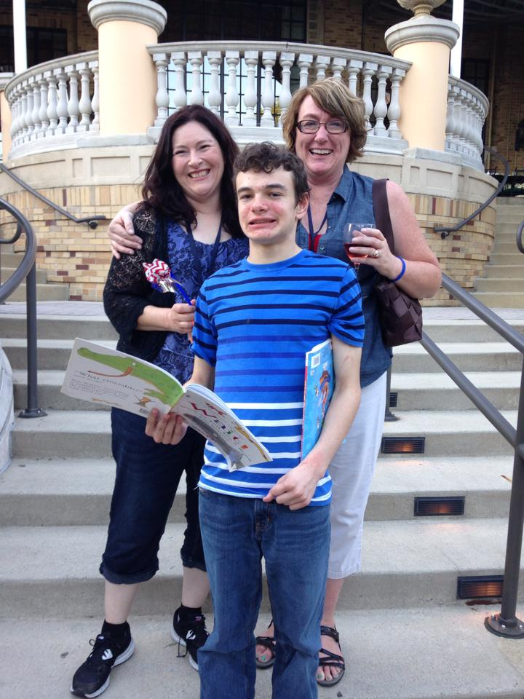
First World TSC Conference, July 2014!

Slide 10
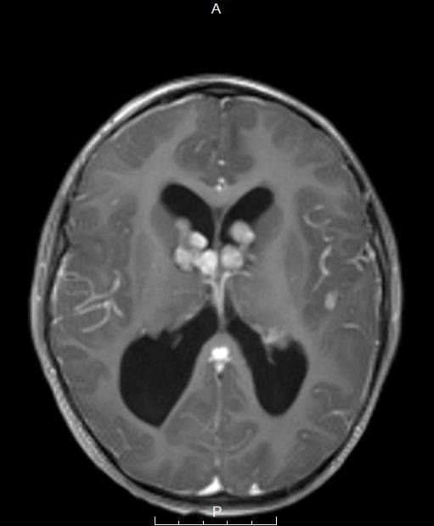
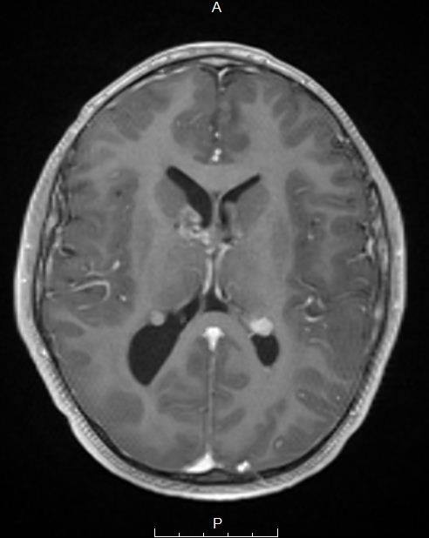
TSC Progress – Building on Discoveries
Medications that reduce tumors without invasive surgery
2008 tumors prior to everolimus
2013 tumors significantly reduced
Permission to use these images was given to me by his mother at the World TSC Conference in Dallas, Texas, July 2018
Notes:
A young boy in Arizona whose mom has been active in the TS Alliance had a large brain tumor that was blocking much of the corridor for his cerebral spinal fluid. The tumor was inoperable, and he participated in an early clinical trial for a drug called Afinitor. This clinical trial saved his life, because Afinitor worked. It reduced his brain tumors.

Slide 11
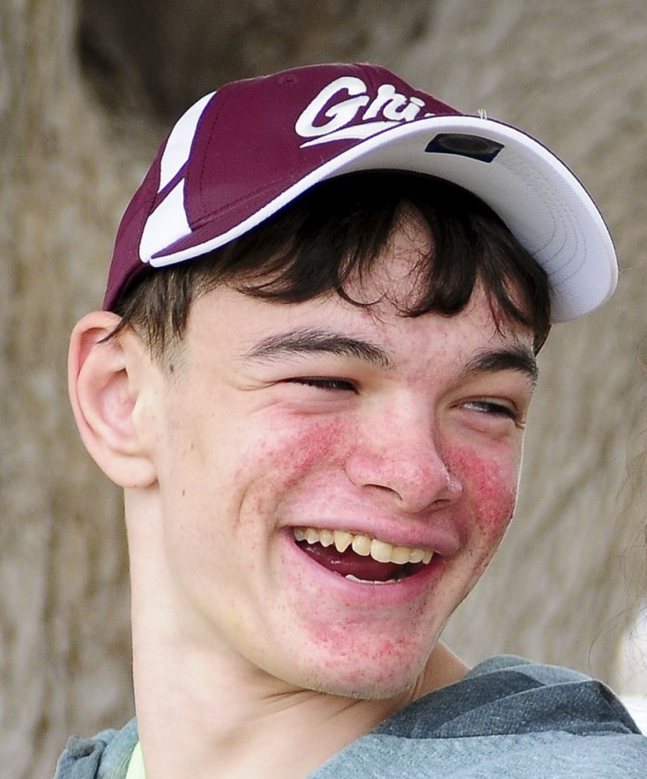
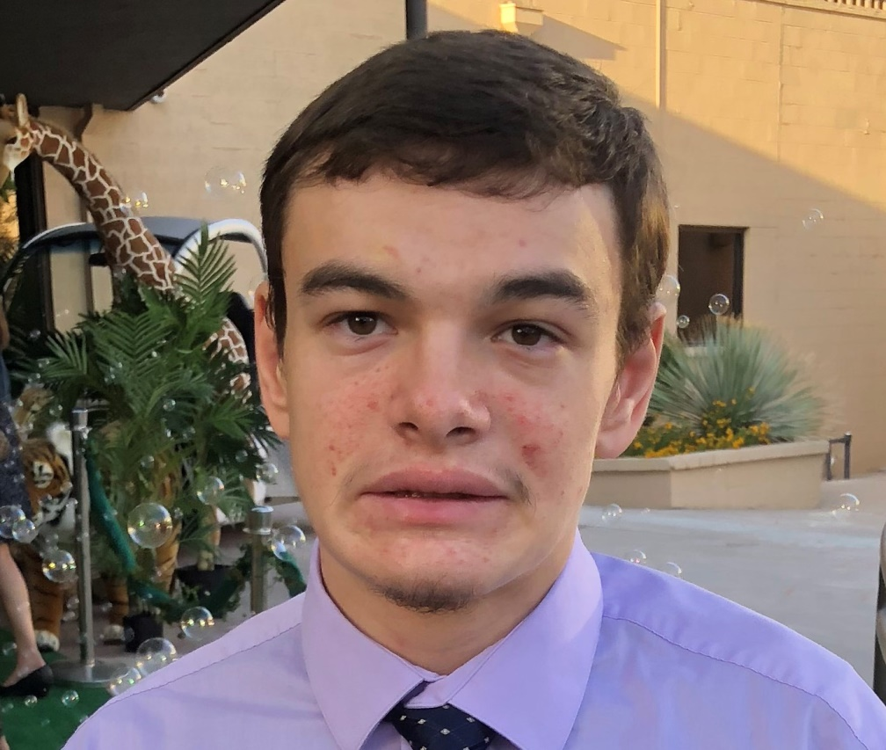
TSC Progress – Directly Helps People
Facial Cream to reduce the tumors on the face
Prior to Rapamycin Facial Cream
Continual improvement with facial cream
Angiofibromas can bleed heavily when irritated
Notes:
They have developed a facial cream that can reduce the growths on the face, without ingesting the drug into the whole body. They have developed a facial cream that can reduce the growths on the face, without ingesting the drug into the whole body.
Jack was fortunate to be part of a clinical trial for the Rapamycin cream. We are able to get the cream prior to wide distribution and it is continually reducing his angiofibromas.
It isn’t merely a cosmetic issue. One time, when Jack had a severe cold and wiped his nose excessively, his angiofibromas bled so much and for so long that I took him to the ER to get help for him. Oddly enough, the ER couldn’t stop the bleeding even with their fancy blood clotting bandaids because Jack wouldn’t leave the bandaid on long enough for it to work. It was his behavioral tutors that came to our aid and worked with him, rewarding him for every 30 seconds he kept the bandaid on, then increasing the time in between awards until finally, he tolerated the bandaid long enough to stop the bleeding.
Jack was fortunate to be part of a clinical trial for the Rapamycin cream. We are able to get the cream prior to wide distribution and it is continually reducing his angiofibromas.

Slide 12
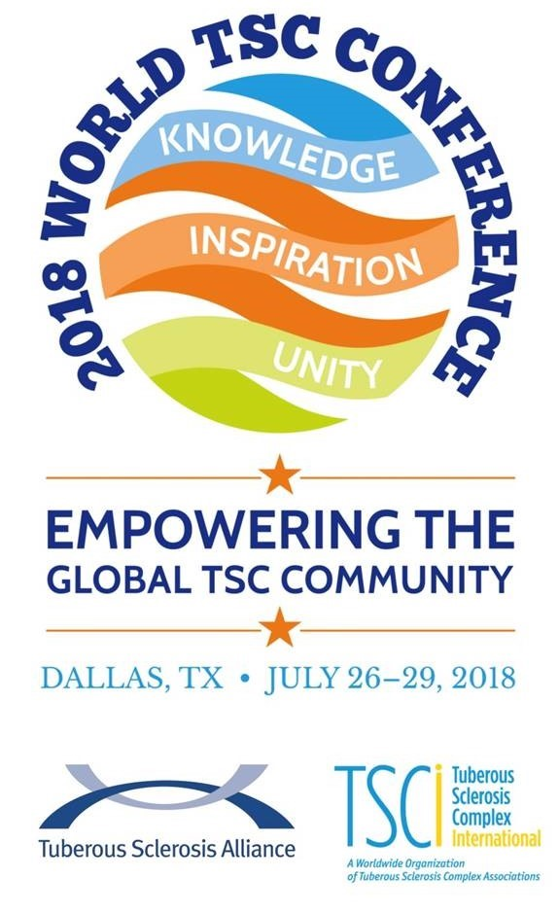
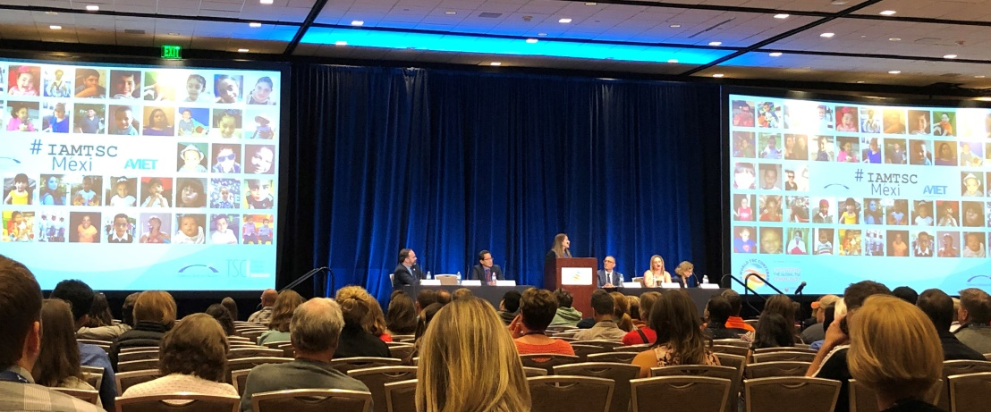
Second World TSC Conference, July 2018!

Slide 13
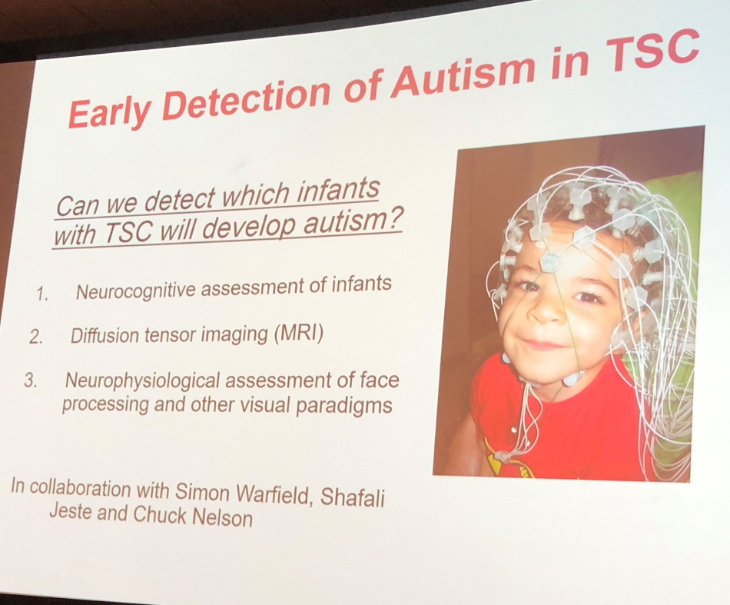
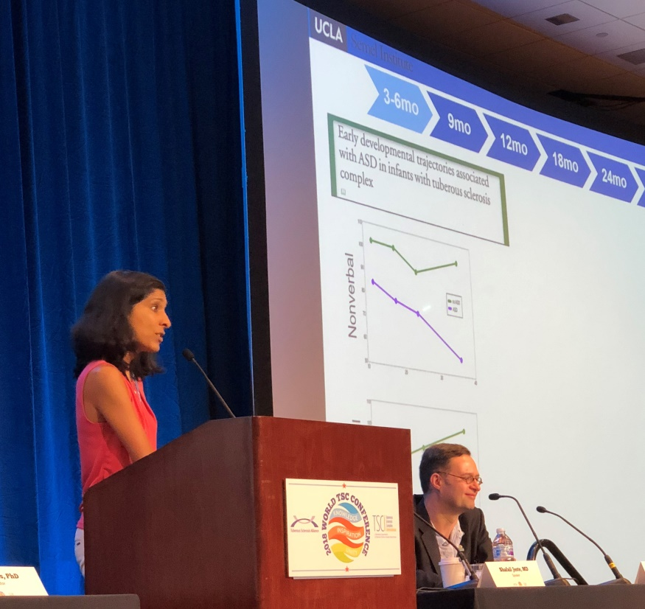
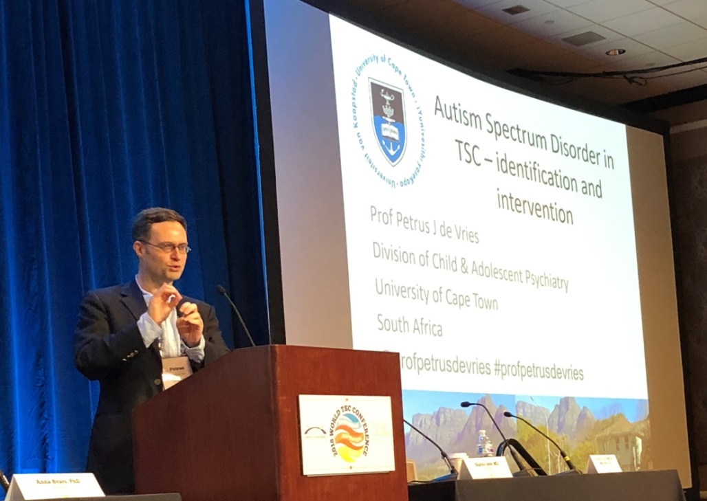
TSC Progress – Autism Study
Dr. Shafali Jeste, UCLA
Professor Petrus de Vries, South Africa
Notes:
The TSC Community is also studying signs of autism in infants, giving insight into how autism develops and progresses.
If autism starts appearing in the infant, they can begin the earliest intervention possible to ward off the severest and harshest manifestations of autism and the life challenges that can arise.

Slide 14
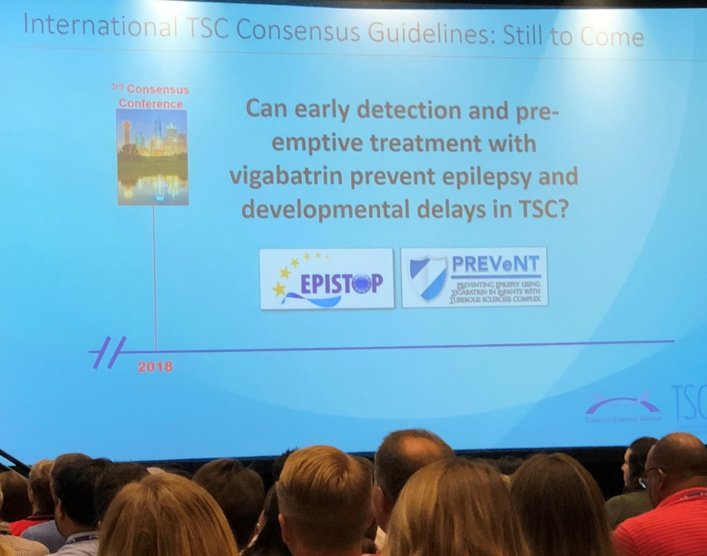
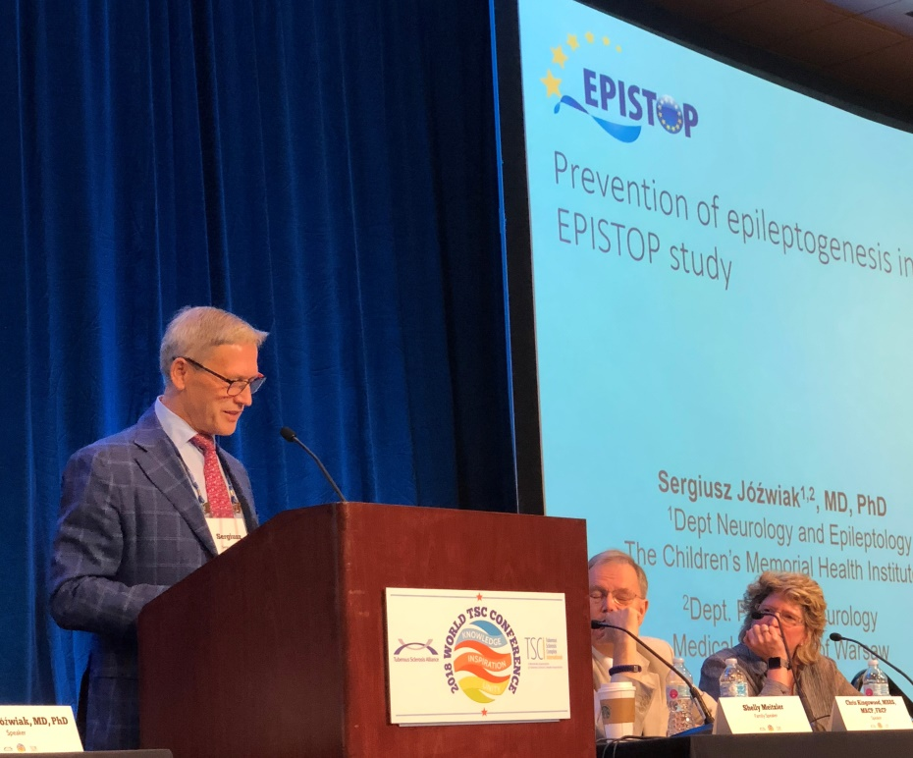
TSC Progress – Preventing Epilepsy in Infants
Infant EEG and Seizure Studies
Notes:
They are studying infants with TSC from the earliest possible moment to detect any evidence of seizure activity in an EEG brainwave scan, before the first physical seizure ever appears.
At the first sign of an abnormal EEG, treatment to prevent seizures begins immediately, thus vastly reducing the likelihood of seizures starting or reducing the severity of those seizures if they do begin.
Stopping or reducing the seizures at this early stage of life gives the child the greatest chance of avoiding the cognitive impairment, intellectual disability and challenging behaviors that can come with TSC.

Slide 15
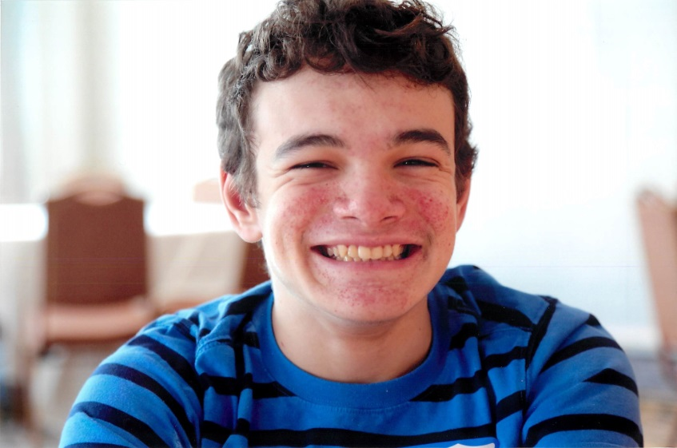
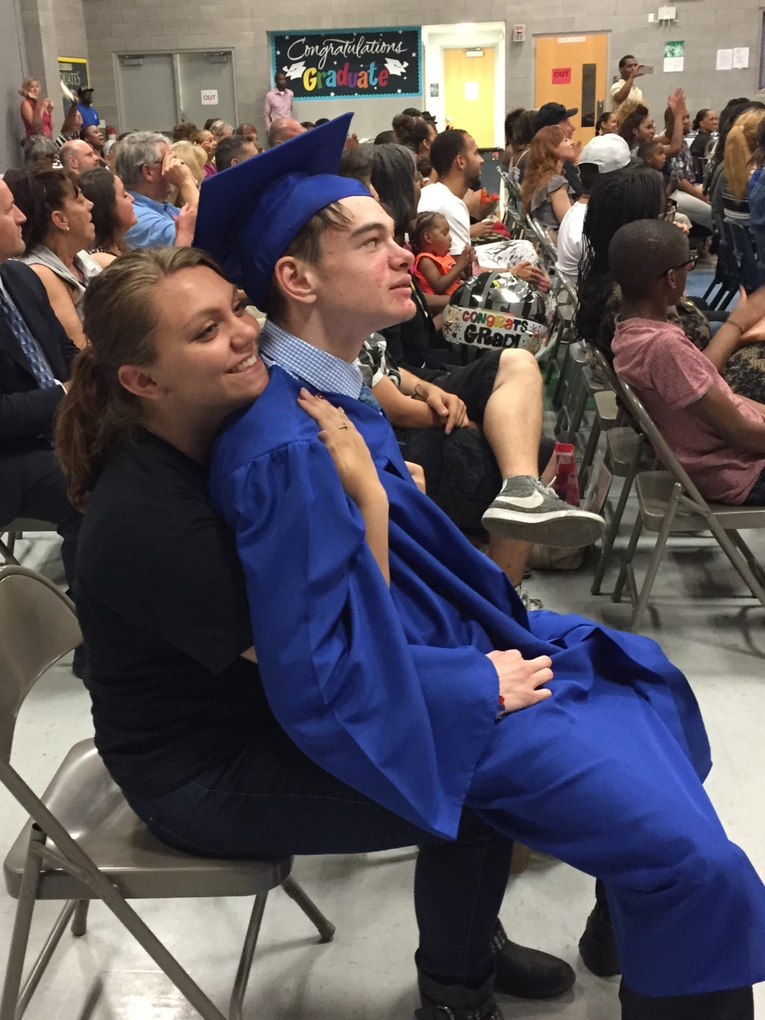
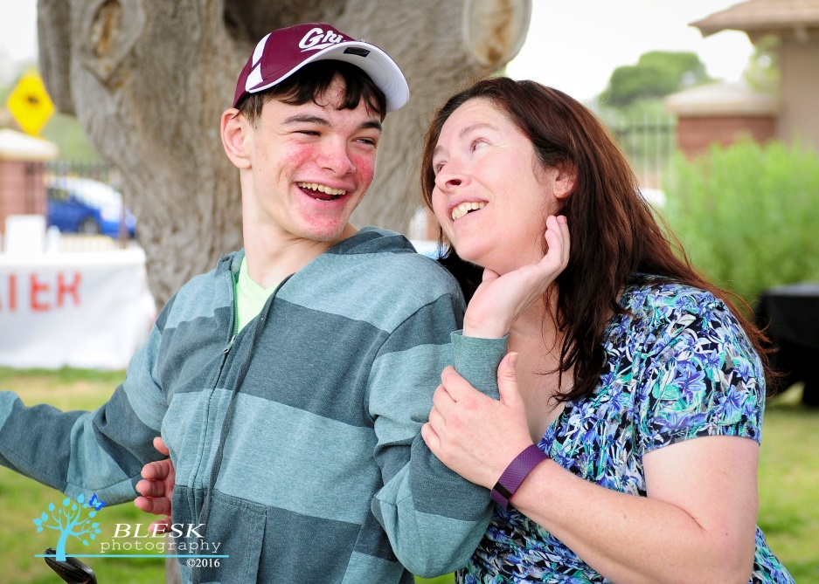
Notes:
Now my beautiful son, Jack, is an adult. He has seizures, autism, communication deficits, intellectual disability, high anxiety, aggressive behaviors and is living in an institution, because of that diagnosis, received 24 years ago.

Slide 16
Third World TSC Conference, July 2022!

Slide 18
www.Toastmasters.org

Slide 19
Toastmaster Meeting Roles
Toastmaster
Word of the Day
Educational Moment
Speakers
Table Topics
General Evaluator
Evaluators
“Ah” Counter
Timer

Slide 20
Table Topics
If you created your own late-night talk show, podcast, or You Tube Channel, who would you invite as your first guest to be interviewed?
What was your best vacation, and why was it the best?

Slide 21
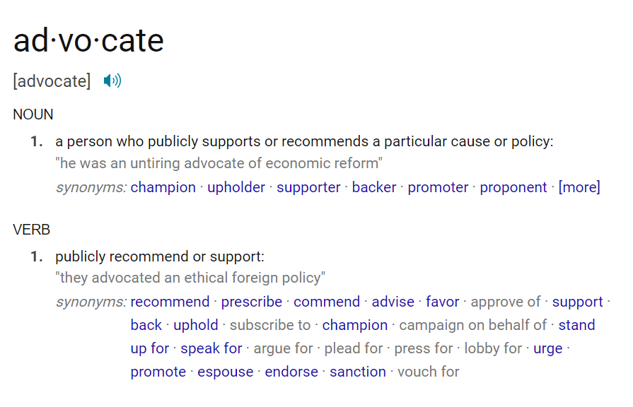
Word of the Day

Slide 22
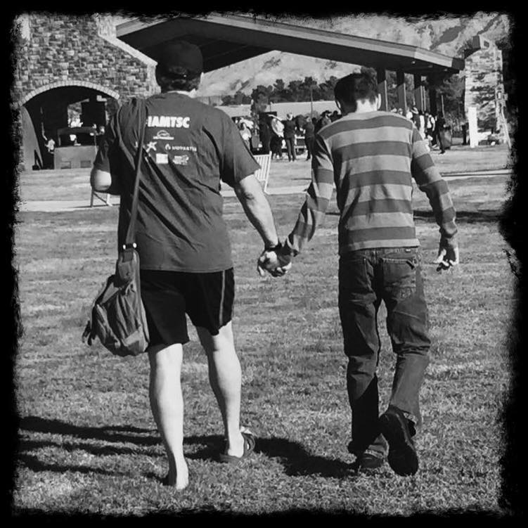
Never doubt that a small group of thoughtful, committed citizens can change the world.
Indeed, it is the only thing that ever has.
Margaret Meade

