Slide 1
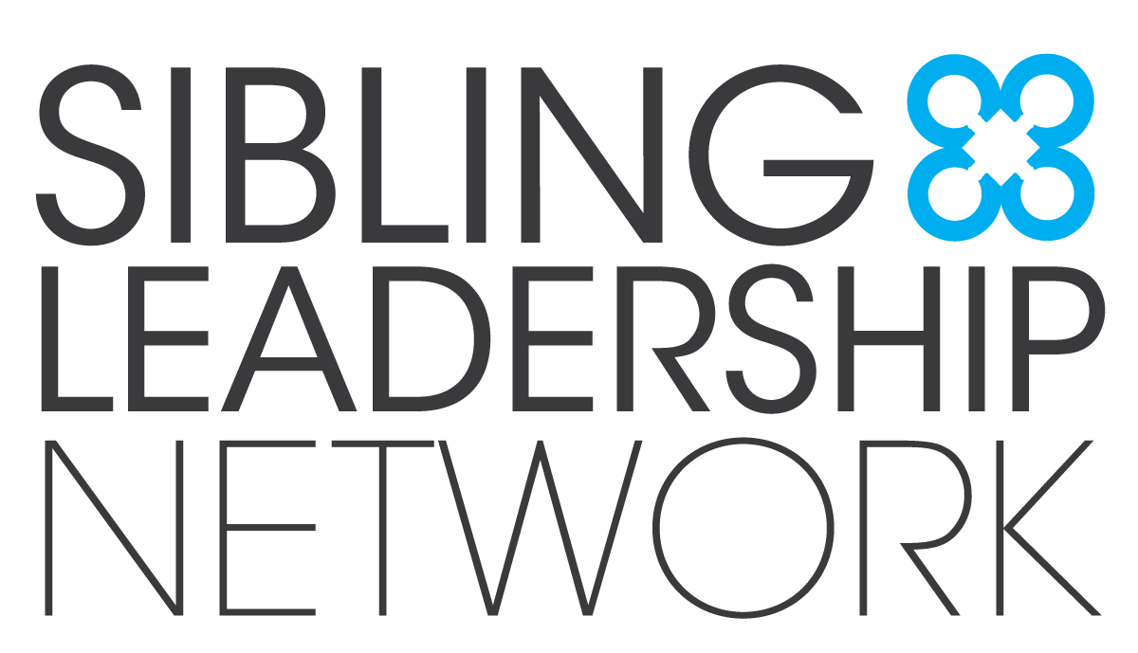
Sibling Support:
The Sibling Leadership Network
Linda Monterroso
Vice Chair, Board of Directors
Sibling Leadership Network

Slide 2
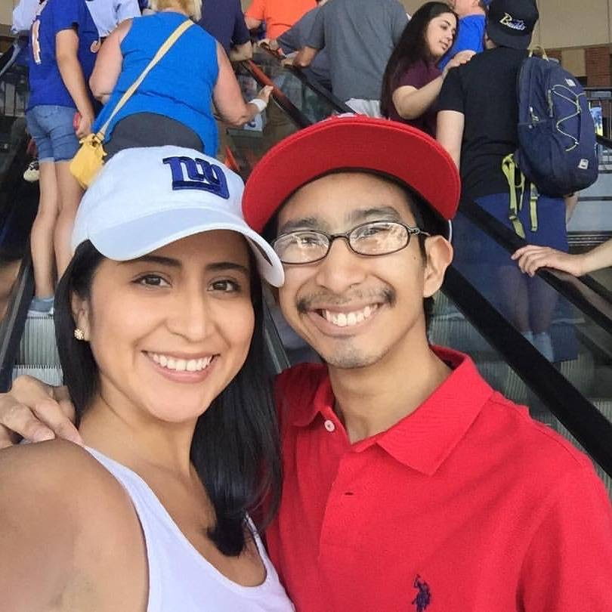
Thanks for being here
Notes:
I want to take a moment to thank you for being here – I know that life can be hectic, so thank you for taking the time to spend the next hour with us. Before you ask, that handsome guy to my right is Steve. He lives in NY so I don’t get to see him in person as much as I want but Facetime

Slide 3
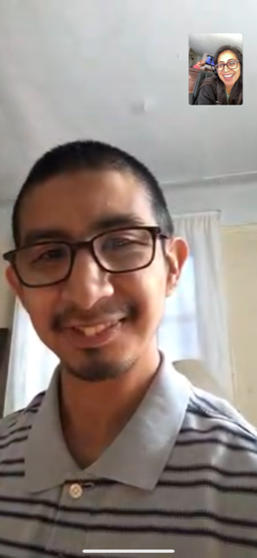
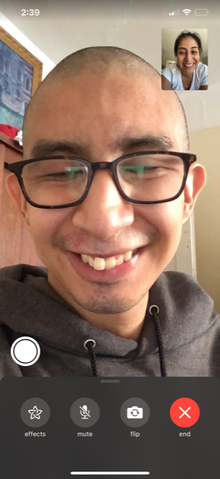
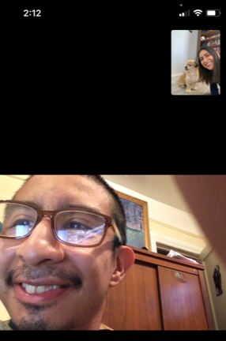
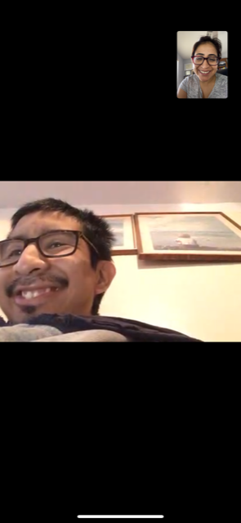
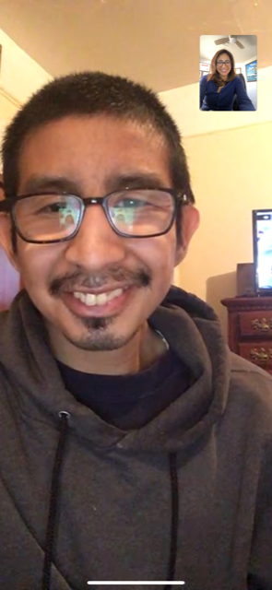
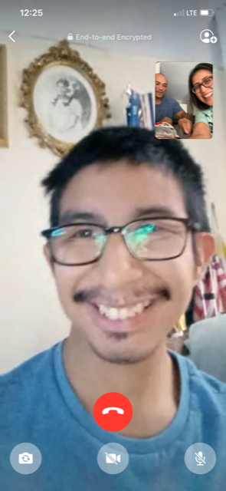
Notes:
A LOT. Steve and I share many things in common, a love of schedules is one of them. We Facetime every day (usually at 7pm) and exchange many imessages in between.
Any of your facetime with your sibs?
Steve is 5 years younger and has an intellectual developmental disability. He lives with my parents, attends a day program his favorite show is the Voice, and he knows how to work the iPAD better than my parents do.

Slide 4
OUR MISSION
To provide siblings of individuals with disabilities
the information, support, and tools
to advocate with their brothers and sisters
and to promote the issues important to them
and their entire families.
www.siblingleadership.org
Notes:
SLIDE: Sibling Leadership Network
- The SLN is a national nonprofit whose mission is To provide siblings of individuals with disabilities the information, support, and tools to advocate with their brothers and sisters and to promote the issues important to them and their entire families.
- The SLN provides information and peer support to siblings of people with disabilities across the lifespan.
- The SLN is welcoming to siblings of people with all types of disabilities and we tend to draw the most members as siblings of people with I/DD.
- The SLN is primarily a volunteer organization and we have a dedicated group from across the country helping to build and grow the network.
- We provide services like monthly virtual meetups, sib mentoring pgrm, EOY Conference, monthly podcast.
· You Don’t have to be a sibling to get involved—Sibling supporters an important part of our network. This includes anyone who supports siblings, including parents, sib-in-laws, other family members, self-advocates, professionals, friends and colleagues of sibs.
· Our network also welcomes siblings of people with disabilities who have died. We believe once a sibling, always a sibling. And welcome in our network.
· Currently, the SLN has 26 chapters in different states, with the vision that eventually every state will have a sibling chapter.
We don’t have a chapter in Nevada yet, but we’ve teamed up with the Nevada Center for Excellence to create a Nevada Chapter. More information on that later.
Chapters are the grassroots of the organization and maintain the more personal contact with people, ensuring that they get the information and support they need at the state and local level. Most of our state chapters are volunteer-led by adult siblings.
Each chapter has its own feel and flavor and all chapters agree to the mission and values of the national SLN.

Slide 5
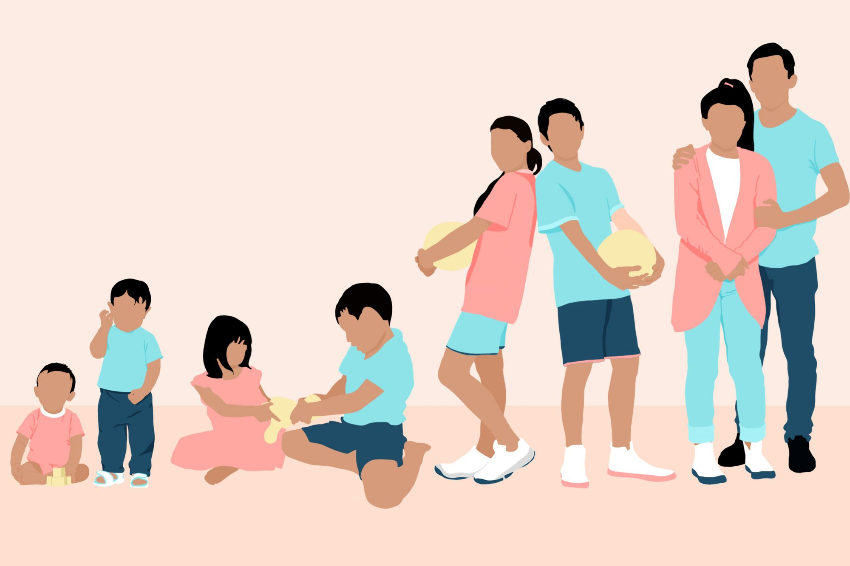
Sibling
Caregiver
Parent
Self-Advocate
Provider
Notes:
Now that you’ve gotten to know a little about me, let’s get to know a little more about you! How many of you are a
are you a: Sibling of a person with a disability? Parent of a person with a disability? Person with a disability? Disability Service Provider? Relative of a person with a disability (aunt, grandparent, other) (You might answer more than one)
Sibling
Parent
Advocate
Self- Advocate
Great to see so many siblings here tonight. And while we’re on the topic of siblings did you know:
Siblings often have the longest-lasting familial relationships.
Siblings often become the next generation of caregivers when parents are unable to provide care. Frequently, the oldest female sibling becomes the caregiver ( raise your hand if this speaks to you!)
Most siblings anticipate fulfilling greater supportive and caregiving roles, the older we get.
The peer nature of the relationship makes siblings uniquely positioned to support their brothers and sisters with disabilities to lead self-determined lives. This support can include many areas such as employment, voting, transportation, relationships and sexuality, healthcare, housing supports, and more.
Another fun fact:
Adult siblings are called the “club sandwich generation” because they often juggle the caregiving of their aging parents, their own children, as well as their brothers and sisters with disabilities. While support programs and services have been developed for individuals with I/DD and their parents, supports for siblings have been limited.

Slide 6
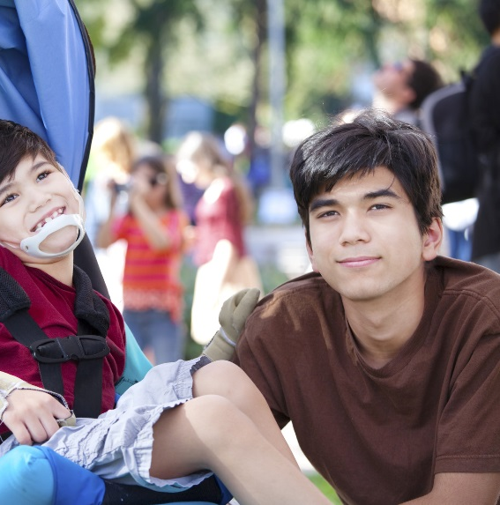
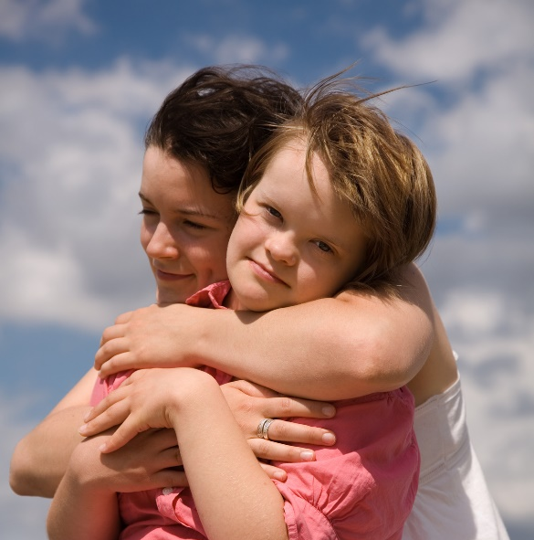
WHY IS THE SIBLING RELATIONSHIP IMPORTANT?
Siblings have longest relationship
Sibling experiences are often overlooked
Siblings have a peer perspective
Notes:
So today we are going to talk about supporting siblings from young siblings to old siblings!
Why is it important to focus on the experience of siblings?
· While the relationship changes over time, siblings often have the longest relationship of their lives with each other. Many of us will be there for each other 20 plus years longer than our parents.
· The peer nature of the sibling relationship uniquely positions us to support each other to lead self-determined lives.
· Yet, the sibling experience is often overlooked and sometimes even forgotten.
· Traditional service and support structures typically focused on the roles that parents play in the lives of their children with disabilities, while less attention has been given to the role that siblings play.
· Each sibling has a unique experience. Even each sibling within a family can have a very different perception. Yet, there are often similarities within that difference.
Another reason to focus on sibs -
• The majority of people with intellectual and developmental disabilities, or IDD, live with their families.
• And, family caregivers are getting older while people with disabilities are living longer.
• There are many aging caregivers. As parents age and are less able to support their adult child with disabilities, sibling involvement becomes more necessary.
• So focusing on sibling support is important!

Slide 7
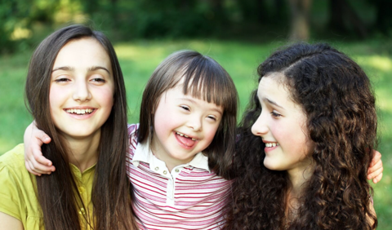
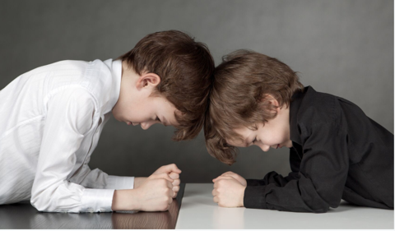
Siblings in childhood
Resources:
The Sibling Support Project -
Sibshops
http://www.siblingsupport.org/
Books:
Views From Our Shoes by Don Meyer
Luna, Yes!/Luna, ¡Sí!
My Brother Charlie by Holly Robinson Peete
Billy’s Sister by Jessica Leving
Notes:
. SLIDE: Childhood
· Let’s start with childhood!
· Because siblings are often the first and most intense peer relationships that children encounter, they learn many social skills from their sibling interactions such as sharing, collaborating, resolving differences, and compromising. Our sibs help prepare us for the world in many ways as we learn how to fight and make up, how to confide in and comfort one another.
· Siblings often learn to be advocates at a young age—handling questions from peers, or addressing people who are staring at their sibling or potentially stigma by association.
· Insert a paragraph about your own childhood – if you would like.
· Childhood is the time is when parents, teachers, professionals, and relatives play an important role in helping equip kids with the information and tools to speak up—they need the language to answer tough questions or respond to ignorant comments. It is helpful to have a rehearsed script to answer questions.
· Sibs are often craving developmentally appropriate information about their sibling’s disability or condition. Parents often assume that siblings know the answers to these questions, but they might not. (Questions that siblings sometimes ask are: What is the name of their sibling’s health condition or disability? How does it affect their sibling? How did their sibling acquire their disability? Did the sibling in any way cause it or can they catch it?)
· Siblings often really want time alone with their parents. This can be hard to schedule but can be critical to meeting the needs of a sibling of a child with a disability.
Resources for young sibs:
· A lot of great resources for younger siblings can be found at the Sibling Support Project website: www.siblingsupport.org
· Sibshops were created by Don Meyer and they are gatherings for siblings to obtain peer support and education within a recreational context.
· Sibshops mix in genuine fun activities - messy crafts, silly games, delicious food with a space to talk about and share what it is like to be a sibling.
· They can vent some typical sibling frustrations, learn about different disabilities, share strategies - like on how to deal with bullies or how to handle situations when their friends come over to play.
· If you go on the Sibling Support website you can find out more about getting training to be a sibshop Facilittor.
· Also, listed some books

Slide 8
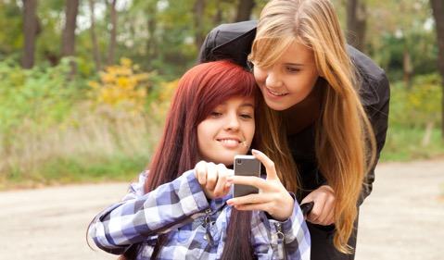
Siblings in the teen years
Resources:
SibTeen on Facebook
Books for older teens:
Sibling Survival Guide by Don Meyer and Emily Holl
Notes:
Slide: TEEN YEARS:
· Sibling relationships continue to evolve from childhood through adolescence. Of course, Adolescence is a time of change that also can alter the sibling relationship. Individuals are going through physical and emotional changes as well as developing their own identity separate from their family and expanding their own social networks.
· At school, teens can become very concerned about fitting in and this can be a time when they become aware of their siblings differences.
It’s important to validate and normalize for teen siblings that a range of emotions is acceptable. It’s a time and they may feel a lot of divergent and conflicting emotions . When I think back, I felt lots of emotions as a teenager…Insert your own if you would like
· Research shows that regardless of how large the family is, most often the oldest sister takes on the greatest caregiving duties for their brother or sister with disabilities. We can really see this develop in the teen years. There might be an older sister that babysits a lot and while this is great, sometimes if can be difficult for siblings to be asked to step into the roles of parent.
·
In addition to needs, there are some opportunities -
· Siblings may provide each other with companionship and emotional support as friends.
· Siblings can serve as a guide in navigating social situations such as at school.
· For siblings that may attend the same school as their brother or sister with disabilities, they could have some important insight from a peer level about things that can be very helpful for parents and teachers.
· Also, siblings could be invited to be part of IEP mtgs and contribute their knowledge and insights. However, make sure the person with disabilities wants their sib there before you extend an invitation.
Teen Resources
· SibTeen is an online closed Facebook group that is a place where teenage sibs of people with disabilities can connect with others who get it. It’s a fun and thoughtful group where members share unique concerns, joys, frustrations, and information with others who truly understand! It is hosted and moderated by the Sibling Support Project that I mentioned earlier.
· The Sibling Survival Guide - essays by siblings of people with disabilities that share indispensable information for teens and adults to navigate the journey of being a sibling.

Slide 9
Peer Support is critical!
Sibling Leadership Network
SibNet on Facebook
Notes:
Slide: Adulthood:
We find that adult siblings need a lot of information and peer support. The adult years bring about things that siblings have been thinking and wondering about but often feel unprepared to walk together with their siblings. Adulthood is a time when roles are being transitioned and re-negotiated. And for siblings of people with disabilities, they may have additional roles they play with siblings.
Peer support is CRITICAL. Often, siblings in their 20s, 30s and 40s tell us they had NEVER met another sibling before - can you imagine if we asked parents to wait 20 years to talk to another parent!?
Because of the peer nature of the relationship, siblings can really provide support with their brothers and sisters in areas such as social media, employment, voting, transportation, relationships and sexuality, healthcare, housing supports, and more.
As mentioned earlier, Most siblings anticipate taking on greater caregiving roles as their parents age.
Parents do an amazing job creating supports but these supports are not often widely known by siblings. Sibs usually have a lot to learn about the service system and how to navigate it. Parents are amazing service navigators. They live and breathe the day-to-day caregiving over a lifetime.
Insert a story about your adulthood, if you would like

Slide 10
Notes:
9. SLIDE: LEARNING CURVE
What we find is that there is a very steep learning curve when sibs take on a greater caregiving role. And, often this coincides with a time when their family is in crisis, which makes everything harder. Siblings need to be prepared sooner. Sibs need information and we need to start be part of future planning conversations sooner and be engaged in the process to the extent we want to be.

Slide 11
Notes:
SLIDE: Club Sandwich Generation
· Many people are familiar with the term “sandwich generation”, but siblings of PWD are often referred to as the “Club Sandwich” generation.
· Siblings have multiple caregiving responsibilities they often juggle. They provide caregiving and support to their aging parents, their own children, as well as the extra layer of their brothers and sisters with disabilities.
· The Ultimate Club Sandwich occurs when Siblings become the next generation of caregivers when parents are no longer able to fill this role.
· This can be overwhelming and “too big to take a bite out of” as this photo of this little girl shows
· As siblings become more involved in the care of their brother or sister with a disability, their own support needs will likely increase. Therefore, it is critical to understand what supports siblings need from their viewpoint.
· Also, as siblings get the support they need, their brothers and sisters with disabilities will have better outcomes.

Slide 12
https://siblingleadership.org/wp-content/uploads/2021/01/Future-planning-for-siblings-of-people-with-disabilities.pdf
Link to Future Planning Resources on the SLN Website
Link to the Arc Center for Future Planning
Notes:
Future planning is something that can really help. We don’t have time to cover this topic thoroughly but it’s important to mention because people are often reluctant to start talking about future planning because it requires them to acknowledge their own mortality. Additionally, families are often overwhelmed at the lack of options and resources - or their lack of knowledge about resources. And many parents talk about how they do not want to “burden” their other children with thoughts of the future. But, most sibs are thinking about it and possibly worrying about it.
There are quite a few resources on our SLN website and the website of the Arc CFP. If you are a sibling, parent, or person with a disability – I encourage you to start the conversation with your family. If you are a provider, please help families – encourage them to start the conversation.

Slide 13
Notes:
Everyone should have a voice and a choice - talk to all the members of the family

Slide 14
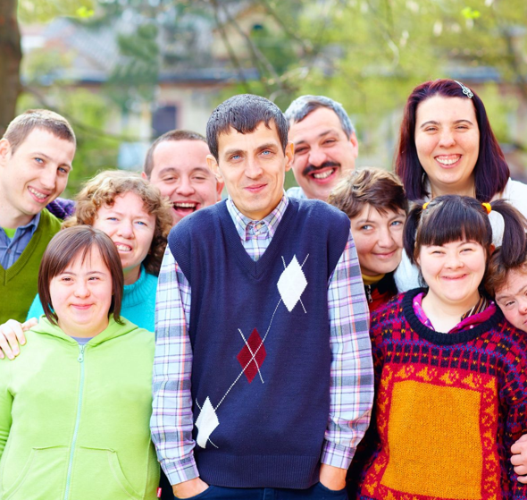
Create policies and programs that support siblings
Include siblings in family future planning meetings.
Ask about siblings during intake meetings.
Host adult sibling gatherings.
Host Sibshops.
Include siblings on your Board, committees, and in your policies about families.
Notes:
For the providers with us today…I want to talk specifically about how you can engage siblings. Resources are key – share them with parents, coworkers, and siblings.
And Create policies and procedures that support siblings
Include siblings in family future planning meetings – young and old. Of course, ask the person with the disability about this first.
Ask about siblings during intake meetings.
Host adult sibling gatherings.
Host Sibshops. –
Include siblings on your Board, committees, and in your policies about families.

Slide 15
Actively reach out to siblings
Siblings may not have ever been invited to an event before!
Directly communicate with siblings.
Support siblings to connect with each other.
Ask the person with a disability how he or she would like her/his sibling to be involved.
Notes:
SLIDE Siblings may not have ever been invited to an event before!
Directly communicate with siblings.
Support siblings to connect with each other.
Ask the person with a disability how he or she would like her/his sibling to be involved.

Slide 16
Don’t expect siblings to be just like parents
Notes:
My sib doesn’t want another parent. And I don’t want to be another parent. Parents are awesome. But siblings can’t just be replacement parents. The Sibling Relationship is really important and special.

Slide 17
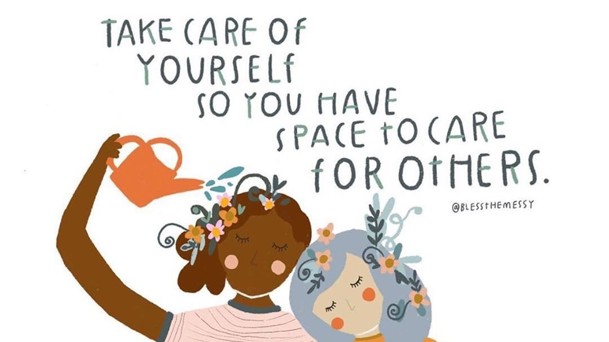
Notes:
Comments/questions/encourage people to tell their own sib story.

Slide 18
Notes:
Visit the Nevada Center of Excellence
Virtual Monthly meetings
In person meetings
6-7pm

Slide 19
Please stay connected www.siblingleadership.org

