Slide 1
Meeting in the Middle – Being Safe Online While Also Advocating for One’s Needs
Aging and Disability Services Division
Rebecca Arvans, PhD & Duane Runyan, PhD
08/03/2022

Slide 2
By the end of this training, attendees should:
Learn basic internet safety skills
Learn how to address online bullying
Discuss self-advocacy skills for being online
Address parental/guardian concerns
Become aware of restrictions and ethical issues

Slide 3
Learn BASIC INTERNET SAFETY SKILLS

Slide 4
OVERVIEW
People with disabilities often want to do the same things everyone else does – live in the community, find a job, have a relationship, lead a healthy life, and...
Use the internet (social media vs. other aspects)
The internet allows access to the world
AND it puts people at risk

Slide 5
OVERVIEW
Threats to safety often result in parents (or guardians and team members) wanting to ban internet entirely, but experts agree educating individuals about online rights and responsibilities is the best way to keep everyone safe.
This means ALL individuals should learn about online safety, including those with disabilities.

Slide 6
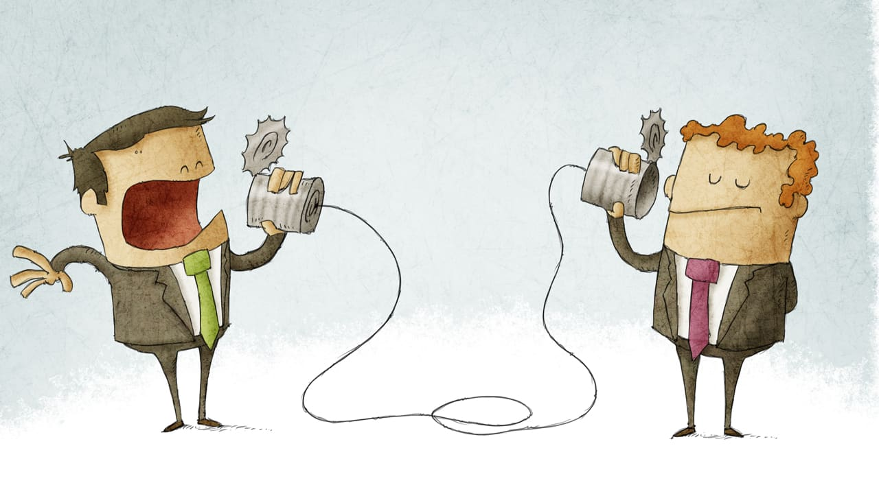
OVERVIEW
Individuals with disabilities might be at particular risk due to an inability to read social skills or to determine if others are trustworthy.
They may not recognize when "get-to-know-you" questions are too personal, inappropriate, or dangerous.
Concerns regarding online behavior do not mean individuals should not be online!
It DOES mean there should be open and honest conversations about online behavior.

Slide 7
The Very, Very Basics
Talk about what is safe and what is not safe to share online.
Review social media and give feedback about anything inappropriate.
TIP: The reviewer might be a trusted authority figure, not necessarily a parent or guardian
Consider: https://www.secca.org.au/wp-content/uploads/2021/01/SECCA-Cyber-Safety-Resource.pdf

Slide 8
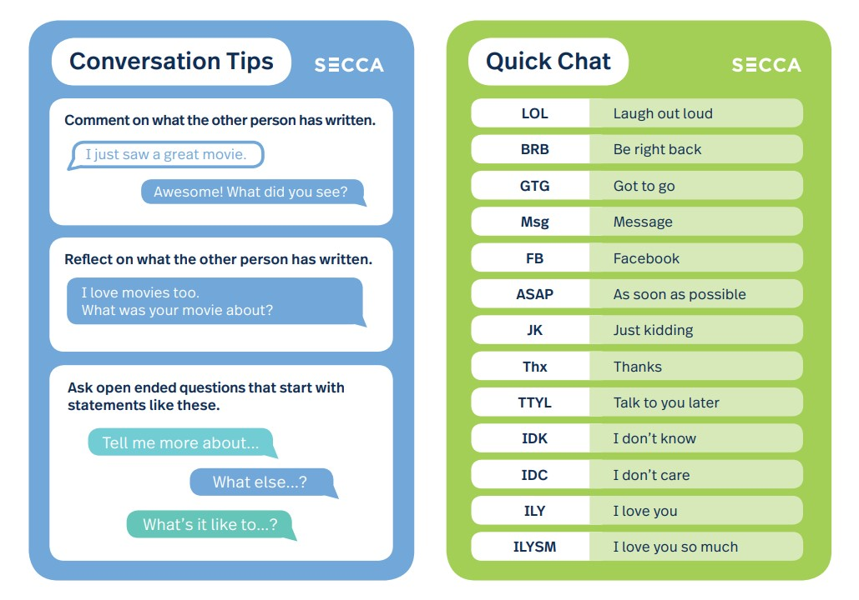
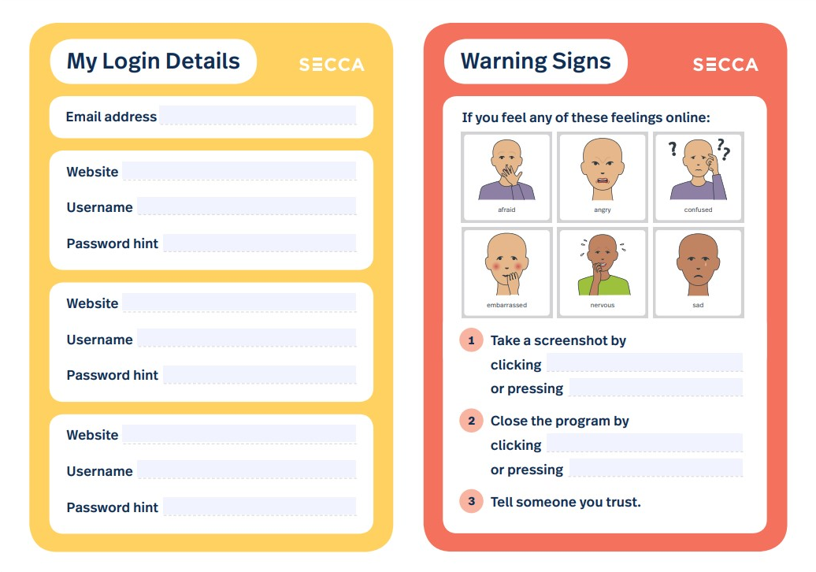
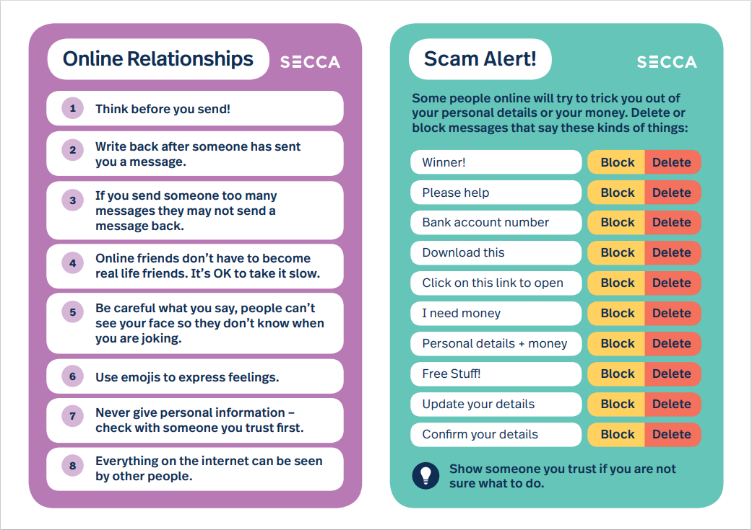
Cyber Safety Resource

Slide 9
The Very, Very Basics
Make sure individuals know anything posted online is not private.
Help individuals with interpreting slang, funny, or sarcastic comments, as needed.
Model and teach kind online behavior.
Know that social skills are needed for online interactions, just as they're needed in person.

Slide 10
The Very, Very Basics
Guidebooks are available for review and help – see guides by Foundation for People with Learning Disabilities:
https://www.anncrafttrust.org/wp-content/uploads/2020/09/staying-safe-online-1.pdf - Social Media
https://www.anncrafttrust.org/wp-content/uploads/2020/09/I-have-made-a-new-friend-online-F.pdf - Making Friends
Teach how to address online bullying.

Slide 11
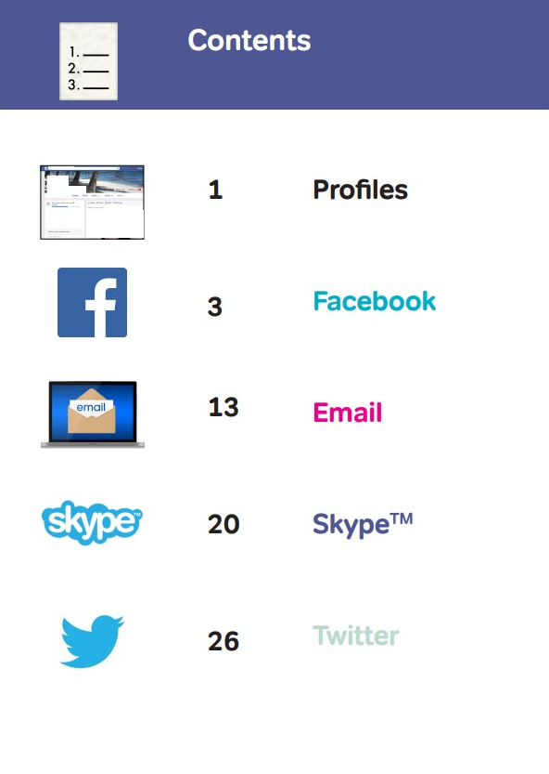
The Very, Very Basics

Slide 12
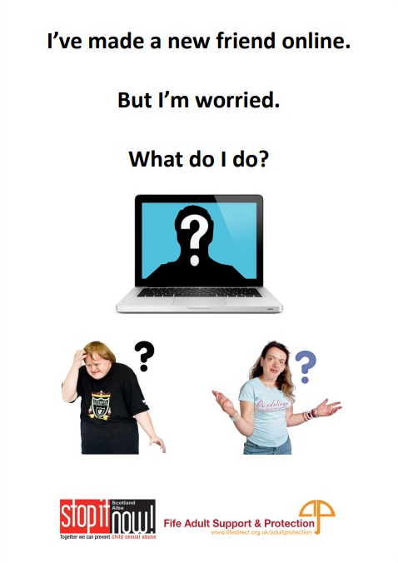
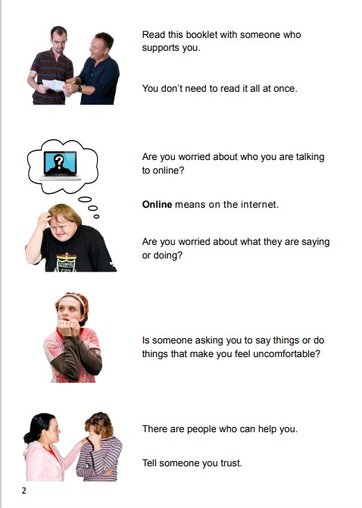
The Very, Very Basics

Slide 13
Learn HOW TO ADDRESS ONLINE BULLYING

Slide 14
OVERVIEW
Cyberbullying is the harassment of others by using the internet.
Individuals with disabilities are almost twice (1.8x) as likely to be bullied, harassed, and victimized online
We need more research!
Parents are often unaware when their children have been bullied online (only 20-30% report).

Slide 15
THE VERY, VERY BASICS
Discuss what bullying looks like
Teach what to do with bullies (Practice!):
Document, document, document
Block individuals who are bullying and harassing
Communicate with team members to address concerns and ensure safety
Encourage buddy systems for learning about new websites

Slide 16
THE VERY, VERY BASICS
https://youtu.be/vtfMzmkYp9E
Also, check out:
https://www.pacer.org/bullying/info/publications/

Slide 17
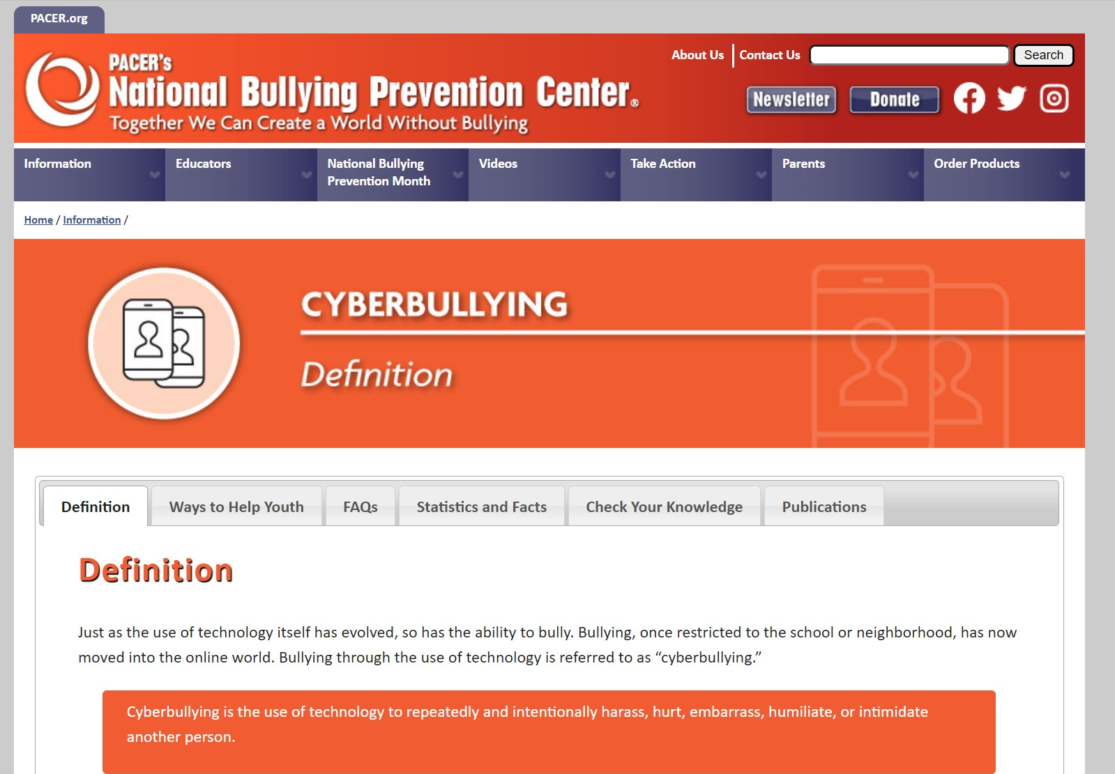

Slide 19
DISCUSS SELF-ADVOCACY SKILLS FOR BEING ONLINE

Slide 20
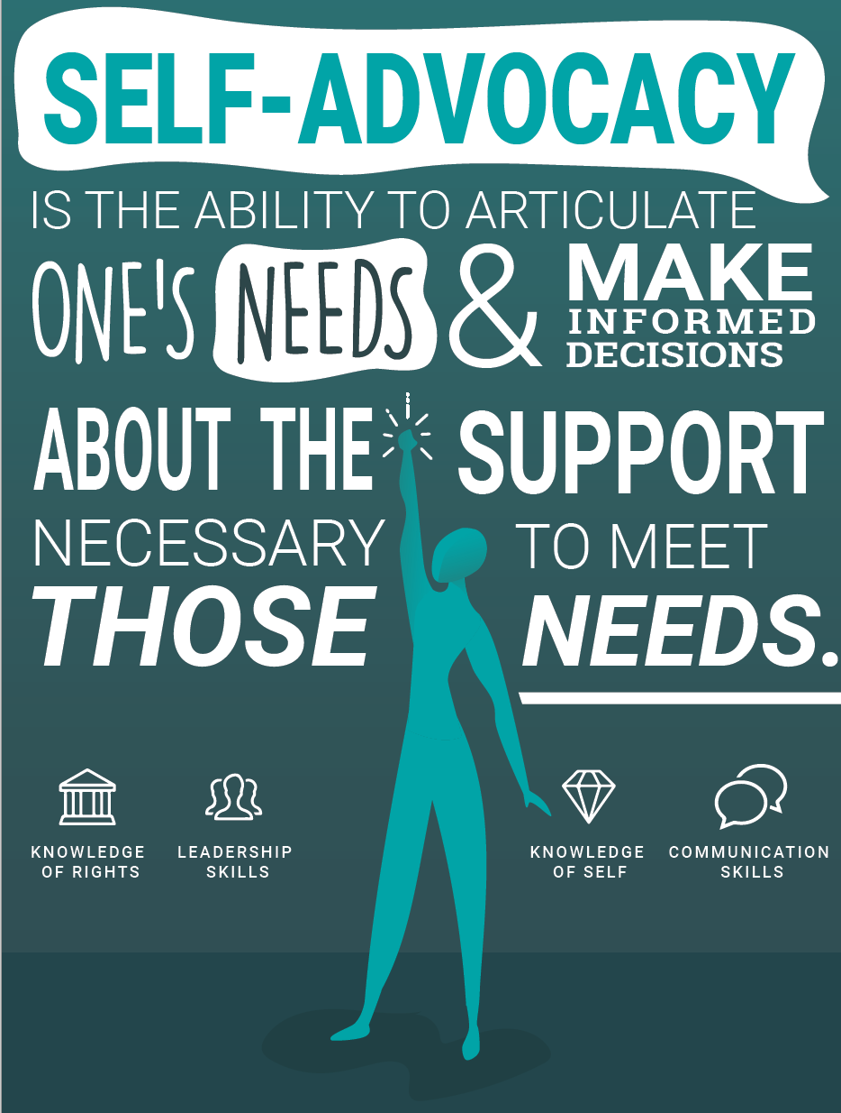
OVERVIEW
Self-Advocacy means asking for what you need while respecting others.
Helps you:
Obtain what you need
Be involved in decisions
Learn to say NO and be okay with that
Express disagreement
Express ideas
Knowing your rights

Slide 21
OVERVIEW
In terms of bullying --> Self-Advocacy skills may address and prevent cyberbullying
In terms of being online --> These skills may also help to convince team members about the importance of accessing the internet
Individuals should be involved in the process of 1) discussion about being online, 2) addressing concerns, and 3) making plans regarding online behaviors.

Slide 22
OVERVIEW
This means helping individuals define their needs, encouraging their ideas, and developing solutions that all meet the needs of all team members.

Slide 23
OVERVIEW
The impact of self-advocacy can lead to...
Growth in leadership abilities
Transformation – individuals can change how others see and ultimately treat them
Changes in the individual, their supports, and their community

Slide 24
ADDRESS PARENT and/or GUARDIAN CONCERNS

Slide 25
Yes, but......
Inclusion is good but not a simple solution
Parents spend time developing "what ifs" scenarios
These concerns can certainly impact accessibility issues for individuals
Concerns are just concerns and not necessarily barriers......

Slide 26
Parent Perception – Adults
7% considered the Internet unsafe for adults without ID
36% considered the Internet unsafe for adults with ID

Slide 27
Parent Perception - Minors
45% considered the Internet unsafe for minors without ID
73% considered the Internet unsafe for minors with ID

Slide 28
Caregivers' Concerns with Internet Safety for people with ID
Disclosing personal information – 66%
Receiving sexual content – 61%
Being threatened – 59%
Bullying – 50%
Financial exploitation – 48%
Trying to meet them against their will – 45%

Slide 29
Prevention Strategies (1 of 3) – High Engagement/Low Structure
What they do on the Internet – 84%
Risks of online chatting with strangers – 72%
Misleading advertising – 69%
Risks of identity theft – 62%
Where to go online (and where not to go) – 61%

Slide 30
Prevention Strategies (2 of 3) - High Structure/Low Engagement
Control time spent online – 36%
Control use of social networks – 31%
To stay nearby/directly observe while online – 28%/ 21%
To put computer in common areas at home – 26%

Slide 31
Prevention Strategies (3 of 3) – Low Engagement
Install programs to prevent spam, malware – 44%
To forbid them sharing information on the Internet – 18%
To forbid them using social networks/social media – 8%
No strategies at all – 13%
Check history of visited webpages – 31%

Slide 32
Weighing Concern with Benefit: Consideration of Risk
Concept of "positive risk-taking approach"
Risks are part of the daily life of any human being
Risk is necessary for development and growth
This conceptualization allows for promoting the identification and positive management of the risks

Slide 33
When parental concern turns to anxiety
"I will decide what is best for my loved one."
Intended consequences
Increased perception of safety
Unintended consequences
What message does this statement send?
Often leads to increased secretive and/or higher risk behavior (e.g., concept of counter control)

Slide 34
Parent and Guardian Concerns
Research has suggested that individual autonomy has benefits that outweigh the concerns
Positive risk-taking allows individuals with ID to make their own decisions
Constructive dialogue with shared decision-making is encouraged

Slide 35
BECOME AWARE OF RESTRICTIONS AND ETHICAL ISSUES

Slide 36
Ethical Issues to Consider
Ethical issues – Internet is constantly evolving in content and resources
Supervision: Do you track, do you block, do you search? (Do you read a journal?)
Limit: Do you assign software that limits accessibility? (Do you limit to only sites for individuals with ID?)
Other factors to consider......

Slide 37
To Restrict or Not Restrict...
If they do not have a guardian – can you tell an adult "no" and impose restrictions around internet?
Self-advocacy and its influence, reviewed earlier in this presentation
Role of the support team
Pros and cons of such restrictions

Slide 38
RESOURCES
Center on Secondary Education for Student with ASD (2016). Internet safety for teens with ASD. https://csesa.fpg.unc.edu/sites/csesa.fpg.unc.edu/files/Internet%20Safety%20for%20Adolescents%20with%20Autism.pdf
Center for Technology Implementation (2014). Teaching students with disabilities about online safety. Washington DC: American Institute for Research.
Chiner, E., Gomez-Puerta, M., & Cardona-Molto, M.C. (2017). Internet and people with intellectual disability: an approach to caregivers' concerns, prevention strategies and training needs. Journal of New Approaches in Educational Research, 6(2), pp. 153-158.
Creative Commons Attribution (2021). How to prevent cyberbullying for children with disabilities. https://www.endcyberbullying.net/blog/how-to-prevent-cyberbullying-for-children-with-disabilities#:~:text=A%20good%20friend%20or%20family%20member%20using%20social,cyberbullying%20too.%20Educate%20Children%20With%20Disabilities%20About%20Cyberbullying.
Foundation for People with Learning Disabilities (2014). Staying safe on social media and online. https://www.anncrafttrust.org/wp-content/uploads/2020/09/staying-safe-online-1.pdf
Fuxman, S., Schneider, S.K., & Heyman, M. (2019). The Ruderman white paper on social media, cyberbullying, and mental health: A comparison of adolescents with and without disabilities. Ruderman Family Foundation.
National Center on Birth Defect and Developmental Disabilities, Centers for Disease Control and Prevention (2020). People with disabilities and chronic diseases: Information about bullying. https://www.cdc.gov/ncbddd/disabilityandsafety/bullying.html
PACER's National Bullying Prevention Center (2022). National Bullying Prevention Center - Information (pacer.org). https://www.pacer.org/bullying/info
Ryan, T.G. & Griffiths, S. (2015). Self-advocacy and its impacts for adults with developmental disabilities. Australian Journal of Adult Learning, 55(1), April 2015.
SECCA (2022). Internet safety cards. https://www.secca.org.au/resources/internet-safety-cards/
Stopbullying.gov (2021). What is cyberbullying. https://www.stopbullying.gov/cyberbullying/what-is-it.
Stop It Now! Scotland & Fife Adult and Support Protection Committee (2020). I've made a new friend online. https://www.anncrafttrust.org/wp-content/uploads/2020/09/I-have-made-a-new-friend-online-F.pdf

Slide 39
Questions?

Slide 40
THANK YOU!

