Slide 1
Fractured Rainbow
Silver State Self-Advocacy Conference 8.3.2022
Samuel J. Hickson, Ph.D., LMSW, MSSA, MBA, ACE-CHC
Social Worker
Department of High Risk

Slide 2
Financial Disclosures
No financial disclosures

Slide 3
Visualization Exercise
Close Your Eyes
As I say these words, think about the emotion that you feel when you hear them.
How did you feel?

Slide 4
Objectives
This presentation will discuss…
Social View on LGBTQIA+ In Medicine
Research on LGBTQIA+ in Primary Care
Demographics of LGBTQIA+ With Disabilities
Challenges for LGBTQIA+ With Disabilities
Self-Advocacy
Resources

Slide 5
Social View On LGBTQIA+ In Medicine

Slide 6
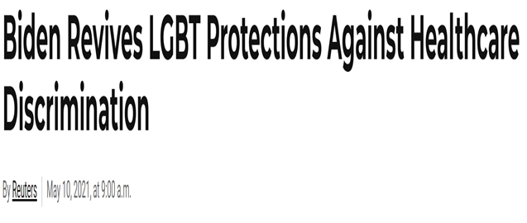
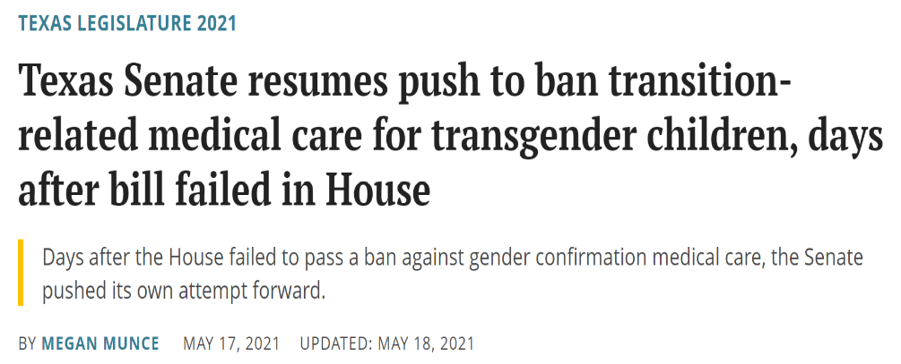
LGBTQIA+ Under Attack
Source: (Chiacu, 2021)
Source: (Munce, 2021)

Slide 7
What Does The Research Say?
2015 Same-Sex Marriage Act and the question of full civil liberties (Perone, 2015).
Health care discrimination exists despite expansion of civil liberties (Emlet et al., 2017; Fallin-Bennet, 2015).
Health needs went unmet due to discriminatory practices (Doyle & Molix, 2016; Figueroa & Zoccola, 2016; Gonzales & Henning-Smith, 2017; Pachankis & Bränström, 2019).
The understanding of the impact of discrimination on health-related behavior is limited (Whitehead et al., 2016).

Slide 8
What Is Previous Research A Problem?
Literature on understanding health-related behavior of sexual minorities outside of mental health and sexual health is scant (Barefoot et al., 2017; Bristowe et al., 2018; Doyle & Molix, 2016).
Fundamental literature focal points have included (a) provider preparedness, (b) geographic location limitations, (c) sexual health discrimination, (d) legal protections, and (e) sexual orientation disclosure (Baldwin et al., 2017; Bowling et al., 2019; Chasin, 2015; Cyrus, 2017).
Pre-existing literature fails to acknowledge the impact of how stigma presents itself in practice and how that stigma impacts health behavior of sexual minorities (Dichter et al., 2018; Dolezal & Lyons, 2017; Ellner & Phillips, 2017; English et al., 2018; Gahagan & Subirana-Malaret, 2018; Hughes et al., 2017).

Slide 9
Research On LGBTQIA+ In Primary Care

Slide 10
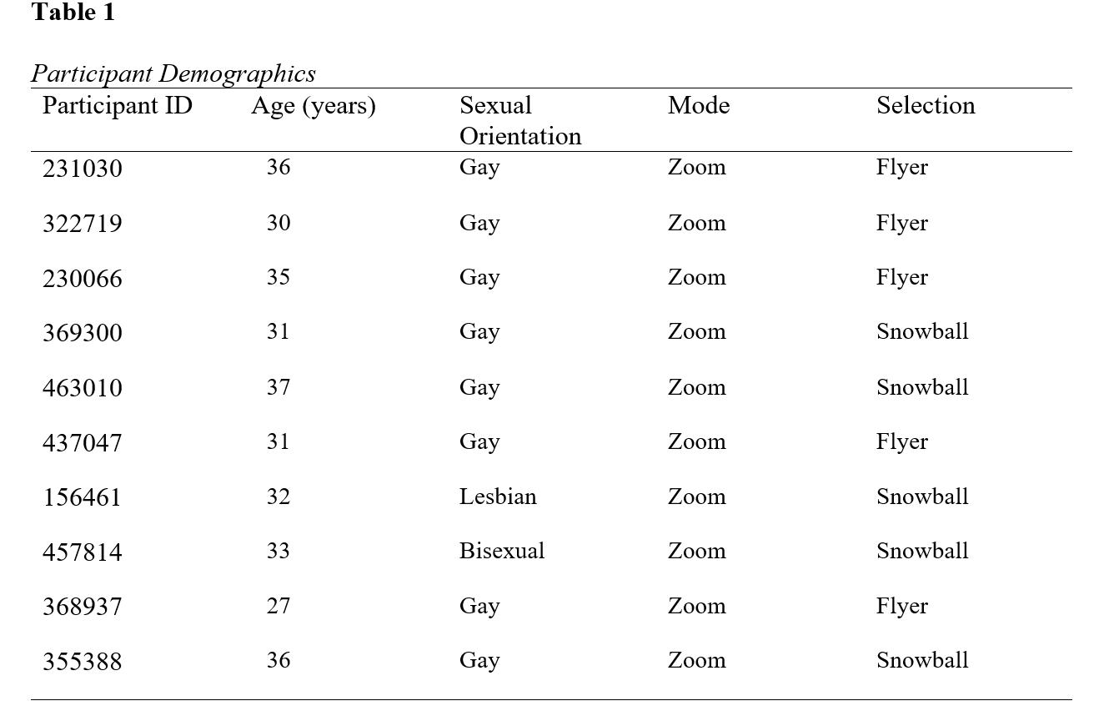
Sexual Minorities in Primary Care/Preventive Medicine

Slide 11
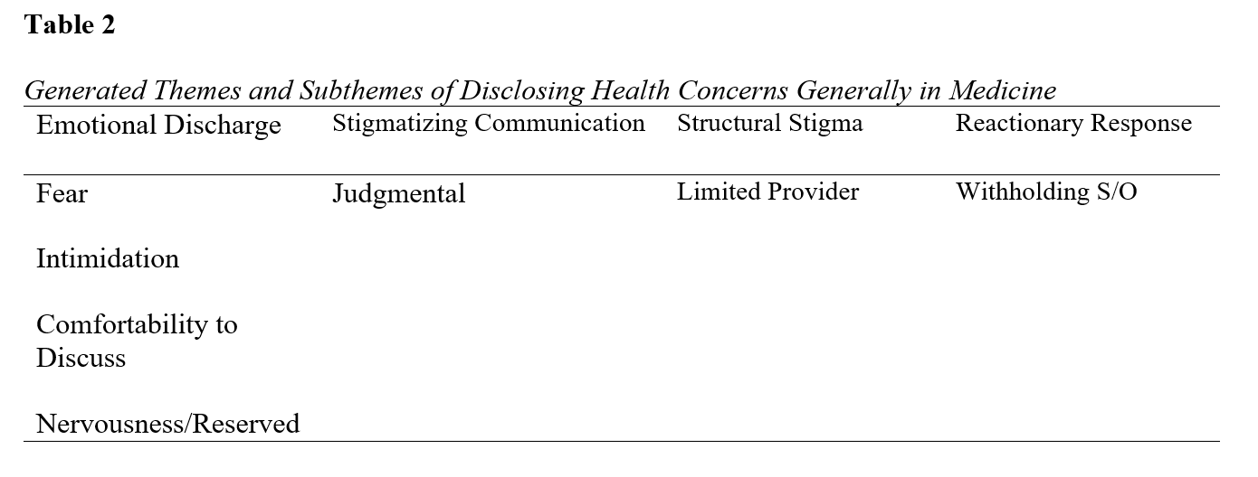
Sexual Minorities in Primary Care/Preventive Medicine

Slide 12
Sexual Minorities in Primary Care/Preventive Medicine

Slide 13
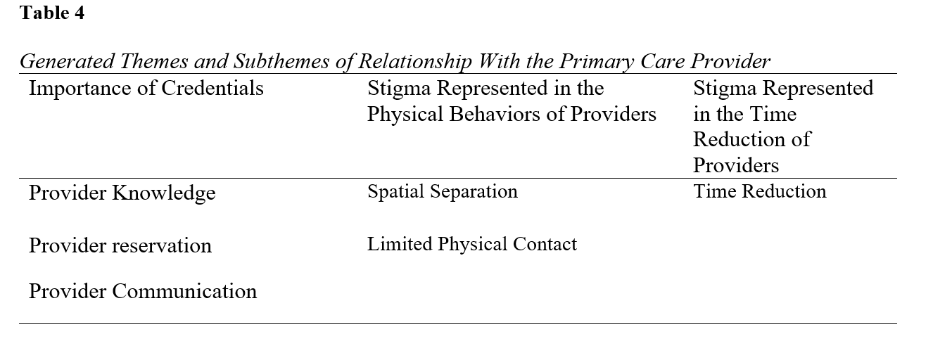
Sexual Minorities in Primary Care/Preventive Medicine

Slide 14
Sexual Minorities in Primary Care/Preventive Medicine

Slide 15
Sexual Minorities in Primary Care/Preventive Medicine

Slide 16
Summary of Results
Limited articles were published during the conduct of this study (Aisner, 2020; Furness et al., 2020; Willging et al., 2020).
Verbal and physical manifestations of stigmatization were found in the participant’s narratives.
Acceptance of the provider toward the LGBTQIA+ community, communication patterns, and exposure to the LGBTQIA+ community were influencing factors impacting the components of health-related behavior.
Provider credentials offer a power differential on the dynamic interaction between sexual minorities and the provider in discussing health care needs.
Barometric change represented as an external presence of self indicates unchartered areas of health care for LGBTQIA+ health research.

Slide 17
Demographics on LGBTQIA+ With Disabilities

Slide 18
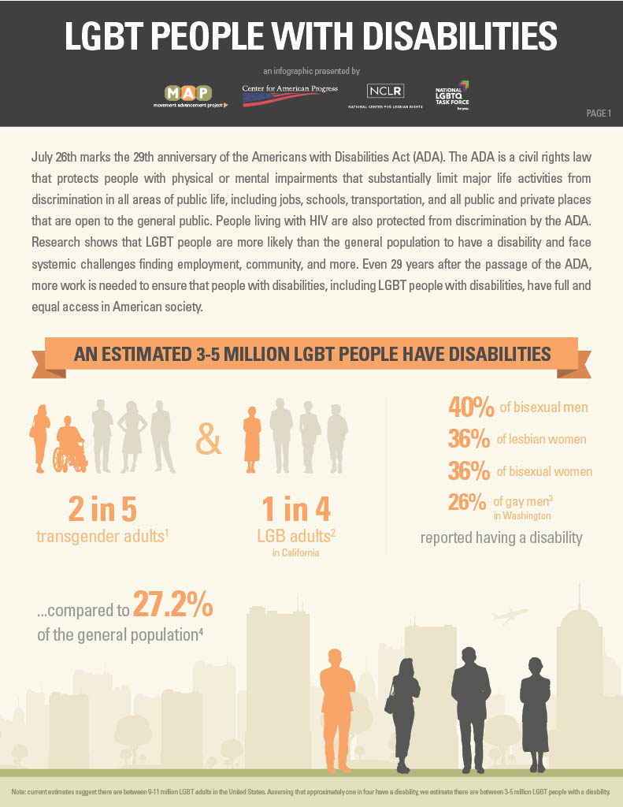
Demographics
3-5 million LGBT have disabilities
40% of bisexual men
36% of lesbian women
36% of bisexual women
26% of gay men
Source: Movement Advancement Project. July 2019. LGBT People With Disabilities. https://www.lgbtmap.org/lgbt-people-disabilities

Slide 19
Challenges For LGBTQIA+ With Disabilities

Slide 20
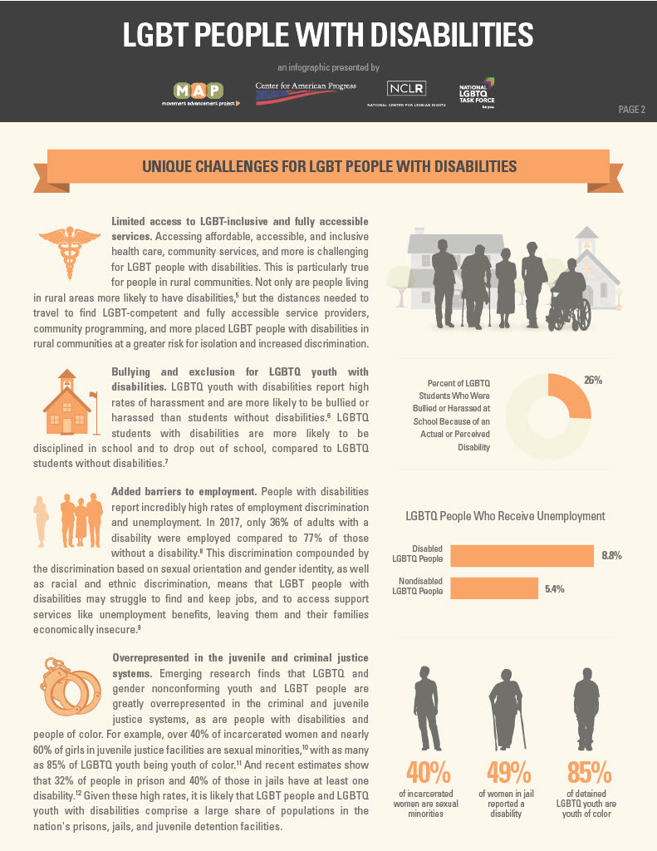
Challenges For LGBTQIA+ With Disabilities
Limited access to full services
LGBTQIA+ youth with disabilities experience higher levels of bullying
Employment barriers
More likely to be caught in the criminal justice system
Source: Movement Advancement Project. July 2019. LGBT People With Disabilities. https://www.lgbtmap.org/lgbt-people-disabilities

Slide 21
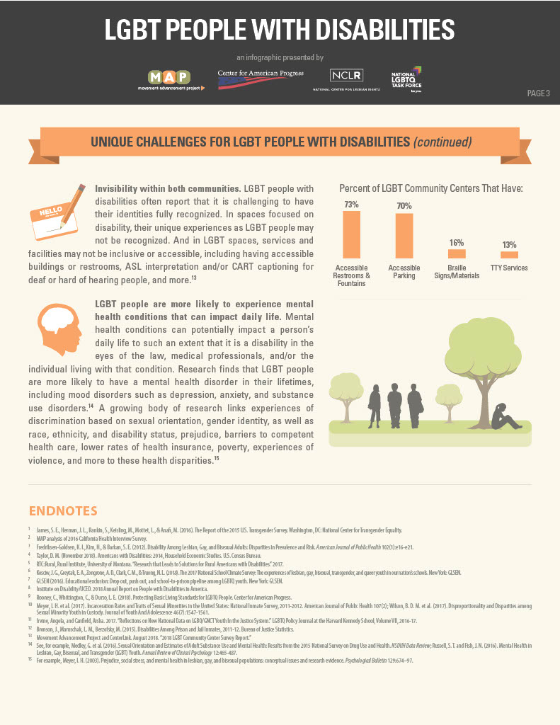
Challenges For LGBTQIA+ With Disabilities (Continued)
Not accepted by either community
More likely to experience mental health conditions
Source: Movement Advancement Project. July 2019. LGBT People With Disabilities. https://www.lgbtmap.org/lgbt-people-disabilities

Slide 22
Self-Advocacy

Slide 23
What Can You Do Exercise?
(1) What can you do in your community to self-advocate or advocate for someone living with a disability?

Slide 24
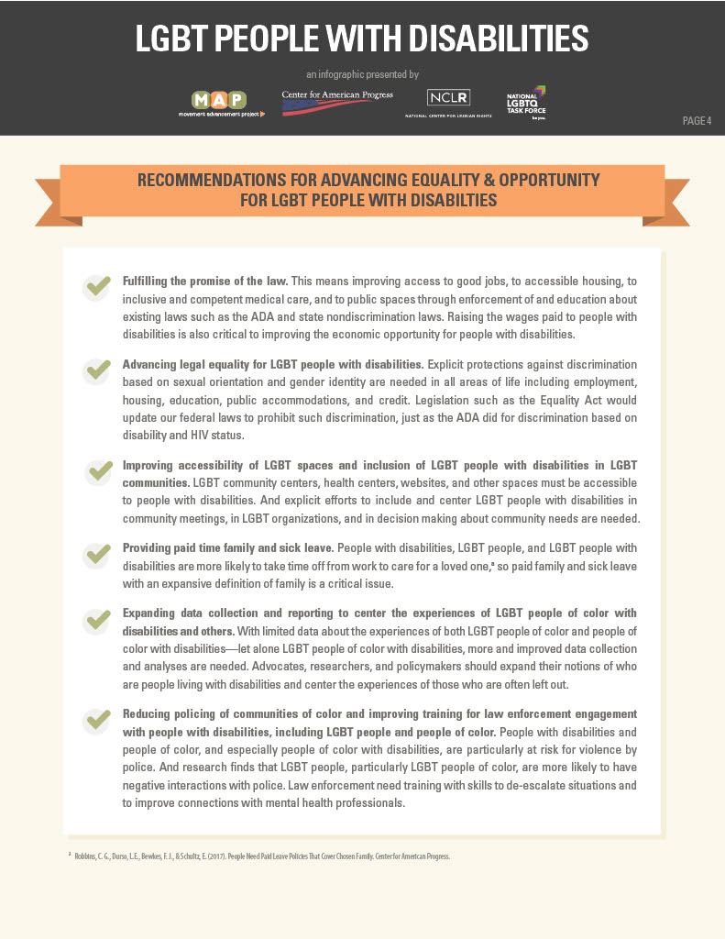
What Does The Community Say?
Understand
Understand ADA laws and how it applies to LGBTQIA+ persons
Advance
Advance legal protections
Improve
Improve access and inclusivity to services
Expand
Expand research on LGBTQIA+ persons living with disabilities
Improve
Improve training
Source: Movement Advancement Project. July 2019. LGBT People With Disabilities. https://www.lgbtmap.org/lgbt-people-disabilities

Slide 25
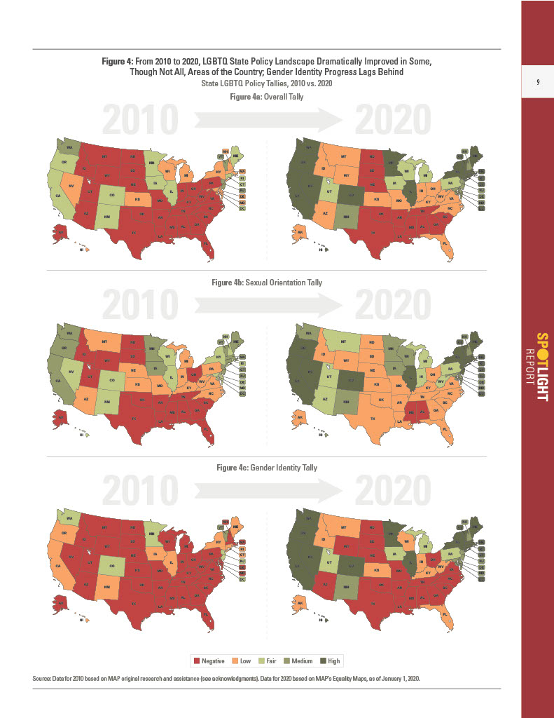
Are You Protected?
Source: Movement Advancement Project. February 2020. Mapping LGBTQ Equality: 2010 to 2020. www.lgbtmap.org/2020-tally-report

Slide 26
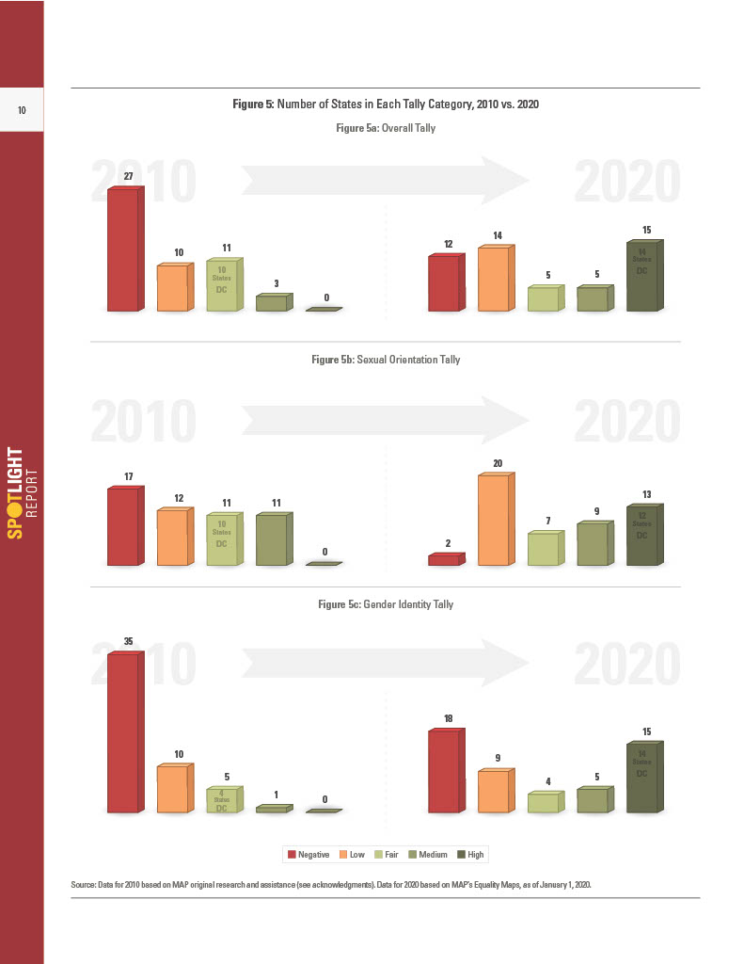
Are You Protected?
Source: Movement Advancement Project. February 2020. Mapping LGBTQ Equality: 2010 to 2020. www.lgbtmap.org/2020-tally-report

Slide 27
Resources For LGBTQIA+ With Disabilities

Slide 28
Where Can You Go?
Local Libraries
Policy Representatives
International Organizations
Non-Profit Organizations
Medical Community

Slide 29
Contact
Samuel J. Hickson, Ph.D., LMSW, MSSA, MBA, ACE-CHC
Intermountain Healthcare Nevada
Department of High Risk
6355 S Buffalo Dr., 3rd Floor
Las Vegas, NV 89113
702.499.8565
samuel.hickson@imail.com

Slide 31
References
Aisner, A. J., Zappas, M., & Marks, A. (2020). Primary care for lesbian, gay, bisexual, transgender, and queer/questioning (LGBTQ) patients. Journal for Nurse Practitioners, 16(4), 281-285. https://doi.org/10.1016/j.nurpra.2019.12.011
Baldwin, A. M., Dodge, B., Schick, V., Sanders, S. A., & Fortenberry, J. D. (2017). Sexual minority women's satisfaction with health-care providers and state-level structural support: Investigating the impact of lesbian, gay, bisexual, and transgender non-discrimination legislation. Women's Health Issues, 27(3), 271-278. https://doi.org/10.1016/j.whi.2017.01.004
Barefoot, K. N., Smalley, K. B., & Warren, J. C. (2017). A quantitative comparison of the health care disclosure experiences of rural and non-rural lesbians. Stigma and Health (Washington, D.C.), 2(3), 195-207. https://doi.org/10.1037/sah0000052
Bowling, J., Baldwin, A., & Schnarrs, P. W. (2019). Influences of health care access on resilience building among transgender and gender non-binary individuals. International Journal of Transgenderism, 20(2), 205-217. https://doi.org/10.1080/15532739.2019.1595807
Bristowe, K., Hodson, M., Wee, B., Almack, K., Johnson, K., Daveson, B. A., Koffman, J., McEnhill, L., & Harding, R. (2018). Recommendations to reduce inequalities for LGBT people facing advanced illness: ACCESSCare national qualitative interview study. Palliative Medicine, 32(1), 23-35. https://doi.org/10.1177/0269216317705102

Slide 32
References
Chasin, C. D. (2015). Making sense in and of the asexual community: Navigating relationships and identities in a context of resistance. Journal of Community & Applied Social Psychology, 25(2), 167-180. https://doi.org/10.1002/casp.2203
Chiacu, D. (2021, May 10). Biden revives LGBT protections against healthcare discrimination. U.S. News & World Report. https://www.usnews.com/news/us/articles/2021-05-10/biden-administration-to-protect-gay-transgender-against-health-care-discrimination-hhs
Cyrus, K. (2017). Multiple minorities as multiply marginalized: Applying the minority stress theory to LGBTQ people of color. Journal of Gay & Lesbian Mental Health, 21(3), 194-202. https://doi.org/10.1080/19359705.2017.1320739
Dichter, M. E., Ogden, S. N., & Scheffey, K. L. (2018). Provider perspectives on the application of patient sexual orientation and gender identity in clinical care: A qualitative study. Journal of General Internal Medicine, 33(8), 1359-1365. https://doi.org/10.1007/s11606-018-4489-4
Chasin, C. D. (2015). Making sense in and of the asexual community: Navigating relationships and identities in a context of resistance. Journal of Community & Applied Social Psychology, 25(2), 167-180. https://doi.org/10.1002/casp.2203

Slide 33
References
Chiacu, D. (2021, May 10). Biden revives LGBT protections against healthcare discrimination. U.S. News & World Report. https://www.usnews.com/news/us/articles/2021-05-10/biden-administration-to-protect-gay-transgender-against-health-care-discrimination-hhs
Cyrus, K. (2017). Multiple minorities as multiply marginalized: Applying the minority stress theory to LGBTQ people of color. Journal of Gay & Lesbian Mental Health, 21(3), 194-202. https://doi.org/10.1080/19359705.2017.1320739
Dichter, M. E., Ogden, S. N., & Scheffey, K. L. (2018). Provider perspectives on the application of patient sexual orientation and gender identity in clinical care: A qualitative study. Journal of General Internal Medicine, 33(8), 1359-1365. https://doi.org/10.1007/s11606-018-4489-4
Dolezal, L., & Lyons, B. (2017). Health-related shame: An affective determinant of health? Medical Humanities, 43(4), 257-263. https://doi.org/10.1136/medhum-2017-011186
Doyle, D. M., & Molix, L. (2016). Disparities in social health by sexual orientation and the etiologic role of self-reported discrimination. Archives of Sexual Behavior, 45(6), 1317-1327. https://doi.org/10.1007/s10508-015-0639-5

Slide 34
References
Ellner, A. L., & Phillips, R. S. (2017). The coming primary care revolution. Journal of General Internal Medicine: JGIM, 32(4), 380-386. https://doi.org/10.1007/s11606-016-3944-3
Emlet, C. A., Fredriksen-Goldsen, K. I., Kim, H., & Hoy-Ellis, C. (2017). The relationship between sexual minority stigma and sexual health risk behaviors among HIV-positive older gay and bisexual men. Journal of Applied Gerontology, 36(8), 931-952. https://doi.org/10.1177/0733464815591210
English, D., Rendina, H. J., & Parsons, J. T. (2018). The effects of intersecting stigma: A longitudinal examination of minority stress, mental health, and substance use among Black, Latino, and Multiracial gay and bisexual men. Psychology of Violence, 8(6), 669-679. https://doi.org/10.1037/vio0000218
Fallin-Bennett, K. (2015). Implicit bias against sexual minorities in medicine: Cycles of professional influence and the role of the hidden curriculum. Academic Medicine, 90(5), 549-552. https://doi.org/10.1097/ACM.0000000000000662
Figueroa, W. S., & Zoccola, P. M. (2016). Sources of discrimination and their associations with health in sexual minority adults. Journal of Homosexuality, 63(6), 743-763. https://doi.org/10.1080/00918369.2015.1112193

Slide 35
References
Furness, B. W., Goldhammer, H., Montalvo, W., Gagnon, K., Bifulco, L., Lentine, D., & Anderson, D. (2020). Transforming primary care for lesbian, gay, bisexual, and transgender people: A collaborative quality improvement initiative. Annals of Family Medicine, 18(4), 292-302. https://doi.org/10.1370/afm.2542
Gahagan, J., & Subirana-Malaret, M. (2018). Improving pathways to primary health care among LGBTQ populations and health care providers: Key findings from Nova Scotia, Canada. International Journal for Equity in Health, 17(1), Article 76. https://doi.org/10.1186/s12939-018-0786-0
Gonzales, G., & Henning-Smith, C. (2017). Barriers to care among transgender and gender non-conforming adults. Milbank Quarterly, 95(4), 726-748. https://doi.org/10.1111/1468-0009.12297
Hughes, R. L., Damin, C., & Heiden-Rootes, K. (2017). Where’s the LGBT in integrated care research? A systematic review. Families Systems & Health, 35(3), 308-319. https://doi.org/10.1037/fsh0000290
Munce, M. (2021, May 17). Texas senate resumes push to ban transition-related medical care for transgender children, days after bill failed in house. The Texas Tribune. https://www.texastribune.org/2021/05/17/texas-transgender-children-medical-care/

Slide 36
References
Perone, A. K. (2015). Health implications of the Supreme Court’s Obergefell vs. Hodges marriage equality decision. LGBT Health, 2(3), 196-199. https://doi.org/10.1089/lgbt.2015.0083
Willging, C., Kano, M., Green, A. E., Sturm, R., Sklar, M., Davies, S., & Eckstrand, K. (2020). Enhancing primary care services for diverse sexual and gender minority populations: A developmental study protocol. BMJ Open, 10(2), e032787. https://doi.org/10.1136/bmjopen-2019-032787

