Slide 1

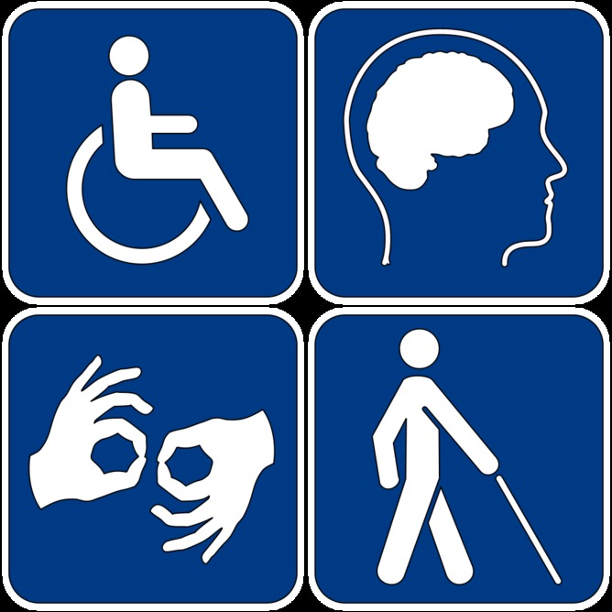
Leadership Among Those Living With Disabilities
August 3, 2022
PRESENTED BY:
Dr. Sherilyn Duckworth, MPH
Immunize Nevada
This Photo by Unknown Author is licensed under CC BY-ND

Slide 2

Objectives
Defining Disabilities
  Disabilities and Health Equity
    Disability 101
      Disability Justice and its Principles
        Political Vision
        Internal Auditing
        Principles
        Access Tools
        Success Stories
        Questions?
This Photo by Unknown Author is licensed under CC BY-SA-NC

Slide 3
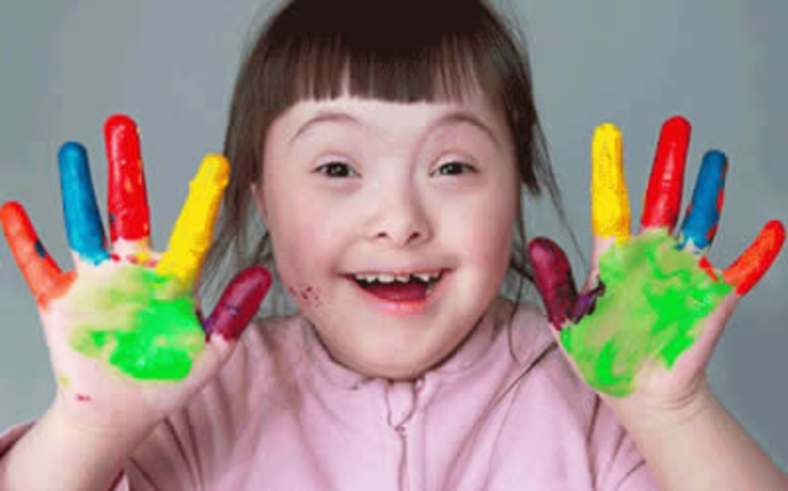
What is DD?
Developmental Disability
severe, long-term disability beginning prior to the age of 22
Impacts cognitive functioning, physical functioning, and development of adaptative skills
This Photo by Unknown Author is licensed under CC BY

Slide 4
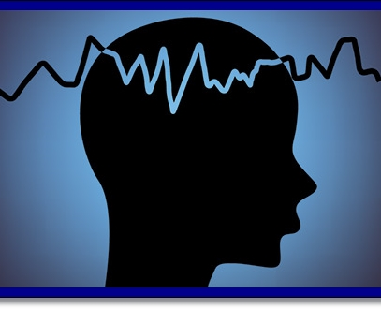
What is ID?
Intellectual Disability
Significant limitations both in intellectual functioning and adaptive behavior as expressed in conceptual, social, and practical skills that are apparent before the age of 18
Considers community environments, cultural and linguistic diversity, differences in communication, sensory, motor, and behavioral factors
This Photo by Unknown Author is licensed under CC BY-SA

Slide 5
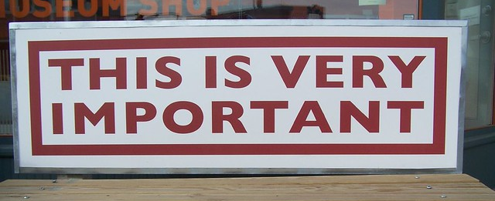
“Treat people the way THEY would like to be treated and not the way YOU want to be treated.”
This Photo by Unknown Author is licensed under CC BY-SA

Slide 6

Leading the way…
Promote early identification
Inclusivity
Prevent and manage the occurrence and impact of health conditions
Increase awareness of special work needs for those with disabilities
Promote healthy behaviors in people with disabilities in the workplace
This Photo by Unknown Author is licensed under CC BY

Slide 7
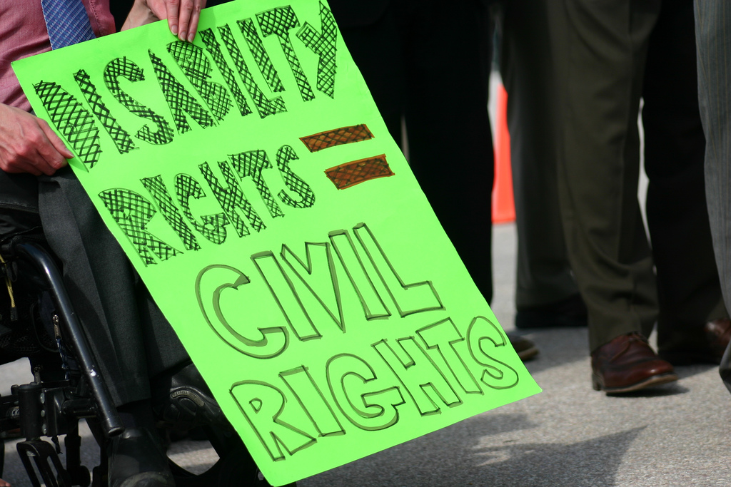
Disability 101
What is Disability Justice?
Political Vision
Completing an Internal Audit
Disability Justice Principles
Access Tools
Success Stories
This Photo by Unknown Author is licensed under CC BY

Slide 8
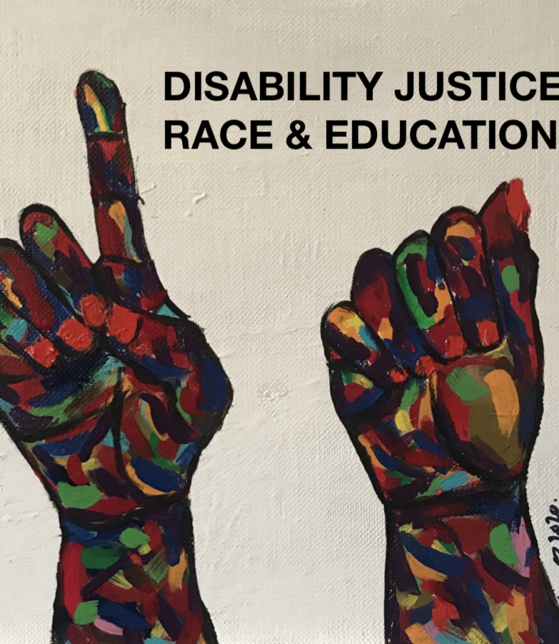
Disability Justice
Term and a movement-building framework
Centers the lives and leadership of disabled Black, Indigenous, and people of color including those who identify as queer, trans, Two Spirit and gender non conforming
This Photo by Unknown Author is licensed under CC BY-SA-NC

Slide 9
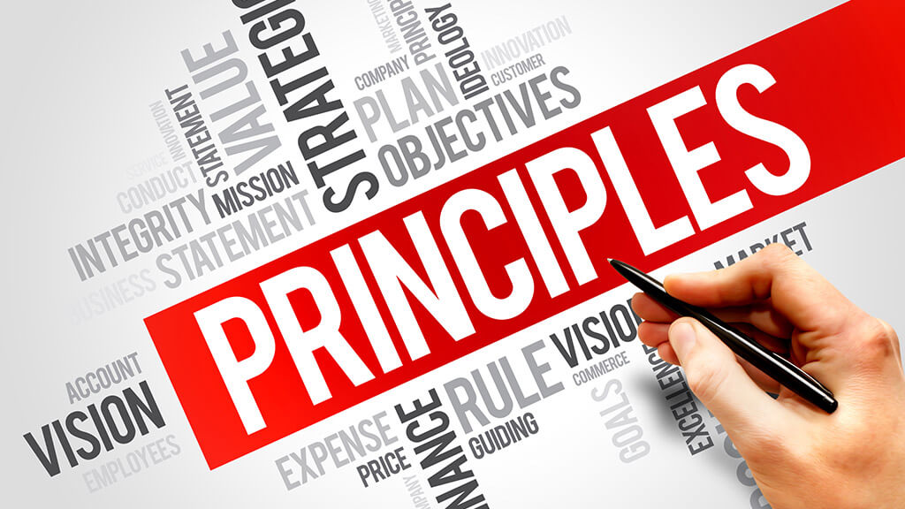
DJ’s Principles
Intersectionality
Leadership of Those Most Impacted
Anti-capitalist Politic
Commitment to Cross-movement Organizing
Recognizing Wholeness
Sustainability
Commitment to Cross-disability Solidarity
Interdependence
Collective Access
Collective Liberation
This Photo by Unknown Author is licensed under CC BY-NC

Slide 10
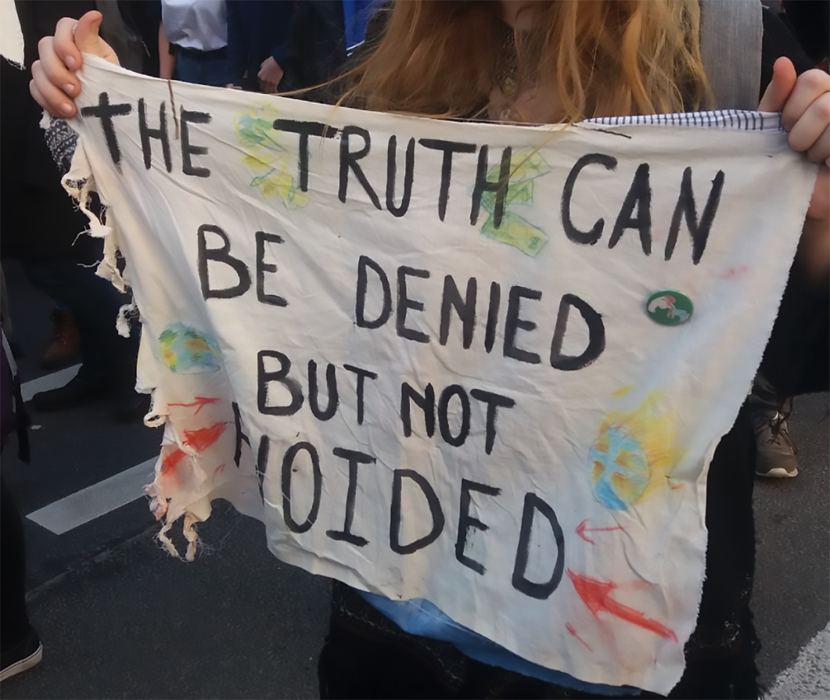
Political Vision
From accessibility options to shifting power
How is DJ influencing our politics and practices?
When policies are created, how are we thinking about disabled people issues?
Are we thinking of disabled people as leaders and members of our organization or just clients to be served?
How are we addressing and mending histories of ableism in our organization?
This Photo by Unknown Author is licensed under CC BY-ND

Slide 11

Internal Auditing
Budgets
Accessible Support Vendors
Number of disabled people working in your organization?
Leadership?
Policy Review
Disability, sick, or caregiving access requests
Required documentation?
Access achievement in anti-ableist way?
This Photo by Unknown Author is licensed under CC BY

Slide 12
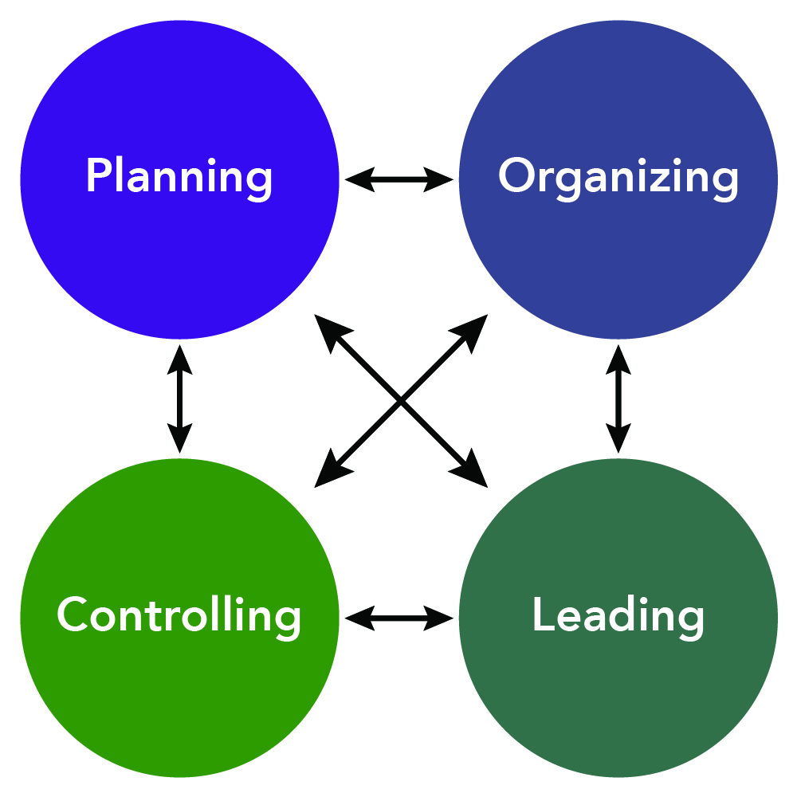
Principles
How are you embodying intersectionality in your DJ work?
How are you ensuring that the people most impacted by ableism are leading?
How are you doing work that’s not disability capitalism?
How are you thinking about and practicing sustainability?
How are you practicing cross-disability solidarity?
What does interdependence mean to you?
How are you doing with collective access?
How have you been working for collective liberation right now with disability justice at the center?
This Photo by Unknown Author is licensed under CC BY

Slide 13

Access Tools
ASL
English, Spanish
Text only with image descriptions
Publicity/Media
Radio/Podcase
Office Space Access
Plain Language
This Photo by Unknown Author is licensed under CC BY-NC

Slide 14
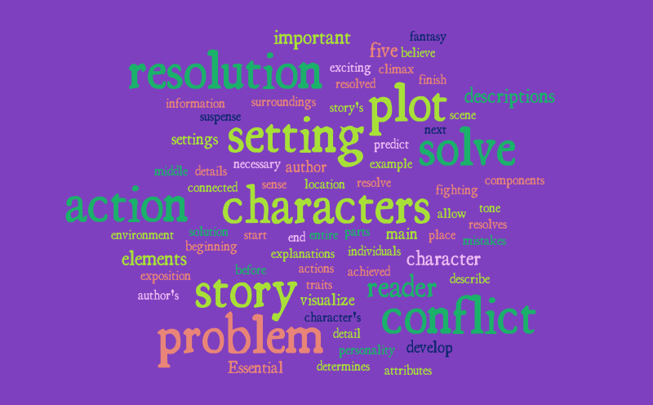
Success Stories
Block Build Be: Oakland, California
Kebo Drew, Queer Women of Color Media Access Project
-- “It’s not a burden to make things accessible. Of course, I want to make a space where my family can come.”
Hand and Hand
Nikkita Oliver’s City Council Campaign & Nikkita4Nice: Seattle, Washington State
This Photo by Unknown Author is licensed under CC BY-NC-ND

Slide 15
“The world is ableist and disabling and things happen…but at the same time it allows us to be way more brilliant than if we weren’t.”

Slide 16
References
Henrichs, S. Health disparities in individuals with intellectual and developmental disabilities. Retrieved from https://dhhs.ne.gov/Documents/Henrichs.pdf
Krahn, G.L., & Fox, M.H. 2013. health disparities of adults with intellectual disabilities: What do we know? What do we do? Journal of Appl Res intellect Disabil: 27(5): 431-446. doi: 10.1111/jar.12067
Piepzna-Samarasinha Laks hmi, L., & Milbern Park, S., 2022. Disability Justice: An audit tool. Retrieved from https://static1.squarespace.com/static/5ed94da22956b942e1d51e12/t/6232af2503a09a54615b8d48/1647488823793/DJ+Audit+Tool.pdf
University of Rochester Medical Center., Strong Center for Developmental Disabilities. 2022. health Equity. Retrieved from https://www.urmc.rochester.edu/strong-center-developmental-disabilities/our-focus-areas/health-equity.aspx

Slide 17
Questions?

