Slide 1
Inclusive Civic Engagement: Voting & Legislative Advocacy
Dr. Sondra Cosgrove
History Professor College of Southern Nevada
Executive Director Vote Nevada
https://vote-nevada.org/ https://vote-nevada-blog.org/ Email: info@vote-Nevada.org

Slide 2
Elections & Voting
ADA Compliant Elections
Bill Idea for 2023:
Include ADA Guidelines in candidate filing information
Sample Ballots
Electronic
Voter Registration Account
Paper Large Print
Set preferences online
Leverage New Technology
What we learned in 2020
Virtual Campaign Events
Accommodations
Transcription
Recordings
One-to-One Interactions
“Going Back”
Old status quo was exclusionary
Increase access needs to stay

Slide 3
Voting: Options EASE, Mail-in, In-person

Slide 4
Ballot Assistance

Slide 5
In-Person

Slide 6
Legislative Advocacy
https://www.leg.state.nv.us/universalaccess.htm

Slide 7
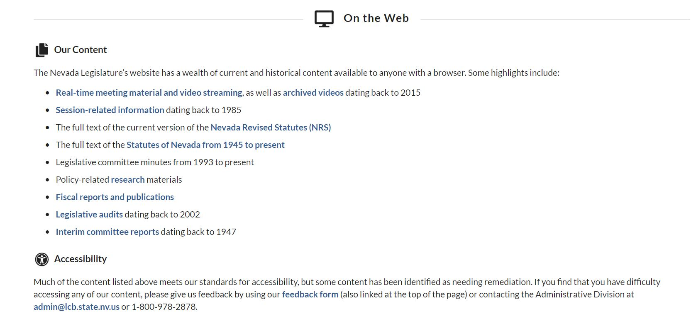

Slide 8
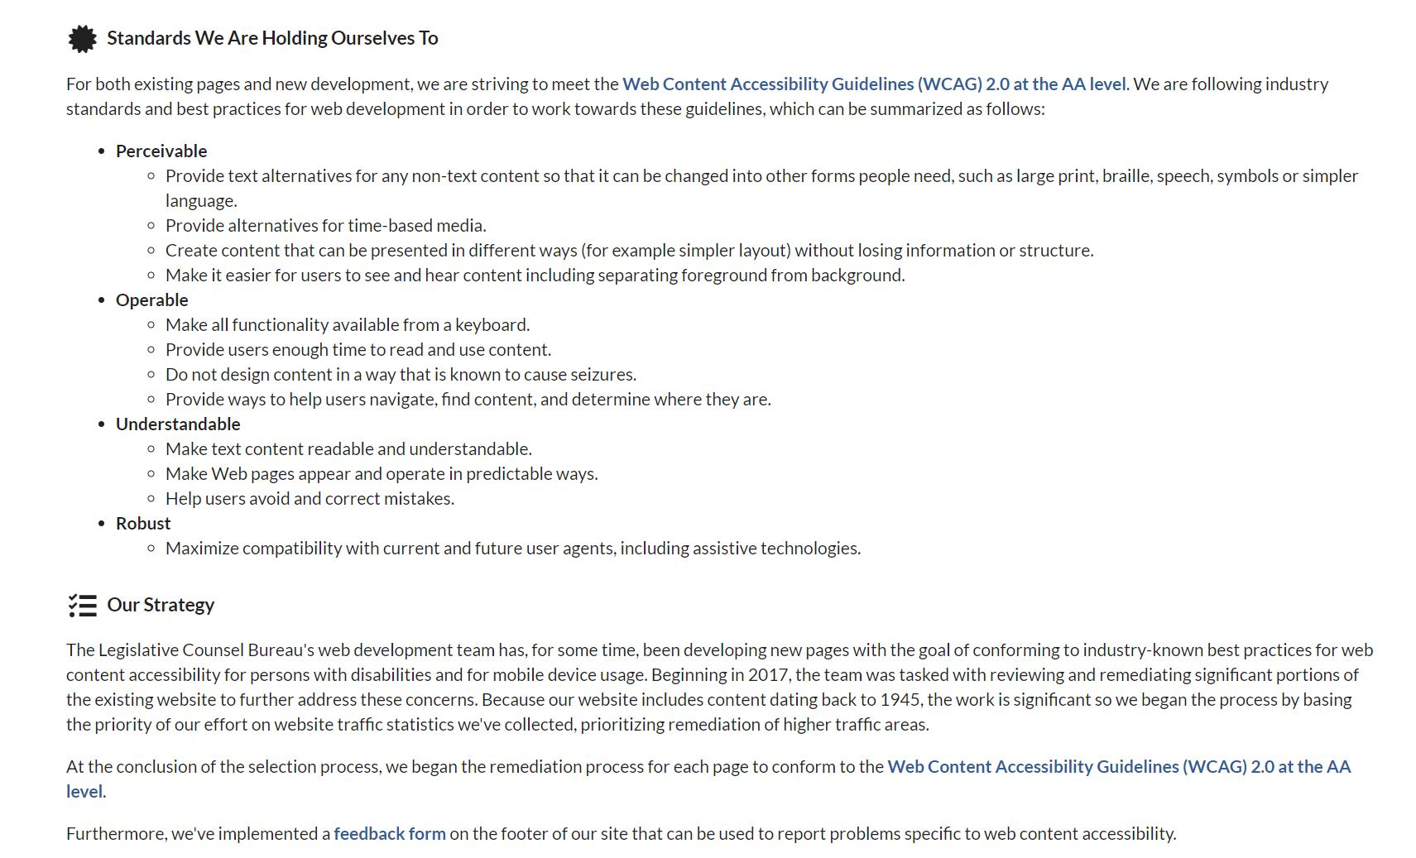

Slide 9
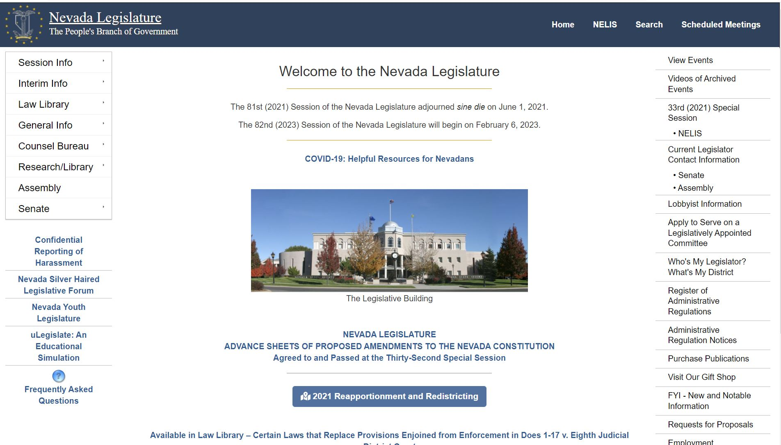

Slide 10
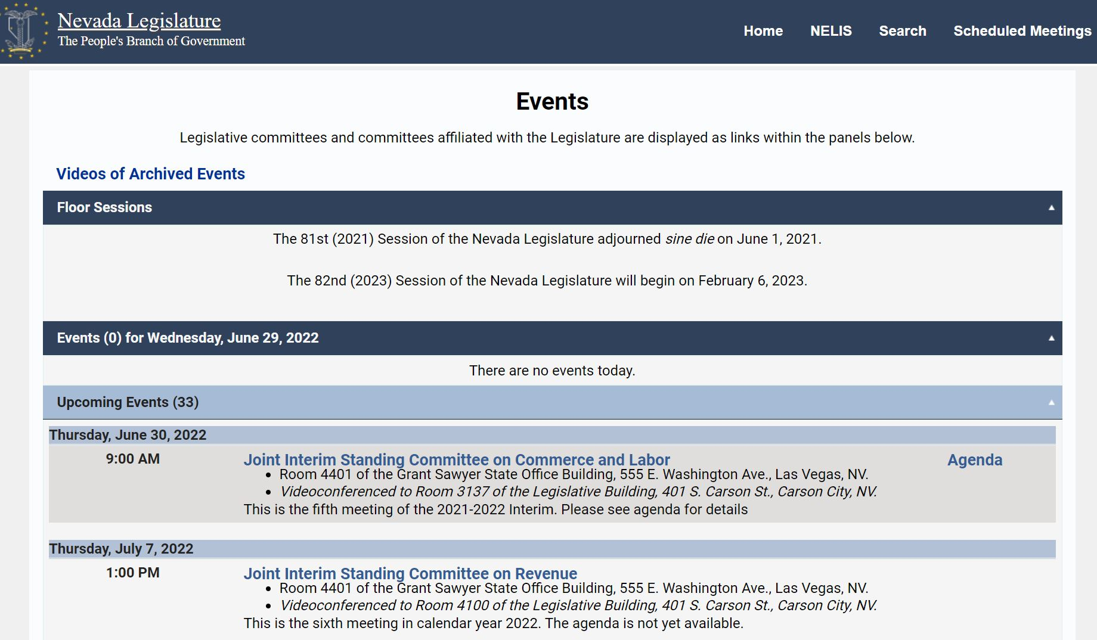

Slide 11
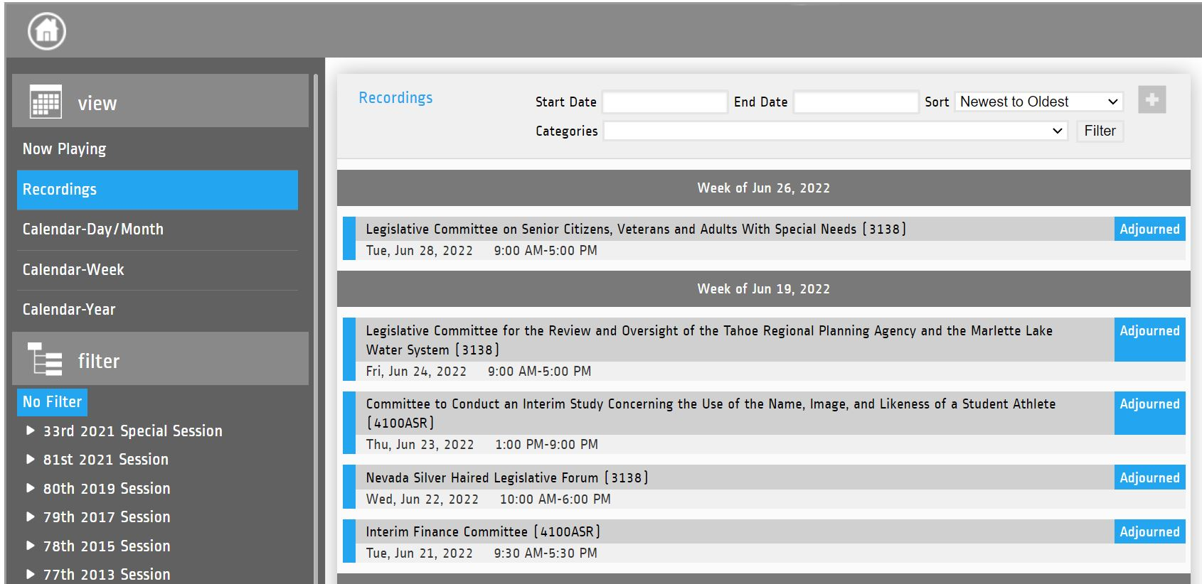

Slide 14
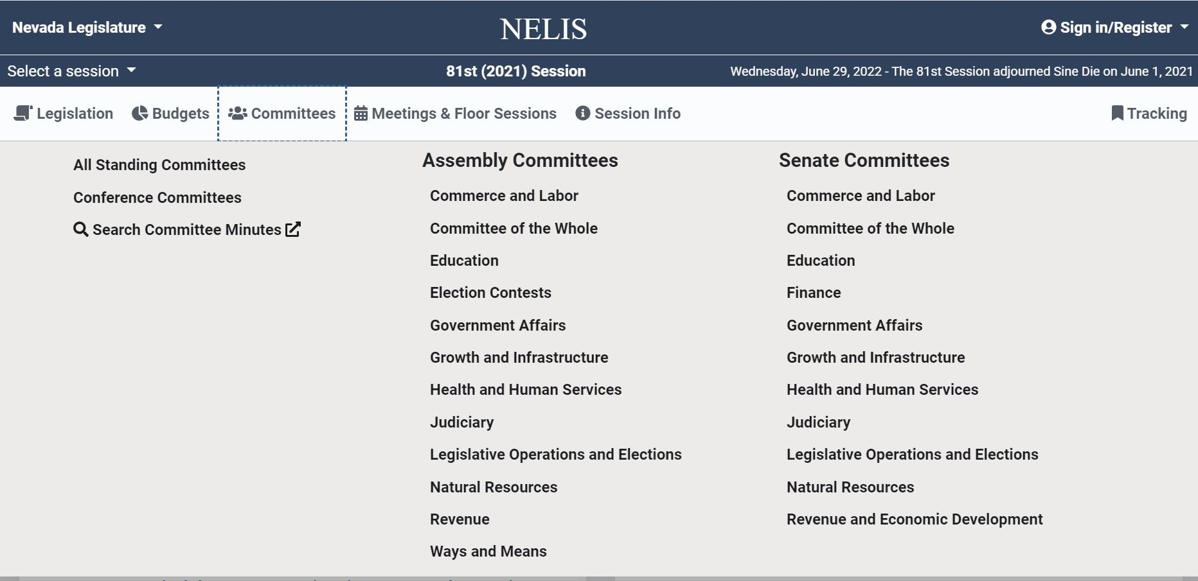

Slide 16
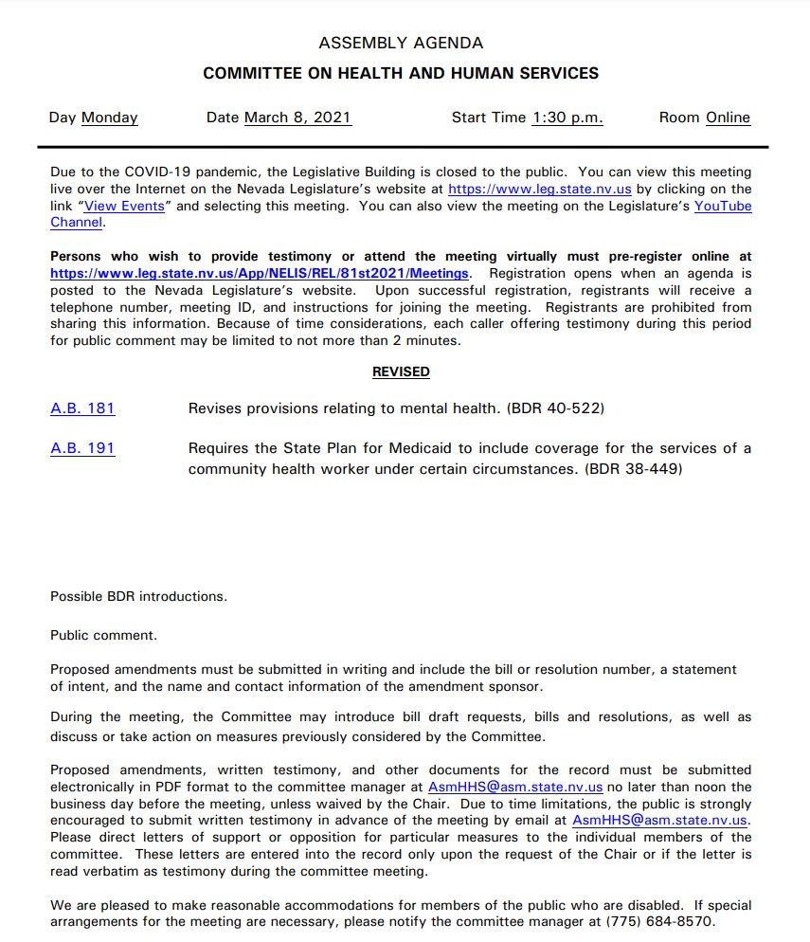

Slide 17
This Photo by Unknown Author is licensed under CC BY-NC

