Slide 1
Down Syndrome Conference 2022
Down Syndrome Connections Las Vegas
Waldina & Fernando Tapia

Slide 2
Thank You
Thank you NGCDD and CLDF for making it possible of us to be able to attend our first Down Syndrome Conference.

Slide 3
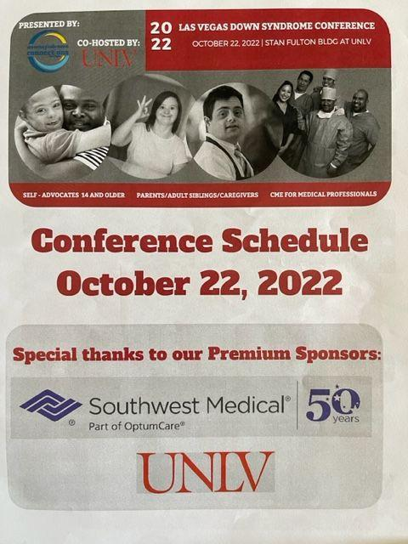
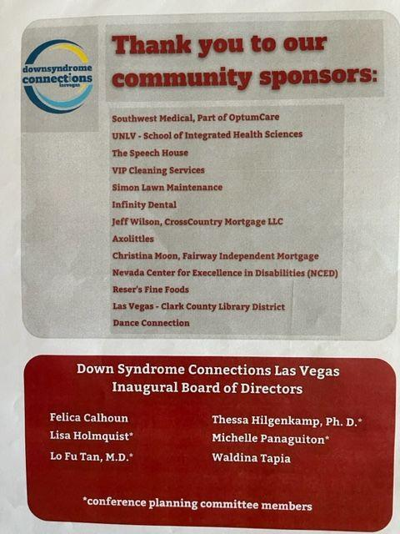
Program Front and Back Page

Slide 4
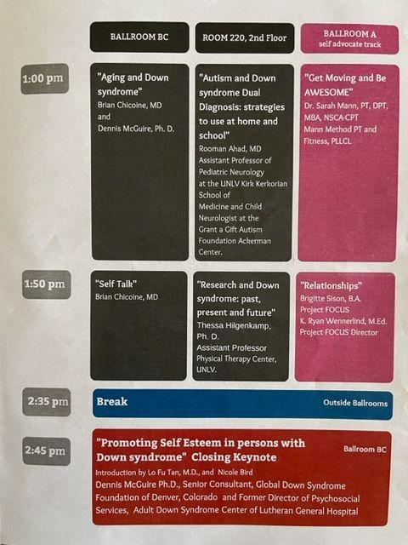
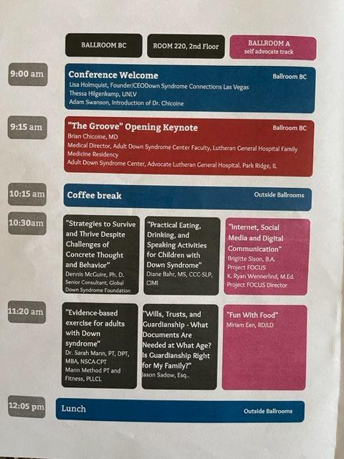
The Program……

Slide 5
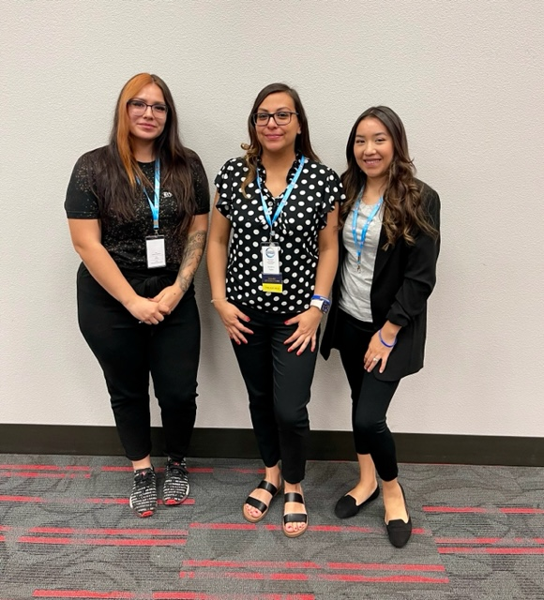
Did it meet your Expectations?
It was better than I expected. There was so much information being shared. I learned so many new things. I met new families and made friends.

Slide 6
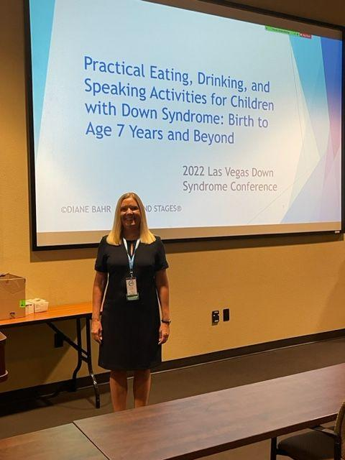
Would You Recommend this particular event?
Yes I would recommend the conference because there was information for babies all the way to adulthood.
For example the “Practical Eating, Drinking and Speaking activities” class given by Diane Bahr
And the “Fun with Food” Class by Miriam Een
Video Of Self Advocates Class "Fun with Food"

Slide 7
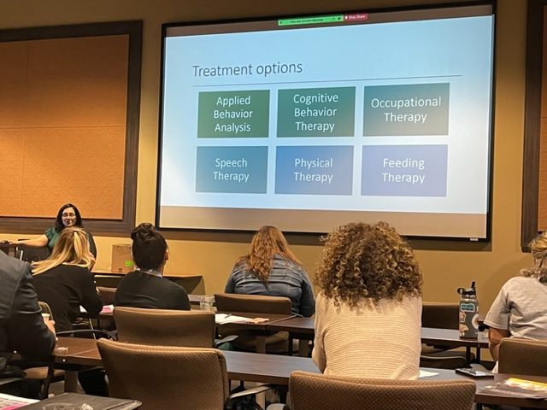
3 Most Significant things you learned at the Event?
A person with T21 can have a dual Diagnosis. For example: Down Syndrome and Autism. Rooman Ahad, MD Assistant Professor of Pediatric Neurology gave us information on where to go and what treatment options were available.

Slide 8
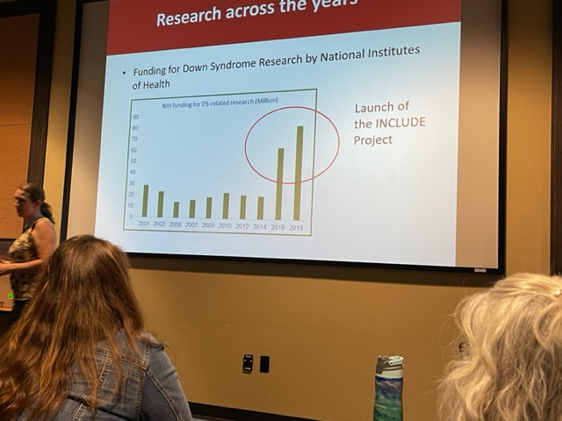
3 Most Significant things I learned at the event?
Number 2. Research is not only about getting blood drawn & testing. Signing up for a research can offer many benefits and free resources. For Example Free Classes that otherwise you would have to pay and monetary compensation for participating.

Slide 9
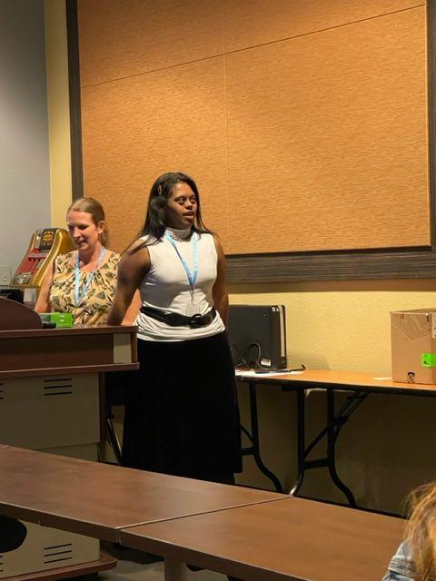
3 Most Significant things I learned at the event?
#3 Someone with T21/Down Syndrome can advocate for themself, CAN go to college, and CAN give speeches at a conference.

Slide 10
What System Change activities will you purse as a result of what I learned?
Have my child attend more classes and therapies. Encouraging her to do things on her own and be independent.

Slide 11
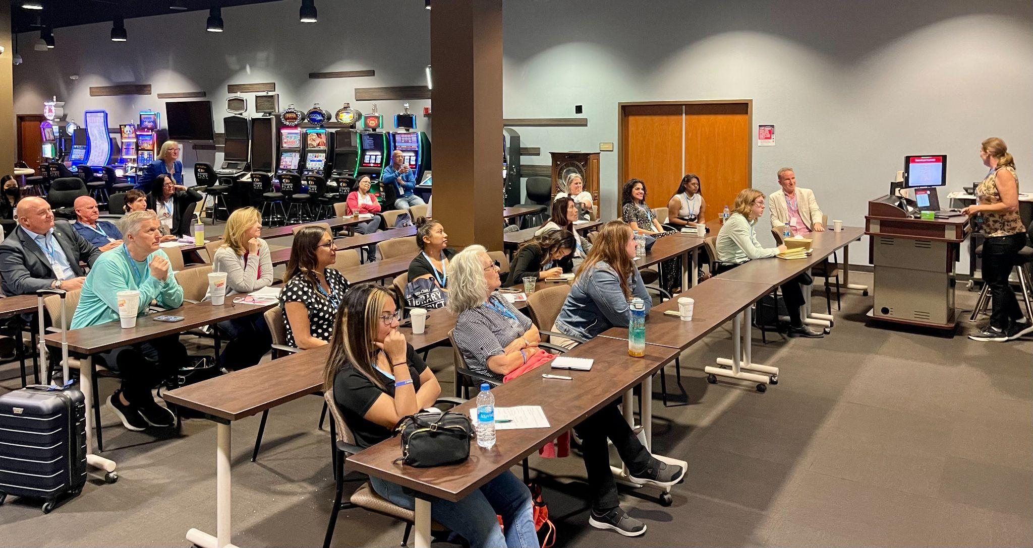
What things would you like to see happen in Nevada, above and beyond what you might do on your own?
I would like to see more financial help for parents who need therapies/ Classes for their kids.

Slide 12
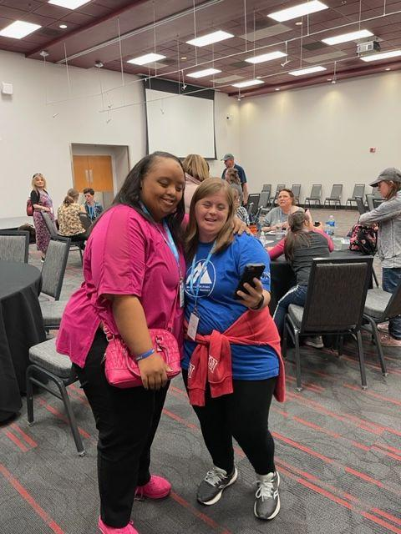
How has your attendance to this event affected your life on a personal level?
It made it more positive. I really like seeing the self advocates in their classes learning, and having fun taking selfies with their friends. It was like getting a glimpse into my daughters future.

Slide 13
Sharing.
I host a monthly meet up for Spanish Speaking Families who have an individual with T21/Down Syndrome. I shared what I learned in the conference with them. I also Volunteer at Down Syndrome Connection Las Vegas and Shared What I learned with them as well. I posted Pics and Video on our social medias
Thank You once again for making it possible for us to attend and learn so much and share with our community.
#LuckyFew
The End.

