Slide 1
HOW TO GET FREE OR CHEAP INTERNET!
2023 NV D/HH Commission Engagement Conference

Slide 2
ACP =
Affordable
Connectivity
Program

Slide 3
FCC =
Federal
Communications
Commission

Slide 4
NEW PROGRAM FOR INTERNET ACCESS
FCC has a grant program called ACP
NAD & NBDA applied for this grant
We got the grant!
GOAL: Get Deaf People to apply for $ to help with Internet Access!

Slide 5
WHERE WILL WE HOST ACP EVENTS?
Birmingham & Las Vegas
10 other cities:
Atlanta ￮ Chicago
Detroit ￮ Los Angeles
New York City ￮ Philadelphia
Sacramento ￮ St Paul
San Francisco ￮ Washington DC

Slide 6
WHAT WILL ACP GIVE YOU?
If you qualify for ACP, then you get:
Up to $30 per month to help you pay for Internet access
Up to $75 per month for same if you live on Tribal Lands

Slide 7
LIMITS OF ACP
One monthly service discount per household
AND
One device discount per household

Slide 8
WHO QUALIFIES?
Household income is at or lower than 200% of Federal Poverty Guidelines OR
A member of household receives: SNAP, Medicaid, Federal Housing Assistance, SSI, WIC, Veterans Pension or Survivors Benefit, Lifeline, Free/Reduced Lunch benefits, or lives on Tribal Lands with specific benefits, or Federal Pell Grant this year

Slide 9
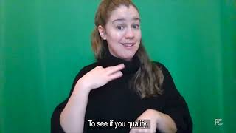
FCC Video on ACP

Slide 10
HOW TO APPLY?
Go to: getinternet.gov/apply
Click on “APPLY”
Fill out! If you’re not sure you qualify, apply anyway!
DO IT NOW! AND LET US KNOW!

Slide 11
THANK YOU

