Slide 1
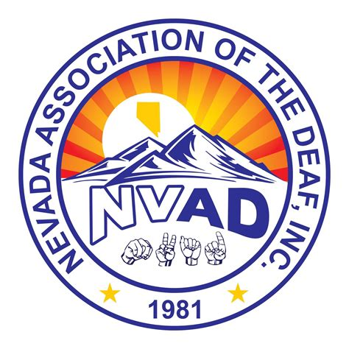
ROLES OF NVAD & NAD
2023 NV D/HH Commission Engagement Conference

Slide 2
Founded: 1981 President: Tim Smalley
Founded: 1880
President: Jenny Buechner
CEO:
Howard Rosenblum

Slide 3
Volunteer Board
Volunteer Board + Team

Slide 4
NVAD & NAD – Purpose?
Goal: Equality & Equity for all of us
Are we satisfied with the status quo?
What do we want to change?
Education, Employment, Access to Hospitals/Doctors and Mental Health, Access to Courts and Lawyers, Access to Private Businesses, Technology, Telecomm, Government Services, and much more!

Slide 5
NVAD & NAD - Relationship
NAD founded to focus on national issues inlcuding federal government, federal laws and regulations, and working with national corporations and organizations
NVAD, as a state association, is the organization for residents of Nevada, and focuses on Nevada government and laws and regulations, as well as situations in the state

Slide 6
NVAD & NAD – Relationship (continued)
NAD cannot survive without state associations and affiliates
NAD has individual members but we depend on state associations to keep us informed on what is happening in each state
State laws are as important as federal laws
State associations’ representatives vote for NAD’s Board, Bylaws and Priorities

Slide 7
NVAD – Why is it Important?
Nevada D/HH Commission is part of the state government and must follow state instructions
If you want to change the state system, need an independent organization = NVAD
All of you can be involved in NVAD to create the change you want to see here
NVAD = important partner of NV D/HH Comm

Slide 8
NAD Priorities
Achieving Equity in Deaf Education
Address Deaf Youth Well-Being
ASL Resources for Deaf Babies
Deaf Senior Issues
Dismantling Racism in the Deaf Community

Slide 9
NAD Services
Legal Representation (very limited)
Legal Referrals
Self-Advocacy Resources such as Advocacy Letters
Other Information & Resources
Youth Program (YLC, Jr NAD, etc)
Communications

Slide 10
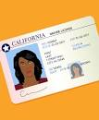
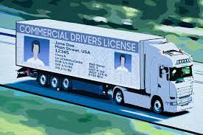
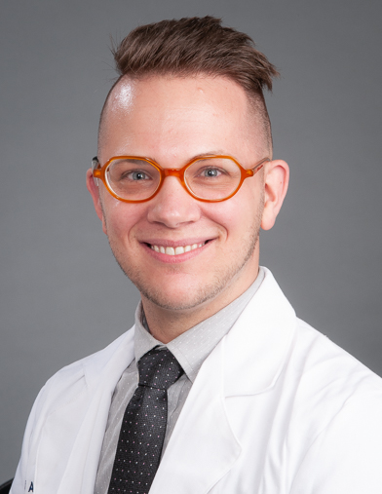
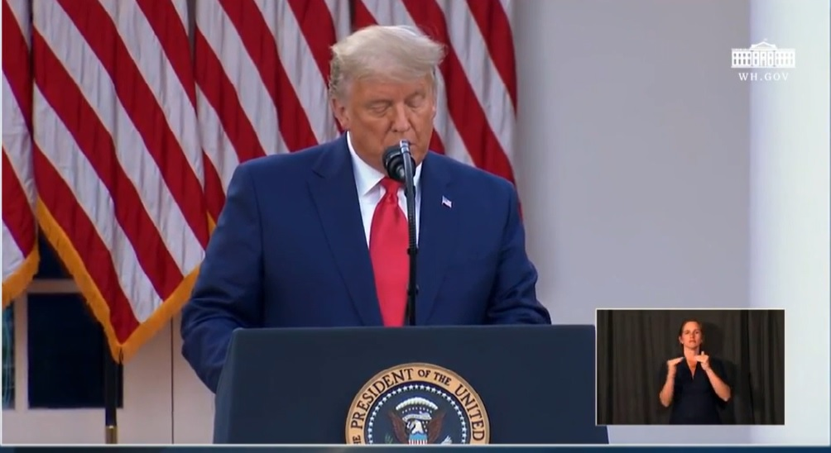
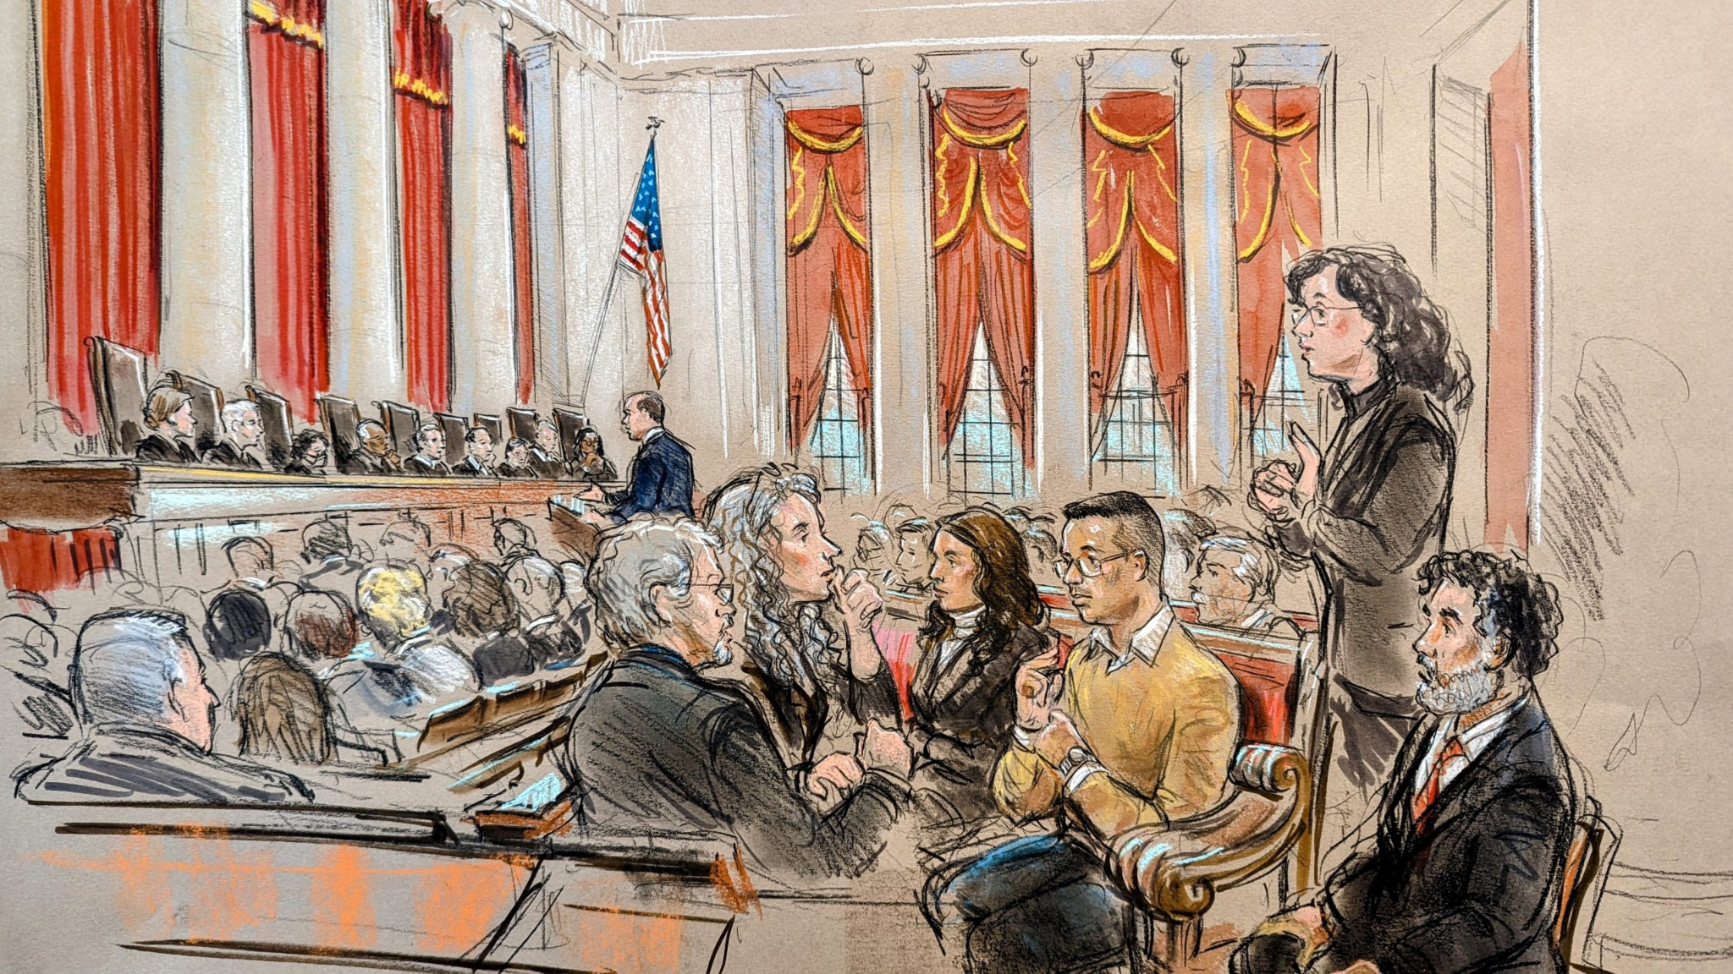
What Has NAD Done?

Slide 11
UPCOMING EVENTS

Slide 12
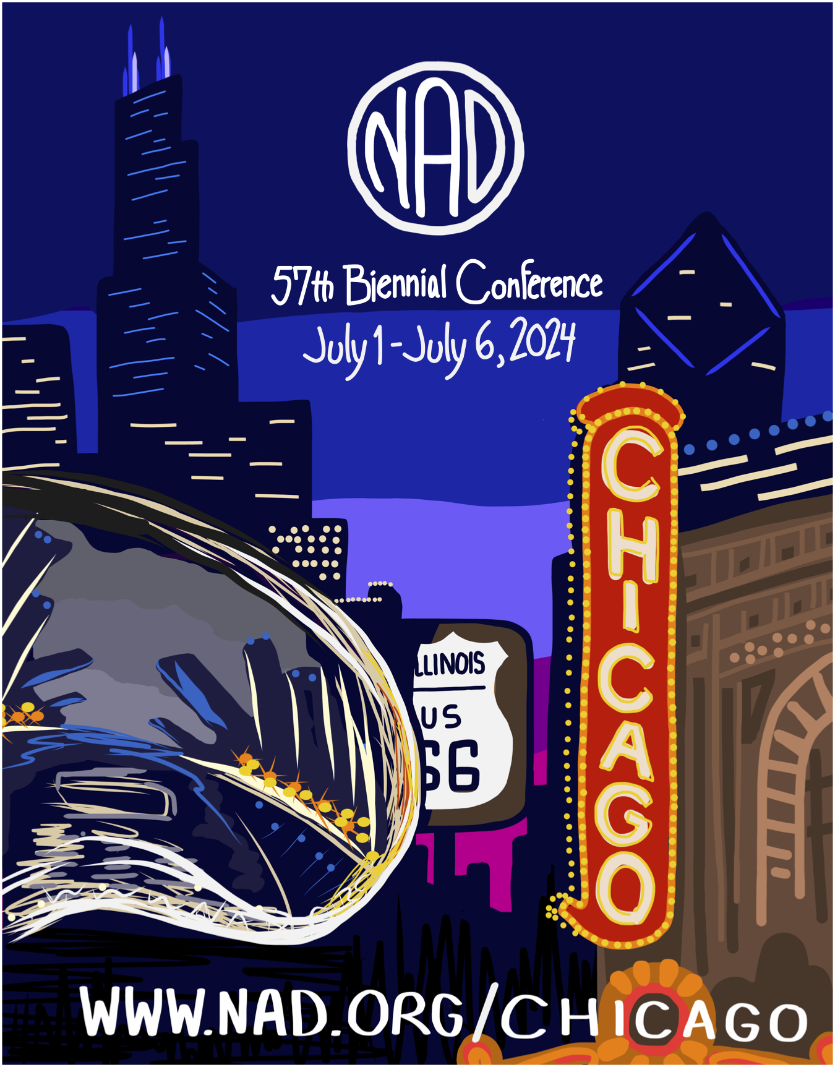
57th BIENNIAL NAD CONFERENCE

Slide 13
THANK YOU
www.nad.org

