Slide 1
Nevada Office of Minority Health and Equity
Statewide Policy Making and Legislative Change
Health Equity Through Advocacy
Tina Dortch, April Cruda, Alexandra Neal
December 16, 2023

Slide 2
Agenda
Introduction to NOMHE
Primer to Public Health, Health Equity, and Policy
Overview of Nevada’s Policy Infrastructure
Outline Policies Around Equity within Accessibility and Accommodations Access
How to Make Your Voice Heard? Advocating In and Out of Legislative Sessions.

Slide 3
Learning Objectives
Participants will be able to understand how public health, health equity, and policy work together.
Participants will gain an introductory understanding of policy creation and actioning within state government.
Participants will become familiar with two examples of legislative or regulatory policies within accessibility and accommodations access.
Participants will learn about how to make your voice heard to policymakers and how data provides examples of public need.

Slide 4
What is the Nevada Office of Minority Health and Equity?
Office located within the Director’s Office of the Nevada Department of Health and Human Services
The vision of the Nevada Office of Minority Health and Equity (NOMHE) is to achieve optimal levels of health and wellness for all minority groups and marginalized communities across the state.
NOMHE’s mission is to avoid and/or reverse disproportionately experienced, health-related disparities among the state’s most vulnerable, high-risk populations.

Slide 5
Public Health, Equity, and Health Equity
Public Health
The science and art of preventing disease, prolonging life, and promoting health through the organized efforts and informed choices of society, organizations, public and private communities, and individuals
Equity
Defined as “the state, quality or ideal of being just, impartial and fair”
Trying to understand and make accessible to people what they need to enjoy full, healthy lives
Health Equity
Achieved when every person has the opportunity to “attain his, her, or their full health potential” and no one is “disadvantaged from achieving this potential because of social position or other socially determined circumstances.”

Slide 6
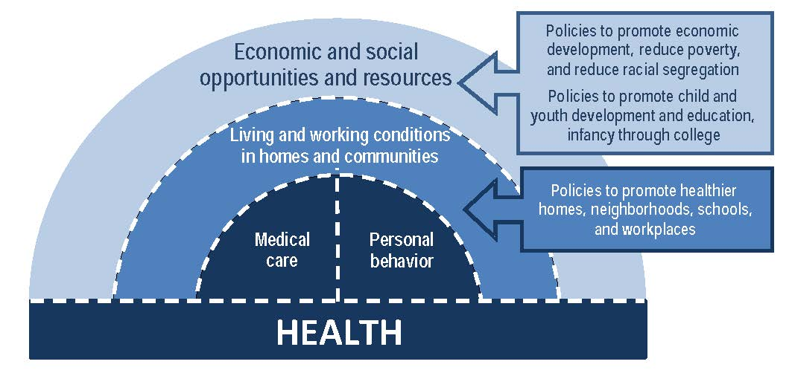
Political Determinants of Health
Political Determinants of Health: How political and social systems influence distribution of resources, opportunities, and power, ultimately affecting the health of communities
Public health professionals advocate for policy change.
Leaders influence policies for a healthier, equitable society.
Analyzing health data by demographic factors (race, ability status) is essential.
Engaging communities in the policy-making process ensures that policies reflect the needs and concerns of diverse populations.
Policies should ensure fair distribution of resources.

Slide 7
Overview of Nevada’s Policy Infrastructure:
Community Need/Input
Bill Draft (BDR)
Legislation
Regulation (Where Applicable)
Implementation
Legislative Branch
Executive Branch
State Agency
City or County Agency
Individual
Community Need

Slide 8
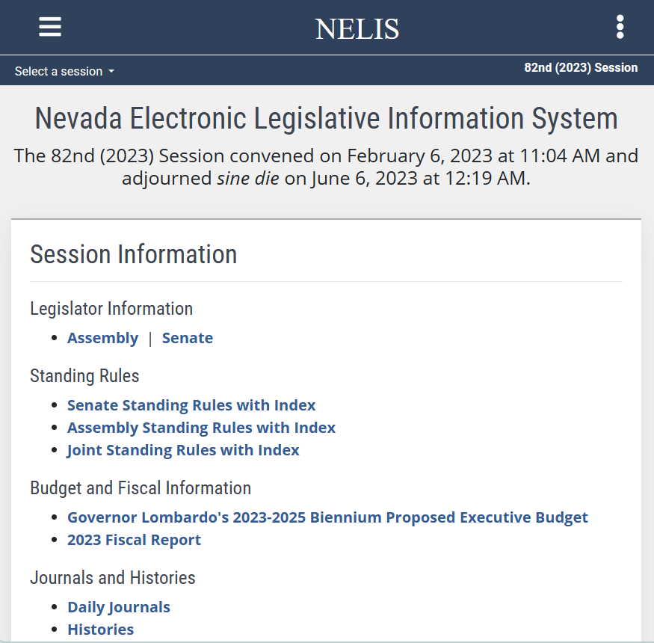
A Note on Legislative Session
All information about Nevada’s legislative sessions can be found on Nevada Electronic Legislative System or NELIS
Legislative Session occurs every odd-numbered year or typically the year after an election year unless there is a special session.
Next legislative session is in 2025
Session lasts 4 months or 120 days.
Incumbents or currently elected legislators and interim committees can introduce / submit a bill draft request prior to legislative session.
Find out your local legislator here: Who's My Legislator / What's My District (arcgis.com)

Slide 9
Dimensions of Diversity, Equity, Inclusion, Belonging and Policy
DIVERSITY pays attention to who is present today, how they are different from each other, and the extent of awareness group members have of differences
EQUITY is making sure you have the tailored resources you need to achieve the same opportunities.
INCLUSION pays attention to the ways and extent to which different people engage in the life of the organization and engage each other over time
BELONGING is making sure people are involved and feel welcome, accepted, and expected to engage, shape, and participate in their environment
Bills that further DEIB
Senate bill 109 ( 2021 Legislative Session) NRS 239B.022 and 239B.026,
Senate Bill 222 (2021 Legislative Session) NRS 232.0083 to 232.0087
Senate Bill 318 ( 2021 Legislative Session) NRS 232.0081
Sex
First Language
Ethnicity
Gender Identity
Sexual Orientation
Race
Education
Marital Status
Maturity
Age
Geographic Origin
Career Field
Religious Affiliation
Diversity
Ability Status

Slide 10
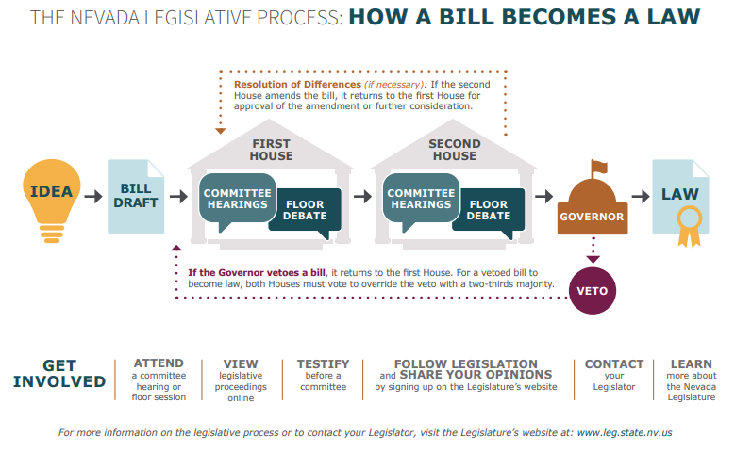
How a Bill Becomes a Law
Committee hearings and action
A committee may vote to pass the bill as written, pass it with amendments, or send it to another committee for more review.
They can also send the bill back to the full legislative body without a specific recommendation.
If the committee does not take any of these actions, the bill does not move forward.

Slide 11
How a Bill Becomes a Law
Common reasons why bills do not pass:
Disagreement among legislators
Lack of public support
Procedural issues
Budgetary constraints
Executive opposition
Time constraints

Slide 12
What Could Have Been? Policy Around Equity within Accessibility and Accommodations Access
H.R. 2373, 117th Congress (2021-2022)
SB 203, Nevada 80th Legislative Session (2019)
Designed to end the practice of paying disabled workers less than the minimum wage and encourage adoption of more inclusive and fair employment practices.
Result: Formally presented to the House of Representatives and sent to the relevant committee for further discussion.
Allocates funds for programs benefitting children with visual/hearing impairments, provide resources for parents, and explores the possibility of creating a specialized public school for these children.
Result: Legislative compromise resulted in modified bill draft that did not fully answer the need presented. This version became law.

Slide 13
Current Laws Equity within Accessibility and Accommodations Access
Nevada Legislation
Senate Bill 544 (2019)
Creates the Patient Protection Commission
Senate Bill 362 (2023)
Establishment of a program for the imprinting of a symbol indicating a medical condition on a driver’s license or identification card including Deaf/Hard of Hearing
Assembly Bill 206 (2023)
Modifies the Nevada Commission for Persons who are Deaf/ Hard of Hearing to allow for more voices on the commission.
Americans with Disabilities Act
Civil rights law that prohibits discrimination against individuals with disabilities in all areas of public life
5 Sections:
Employment
Public Services- State and Local Government
Public Accommodations and Services operated by Private Entities
Telecommunications
Miscellaneous Provisions

Slide 14
Who Impacts Your Life and How Can You Get to Know Them? Or Civic Engagement
Community
Legislative Branch
Executive Branch
State and Local Agencies
City and County Officials

Slide 15
State Committees, Boards, and Commissions
Community
Legislative Branch
Executive Branch
State and Local Agencies
City and County Officials
Short Term Opportunities
Public Interest Driven, Ad Hoc
Ex: NOMHE Black Leadership Advisory committee
Long Term Opportunities
Statute Driven
Ex: Division of Aging and Disability Services Task Force on Alzheimer’s Disease
Ex: NOMHE Advisory Committee
Legislative Advisor

Slide 16
Communications with Local Agencies
How to engage local officials and agencies?
Check out Department of Administration website for a list of government public access meetings.
Email/ Call your local elected officials
Attend local events/ meetings
Community Liaisons
State Diversity Inclusion Liaisons
City/County Parks and Recreation Offices
City/County Community Engagement Offices
City/County/Health District/ Emergency Service community outreach office
Community
Legislative Branch
Executive Branch
State and Local Agencies
City and County Officials

Slide 17
Uncounted = Unserved How can you advocate as a part of your community?
Community
Legislative Branch
Executive Branch
State and Local Agencies
City and County Officials
The Importance of Your Story
Identify the issue
Gather relevant data
Engage community members, local leaders, and relevant organizations to build support
Collaborate with Advocacy Groups
Meet with decision-makers to present data-backed arguments and discuss potential solutions

Slide 18
How can you advocate as a part of your community?
Minority Health Report
Behavioral Risk Factor Surveillance System
Assisted in identifying COVID-19 pandemic need for resources
Assists State and Federal Government establish supportive and preventative services
Patient Protection Commission
Reviews issues related to the health care needs of Nevada residents and the accessibility, affordability, and quality of health care
The Importance of Data
Community
Legislative Branch
Executive Branch
State and Local Agencies
City and County Officials
Notes:
Tina
MHR as a resource
-how quantifying trends builds support for issue
-The Minority Health Report does not have the
Examples of state developed reports used to validate policy and implementation needs/creation.
Minority Health Report – Nonlegislative data source/ document developed by the State of Nevada that is populated by information/ facts/ surveys collected by the state
BRFSS- Manage Expectations
Responses have to be statistically relevant.
There is a childhood and Adult Survey
The system for telephonic support may not be as accessible for the D/HH community.
There is a cost implication for adding questions.
Opportunity for Advocacy
Patient Protection Commission is data driven and can request a select number of BDR

Slide 19
Questions?

Slide 20
Resources
https://ppc.nv.gov/
https://notice.nv.gov/
https://www.leg.state.nv.us/universalaccess.htm
https://www.leg.state.nv.us/App/NELIS/REL/82nd2023
https://www.nevadaddcouncil.org/legislative-information/
https://nvlcb.maps.arcgis.com/apps/instant/lookup/index.html?appid=0815e77623f04028993e9f3ecc56174e
https://dhhs.nv.gov/uploadedFiles/dhhsnvgov/content/Programs/Office_of_Analytics/Minority%20Health%20Report%202023.pdf

Slide 21
Contact Information
Tina Dortch, MPA
Program Manager
tdortch@dhhs.nv.gov
April Cruda, MPH
Program Officer II
acruda@dhhs.nv.gov
Alex Neal, MS
Minority Health and Equity Specialist
a.neal@health.nv.gov
https://dhhs.nv.gov/Programs/CHA/MH/

