Slide 1
NEVADA LEGISLATURE: CONNECTING PEOPLE TO POLICY Nicolas C. Anthony Nevada Commission for Persons who are Deaf and Hard of Hearing Engagement Conference 2023
Notes:
Introduction
I am Nicolas Anthony, Research Director of the Research Division of the Legislative Counsel Bureau
Been with the Legislative Counsel Bureau since 1999, Attorney and worked in Legal Division
Worked and staffed 12 Legislative Sessions
We have a staff of approximately 50 nonpartisan professionals in the Research Division. We serve both houses of the Legislature and both parties as professional non-partisan staff.
It is an honor and a pleasure to be with you today

Slide 2
RESEARCH PUBLICATIONS AND MATERIALS
2023-2024 GUIDE TO THE LEGISLATURE
2023 POCKET GUIDE
OTHER LCB PUBLICATIONS/RESOURCES
PRESENTATIONS
Notes:
Before we begin, I would like to highlight a few of our non-partisan publications and materials that you all should have in your binders today. I am hopeful that those will be helpful resources for you in the future.

Slide 3
Overview
The Capital
Legislative Structure
The Legislative Counsel Bureau
The Legislative Process
BDRS/Fiscal Notes
Tips for Testifying Before Legislative Committees​
​
Resources for Tracking Legislation and Policy
Notes:
This afternoon we are going to provide an overview of the Legislature/legislative structure and process;
Carson City as the Capital
Legislative Structure
The Legislative Counsel Bureau
The Legislative Process
BDRs/Fiscal Notes
Discuss opportunities and tips for working with the Legislature.
End with resources to track legislation

Slide 4
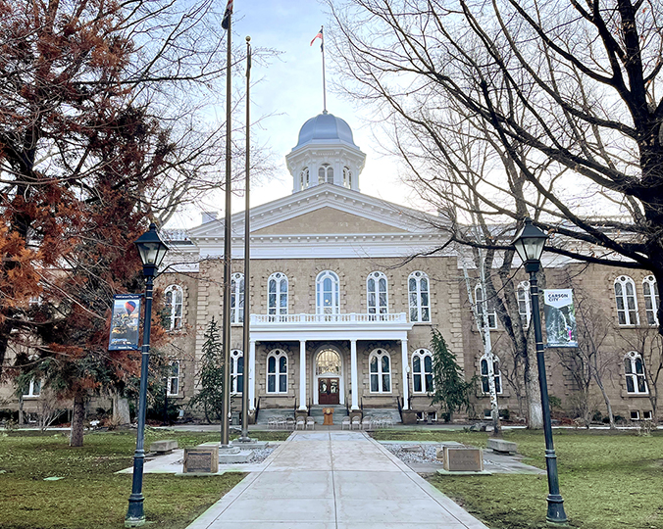
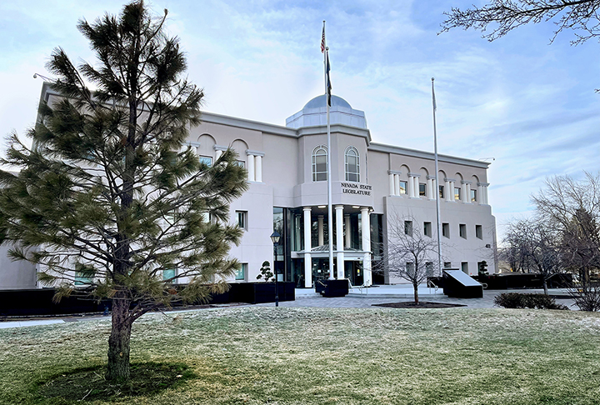
Carson city
C
Notes:
Carson City is the Capital of Nevada. The Capitol building (Governor and Executive Branch) on the left. The legislative building is on the right.
Why Carson City? By 1860 the town's population stood at 500 people. Soon Abe Curry took steps to have Carson City named territorial capital. He argued that it was close to the main lines of travel in the region. Timber on the hills to the west and silver to the hills on the east. On November 25, 1861, Carson City was named the permanent capital of Nevada Territory.
In October 1864, Nevada became a state, and Carson City was chosen to serve as the state capital.
Nevada Constitution provides that Carson City is the “seat of government.”
It is a beautiful place if you haven’t had the chance to make it up there. Lots of history and outdoor activities with Lake Tahoe being very close.

Slide 5
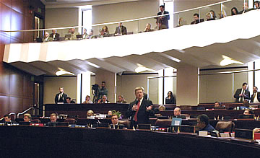
Legislative structure
Senate
21 Members, 4-Year Terms
Assembly
42 Members, 2-Year Terms
Regular Legislative Sessions–Biennial
Regular sessions held in odd-numbered years
Sessions begin on the first Monday in February
Limited to 120-calendar days
The 83rd Legislative Session starts February 3, 2025
Notes:
The Nevada Constitution allows the legislature to be up to 75 members. It is currently at 63, with 21 in the Senate and 42 in the Assembly.
Qualifications: Must be at least 21 years of age. Must be a resident of the State for at least one year, a “qualified elector,” and resident in the district to be represented.
Regular sessions are held every two years, begin on the first Monday in February and limited to 120-calendar days. Nevada is one of only 4 states (NV, TX, MT, and ND) with biennial legislatures!!!
During session, each house currently consists of nine standing policy committees and one money committee.
During the 20 months between sessions, referred to as the interim, with passage of AB 443 from the 2021 Session we have a new interim committee structure. There are interim standing committees that mirror session committees. The interim committees are tasked with studying emerging issues and reviewing the implementation of legislation from previous sessions. Generally, their goal is to identify recommendation(s) for legislation for the next session. We also have the Legislative Commission, which oversees the LCB and reviews regulations among other things, and the Interim Finance Committee which reviews changes to the State budget.

Slide 6
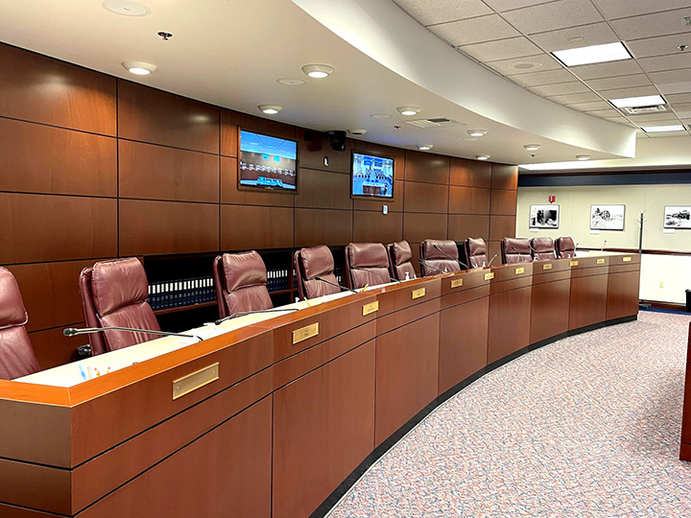
Legislative Interim
Legislative Interim
20 months between sessions
AB 443 (2021)
Nine Joint Interim Standing Committees
Commerce and Labor
Education
Government Affairs
Growth and Infrastructure
Health and Human Services
Judiciary
Legislative Operations and Elections
Natural Resources
Revenue
Notes:
The Nevada Constitution allows the legislature to be up to 75 members. It is currently at 63, with 21 in the Senate and 42 in the Assembly.
Qualifications: Must be at least 21 years of age. Must be a resident of the State for at least one year, a “qualified elector,” and resident in the district to be represented.
Regular sessions are held every two years, begin on the first Monday in February and limited to 120-calendar days.
During session, each house currently consists of nine standing policy committees and one money committee.
During the 20 months between sessions, referred to as the interim, with passage of AB 443 from the 2021 Session we have a new interim committee structure. There are interim standing committees that mirror session committees. The interim committees are tasked with studying emerging issues and reviewing the implementation of legislation from previous sessions. Generally, their goal is to identify recommendation(s) for legislation for the next session. We also have the Legislative Commission, which oversees the LCB and reviews regulations among other things, and the Interim Finance Committee which reviews changes to the State budget.
Interim meetings often held in both Carson City and Las Vegas (at the Grant Sawyer Building) with videoconferencing between the two locations.

Slide 7
The Legislative Counsel Bureau (LCB)
The LCB is the nonpartisan, central staff for the Nevada Legislature.
No paid political staff is employed by the Bureau.
Lobbying by LCB staff is prohibited:
No campaign or political activities; and
Cannot display items that advocate for a candidate or partisan activity.
Notes:
The LCB is permanent, nonpartisan staff for the Nevada Legislature.
As nonpartisan staff, LCB employees cannot get involved in organized politics, and are not allowed to display bumper stickers or campaign signs.

Slide 8
The LCB: Purpose of Design
To discourage interference and limit political pressure;
To give staff independence that helps ensure lawmakers get unbiased information;
In some states, each house (even each party within the houses) has its own staff. Nevada’s LCB staff works for both houses and all members; and
Ensure consistency in staffing from one session to the next.
Notes:
The nonpartisan nature of the LCB is to discourage interference from special interests and limit pollical pressure on staff and the process.
It helps to ensure that staff is independent. The way legislatures employ staff varies from state to state. In some states, staff is employed by the houses and in other states staff is employed by the political parties. Maintaining permanent staff ensures consistency from session to session, i.e. institutional knowledge.

Slide 9
The LCB: Today
Over 300 permanent staff.
Additional temporary staff is hired for sessions only.
Consists of five (5) divisions:
Administrative
Audit
Fiscal Analysis
Legal
Research
Notes:
LCB staff, house staff, janitors, and police officers.

Slide 10
The LCB: Research Division
Provides policy analysis and prepares reports and publications on topics of interest to legislators and the public.
Houses the Research Library, an excellent source of information for legislative documents and research materials.
Contains a Constituent Services Unit that assists legislators with questions and requests from the voters in their districts.
Provides primary committee staff support to nearly all policy committees during the session and throughout the interim.
Notes:
You have all been distributed the Legislative Guide and the Legislative Pocket Guide, in addition to other publications prepared by the Research Division.

Slide 11
Legislative Process: IDEAS Become Bills
Where Do bills come from:
Idea for a bill (constituents, legislative hearings, personal experience, ideas from your campaign)
Policy analysis and research on the idea (information from our research/policy staff, needed changes to current law, national organizations, model legislation from other states, etc.)
“Hot topics” from other states and responding to national trends
After the idea is formulated, researched, and refined, the Legislator submits a bill draft request (BDR) with the Legal Division of the Legislative Counsel Bureau (LCB). The Legal Division prepares the BDR and delivers it to the sponsor (requester).
Notes:
Turning to the Legislative Process and how laws are made. There is an old joke about making sausage but I will spare you the details.

Slide 12
BILL DRAFTS (BDRS)
Bill Draft Request (BDRs)
On July 1 preceding each regular session, and each week thereafter until the adjournment of the Legislature sine die, the Legislative Counsel shall prepare a list of all requests received by the Legislative Counsel for the drafting of legislative measures for the regular session.
Incumbent members of the Assembly 10 BDRs – Newly elected members 6 BDRS
Incumbent members of the Senate 20 BDRs – Newly elected members 12 BDRS
Additional BDRs from Chairs of Standing Committees/Leadership
Requests from Interim Committees
Requests from Governor, Constitutional Officers, Supreme Court, Local Governments, and other bodies.
Notes:
BDRs = Bill Draft Requests for legislation

Slide 13
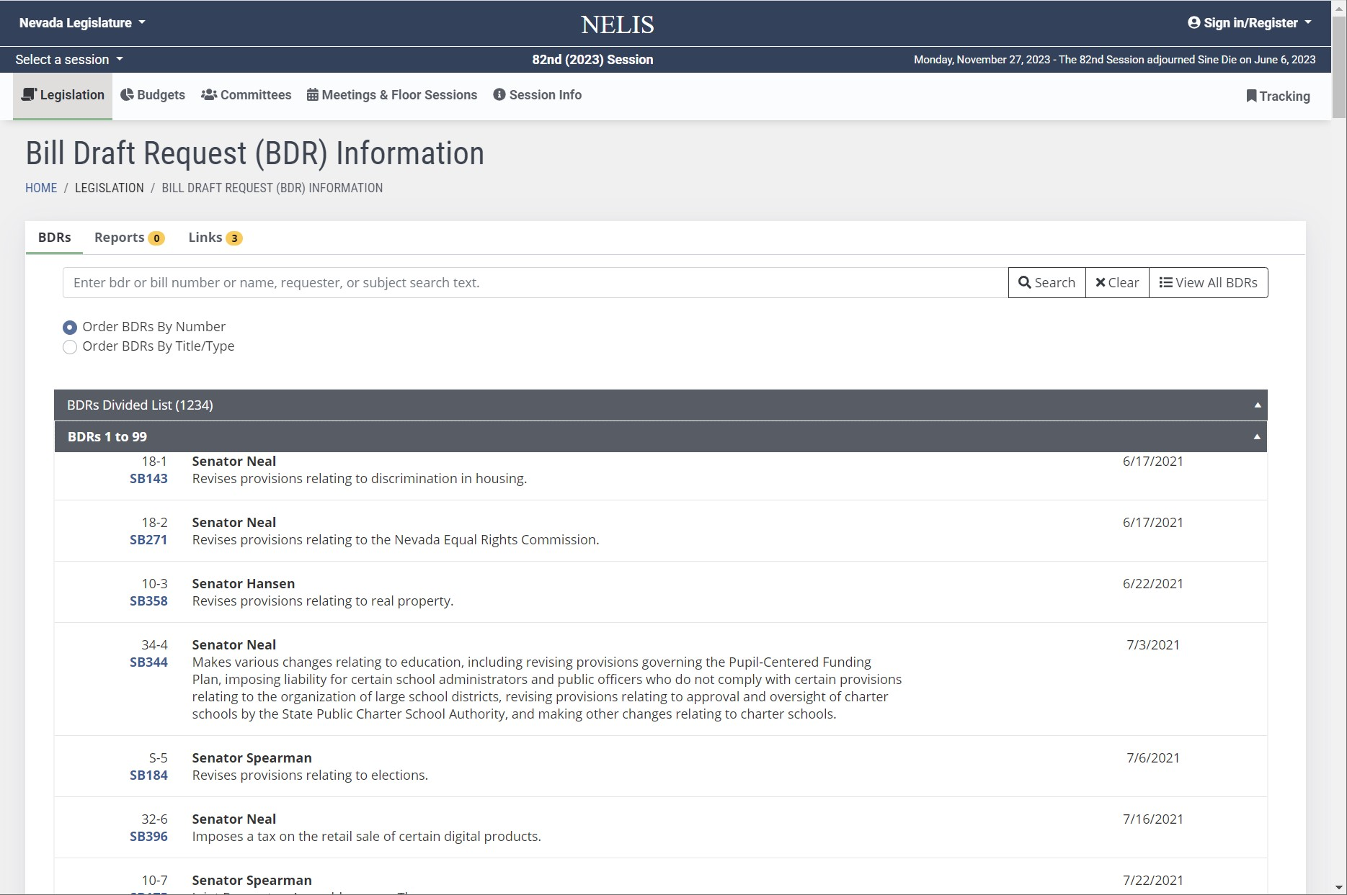
BDR List
Notes:
There were over 1,200 bdrs on the bdr list.
Legislature considered 1096 bills and resolutions
610 Bills were approved by both houses.
Governor vetoed 75 – meaning 535 bills became law.

Slide 14
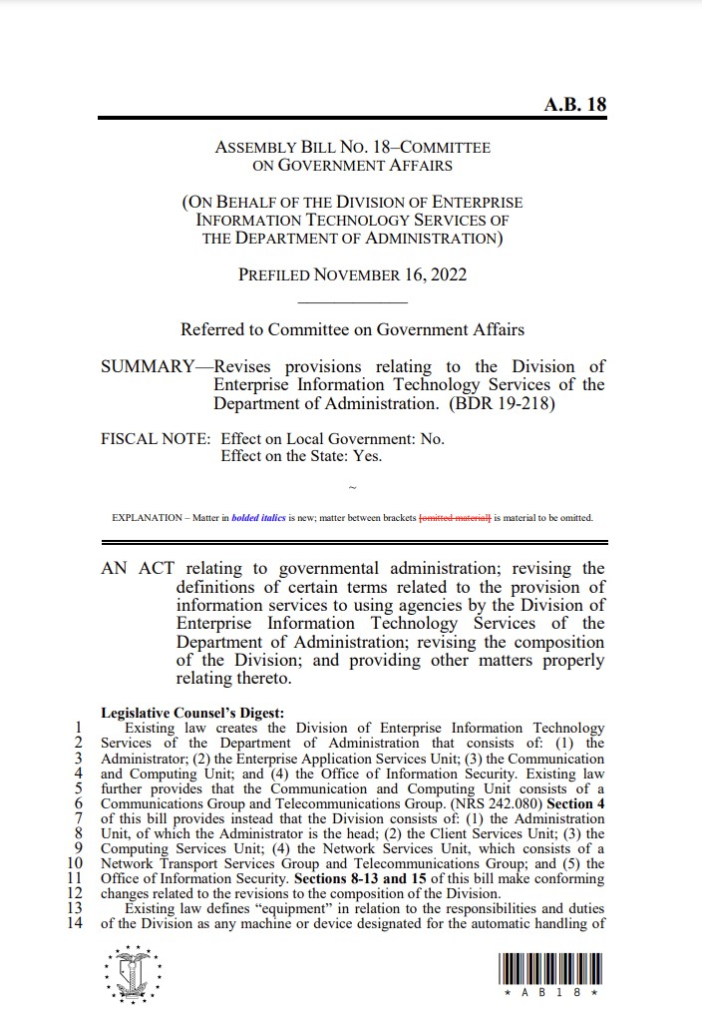
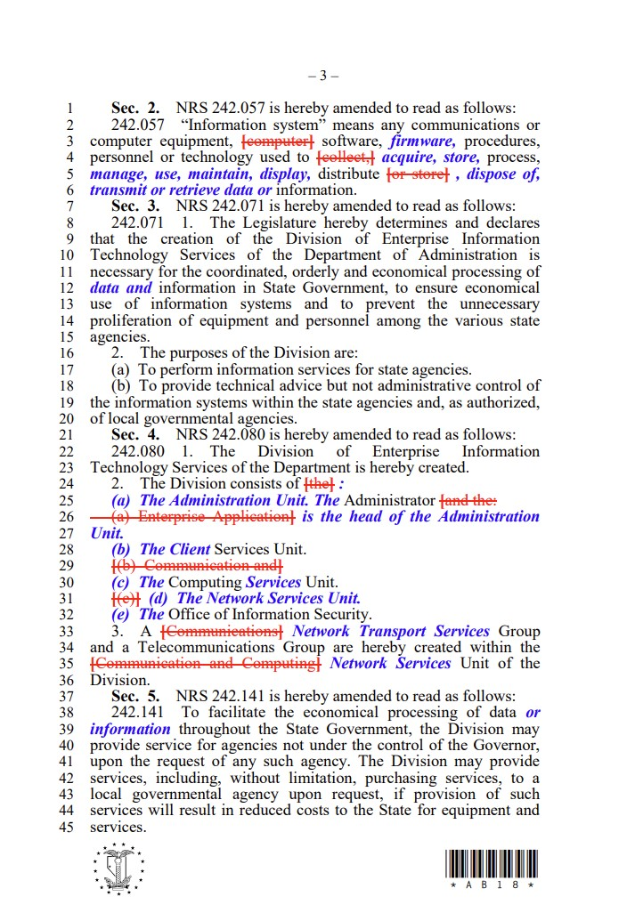
Legislative Bills
Notes:
This is a picture of a bill. The bill is assigned a number (AB 18)
It will have a Legislative Counsel’s Digest – explaining what the bill does.
The text of the bill will have deleted language in red strikethrough followed by new language in blue italics. Existing law language is in black lettering.

Slide 15
FISCAL NOTES (NRS 218D.415 – 218D.485)
1. The Legislative Counsel reviews BDR for fiscal impact.
2. The Fiscal Analysis Division shall obtain a fiscal note on:
(a) Any bill or joint resolution which creates or increases any fiscal liability or decreases any revenue which appears to be in excess of $2,000; and
(b) Any bill or joint resolution which increases or newly provides for a term of imprisonment in the state prison or makes release on parole or probation from the state prison less likely,
The fiscal note must contain a reliable estimate of the anticipated change in appropriation authority, fiscal liability or state revenue under the bill or joint resolution, including, to the extent possible, a projection of such changes in future biennia.
Notes:
Committees make several types of recommendations on legislative measures that come before them for consideration.

Slide 16
Fiscal Notes Cont…
The summary of each bill or joint resolution introduced in the Legislature must include the statement:
(a) “Fiscal Note: Effect on Local Government: May have Fiscal Impact,”
“Fiscal Note: Effect on Local Government: No,” or
“Fiscal Note: Effect on Local Government: Increases or Newly Provides for Term of Imprisonment in County or City Jail or Detention Facility,”
(b) “Effect on the State: Yes,”
“Effect on the State: No,”
“Effect on the State: Contains Appropriation included in Executive Budget,”
“Effect on the State: Executive Budget,” or
“Effect on the State: Contains Appropriation not included in Executive Budget,”
Notes:
Fiscal Notes

Slide 17
Fiscal Notes Cont…
The fiscal note must be factual and concise in nature, and must provide a reliable estimate of the dollar amount of effect the bill or joint resolution will have.
If the agency or local government concludes that no dollar amount can be estimated, the fiscal note must so state with reasons for such a conclusion.
Whenever a bill or joint resolution is submitted to an agency for a fiscal note, the agency shall prepare the fiscal note and return it to the Fiscal Analysis Division within 5 working days. The Fiscal Analysis Division may extend the period for not more than 10 additional working days if the matter requires extended research.
Notes:
Fiscal Notes

Slide 18
Legislative process
How a bill becomes a law
1. Initial Steps by the Author
Idea, Bill Draft Request (BDR)
LCB Legal Division
2. Action in the House of Origin
Introduction (1st reading) becomes a “bill and given a bill number”, Refer to Committee, Public Hearing, Recommendation, Amendment (Second Reading), Floor Debate and Final Vote (Third Reading)
3. Action in the Second House
Same as House of Origin
4. Resolution of Differences
Conference Committee
5. Role of the Governor
Sign, Not Sign, Veto
Notes:
Drafting and passing legislation is more than just a bill sitting on capitol hill. Some of you all may remember that little School House Rock jingle from Saturday morning cartoons.

Slide 19
Legislative Process - Committees
EIGHT POLICY COMMITTEES IN EACH HOUSE
COMMERCE AND LABOR
EDUCATION
GOVERNMENT AFFAIRS
GROWTH AND INFRASTRUCTURE
HEALTH AND HUMAN SERVICES
JUDICIARY
LEGISLATIVE OPERATIONS AND ELECTIONS
NATURAL RESOURCES
Notes:
Committees

Slide 20
LEGISLATIVE PROCESS – REVENUE AND MONEY
EACH HOUSE ALSO HAS TWO MONEY RELATED COMMITTEES
REVENUE (TAX)
WAYS AND MEANS (ASSEMBLY) AND FINANCE (SENATE)
Notes:
Money Committees

Slide 21
Legislative Process
Committee Hearings – Action in Committee
When the committee might act?
At the committee hearing (same day the bill is heard); or
At a subsequent work session
A bill dies if no action is taken by the committee passage deadline (unless the bill is exempt from the deadlines.)
Committee First House: April 14 (68th day of Session)
Committee Second House: May 19 (103rd day of Session)
Notes:
When the committee might act? Subject to deadlines on the 120 calendar which keeps the process moving.
At the committee hearing (same day the bill is heard); or
At a subsequent work session.

Slide 22
Legislative Process
Committee hearings
Committee chair schedules bills:
Agendas are posted.
All meetings are public.
Most meetings are videoconferenced from Carson City to Las Vegas and the public is encouraged to participate.
Notes:
Hearings

Slide 23
Legislative Process
Committee hearings – common committee actions
Do Pass
Amend and Do Pass
Do Adopt
Rerefer (with or without recommendation)
Indefinitely Postpone (IP)
No Action
Notes:
Committees make several types of recommendations on legislative measures that come before them for consideration.

Slide 24
Legislative Process
Step by Step
Bill reported out of committee with a recommended action.
Second Reading and amendment of bills.
Bill read a second time;
Amendments, if any, are considered and adopted; and
If adopted, bill reprinted and “engrossed”.
Third Reading and General File.
Bill read third time on General File and any additional amendments considered.
General file – Debate merits of bill and final vote.
First House Passage Deadline–April 25 (79th day of Session)
Exemptions may apply for certain fiscal measures or bills relating to legislative business
Second House Passage Deadline–May 26 (110th day of Session)

Slide 25
Legislative process: Conference Committees
Resolution of house differences (if Necessary)
If the bill has no amendments in the second house, it goes to the Governor.
If the bill is amended by the second house:
Does the first house “Concur” with the second house’s amendment? If so, the bill goes to the Governor.
If the first house does not concur (does not agree with) the second house amendment, does the second house “Recede” its amendment? If so, the bill goes to the Governor.
If the second house does not recede, the bill is assigned to a conference committee.
Notes:
There is a process for working out differences between the houses known as Conference Committees.
Conference committees include a few members from each house. They can work out differences in a number of ways. If the bill is amended by the committee, it must be approved by each house.

Slide 26
Legislative process
Role of the governor
Sign the bill;
Within five (5) days if Legislature in session (excluding the day of receipt and Sundays);
Within ten (10) days if Legislature has adjourned (excluding the day of receipt and Sundays);
Veto the bill; and
Not sign the bill within the period allowed (effectively allowing the bill to go into law without the Governor’s signature).
Notes:
There a few options when a bill reaches the Governor’s desk.

Slide 27
Providing Testimony to the Legislature: Preparation
Understand the process.
Be flexible on the presentation length.
Be strategic with your goals.
Be aware of the rules and what the chair wants.
Check the schedule and be at the right place at the right time.
Watch a committee meeting ahead of time.
Check media for breaking news.
Remember legislative meetings may be conducted via videoconference in both Carson City and Las Vegas.
Sometimes public testimony is also allowed via call-in telephone participation.
PRACTICE.
Notes:
Preparation

Slide 28
Providing Testimony to the Legislature: The Presentation
Dress professionally.
First 30 seconds are very important.
Know how to greet the chair and audience (Chair ____).
Summarize, be accurate but not too technical.
Avoid jargon.
Use handouts sparingly.
Use PowerPoint presentations selectively.
Remember: YOU are the expert.
Be flexible – sometimes agenda items are taken out of order.
Make eye contact.
Notes:
Never use first names! Use Senator or Assembly Member.
Make eye contact and be personable.

Slide 29
Providing Testimony to the Legislature: Questions
Try to anticipate.
“I don’t know” is often the correct answer.
Think before answering.
Go through the chair when responding (the chair may then permit you to respond directly to the committee member.)
IMPORTANT – Triple check your facts and figures and be prepared to explain the source of your data. Remember, what you say will become part of the public record.
Notes:
Testimony

Slide 30
Advocating Your Issues
Choose a Legislator(s) who you think will support your position.
Explain the positive aspects and benefits of your suggested legislation.
Explain what the opposition might be.
Prepare the Legislator.
Notes:
Advocacy

Slide 31
Advocating Your Issues
Be calm, controlled, and prepared.
Think your position through and weigh all sides of the issue.
Present your position in a non-threatening and professional manner.
Notes:
Advocacy

Slide 32
Advocating Your Issues
Do Not:
Lecture.
Be disrespectful toward members of the public or staff.
Make demands or threatening statements.
Disrupt the meeting.
Use civil disobedience.
Notes:
Do Nots

Slide 33
Ways to Stay Informed and Involved
Sign up for Bill Tracking.
Search the BDR list (limited information until introduction).
Listen to or watch current or past hearings online.
Check website for updates: www.leg.state.nv.us.
Track legislative documents using “NELIS”.
Get to know legislators and legislative staff.
Notes:
Involvement

Slide 34
Ways to Stay Informed and Involved
Attend interim meetings, committee hearings, or floor sessions during session.
Register to follow interim committees.
Provide public testimony at a hearing.
Submit comments to the committee in writing.
Talk to the Legislators.
Notes:
Involvement

Slide 35
Bill tracking
Nevada Electronic Legislative Information System (NELIS)
Information always available:
Bills – Reports – Bill Actions and Status
Personalized Legislative Tracking (PLT)
Subscription to BDRs, bills, and budgets–Up to ten (10) bills for free.
Notifications of Hearings and Status (not a free option).
Various Subscription Levels.
Email: publications@lcb.state.nv.us
Phone: (775) 684-6835
Notes:
Helpful online resources to track BDRs, bills, budgets during session. Can also be notified of changes.

Slide 36
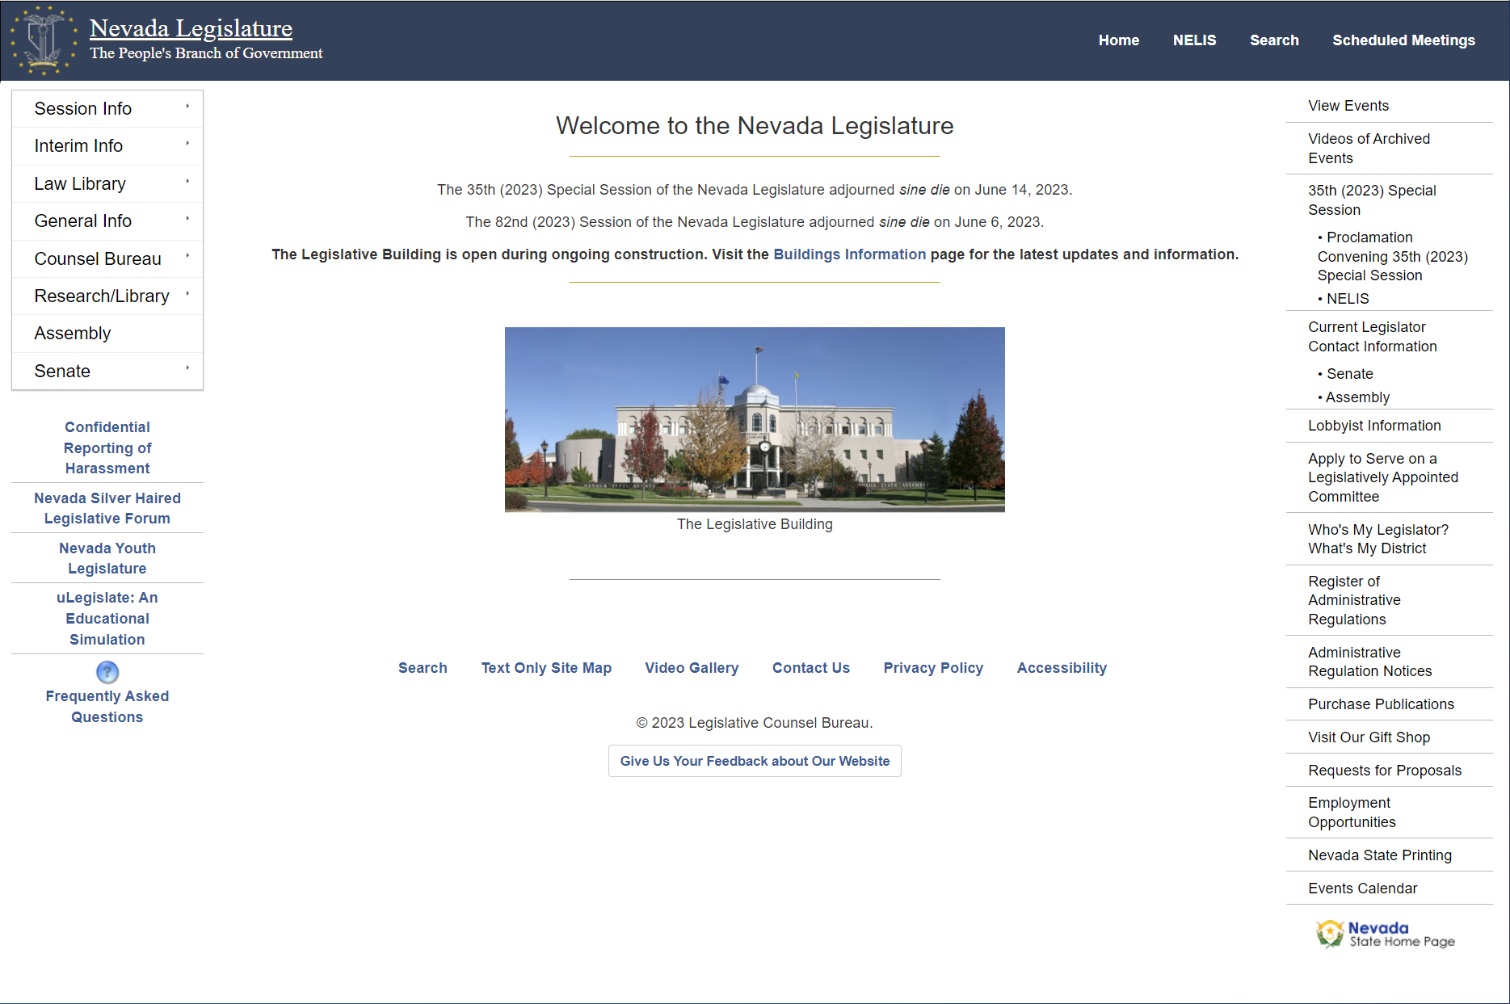
https://www.leg.state.nv.us/
Notes:
This is our legislative webpage at www.leg.state.nv.us

Slide 37
Requests for accommodations
The Nevada Legislature is committed to making its programs, services, and activities accessible to people of all ages and abilities.
In order to ensure that everyone can fully participate in government and has equal access to information, the Legislature provides the following accommodations upon request: Interpreters, communications access real-time translation (CART), assistive listening devices, bill text or publications in large print, and transcripts for meeting audio or video transcripts. Requests for these or other accommodations should be directed by email to accessibility@lcb.state.nv.us or by phone at 775‑684‑6903.
Requests should be made 72 hours in advance whenever possible. The Nevada Legislature may not be able to provide accommodations requested less than 72 hours prior to an event or meeting.
Notes:
Accomodations

Slide 38
contact
Nicolas C. Anthony
Research Director
Nanthony@lcb.state.nv.us
Research Division
(775) 684-6825
research@lcb.state.nv.us
Constituent Services Unit
(775) 684-6740
csu@lcb.state.nv.us
Research Library
(775) 684-6827
library@lcb.state.nv.us
Notes:
Provide our contact information. No wrong door. Feel free to contact us any time.
Reiterate that we work all interim and have Constituent Services.
Thank you for allowing me to be here today!

