Slide 1
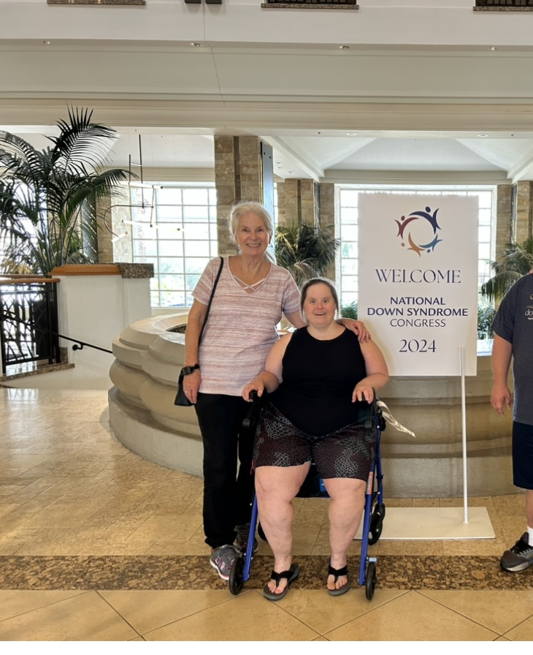
National Down Syndrome Congress Convention Phoenix, AZ 7/25-7/28/24 Attended by Jeanette and Renee Shoemaker

Slide 2
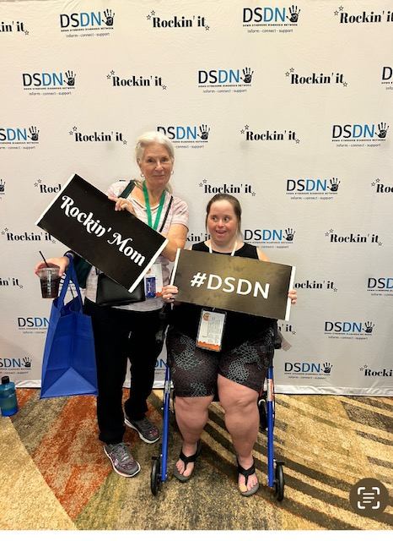
The Basics
Begin by registering in March, selections for workshops will come out later.
Review of scheduled workshops, deep dives, registration, exhibit hall, vendors.
Schedule at a glance for each day. Sharing sessions – moms, dads, siblings.
Workshop cycles – about 7, pick a title and review in book to see if it’s what you are looking for, range from infant to adults.
Info on studies, trials, research.
Kids camp, Youth/adult workshops.
Dances/talent show.
Event in community to attend such as Disney World, baseball game.

Slide 3
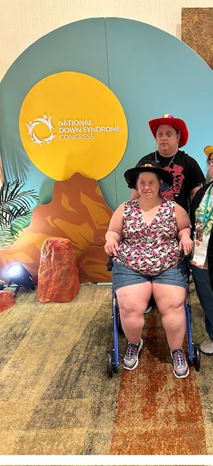
Renee and I arrived at the Down Syndrome Conference in AZ on Thursday and picked up our registration documents and schedules. We met up with friends and took pictures and gave hugs all around. Renee likes to hug. We visited the Exhibit Hall and got loaded up with freebies and lots of information.

Slide 4
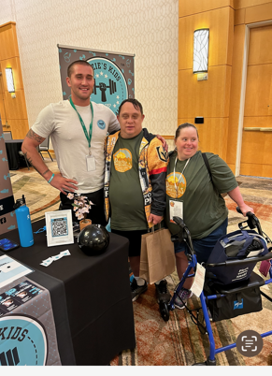
Renee signed up with Linda Crnic Institute for Down syndrome/trismony 21research. She had blood drawn and did a saliva test. This will be used for research to benefit all Down Syndrome children and adults.

Slide 5
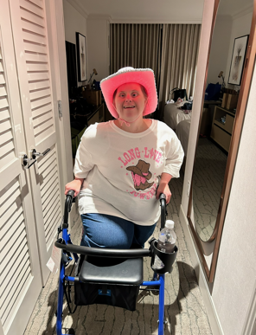
Friday
We met with friends and planned our workshops and activities. Renee attended the youth and adult conference kick off and I went to my first workshop on eye care and research followed with Alzheimer's. Found that 100% of those with Down Syndrome face this disease. Plans were made for dinner then off of the dance with the country theme and Renee dressed the part. I was so pleased with her as she actually got out there and participated with the video dancing and was sure doing the moves. This was great social time for her. Renee’s workshop was pasting picture for likes and dislikes. She answered questions mostly with answers involving a family name. Renee is very attached to her family.

Slide 6
Saturday
Saturday began with a full day of workshops for both of us. My classes included Life Experiences and the feeling status. Anxiety and depression were discussed in the workshop and I thought for sure they were talking about Renee. Following that it was off to the Regression in Down Syndrome. Interplay with SSI, SSD, DAC and all of the other acronyms can be confusing. He did say that SS.gov is a very good sight to explain things.

Slide 7
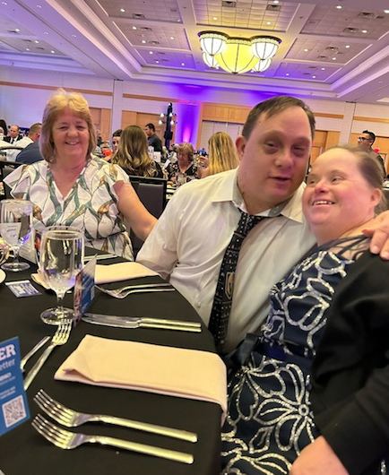
Saturday Evening
Saturday night was the awards banquet and dance. Renee grew very tired and could not stay up for the dance.

Slide 8
Sunday
Sunday morning Renee went to be a cheerleader for her friends in the talent show while I went off to the last two classes on aging and the weight puzzle.

Slide 9
Closing
Plans were discussed about attending the next conference in Dallas. Renee said her goodbyes and said “see you next year”.

Slide 10
Thank you! Jeanette and Renee Shoemaker
jfsinlv@icloud.com
702-445-2480

