Slide 1
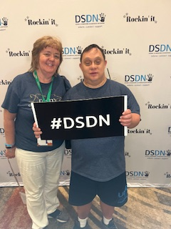
52nd Annual Convention National Down syndrome congress July 25-28, 2024 Phoenix, az Attended by: Veronica and Matt Fiscus

Slide 2
Agenda for Veronica
Sessions attended:
Down Syndrome and the effects on the feet.
Alzheimer’s Disease and Down Syndrome
The Life Experience and Feeling Study – mental health landscape
What we learned at the Adult Down Syndrome Center
Common & Uncommon Health Conditions
Aging
The Weight-Health Puzzle for teens & Adults

Slide 3
Agenda for Matt:
Mental Wellness 2.1
Creating a 1-page Profile
Discovering Your Inner Actor with Theater Games
Movement for Sports
My Story, My Elevator Speech

Slide 4
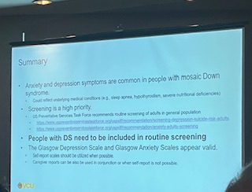
Veronica’s main Takeaways:
Flat feet common in Down Syndrome and requires special care. I need to give Matt a break when he’s complaining about his feet. He may require special treatment for his toenails.
High risk of Alzheimer’s in Down Syndrome if the person lives long enough. Stats report 100% for those 65 and older vs 10% for regulation population at 65. Down Syndrome may be the key to treatment for everyone in this area. There’s hope of treatment with studies that are currently underway but it’s very expensive.
Not all people with Down Syndrome are “Happy”. Mental health is an issue and their symptoms can be unique. Anxiety is not uncommon. Therapy may be needed. Their fear is in the moment of what’s happening.

Slide 5
Continued:
Self talk is not a bad thing and can be helpful. Getting your person with Down Syndrome in the “groove” can help with their routine but can be an issue if the routine has to change unexpectedly. Need to be creative. Sensitivity to different areas may be misinterpreted to mental illness. Need a therapist that is familiar with Down Syndrome to avoid getting a wrong diagnosis.
I learned that Matt has most of the “common conditions of Down Syndrome”. He has the thyroid issues and sleep apnea. The good news is that cancer and high blood pressure are less common. The life expectancy of people with Down Syndrome has increased from 28 years in 1984 to 60 in 2018. Doctors should run necessary tests if the person with Down Syndrome shows symptoms. Don’t pass it off as “that’s just Down Syndrome”.
The Aging session was a bit disappointing. It was mainly focused on dementia/Alzheimer’s and no other issue related to aging.
The Weight-Health Puzzle gave good suggestions on how to talk about food and eating with your person with Down Syndrome. The recommendation is to do the “self-talk” with them to see how decisions are made about choosing foods.

Slide 6
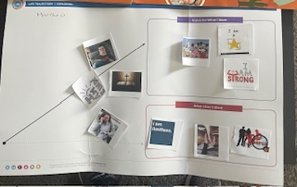
Matt’s Main Take Aways
Matt enjoyed making the Life Trajectory page.
Matt is a born actor and loved playing the theater games.
Matt is also a born athelete so enjoyed learning about movement with sports.
Matt is “Mr. Outgoing” so he had no trouble coming up with his “Story, elevator speech”.

Slide 7
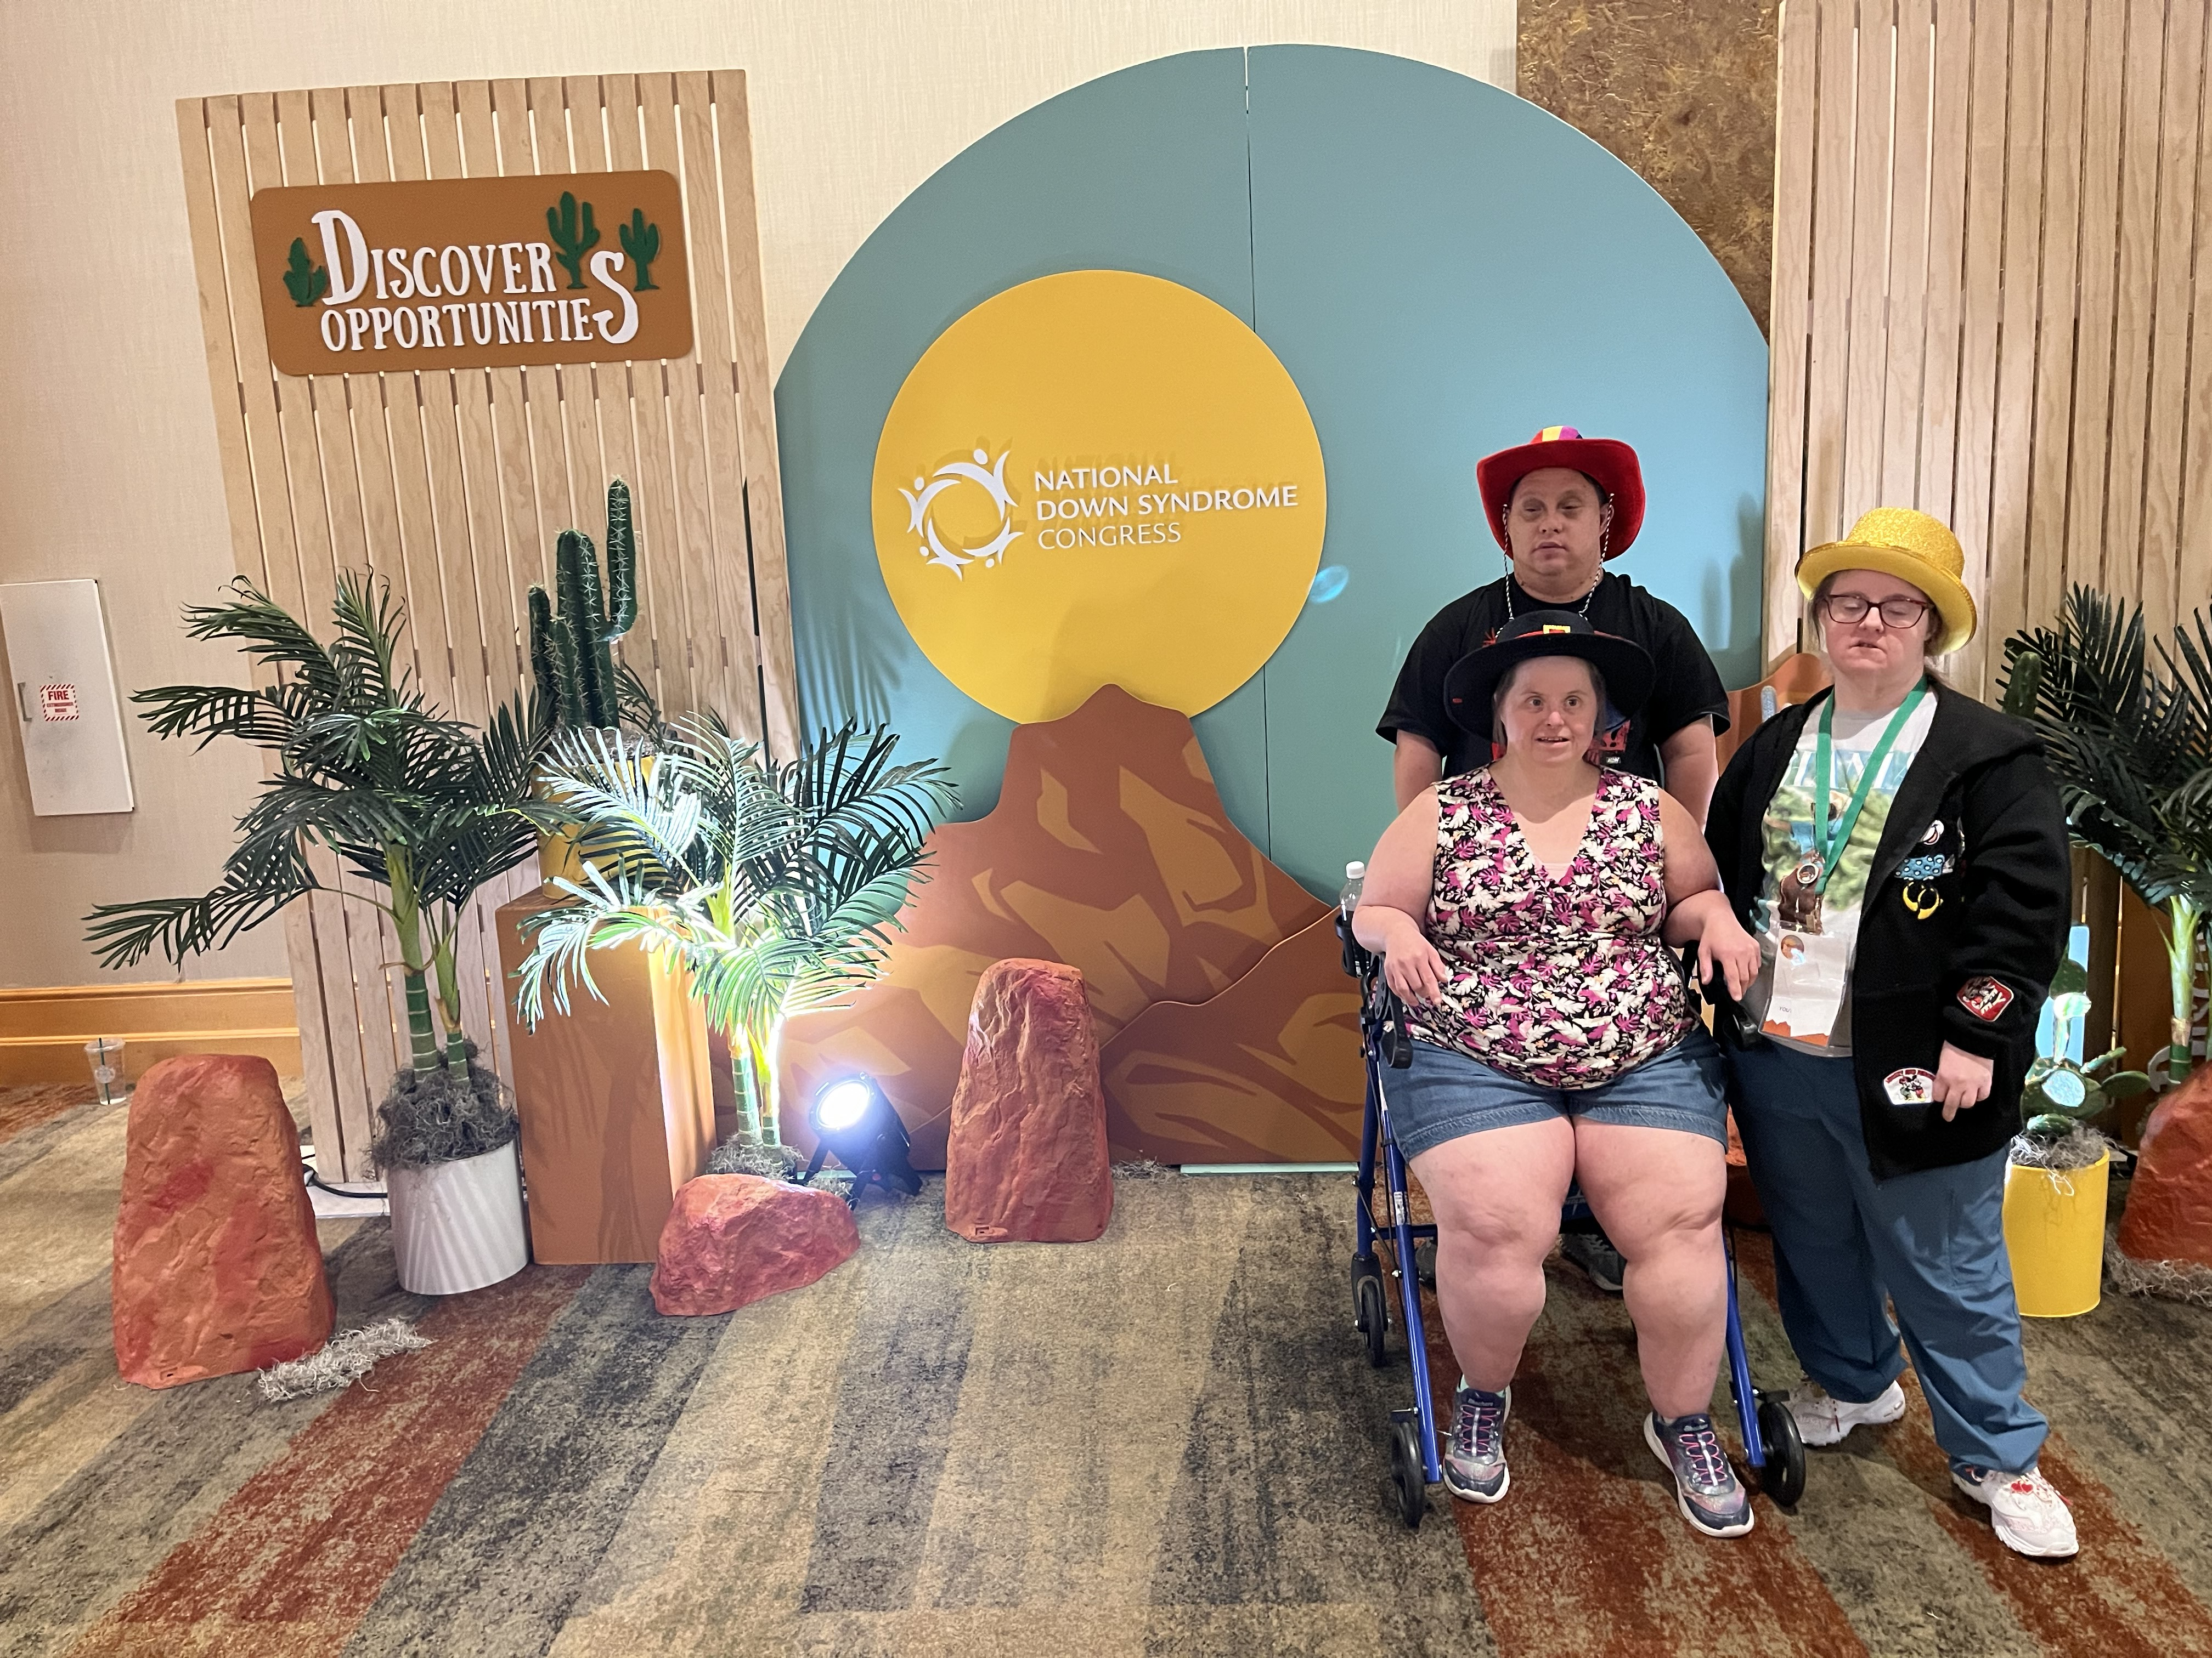
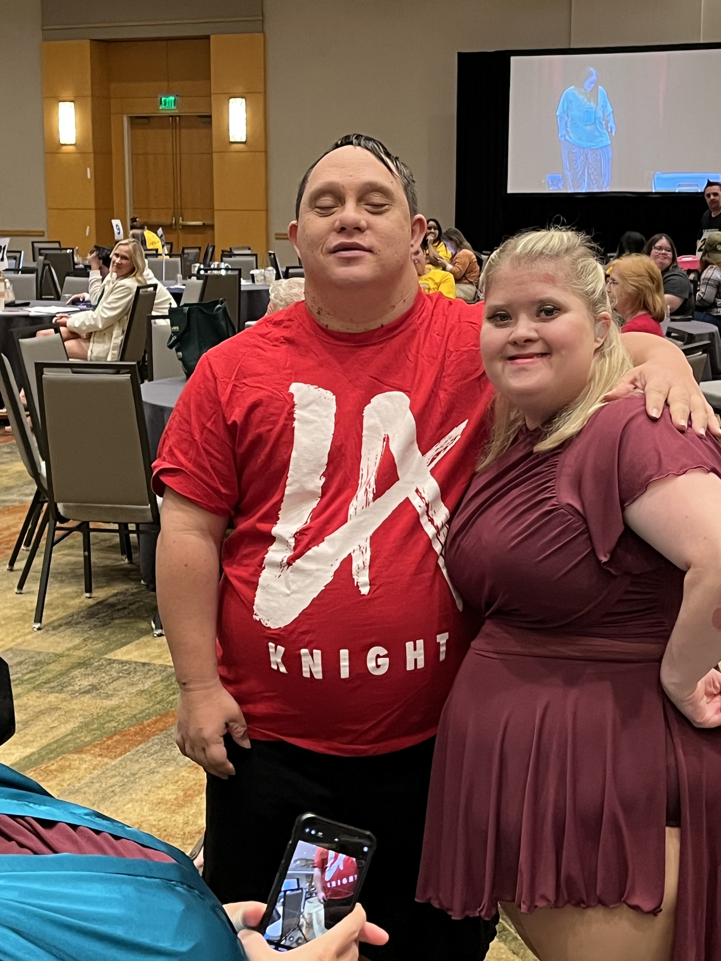
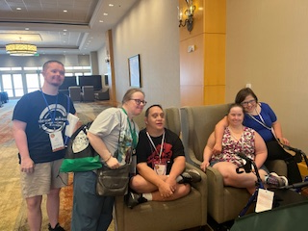
Other Benefits from the conference:
Matt enjoys being with other people who look like him, like what he likes and does what he likes to do. He’s met many friends that he sees each year at conference. He also has friends that moved away that he gets to see at conference.

Slide 8
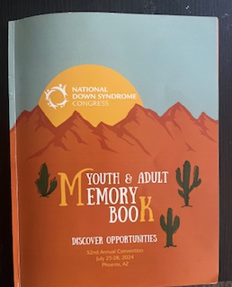
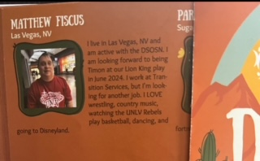
Memory Book
Matt enjoys getting his memory book each year and looks through it carefully for his friends to see who is coming.

Slide 9
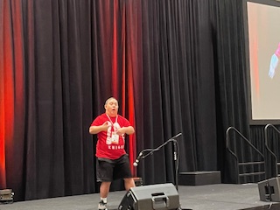
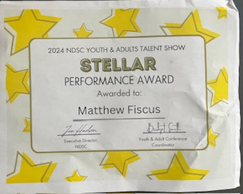
Talent Show!
Matt LOVES participating in and watching the Talent Show. He never misses participating. This year he danced to Luke Bryan’s “Crash My Party”. And there’s a guarantee, he’s going to talk on the microphone afterwards.

Slide 10
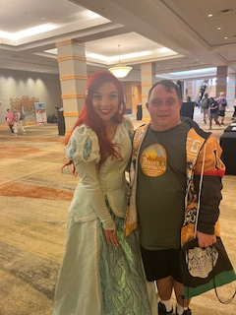
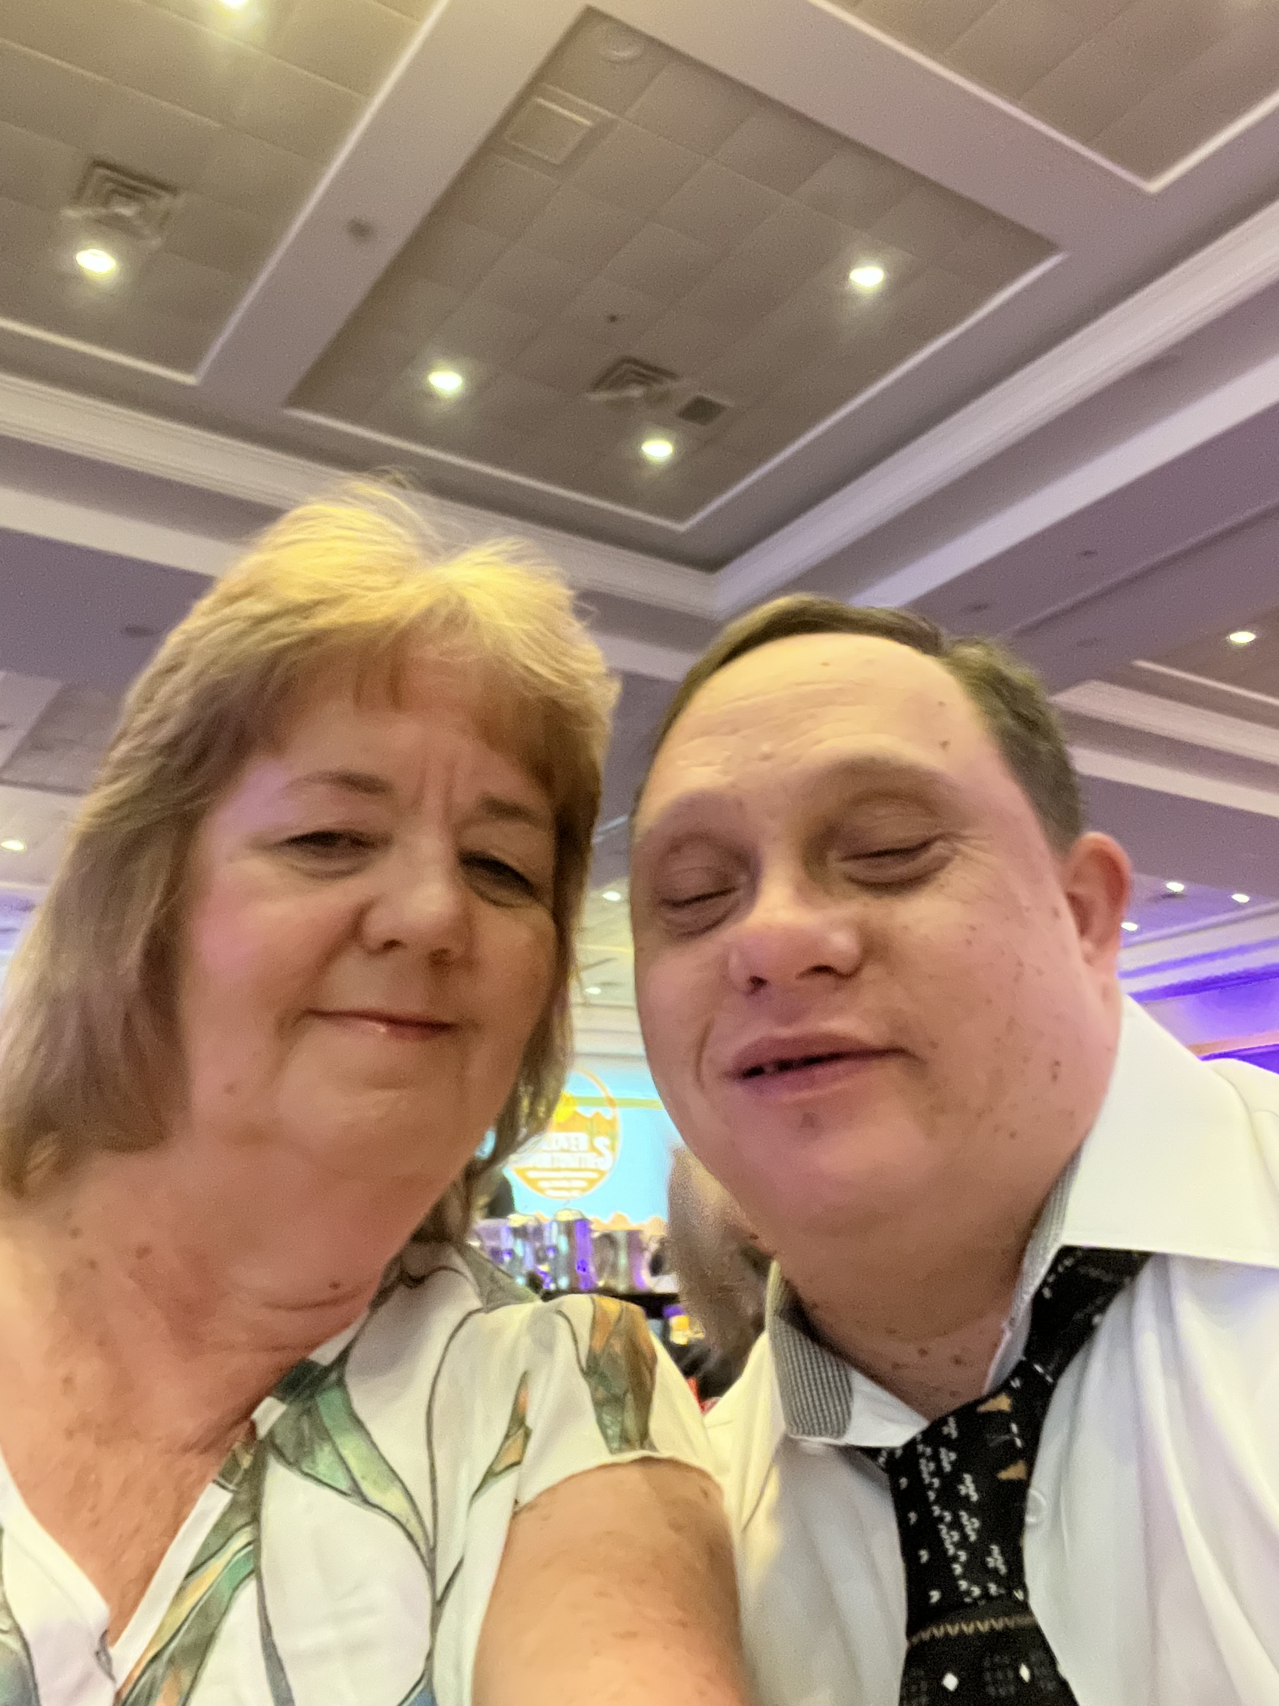
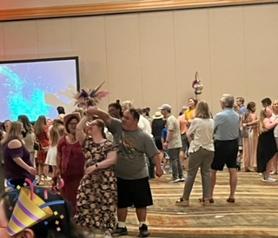
Exhibit Hall, Banquet and dance
The Exhibit Hall always has fun and exciting booths to learn about new products or services. We always come home with great information.
The Banquet is a fun dinner Saturday night with awards where we get to get dressed up followed by a dance. This is the second dance of the conference. The first dance was Friday night and was “country” themed, which Matt loved.

Slide 11
Final takeaways
We learned at lot at the conference, brought home good ideas and resources to use in the future. We will share this information with others in the Down Syndrome community through the DSOSN and others that may be interested. We are thankful that we were given the opportunity to attend with the help of the Nevada Governor’s Council.
This is Matt after the end of the conference day on Saturday.

Slide 12
THANK YOU
Veronica and Matt Fiscus
vmfiscus24@gmail.com
702-378-6680

