Slide 1
NDSS advocacy Conference 2025

Slide 2
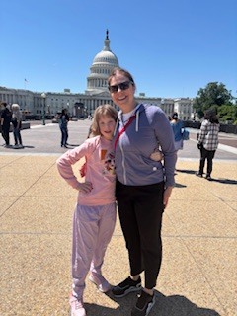
Overcoming nervousness

Slide 3
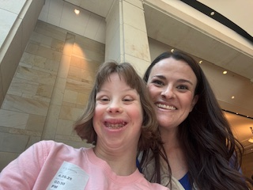
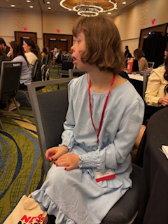
Learning from our experts

Slide 4
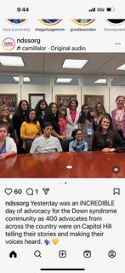
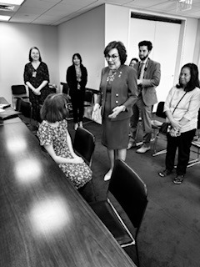
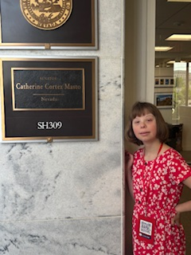
The Power of Communication

Slide 5
Advocating
Ensuring Nationwide Access to a Better Life Experience (ENABLE) Act (S. 627/H.R. 1436) to ensure three important provisions of earlier ABLE bills are made permanent
allows an employed beneficiary to contribute an additional contribution
qualified beneficiaries to qualify for a nonrefundable saver’s credit of up to $1,000
allow qualified beneficiaries to roll over 529 education savings account into ABLE accounts penalty free

Slide 6
Advocating
Protect Medicaid!
Evolving issue
Some Members of Congress believe the government should spend less money on Medicaid and therefore, cuts to Medicaid are currently among the top proposed cuts in budget reconciliation.
Reach out to your elected officials and let them know why this program is important to YOU!

Slide 7
Advocating
Charlotte Woodward Organ Transplant Discrimination Prevention Act
would prohibit discrimination on the basis of disability in cases of organ transplants and provide recourse to individuals who feel they have been discriminated against
bill was passed by the House Energy and Commerce Committee on April 29, 2025

Slide 8
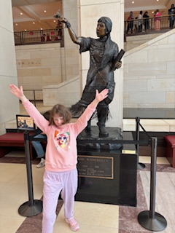
Your voice matters
Share your feedback
https://ndss.org/ndss-action-alerts
https://ndss.org/resources/advocacy-resources
Kenley in front of the Sarah Winnemucca statue reminding us that activism and advocacy matter.

