Slide 1



Know Your Rights:
Understanding Youth ADA Protections

Slide 2


Table of contents
01
Who Am I?
02
Youth and the ADA
03
04
The Advocacy Lab Activity!
Self-Advocacy
Presented by Nevada Statewide Youth Action Council
Notes:
Engage in this team-based activity where you can learn to create your own policy!

Slide 3


Who Am I?
Kaison Fong
Student at the University of Nevada, Reno
Works to empower all youth with disabilities and promote disability rights across Nevada.
Notes:
Calvin Le: He is a student at the College of Southern Nevada and is a member of Nevada SILC’s Youth Action Council (YAC), working to advocate for youth with disabilities. As a member of the Organization of Chinese Americans (OCA), he has engaged in advocacy efforts for the Asian American and Pacific Islander community in Las Vegas, Nevada. He also works to provide tutoring and educational support to underserved students through the nonprofit organization, LearnToBe. Outside of his passion for public health and education, Calvin enjoys spending his time with his family and friends.
Kaison Fong: Kaison Fong is a student at the University of Nevada, Reno, and a member of Nevada SILC’s Youth Action Council (YAC). As part of YAC, Kaison works to empower all youth with disabilities and promote disability rights across Nevada. He also serves on the Nevada Secretary of State Cisco Aguilar’s Youth Advisory Task Force, where he focuses on increasing civic engagement and conducting youth outreach throughout the state. Kaison also volunteers and teaches math classes at Youth Euclid Association, a local nonprofit organization dedicated to expanding access to low-income students. He is passionate about political science and public policy, particularly inclusive policy through legislation.
Hannah Hanson: Hannah Hanson is a member of Nevada SILC’s Youth Action Council (YAC) where she works to advocate for people with disabilities in Nevada. She is especially interested in removing barriers posed by limited transportation options in rural communities. She has previously been involved in the Society of Women Engineers (SWE) where she advocated for minority groups in engineering and worked on initiatives to improve student retention and feelings of belonging. She works as a chemical engineer in Nevada’s gold mining industry and also volunteers at the California Trail Interpretive Center.

Slide 4



Foundations: How Does the ADA Protect Youth?
DISABILITY RIGHTS!

Slide 5





ADA Overview
  Americans with Disabilities Act (1990) - prohibits discrimination
on the basis of disability
  Amended in 2008, broadening definition of disability
  Relevant sections to youth:
    Title II: covers public schools and programs (government entities)
    Title III: public accommodations (such as summer camps)
  Roots in Section 504 of the Rehabilitation Act of 1973

Slide 6


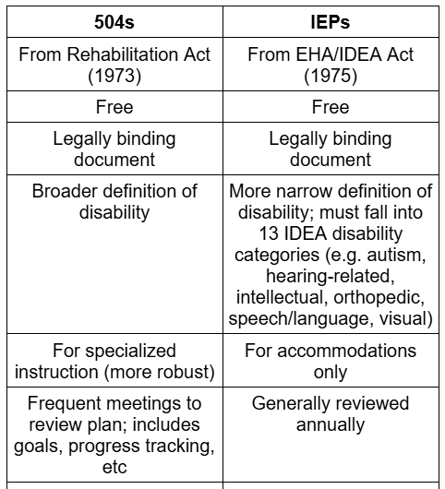


504s and IEPs: Side by Side

Slide 7

How Do Accommodations Work?
  Key principles: individualized, collaborative, dynamic, proactive
  Instructional:
    Ex: extended time on assignments, regular check-ins, visual aids, ASL, Braille
  Assessment:
    Ex: extended testing time, quiet/small group testing, preferential seating, verbal testing, regular breaks
  Environmental:
    Ex: accessible restrooms, elevator/ramp access, sensory support, wheelchair tray
  Organizational:
    Ex: modified homework pacing, staff notetaking support, planners, early access to materials
  Assistive technology:
    Ex: adaptive keyboards/mice, text-to-speech, screen readers, closed captioning

Slide 8





College ADA Accommodations
  Reach out to Disability Resource Center (DRC) with documentation
  Contact professors to arrange specific accommodations for each class
  Accessible housing/dorms
  No individualized instruction
  Requires greater self-advocacy and independence; no parental involvement

Slide 9


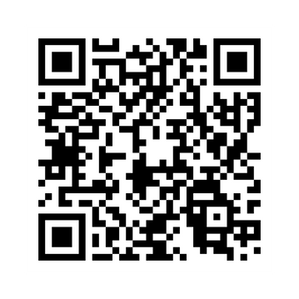
H.R. 3939 - RISE Act
- Currently in Committee
- Makes accessing disability accommodations
easier when transitioning to college
-Transparency in accommodation policies
-Authorizes $10 million for National Center
Political Activism:
- QR code for govtrack.us page
- Contact your representative and express your support
- Encourage people in your community to do the same

Slide 10





Disability and Marginalized Communities
  Disability intersects with race, gender, income, etc.
  Students of color less likely to receive early intervention, but more likely to be suspended or expelled (Black students 3x)
    More likely to be identified in special ed and placed in restrictive settings
  Language barriers for immigrant families
    Cultural stigma
  Lack of resources for low-income families

Slide 11


Disability and Equity Outcomes
  Represent 17% of enrollment, but account for 2% of AP students, 4% of dual-enrolled students
  ~15% HS dropout rate, compared to ~5% national average
  Around half as likely as national average to hold bachelor’s degree
  Less than half of students with disabilities request accommodations in college

Slide 12


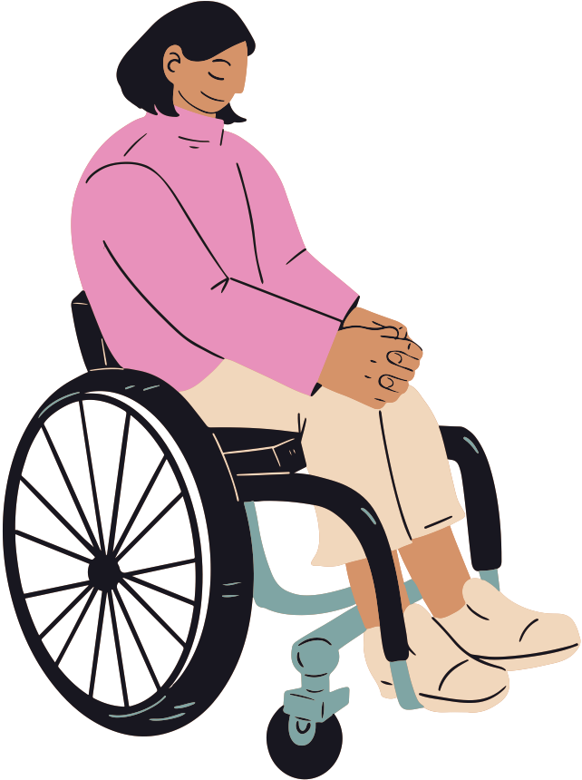
Disability and Discipline
  Represent 17% of enrollment but 29% of those suspended, 21% of those expelled, 27% of those referred to law enforcement
  Should not be punished for behavior caused by disability
  Removal >= 10 days: change in placement
  Parental notice and informed of rights
  Dept. of Education has repeatedly found frequent violations of discipline rules
  Special cases: weapons, drugs

Slide 13



Disability and Juvenile Justice
  Up to 70% of youth in JJ network have a disability
  Lack of compliance with IDEA in juvenile facilities
  “School-to-prison” pipeline: lack of support, missed early intervention
  Undiagnosed learning/emotional disabilities or disorders
  Ensure behavioral issues addressed through supports, screenings, restorative justice

Slide 14



Access to Public Programs and Services
  Titles II and III of ADA ensure participation in all public programs, not just school
  Ex: recreation, libraries, parks, camps, transportation
  Need to comply with ADA Accessible Design standards, reasonable accommodations
  Participation must be the same as non-disabled individuals

Slide 15




Self-Advocacy Tips
  Advocate early!
  In case of conflict with school, reach out to third parties or local advocates.
  Know your rights (ADA, 504/IEPs, IDEA)!
  Document everything in writing.
  Speak up beyond school!
  Be firm, but respectful.
  Know your needs and ideal accommodations!

Slide 16
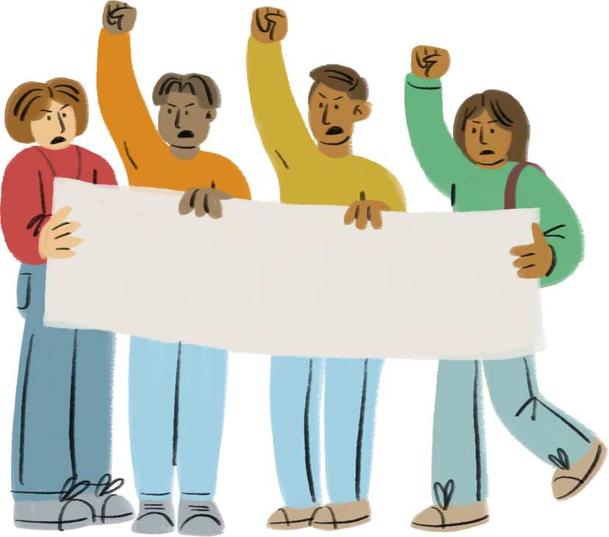
It’s Your Turn: The Advocacy Lab!
  Break into groups and discuss each of the three student profiles on the handout - what accommodations will help them most? How can they self-advocate for themselves?
  Take turns sharing your ideas!
Equity!

Slide 17




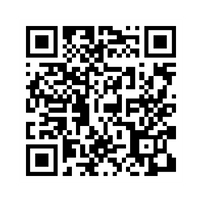


Thanks!
Do you have any questions?
Our Website: www.nvsilc.com
haiyen@adsd.nv.gov
(702) 757-7990
YouTube: @nvyac
Instagram: @nevada_yac
ACTIVISM!
CREDITS: This presentation template was created by Slidesgo, and includes information from the PIHE Advocacy Workshop and adl.org

