Slide 1
The Arc of nevada
2026 Funding Proposal to Support the DD Council’s
Five-Year State Plan

Slide 2
Next Steps Vocational Rehabilitation: Pre-ETS

Slide 3
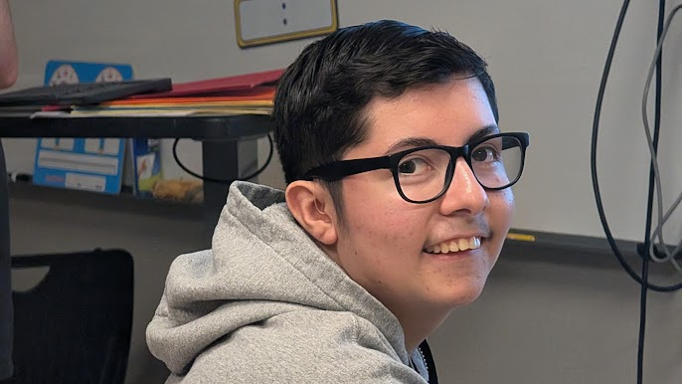

Slide 4
Next Steps Vocational Rehabilitation: Pre-ETS
2025-26 School Year was The Arc’s first year providing services.
Provided Services to four schools (Mater Academy, Helen J. Stewart, Valley High School, Desert Oasis) in five classes.
Total of 32 students participated (including 6 intensive).
Have been asked to return to Valley and provide services for four classes.
Goal for 2026 fall – increase from four schools to six schools and from five classes to 9 classes.

Slide 5
Vocational Rehabilitation: Pre-ETS Request ($7,825)
Curriculum materials – supplement learning objectives.
Staff Time – Pt Job Coach for Reno and Las Vegas
  Expand capacity

Slide 6
Alignment with NGCDD’s Goals
Goal 1 – Self-Determination & Informed Choice
Goal 2 – Employment & Advocacy

Slide 7
Next Steps: Your Road to Success Pre-ETS Summer Camp

Slide 8
Next Steps Road to Success: Pre-ETS Camp
The Arc was asked in December 2025 to host a summer camp.
Camp is one week (5 days) in July.
Up to 12 students can attend.
Objective of camp is to expose students to job and career options.
Will go to five different locations: Cowbunga Canyon, Clark County Government Center, UNLV, The Animal Foundation, and Cosco

Slide 9
Next Steps Road to Success Pre-ETS Camp Request ($6,450)
Admission to location
Safety materials
Staff Prep Time (Tamera) – Planning time is not reimbursed.
Transportation*

Slide 10
Alignment with NGCDD’s Goals
Goal 1 – Self-Determination & Informed Choice
Goal 2 – Employment & Advocacy

Slide 11
Vocational Rehabilitation – Supportive Employment Services

Slide 12
Vocational Rehabilitation: Supportive Services
Currently have service agreement for Non-Supported Employment (not directly tied to job placement or retention.
Currently seeking service agreement amendment to include Supportive Services (directly help individuals get, keep, or advance in a job).
Need ACRE Basic Certification training (Tamera is ACRE certified)
  40 hours of online training
  Pass final test with 80% or higher

Slide 13
Vocational Rehabilitation: Supportive Services($1,580)
Curriculum materials – supplement job readiness.
ACRE training – current employee (Alex) and new employee.

Slide 14
Alignment with NGCDD’s Goals
Goal 1 – Self-Determination & Informed Choice
Goal 2 – Employment & Advocacy

Slide 15
Pal Around Community Inclusion Activities

Slide 16
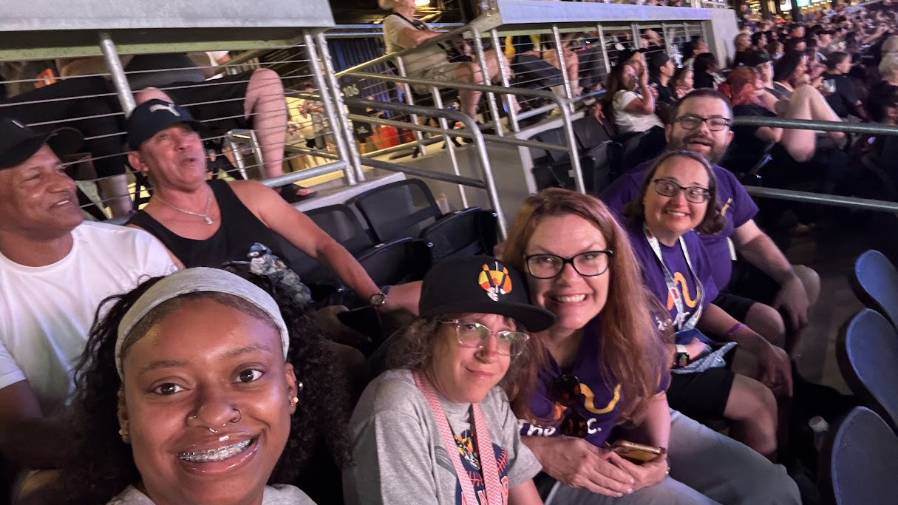

Slide 17
Pal Around Community Inclusion Activities
Over 50% of people with ID/D report feelings of isolation and chronic loneliness.
Increases risk of depression by 40% and anxiety by 25%.
Pal Around activities are monthly.
2025 had 233 (duplicated) people participated in activities. 2026 has 200 (duplicated) people.
Have committee of people with ID/D to make suggestions on activities.

Slide 18
Vocational Rehabilitation: Supportive Services($8,870)
Activity Fees – Admission tickets, food, etc.
Expand to Reno for quarterly activity
PT Program Coordinator in Reno – capacity building

Slide 19
Alignment with NGCDD’s Goals
Goal 3 – Improving services across the state.

Slide 20
Self Advocacy Empowerment: Seat at the Table

Slide 21
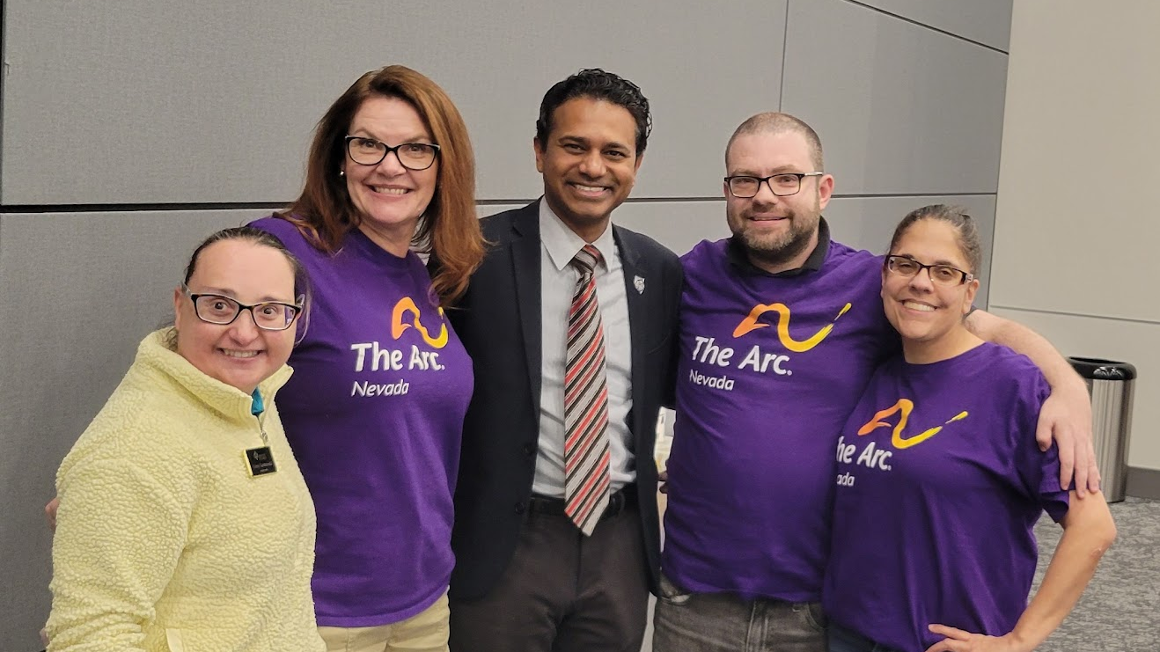

Slide 22
Self-Advocacy Empowerment: Seat at the Table
2026 - Held 2 trainings and attended 1 interim committee.
Learning Objectives
  Legislative Literacy & Process.
  Provide Advocacy & Communication Skills.
  Direct Civic Engagement.

Slide 23
Self-Advocacy: Seat at the Table($1,000)
Transportation to interim committees.
Staff time to coordinate trainings and interim committees.

Slide 24
Alignment with NGCDD’s Goals
Goal 2 – Advocacy
  2.1 – Participation in legislative sessions and facilitating meetings with legislators.

Slide 25
Bridge Builders: Beyond the Barrier Training

Slide 26
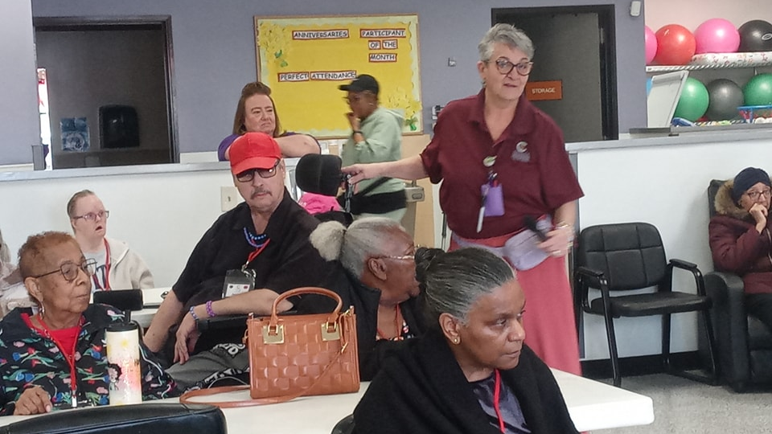

Slide 27
Bridge Builders: Beyond the Barrier Training
2025 – 275 participants (duplicated) attended Digital Literacy Trainings at Betty’s Village and Nevaa Adult Day Centers.
Topics
  Digital Habits & Citizenship
  Email Basics
  Cyber Security
2026 – 16 people attended our Fraud Awareness Seminar (co-sponsored with Meadows Bank).
Topics
  Digital & Financial Literacy including ABLE accounts.
  Emergency Preparedness.
  Wellness & Self-care

Slide 28
Bridge Builders: Beyond the Barrier Training($5,120)
Program Coordinator – determine topics, secure location, speakers, market event to community.

Slide 29
Alignment with NGCDD’s Goals
Goal 1 – Self-Determination & Informed Choice
Goal 2 –Advocacy
Goal 3 – Strengthening Systems

Slide 30
Workforce Development

Slide 31
Workforce Development
Expanding Services for 2027 and Beyond to address critical shortages in specialized healthcare in Nevada.
Secure Medicaid Credentialling and Contract with all 5 Managed Care Organizations.
Recruit additional staff

Slide 32
Workforce Development ($15,950)
Medicaid Credentialing
Contract with all 5 Managed Care Providers
Recruitment & Hiring Costs
Staff Training
  ACRE Training (previously mentioned)
  Food Protection Manager Course (Pre-ETS requirement for Food Handler Module).

Slide 33
Alignment with NGCDD’s Goals
Goal 3 – Strengthening Systems

Slide 34
Administrative Support

Slide 35
Administrative Support
As The Arc of Nevada grows and expands, the need for a strong foundation grows.

Slide 36
Administrative Support($50,600)
Outreach materials & supplies
Website maintenance
Insurance
Bookkeeping
Software

Slide 37

THANK YOU

