Slide 1

WELCOME TO SUNFLOWER HD TRAINING

Slide 2

What Is the Hidden Disabilities Sunflower?
The Hidden Disabilities Sunflower is an internationally recognized symbol used by individuals with non-visible disabilities who may need additional assistance, patience, or communication support.
Passengers may display the Sunflower on a lanyard, pin, bracelet, badge, or keychain.

Slide 3
Examples of Hidden Disabilities
Autism or neurodivergence
Anxiety, PTSD, or mental health conditions
Hearing or vision differences
Chronic pain or fatigue
Learning differences
Neurological or medical conditions
Dementia or cognitive challenges
These disabilities are not always visible but may affect communication, decision-making, or mobility.

Slide 4

How Staff Should Assist Sunflower Passengers
✔ Offer patience and extra time
✔ Communicate calmly and clearly
✔ Ask supportive questions such as:
“Please let me know how I can help you today.”
✔ Provide simple explanations
✔ Reduce stressful conditions when possible
✔ Always respect privacy and dignity

Slide 5
What to Avoid
✘ Do not ask for medical details
✘ Do not assume the nature of the disability
✘ Do not rush or pressure the passenger
✘ Do not speak in a patronizing tone
✘ Do not require proof of disability

Slide 6
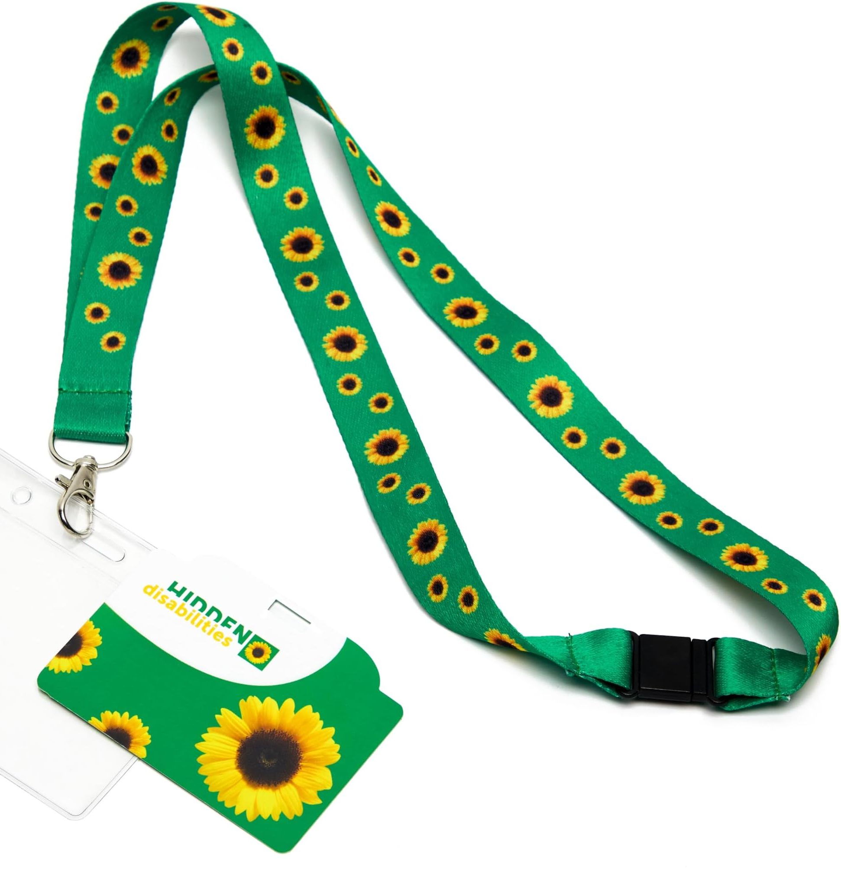
LOCATION OF LANYARDS
Terminal 1 Baggage Claim Airport Information Booth
Terminal 1 Level 2 Esplanade Airport Information Booth
Terminal 3 Ticketing Level 2 Airport Information Booth
Terminal 3 Baggage Claim Level 0 Airport Information Booth

Slide 7
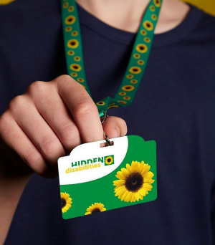
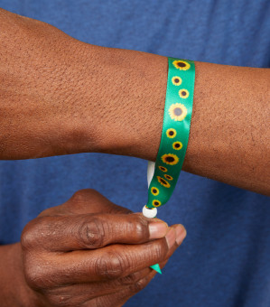
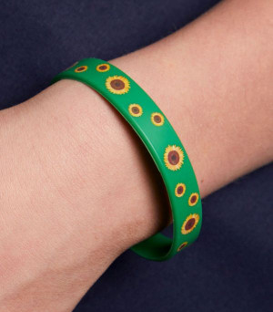


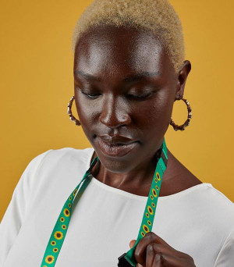

SUNFLOWER PRODUCTS

Slide 8
FAQs
Do I have to pay for a lanyard?
No. Member businesses and organizations agree to provide lanyards free of charge to customers who need them.
Do I need to ask for documentation?
No. Participation is voluntary, and passengers are not required to disclose their disability or provide any documentation.
Does the sunflower guarantee fast-tracking?
No, wearing a sunflower does not grant fast-track access through security or any other preferential treatment.
What if the passenger needs more help?
The program does not override the need for passengers to pre-arrange special assistance with their airline in advance.

Slide 9

SUNFLOWER RULE OF 6
Ask if you can help
Be kind
Listen closely
Have patience
Do not judge
Show respect

Slide 10
ADA PROGRAM CONTACT
Danielle Mose
ADA Coordinator/ Assistant Safety Officer
Clark County Department of Aviation
(702) 261-5729
ADACoordinator@lasairport.com

