Slide 1
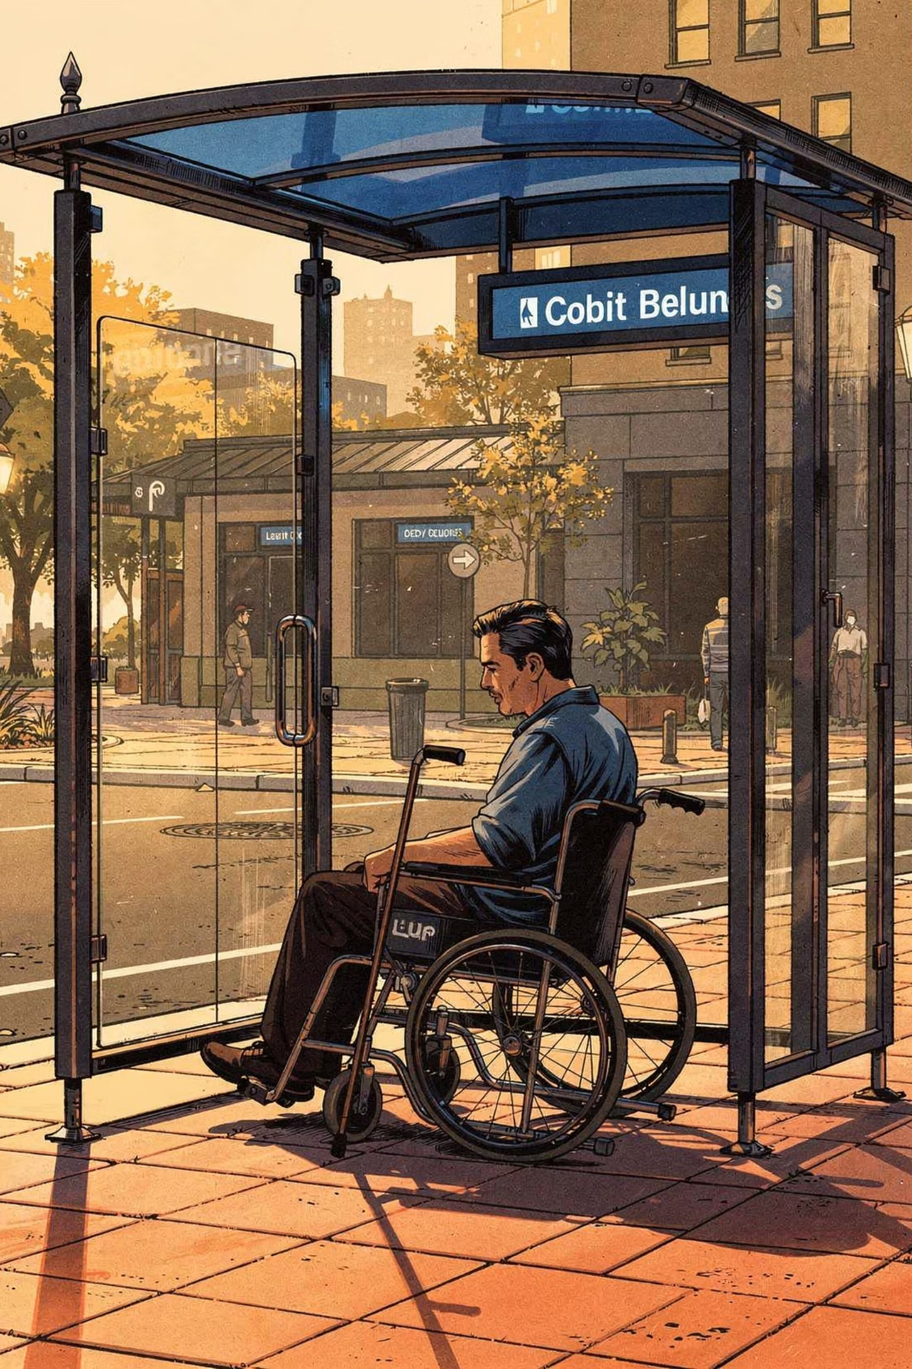
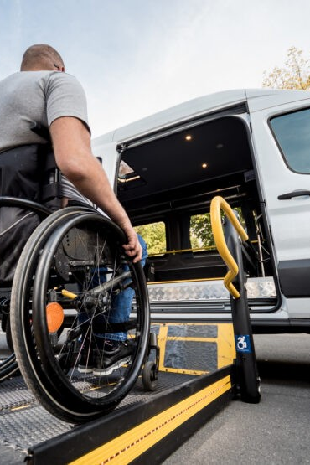
Transportation Access for Adults with Disabilities
Lack of transportation is a critical barrier preventing adults with neurodivergences and with disabilities from living independently — affecting employment, healthcare, education, and daily life.
According to the Bureau of Transportation Statistics (BTS) at the United States Dept. of Transportation in its 2022 National Travel Survey (NHTS):
10M
Working-Age Adults
Ages 18–64 with travel-limiting disabilities (BTS, 2022)
7.7M
Older Adults
Ages 65+ with self-reported travel-limiting disabilities

Slide 2
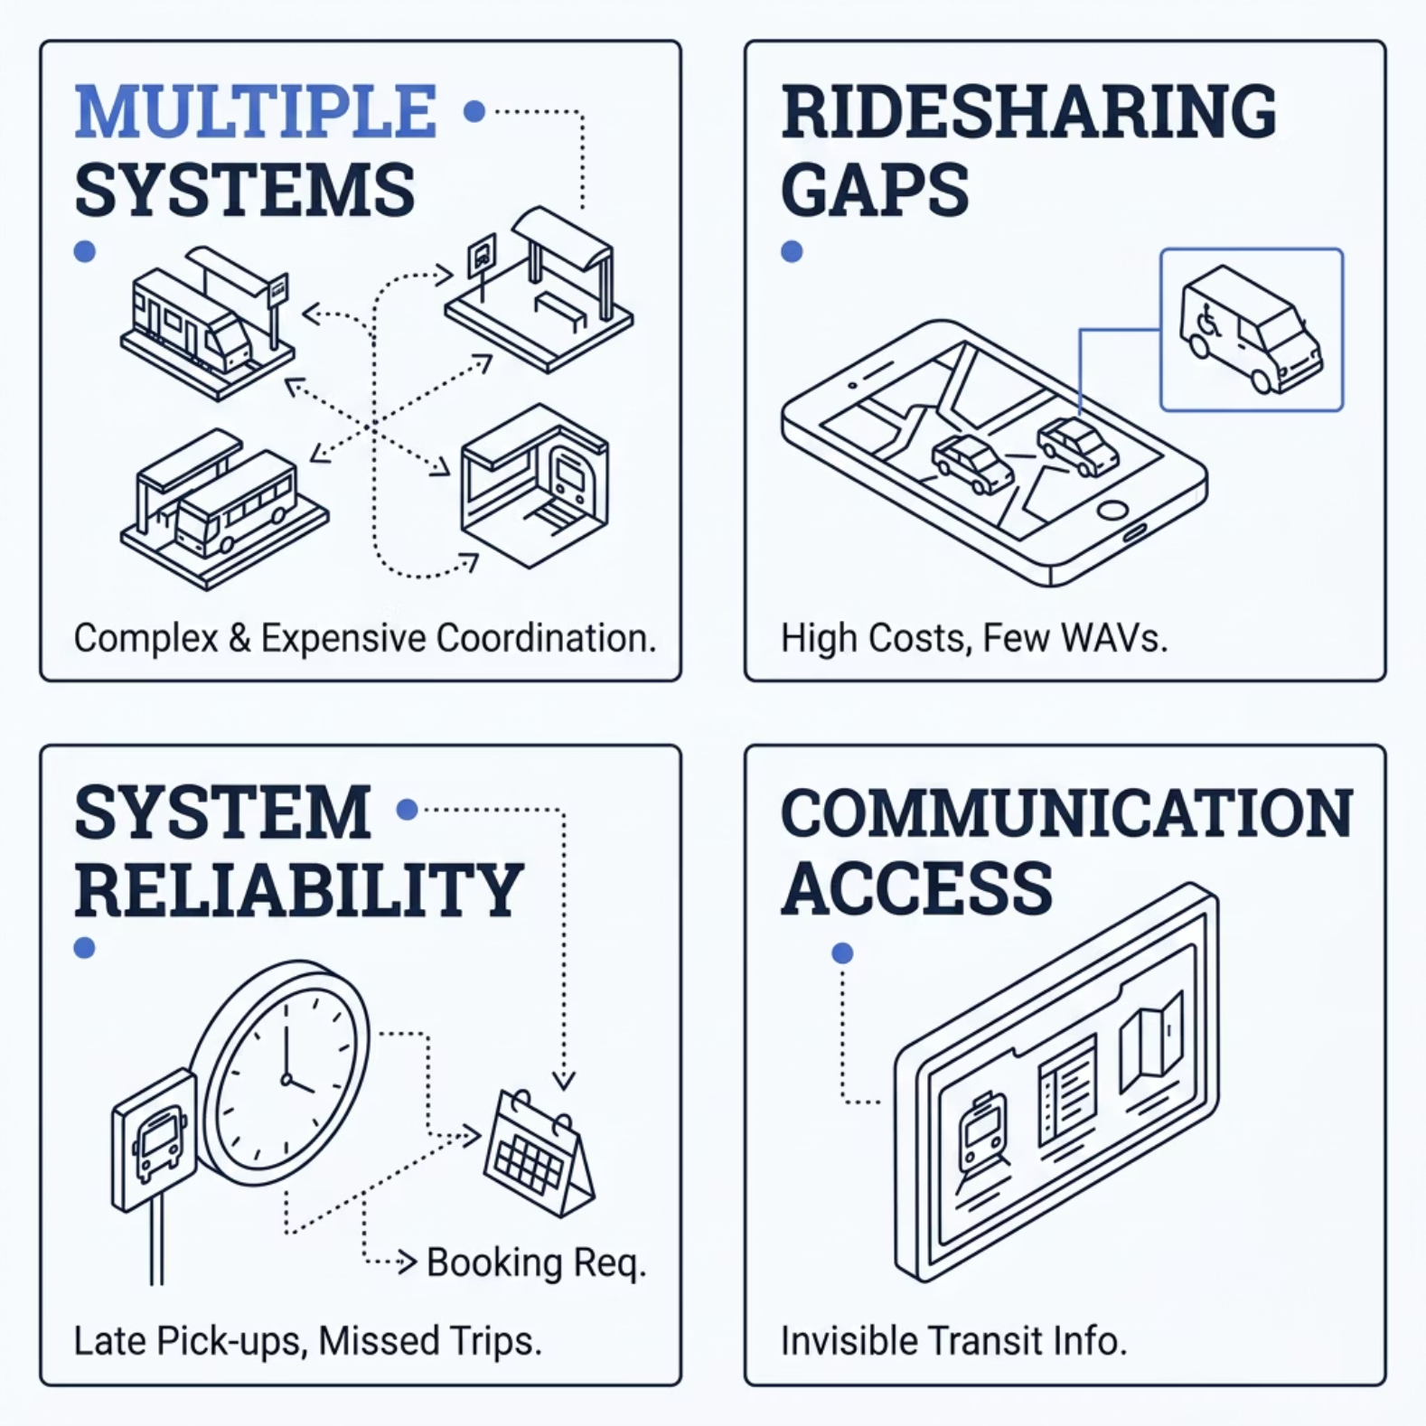


National Barriers to Transportation
MULTIPLE SYSTEMS
RIDESHARING GAPS
The Accessible Transportation Resource Center in a December 2024 survey identified four recurring themes nationwide:
Multiple transit systems make travel complex and costly
Ridesharing lacks wheelchair-accessible vehicles
Paratransit reliability is challenged by missed trips and advance booking
Communication about transit options is often inaccessible
SYSTEM RELIABILITY
COMMUNICATION ACCESS
Additional barriers: no paratransit after 5 p.m. or on weekends, high costs, and inaccessible transit information.

Slide 3
Las Vegas Valley: Local Survey Findings
A local survey of Henderson, Las Vegas, and North Las Vegas confirmed the national picture. In 85% of families, the caregiver was the primary transportation provider. Most did not require specialized vehicles.
Travel Frequency
~65% of adults with disabilities need transportation 1–4+ days per week for work, medical, recreation, and school
Top Concerns (Families)
Top Concerns (Adults with Disabilities)
Access & Safety 23% · Availability 20% · Travel Time 17% · Cost 14%
Availability 24% · Cost 22% · Safety 21% · Access & Time close behind top 3 concerns

Slide 4
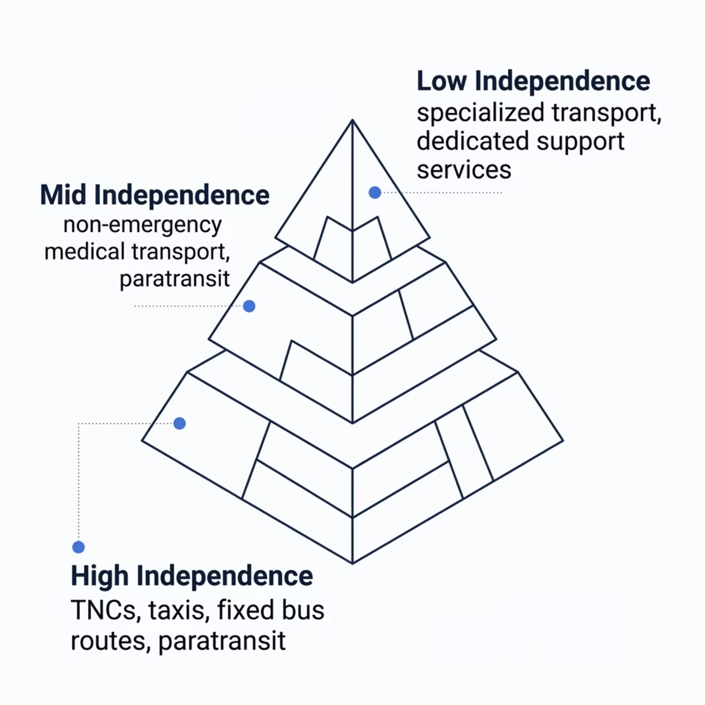
TRiPS Project: Purpose & Plan
Purpose
Plan
Create a new, affordable, and sustainable transportation method through a supportive network of public and private partners — enabling adults with disabilities to reach appointments, jobs, school, grocery stores, and more.
Launch with 100 adults with disabilities in the Las Vegas Valley. Track usage, identify gaps, and scale incrementally. Riders access multiple providers regardless of time, distance, purpose, or cost.
TIERS of Transportation
Types of transportation will be based upon the independence level (high, medium, low) of the adult with the disability (“rider”) and the volume/how often transportation is needed per week.

Slide 5
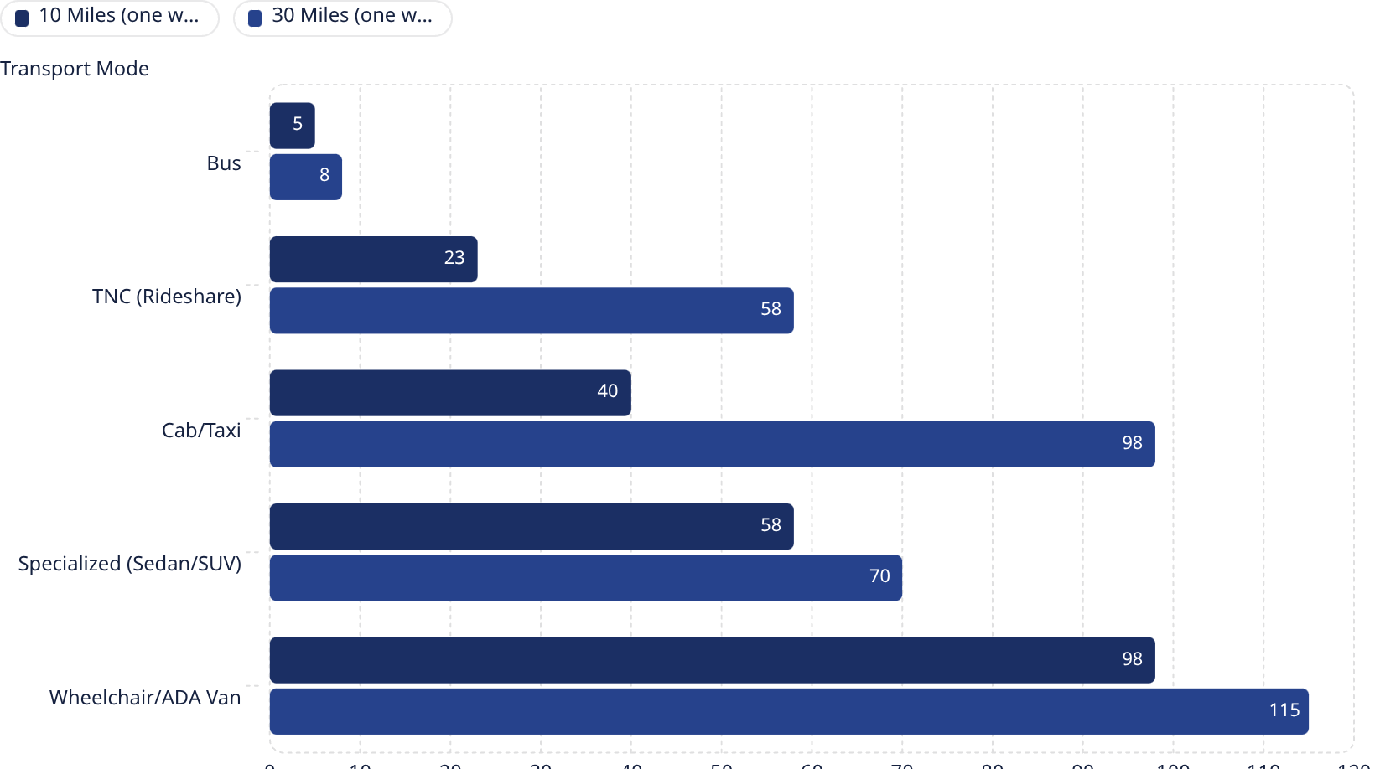

Cost of Travel in the Las Vegas Valley
Average Cost: ~$50 One Way
Typical Las Vegas Valley trips range from 10 miles ($40 avg) to 30 miles ($60 avg). Given the limited income of many adults with disabilities, cost is a central factor in designing the TRiPS Project compensation model for providers.
Specialized and ADA-accessible transport can cost up to $210 one way — far beyond what most disabled adults can afford independently.

Slide 6
PROJECT Structure
1
2
Coordinating Agency
Providers
A non-profit or for-profit agency manages the app, provider payments, and RTC background checks. Serves as the central point of contact for riders and providers.
Apply through the agency, pass background checks, and commit to 6-month renewable terms. Must honor scheduled rides and return TRiPS Project door magnets upon exit.
3
4
TRiPS Project Passport
Vehicle ID
Each rider inputs personal preferences per ride — e.g., no loud music, no conversation, or a "warm hand-off" ensuring the rider is left with a person, not alone.
Providers display TRiPS Project door magnets so riders can easily identify participating vehicles.

Slide 7

Rider Eligibility & Program Tracking
Who May Participate?
Tracking Progress
Any adults with neurodivergences or disabilities who can show one of the following:
Digital surveys will be sent to all 100 riders and providers once at 30 days, once at 6 months, and once at 1 year to measure success and identify improvements.
IEP / Multidisciplinary Team (MDT) documentation
Open or previously closed vocational rehabilitation case
Expired or current Paratransit case
Documentation of physical and/or mental disability
There will be a 24-hour digital drop box that allows real-time feedback from riders and providers — enabling the TRiPS Project to respond and refine continuously.

Slide 8
Education and Communication
Effective communication and ongoing education are vital to the TRiPS Project's success, ensuring all stakeholders are informed and engaged.
Reaching Riders & Advocates
Engaging Providers & Businesses
Building a Digital Hub
Ensuring Continuous Communication
We will actively engage with vocational rehabilitation, transition specialists, non-profits, schools, and programs serving disabled individuals to ensure riders are aware of the TRiPS Project.
Direct outreach will invite local transportation providers and businesses to join the network, fostering partnerships that expand accessible travel options.
A dedicated website and social media presence will serve as central resources, providing clear information on how to utilize or offer transportation services through the TRiPS Project.
Multi-level education for diverse audiences and real-time communication channels will be implemented to keep riders, providers, and community partners constantly informed and connected.

Slide 9


Summary: A Community-Driven Solution
Only through joint efforts can we attain our goal and assist adults with neurodivergences and disabilities to thrive.
Flexible & Sustainable
Community-Wide
Create a network of private businesses, public organizations, and state/local resources working collectively to create transportation options for adults with disabilities.
A collaboration of microtransit, paratransit, rideshare, medical transport, and private businesses. Creating a network of community support is key.
Addresses Real Needs
Tackles accessibility, safety, availability, cost, and time — the community's top concerns

